Slide 1
Technology Fundamentals for Analytics
Jason Kuruzovich

Slide 2
Machine Learning

Slide 3
Kaggle Assignment 1
Due Next Monday

Slide 4
"Field of study that gives computers the ability to learn without being explicitly programmed” -Arthur Samuel (on machine learning)

Slide 5
Categories of Machine Learning Problems
Classification
Classification is the problem of identifying to which of a set of categories (sub-populations) a new observation belongs, on the basis of a training set of data containing observations (or instances) whose category membership is known.
Prediction
Prediction of a dependent variable

Slide 6

What is this????

Slide 7
When computer scientists at Google’s mysterious X lab built a neural network of 16,000 computer processors with one billion connections and let it browse YouTube, it did what many web users might do — it began to look for cats.

Slide 8
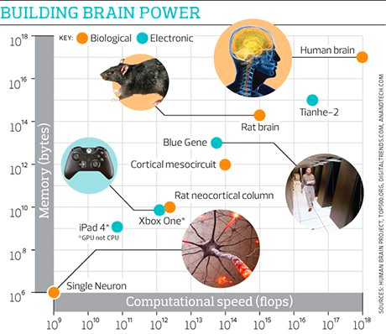

Slide 9

Building high-level features using large scale unsupervised learning
“Contrary to what appears to be a widely-held intuition, our experimental results reveal that it is possible to train a face detector without having to label images as containing a face or not. Control experiments show that this feature detector is robust not only to translation but also to scaling and out-of-plane rotation.”
Notes:
http://arxiv.org/abs/1112.6209

Slide 10
What do we mean by “unsupervised learning?”

Slide 11
Unsupervised Learning
Unsupervised Learning
In machine learning, the problem of unsupervised learning is that of trying to find hidden structure in unlabeled data.
Example: Could you create categories of customers based on their purchase behavior and demographics

Slide 12
Supervised vs. Unsupervised Learning of Cats
Unsupervised Learning
Here are a bunch of images…..classify them into different object classes
Supervised Learning
Here are a bunch of images and we have already classified them into which ones are cats
We will train our algorithm using a subset of data where we will give you the answers
Then we will test you on a group were we don’t give you the answer

Slide 13
Classification
Classification – Unsupervised Learning
K-means Clustering
Hierarchical Clustering
Classification - Supervised Learning
Logistic Regression (2 categories DV)
Naïve Bayes
Support vector machines

Slide 14
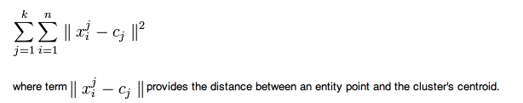
Unsupervised Learning - Classification
K-Means Clustering
A simple learning algorithm for clustering analysis. The goal of K-Means algorithm is to find the best division of n entities in k groups, so that the total distance between the group's members and its corresponding centroid, representative of the group, is minimized. Formally, the goal is to partition the n entities into k sets S_{i}, i=1, 2, ..., k in order to minimize the within-cluster sum of squares (WCSS), defined as:
Notes:
http://en.wikibooks.org/wiki/Data_Mining_Algorithms_In_R/Clustering/K-Means

Slide 15
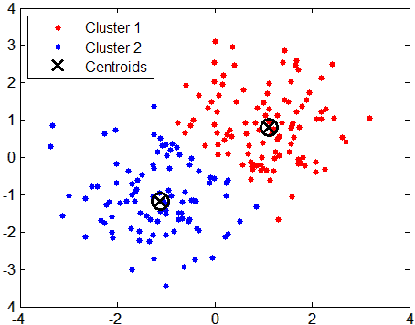
K-Means Clustering

Slide 16
K-Means
How many clusters should there be?
No predetermined amount
What are meaningful labels?
This can be an n-dimensional space

Slide 17
Supervised Learning
Machine learning focuses on prediction (not understanding relationship
Training Data – Used to tune the associated algorithm to make accurate predictions
Test Data –Used to assess the capabilities of the model
Implementation – Algorithm is implemented in the context of a business process

Slide 18
Supervised vs. Unsupervised Learning
Supervised Learning
In supervised learning, each example is a pair consisting of an input object (typically a vector) and a desired output value (also called the supervisory signal). A supervised learning algorithm analyzes the training data and produces an inferred function, which can be used for mapping new examples.

Slide 19

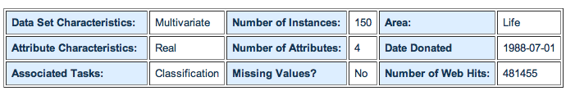
Supervised Learning Example
Categories/Group membership
How can we classify individual samples into different class?
1. sepal length in cm 2. sepal width in cm 3. petal length in cm 4. petal width in cm 5. class: -- Iris Setosa -- Iris Versicolour -- Iris Virginica
http://archive.ics.uci.edu/ml/datasets/Iris

Slide 20
Decision Tree
Decision Tree is a flow-chart like structure in which internal node represents test on an attribute, each branch represents outcome of test and each leaf node represents class label (decision taken after computing all attributes). A path from root to leaf represents classification rules.
A decision tree consists of 3 types of nodes:
Decision nodes - commonly represented by squares
Chance nodes - represented by circles
End nodes - represented by triangles

Slide 21
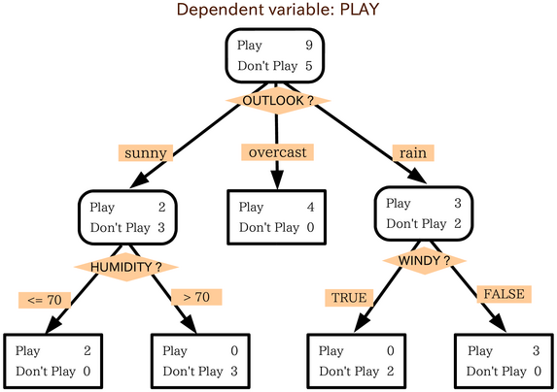
Decision Tree - Golf

Slide 22
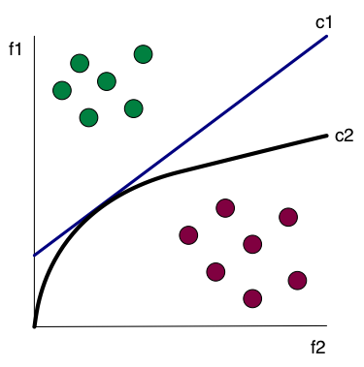
Linear (c1) and Nonlinear (c2) Classification

Slide 23
Regression Trees
A data-analysis method that recursively partitions data into sets each of which are simply modeled using regression methods.

Slide 24
Bayesian Methods
Learning and classification methods based on probability theory.
Bayes theorem plays a critical role in probabilistic learning and classification.
Uses prior probability of each category given no information about an item.
Categorization produces a posterior probability distribution over the possible categories given a description of an item.

Slide 25
Bayes Theorem
Given a hypothesis h and data D which bears on the hypothesis:
P(h): independent probability of h: prior probability
P(D): independent probability of D
P(D|h): conditional probability of D given h: likelihood
P(h|D): conditional probability of h given D: posterior probability

Slide 26
Example - Bayes
Marie is getting married tomorrow, at an outdoor ceremony in the desert. In recent years, it has rained only 5 days each year. Unfortunately, the weatherman has predicted rain for tomorrow. When it actually rains, the weatherman correctly forecasts rain 90% of the time. When it doesn't rain, he incorrectly forecasts rain 10% of the time. What is the probability that it will rain on the day of Marie's wedding?

Slide 27
Example - Bayes
Event A₁. It rains on Marie's wedding.
Event A₂. It does not rain on Marie's wedding.
Event B. The weatherman predicts rain.
P( A₁ ) = 5/365 =0.0136985 [It rains 5 days out of the year.]
P( A₂ ) = 360/365 = 0.9863014 [It does not rain 360 days out of the year.]
P( B | A₁ ) = 0.9 [When it rains, the weatherman predicts rain 90% of the time.]
P( B | A₂ ) = 0.1 [When it does not rain, the weatherman predicts rain 10% of the time.]

Slide 28
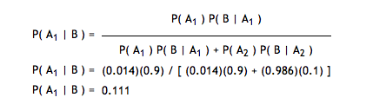
Example - Bayes
We want to know P( A₁ | B ), the probability it will rain on the day of Marie's wedding, given a forecast for rain by the weatherman. The answer can be determined from Bayes' theorem, as shown below.

Slide 29
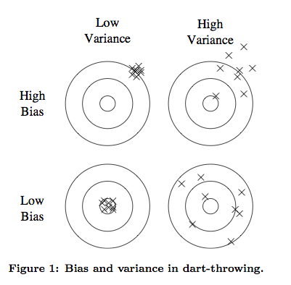
Bias and Variance in Outcome

Slide 30
Neural Networks - Prediction
artificial neural networks are computational models inspired by animal central nervous systems (in particular the brain) that are capable of machine learning and pattern recognition. They are usually presented as systems of interconnected "neurons" that can compute values from inputs by feeding information through the network.

Slide 31
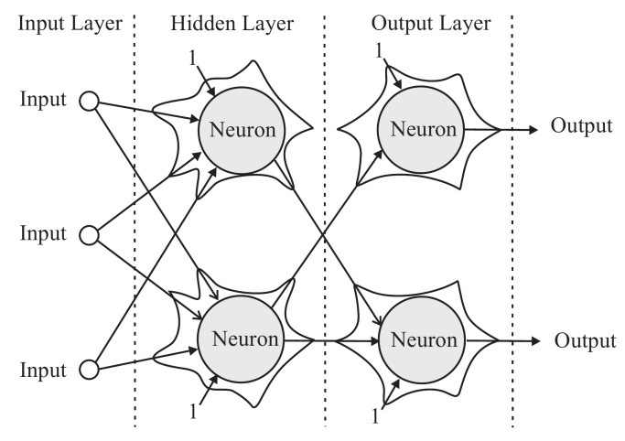
Neural Networks

Slide 32
Neural Network vs. Regression
Neural Networks are likely to provide better predictions than regression based analyses
However, unlike regression we can’t directly understand the “hidden” layer resulting from the analysis

Slide 33
Super Learners
Rather than creating each algorithm separately, we can put a wrapper class around an algorithm to validate it
http://cran.r-project.org/web/packages/SuperLearner/vignettes/SuperLearnerPresent.pdf

Slide 34
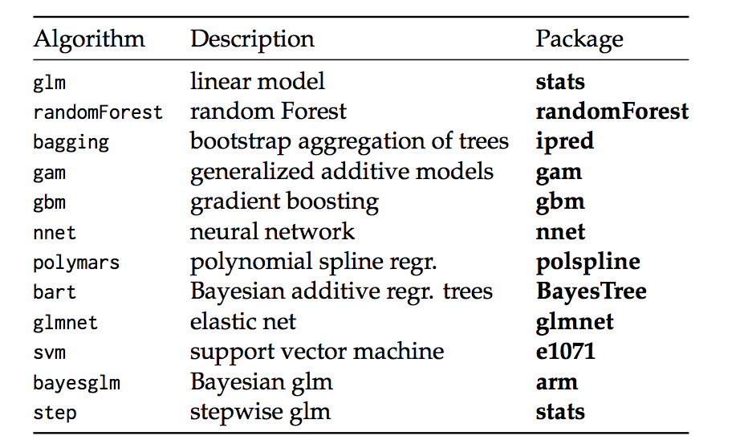
Super Learner

