Slide 1
Technology Fundamentals for Analytics
Jason Kuruzovich

Slide 2
Statistical Models
Provide explanations for things
What is the role of gender in school performance
Which groups perform better
What foods reduce your likelihood of dying
Estimate magnitude of effect
How much does an increase in police reduce crime?
How much does spending on education influence student performance?

Slide 3
Statistical Inference vs. Prediction
Statistical Inference: Determine the underlying relationship for broader management issues
Do smaller classes lead to better student outcomes?
Prediction: Provide a prediction of the resulting relationship
Which of the population of applicants is likely to be a better employee?

Slide 4
So if you can actually add VALUE in PREDICTION, customers are likely to be VERY HAPPY

Slide 5
 | Goals
Traditional Statistics | EXPLAIN the role of specific constructs
Predictive Analytics | CALCULATE an ACCURATE PREDICTION

Slide 6
PREDICTION DIFFERENCES result from the VARIABLES and the MODEL

Slide 7
 | Variables | Model
Traditional Statistics | MEASURE VALIDATED CONSTRUCTS of interest used by OTHER RESEARCHERS | DATA REDUCTION and EASY UNDERSTAND RELATIONSHIP ANALYSIS (SEM or REGRESSION)
Predictive Analytics | INCLUDE ALL AVAILABLE DATA (there might be some relevant nuggets) | Complex BLACK BOX methods like NEURAL NETWORKS and SUPPORT VECTOR MACHINES

Slide 8
Types of Models
Classification
Regression
Clustering

Slide 9
Regression Basics
Data/Distribution of DV/Model
Equation
R2
Statistical Testing and p Values
Beta Coefficients
Regression Assumptions
Advanced topics, Anova, Logistic Regression

Slide 10
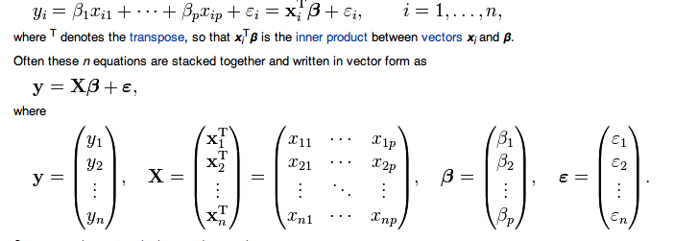
Regression Equation

Slide 11
Regression Analysis: Data/Distribution
Examine the nature of the variable you are predicting
Binary?
Ordinal?
Numeric?
Distribution?

Slide 12
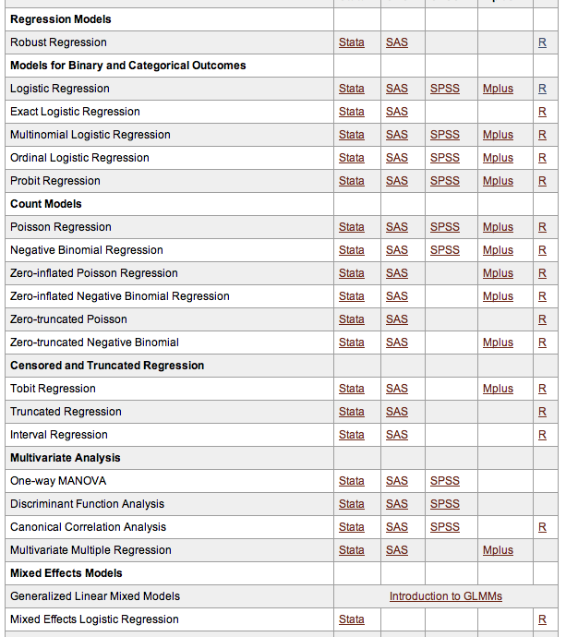
http://www.ats.ucla.edu/stat/dae/

Slide 13
Example – Online Auction
Was the reserve price met?
Yes/No -> Logistic Regression
What is the final high bid price?
Price -> OLS or Robust Regression
How many bidders were there?
Count -> Poisson Regression

Slide 14
Regression Basics: Draw a line that minimizes the total distance (error) between the line and the various points

Slide 15
R2
In statistics, the coefficient of determination, denoted R2 and pronounced R squared, indicates how well data points fit a line or curve. It provides a measure of how well observed outcomes are replicated by the model, as the proportion of total variation of outcomes explained by the model.[1]

Slide 16
Measures of Variation: The Sum of Squares
SST = Total Sum of Squares
measures the variation of the Y_{i} values around their mean Y
_
SSR = Regression Sum of Squares
explained variation attributable to the relationship between X and Y
SSE = Error Sum of Squares
variation attributable to factors other than the relationship between X and Y

Slide 17
Measures of Variation: The Sum of Squares
Y
∧
SSE =∑(Y_{i} - Y_{i} )²
_
Y_{i} = b₀ + b₁X_{i}
∧
SST = ∑(Y_{i} - Y)²
_
∧
SSR = ∑(Y_{i} - Y)²
_
Y
X
X_{i}

Slide 18
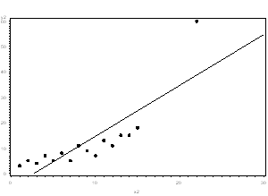
Outliers: Important to Visualize

Slide 19
Variance Explained
SSR regression sum of squares
r² = =
SST total sum of squares
Measures the proportion of variation that is explained by the independent variable X in the regression model

Slide 20

Adjusted R2
The use of an adjusted R2 (often written as and pronounced "R bar squared") is an attempt to take account of the phenomenon of the R2 automatically and spuriously increasing when extra explanatory variables are added to the model.

Slide 21
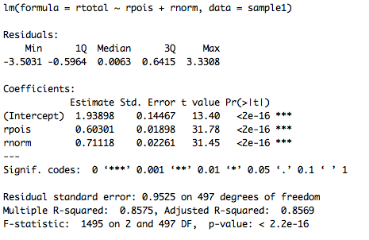
R2 in R

Slide 22
Statistical Testing
“Null Hypothesis” of no effect of independent variable on dependent variable
If the p-value is less than the required significance level (equivalently, if the observed test statistic is in the critical region), then we say the null hypothesis is rejected at the given level of significance. Rejection of the null hypothesis is a conclusion.

Slide 23
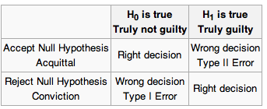
Statistical Testing
p<0.10 “Marginally Significant”
P=0.05 “Significant”
P<0.01/001 “Significant, low probability of type I error”
Rejecting the null hypothesis when it is in fact true is called a Type I error.
P value indicates how frequently you will make a Type I error

Slide 24
Statistical Testing
This is really small p values, indicating a very small chance of type I error

Slide 25
Statistical Testing
The power of a statistical test is the probability that the test will reject the null hypothesis when the alternative hypothesis is true (i.e., the probability of not committing a Type II error).
As the power increases, the chances of a Type II error occurring decrease.
Increase power by increasing sample size

Slide 26
β Coefficient
Beta coefficients indicate how the change in independent variables influence the change in dependent variables
Very difficult to interpret by themselves, dependent upon scale, relationship, significance

Slide 27

Factor Variables
Factor type variables have N levels and will report N-1 beta coefficients
Coefficients are always relative to the omitted level
EXAMPLE: 2 Levels: Vocational/General/Academic
Academic>General; Vocational < General

Slide 28
Statistical Testing
How much will change in independent variable change DV

Slide 29
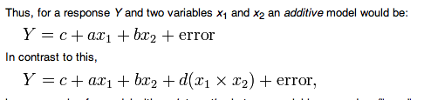
Interaction Effect Regression
In statistics, an interaction may arise when considering the relationship among three or more variables, and describes a situation in which the simultaneous influence of two variables on a third is not additive. Most commonly, interactions are considered in the context of regression analyses.

Slide 30
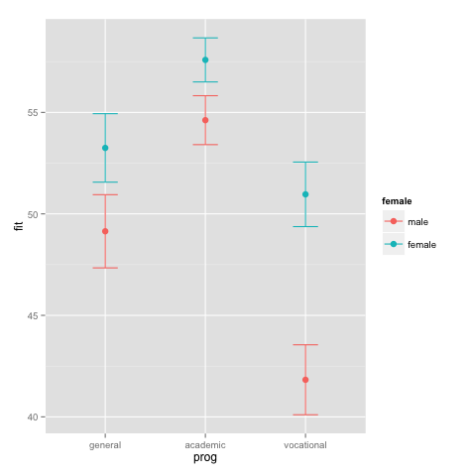
Interaction Effects
EXAMPLE
Prog*gender

Slide 31
Statistical Testing and Big Data
Statistical Significance (the is a relationship based on rejecting the null hypothesis) and practical significance two different things
Almost all variables will be significant in many analyses involving large datasets
Important to understand the marginal effect
Example: Find the effect of one standard deviation change of independent variable on a dependent variable

Slide 32
Coefficients of Determination (r²) and Correlation (r)
Y
r² = 1,
r = +1
Y
r² = 1,
r = -1
^
Y
=
b
+
b
X
i
0
1
i
^
Y
=
b
+
b
X
i
0
1
i
X
X
r² = .8,
r = +0.9
r² = 0,
Y
Y
r = 0
^
^
Y
=
b
+
b
X
Y
=
b
+
b
X
i
0
1
i
i
0
1
i
X
X

Slide 33
Statistical Test
The F-test tests the null hypothesis that the regression does not explain a significant proportion of the variation in Y
The F-Ratio is related to the R², such that the higher R², the higher the F-Ratio

Slide 34
Associated Assumptions
All models have some limitations, but many are very useful
Statistical Analysis: Close observance of assumptions is necessary in order to ensure that statistical insights are relevant
Predictive Analysis: A model’s usefulness in making predictions and can be assessed directly, making underlying assumptions less relevant

Slide 35
Regression Assumptions

Slide 36
Best Linear Unbiased Estimate (BLUE)
If the following assumptions are met:
The Model is
M1 Complete
M2 Linear
M3 Additive
Variables are
V1 measured at an interval or ratio scale
V2 without error
The regression error term is
E1 normally distributed
E2 has an expected value of 0
E3 errors are independent
E4 homoscedasticity
E5 predictors are unrelated to error
E6 In a system of interrelated equations the errors are unrelated to each other

Slide 37
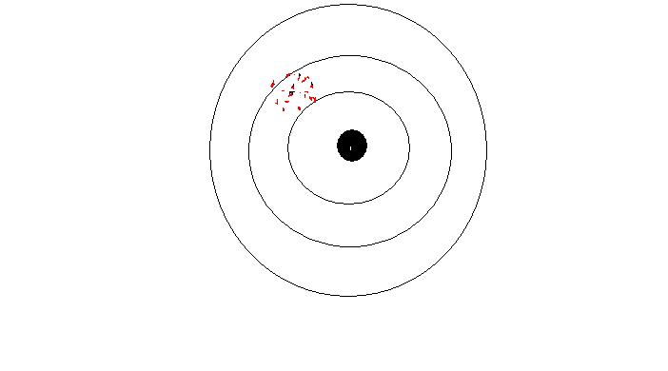
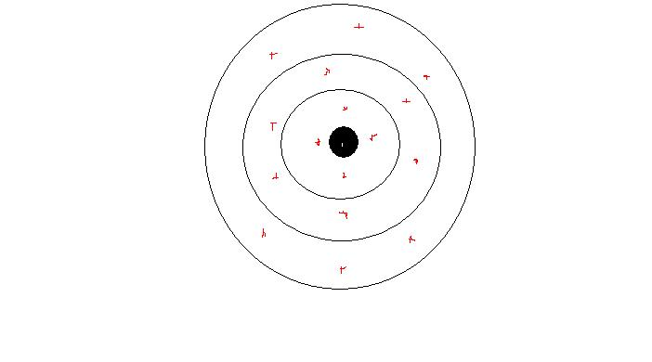
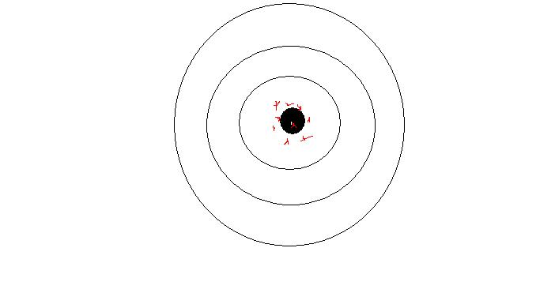
The Three Desirable Characteristics
Lack of bias
E(b)=β b is the sample β is the true, population coefficient
On the average we are on target
Efficiency
Standard error will be minimum
OLS will minimize σ² (the error variance)
Consistency
As N increases the standard error decreases
Notice: as N increases so does Σx_{i}²

Slide 38
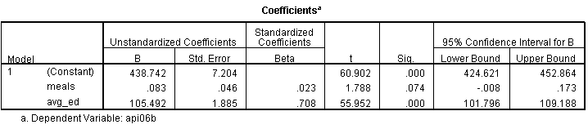
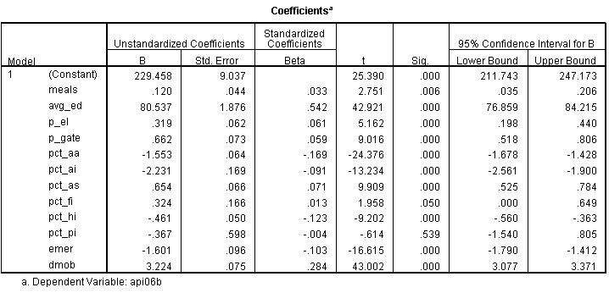
M1 Completeness
Meals
Parents’ education

Slide 39
Diagnosis and Remedy
Complete model means no relevant independent variable is omitted
Diagnosis
Theoretical
Remedy
Including new variables

Slide 40
M2 Linearity
Violation of linearity
An almost perfect relationship will appear as a weak one
Almost all linear relations stop being linear at a certain point

Slide 41
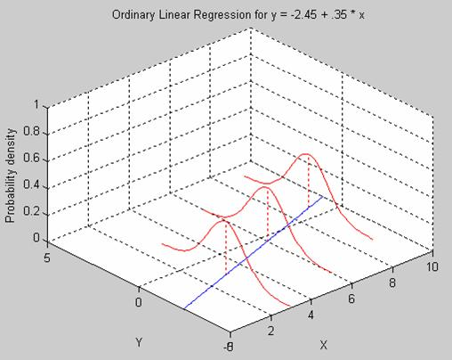
E1 Normally Distributed Error

Slide 42
Non-Normal Error
Our calculations of statistical significance depends on this assumption
Statistical inference can be robust even when error is non-normal
Diagnosis:
You can look at the distribution of the error. Because of the homoscedasticity assumption (see later) the error when summed up for each prediction should be also normal. (In principle, we have multiple observations for each prediction.)
Remember! Our measured variables (Y and X) do not have to have a normal distribution! Only the error for each prediction.
Remedy:
Any non-linear transformation will change the shape of the distribution of the error

Slide 43
E2 Error Has a Non-Zero Mean
The solid line gives a negative
The dotted line a positive mean
This can happen when we have some selection problem
Diagnosis:
Visual scatter plot will not help unless we know in advance somehow the true regression line
Remedy:
If it is a selection problem try to address it.
1.000
.998
.996
.994
.992
.990
.988
Z
.986
Rsq = 0.6211
200
400
600
800
1000
1200
X

Slide 44
E3 Non-independent errors
Example 1: Suppose you take a survey of 10 people but you interview everyone 10 times.
Now your N=100 but your errors are not independent. For the same person you will have similar errors
Example 2: Suppose you take 10 countries and you observe them in 10 different time period
Now your N=100 but your errors are not independent. For the same country you will have similar errors
Example 3: Suppose you take 100 countries and you observe them only once. Now your N=100. But countries that are next to each other are often similar (same geography and climate, similar history, cooperation etc.). If your model underpredicts Denmark, it is likely to underpredict Sweden as well.

Slide 45
Diagnosis & Remedy
It is called autocorrelation because the correlation is between cases and not variables, although autocorrelations often can be traced to certain variables such as geographic distance or same country or person or family.
Diagnosis
Visual, scatterplot
Checking groups of cases that are theoretically suspect
Certain forms of serial or spatial autocorrelations can be diagnosed by calculating certain statistics (e.g., Durbin-Watson test)
Remedy:
You can include new variables in the equation
E.g.: for serial (temporal) correlation you can include the value of Y in t-1 as an independent variable
For spatial correlation we can often model the relationships by introducing an weight matrix

Slide 46
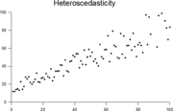
E4 Heteroscedasticity
Homoscedasticity means equal variance
Heteroscedasticity means unequal variance
We assume that each prediction is not just on target on average but also that we make the same amount of error
Heteroscedasticity results in biased standard errors and statistical significance

Slide 47
E5 Predictor Related to Error
Error represents all factors influencing Y that are not included in the regression equation
If an omitted variable is related to X the assumption is violated. This is the same as the Completeness or Omitted Variable Problem
Diagnosis:
The error will ALWAYS be uncorrelated with X, there is no way to establish the TRUE error
Theoretical
Remedy:
Adding new variables to the model

Slide 48
E6 Correlated errors across interrelated equations
We sometimes estimate more than one regression.
Suppose Y_{t}=a+b₁X_{t-1}+b₂Z_{t-1}+e but
X_{t}=a’+b’₁Y_{t-1}+b’₂Z_{t-1}+e’
e and e’ will be correlated
(whatever is omitted from both equations will show up in both e and e’ making them correlated)
This is also the case in sample selection models
S=a+b₁X+b₂Z+e S is whether one is selected into the sample (Szelenyi: does one engage in household farming)
Y=a+b’₁X+b’₂Z+b’₃W+b’₄V+e’ Y is the outcome of interest (Szelenyi: if one does engage in household farming how much value does he produce)
e and e’ will be correlated
(whatever is omitted from both equations will show up in both e and e’ making them correlated)

Slide 49
ANOVA
ANOVA is a particular form of statistical hypothesis testing heavily used in the analysis of experimental data.
A statistically significant result (when a probability (p-value) is less than a threshold (significance level)) justifies the rejection of the null hypothesis.

Slide 50
Logistic Regression
Logistic regression or is a type of regression analysis used for predicting the outcome of a categorical dependent variable (a dependent variable that can take on a limited number of values, whose magnitudes are not meaningful but whose ordering of magnitudes may or may not be meaningful) based on one or more predictor variables.

Slide 52

Next Time
Machine Learning…..

