Slide 1
Technology Fundamentals for Analytics
Jason Kuruzovich

Slide 2
Key Topics, Last Class
What are R Packages?
What is a delimited file? How are they used?
What is normalization?
What is a join?

Slide 3
R and Packages
Packages are collections of R functions, data, and compiled code in a well-defined format.
R comes with a standard set of packages.
Others are available for download and installation.
External packages only have to be installed once, but they have to be loaded each time they are used.
You can create your own packages and contribute them back to the ecosystem

Slide 4
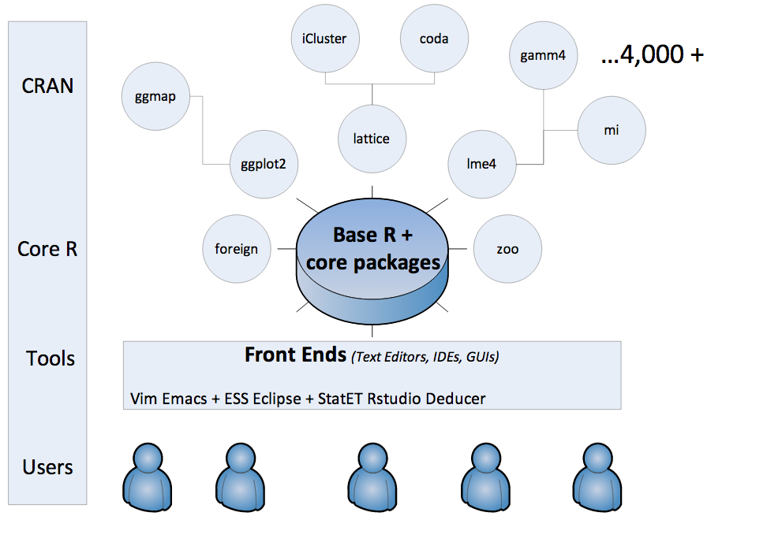
R

Slide 5
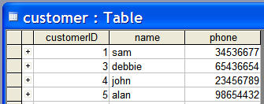
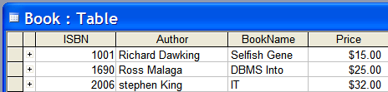
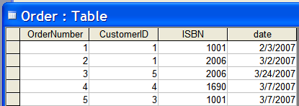
Relational Database Approach
Create a series of logically related two-dimensional tables to store their information
We have 3 tables – a table for book related data, another for customer related data, and finally a table for order related data
How are these “logically” related?

Slide 6
Logical Structure of the database:
Tables are connected using Foreign Keys
Primary Key
Primary Key
Foreign Key
Foreign Key
Primary Key
Text Representation of Tables
Customer (CustomerID, Name, Phone)
Book (ISBN, Author, BookName, Price)
Order (OrderNumber, CustomerID, ISBN, Date)

Slide 7
Storing Data – Where Is IT
File Systems
Traditional File
Distributed File System (HDFS)
Cloud File Storage (S3)
Relational Databases
Overview
NoSQL/Document Databases
API WEB
SPARQL Endpoint

Slide 8
File Systems
File systems
Maintain consistent data storage
Ensure against data failure

Slide 9
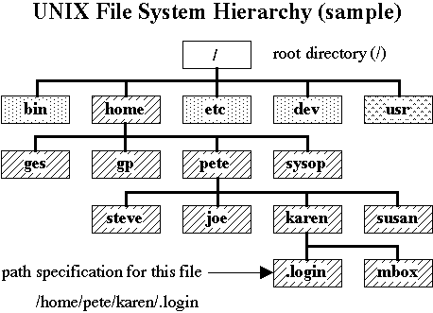
Traditional File System

Slide 10
Traditional File System
Limitations
File System on a Single Disk can Fill up
RAID (redundant array of independent disks, originally redundant array of inexpensive disks[1][2]) is a storage technology that combines multiple disk drive components into a logical unit. Data is distributed across the drives in one of several ways called "RAID levels", depending on the level of redundancy and performance required.

Slide 11
Storage Area Network
SAN – Storage Area Network A storage area network (SAN) is a dedicated network that provides access to consolidated, block level data storage. SANs are primarily used to make storage devices, such as disk arrays, tape libraries, and optical jukeboxes, accessible to servers so that the devices appear like locally attached devices to the operating system. A SAN typically has its own network of storage devices that are generally not accessible through the local area network by other devices.

Slide 12
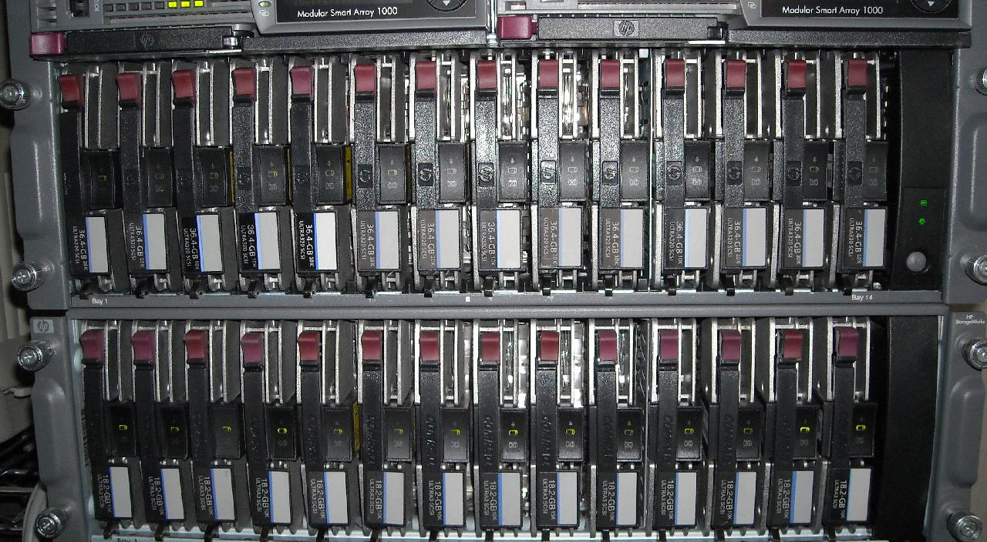
Storage Area Network

Slide 13
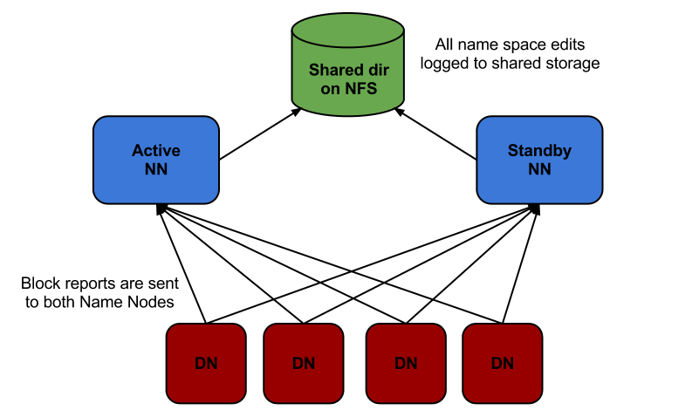
Files and Distributed File Systems
HDFS – Hadoop File System is a HDFS is a distributed, scalable, and portable file system written in Java for the Hadoop framework.
3 Copies of Data

Slide 14
File Structure
Often necessary to transmit data and retain meaning
A common set of files structures:
Delimited File (CSV/Tab) [fixed structure]
JSON [flexible structure]
XML [flexible structure]

Slide 15
Delimited File
Delimited files are often used to transfer data between applications
Comma delimited
Tab delimited
Simple solution, but delimited files don’t store data type information and can result in “delimiter collisions”
"Date","Pupil","Grade"
"25 May","Bloggs, Fred","C"
"25 May","Doe, Jane","B"
"15 July","Bloggs, Fred","A"
"15 April","Muniz, Alvin ""Hank""","A"

Slide 16
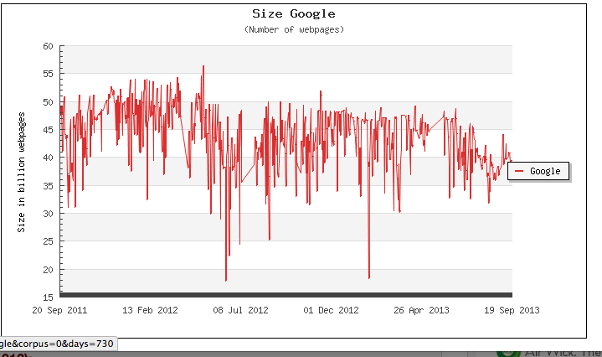
Indexed Files on Google

Slide 17
Other Estimates
~ 1 Trillion Pages
http://www.cnn.com/2011/TECH/web/09/12/web.index/index.html

Slide 18
Preferred Methods for Getting Data
Bulk Data Download/Cloud Access
Easiest way to get large datasets
API
Make specific calls to data resources
Screen Scraping (last resort)
Parse data from html

Slide 19
Bulk Data Download
Specialty Sites
Baseball Databank (CSV file or .sql database archive)
Government (Data.gov)
Education Data link
Economic Data link
Data Marketplaces
Infochimps link
Amazon link (Mapping drives so don’t have to do upload/download)

Slide 20
Why Would Companies Make Data Available Via API?

Slide 21
Data/API Strategy
Twitter
Make data available, enabling an ecosystem of developers to surround the platform, making it more valuable
Facebook
Make data available, enabling an ecosystem of developers to surround the platform, making it more valuable

Slide 22
API Access and Data
Application programming interfaces (APIs): Programming hooks, specifications, or guidelines published by firms that tell other programs how to get a service to perform a task such as send or receive data
Empowering developers to build against your platform doesn’t just create value for partners; the API provider wins as well by expanding the ecosystem, increasing retention, and driving up the value of the platform.
Notes:
Read more at http://venturebeat.com/2013/08/31/api-economy/#z1H2PHajvumblUla.99

Slide 23
Facebook as a Platform
In May 2007, at a conference called F8, Mark Zuckerberg announced that he was opening up the screen real estate on Facebook to other application developers
Facebook published a set of application programming interfaces (APIs) that specified how programs could be written to run within and interact with Facebook
Any programmer could write an application that would run inside a user’s profile

Slide 24
Facebook as a Platform
Developers can charge for their wares, offer them for free, and even run ads
Facebook let developers keep what they made
A key distinction: MySpace initially restricted developer revenue on the few products designed to run on their site, at times even blocking some applications
The choice was clear, and developers flocked to Facebook
To promote the new apps, Facebook runs an applications area on the site where users can browse offerings

Slide 25
Facebook as a Platform
Each application potentially added more value and features to the site without Facebook lifting a finger
Some applications were accused of spamming friends with invites to install them
There were security concerns and apps that violated the intellectual property of other firms

Slide 26
RESTful APIs
Many initial visions of how systems would work together using web services (SOAP/XML)
Transition to RESTful APIs that utilize HTTP
Client-Server
Stateless
Cache
Uniform Interface
Layered System
Source Roy Thomas Felding
http://www.ics.uci.edu/~fielding/pubs/dissertation/rest_arch_style.htm

Slide 27
What do we mean by an API utilizing HTTP?

Slide 28
HTTP
The Hypertext Transfer Protocol (HTTP) is an application protocol for distributed, collaborative, hypermedia information systems. HTTP is the foundation of data communication for the World Wide Web.
Hypertext is structured text that uses logical links (hyperlinks) between nodes containing text. HTTP is the protocol to exchange or transfer hypertext.
WIKIPEDIA ENTRY)

Slide 29
HTTP
Use of HTTP simplifies data resource management because http can be used from whatever language the individual is using
Example
https://explore.data.gov/views/3vvm-4qnc/rows.json?accessType=DOWNLOAD

Slide 30
While Databases…
HTTP API
Port is typically available
Driver Common
Databases
Different databases, different ports may not be available (MySQL 3306)
Different types of drivers

Slide 31
Authentication
No Authentication
API Key Authentication
Oauth/ Username password

Slide 32
Web Scraping

Slide 33
Data Scraping
Web Pages often have a similar structure, this can be leveraged to “scrape” data in such a way that it can be used (in matrix)
Tools
Connotatehttp://pages.connotate.com/replace-outdated-web-scraping.html
Packages
Beautiful Soup
Scrapy
http://scrapy.org/

Slide 34
Data Scraping
PROBLEM: Any changes in html structure can break a web scraper
Sample Procedure
Index
Download HTML file
Parse data and store in relational database
Analyze data

Slide 35
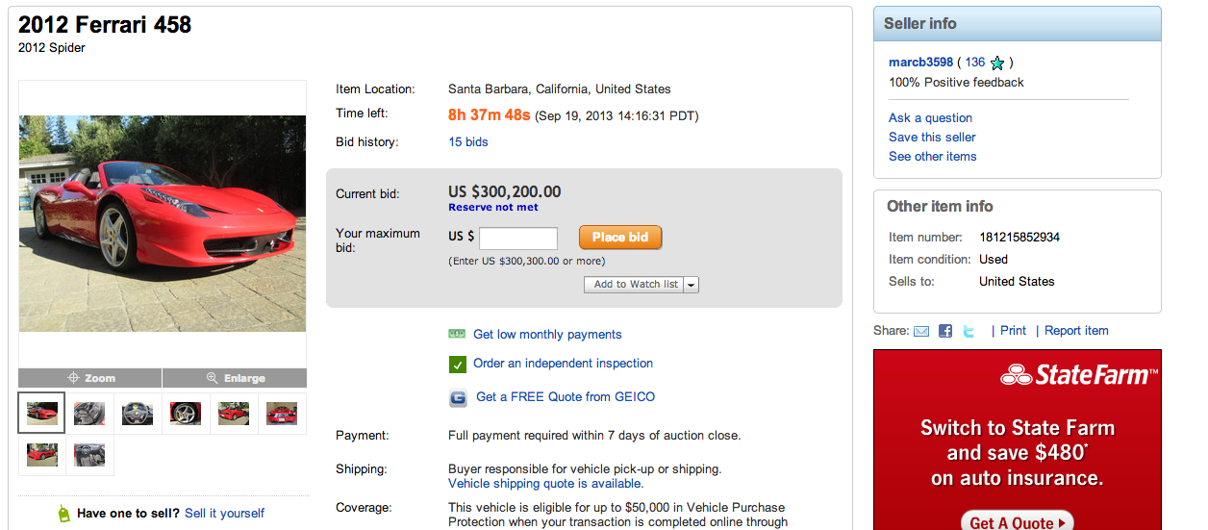
What Relevant Data is Here
http://cgi.ebay.com/ebaymotors/2012-Spider-/181215852934?pt=US_Cars_Trucks&hash=item2a314e7986#ht_500wt_1182

Slide 36
JSON
JavaScript Object Notation, is a text-based open standard designed for human-readable data interchange. It is derived from the JavaScript scripting language for representing simple data structures and associative arrays, called objects. Despite its relationship to JavaScript, it is language-independent, with parsers available for many languages.

Slide 37
JSON – Example
[
{
"year": 1997,
"make": "Ford",
"model": "E350",
"description": "ac, abs, moon",
"price": 3000
},
{
"year": 1999,
"make": "Chevy",
"model": "Venture \"Extended Edition\"",
"description": "",
"price": 4900
}
]

Slide 38
JSON - Example
{
"book": [
{
"id":"01",
"language": "Java",
"edition": "third",
"author": "Herbert Schildt"
},
{
"id":"07",
"language": "C++",
"edition": "second"
"author": "E.Balagurusamy"
}]
}

Slide 39
XML
Extensible Markup Language (XML) is a markup language that defines a set of rules for encoding documents in a format that is both human-readable and machine-readable.
The design goals of XML emphasize simplicity, generality, and usability over the Internet.[6] It is a textual data format with strong support via Unicode for the languages of the world. Although the design of XML focuses on documents, it is widely used for the representation of arbitrary data structures, for example in web services/API.

Slide 40
XML - Example
<note>
<to>Tove</to>
<from>Jani</from>
<heading>Reminder</heading>
<body>Don't forget me this weekend!</body>
</note>

Slide 41
XML
<food>
<name>Avocado Dip</name>
<mfr>Sunnydale</mfr>
<serving units="g">29</serving>
<calories total="110" fat="100"/>
<total-fat>11</total-fat>
<saturated-fat>3</saturated-fat>
<cholesterol>5</cholesterol>
<sodium>210</sodium>
<carb>2</carb>
<fiber>0</fiber>
<protein>1</protein>
<vitamins>
<a>0</a>
<c>0</c>
</vitamins>
<minerals>
<ca>0</ca>
<fe>0</fe>
</minerals>
</food>

Slide 42
Scale Databases: MySQL Cluster
Distributed, in-memory cluster and database
ACID transactions with check pointing, logging and recovery
No single point of failure, automatic fail-over
Enables increased capacity for reads and write actions
Database transparently fragmented over several nodes
Client Access
Server “Group” use Same Virtual IP Address
Load Balance New Clients to Servers
MySQL S₁
Management Node
MySQL S_{n}
Config, start, stop of Nodes
Node 1
Node 2
Node Group acts as single “Unit” to MySQL
Same data is replicated between all nodes
Can have different Node Groups replicating different “fragments” of data
Each node resides on different machine
All queries load balanced between Nodes
NDBCluster storage engine in MySQL handles load node selection
Node 3
Node 4
Node Group
Notes:
A database clustering architecture, such as MySQL Cluster and Emic m/cluster, organize multiple MySQL servers to operate together as a unit to eliminate single points of failure. The servers communicate with one another to keep their systems synchronized and identical. All servers in a database cluster can handle read and write queries, providing an increased capacity for all types of requests while resisting individual server failures. A virtual IP or DNS round robin solution is used to have client applications load balance between different servers and to also detect individual server failures. The configuration and management of a database cluster is more complicated than a shared storage architecture or replication, but is the only non-disk mechanism to have multiple servers make the same database available in a transactionally safe way.

Slide 43
Relational Databases - Limitations
Horizontal Scaling - To scale horizontally (or scale out) means to add more nodes to a system
Vertical Scaling - To move to a larger computers.
For global Internet solutions, what would be the preferred mode of scaling?

Slide 44
Horizontal Scaling with Commodity Servers is Facebook, Google, and Other Technology Companies Create Global Infrastructure

Slide 45
Facebook and Google both had to reimagine the database, why?

Slide 46
Jeremy Zawodny Craigslist Software Engineer
In the last 10 years, the Internet has challenged relational databases in ways nobody could have foreseen. Having used MySQL at large and growing Internet companies during this time, I’ve seen this happen firsthand. First you have a single server with a small data set. Then you find yourself setting up replication so you can scale out reads and deal with potential failures. And, before too long, you’ve added a caching layer, tuned all the queries, and thrown even more hardware at the problem. Eventually you arrive at the point when you need to shard the data across multiple clusters and rebuild a ton of application logic to deal with it. And soon after that you realize that you’re locked into the schema you modeled so many months before. Why? Because there’s so much data in your clusters now that altering the schema will take a long time and involve a lot of precious DBA time. It’s easier just to work around it in code. This can keep a small team of developers busy for many months. In the end, you’ll always find yourself wondering if there’s a better way—or why more of these features are not built into the core database server.

Slide 47

Apache Cassandra is an open source distributed database management system designed to handle very large amounts of data spread out across many commodity servers while providing a highly available service with no single point of failure.
It is a NoSQL solution that was initially developed by Facebook and powered their Inbox Search feature until late 2010
Jeff Hammerbacher, who led the Facebook Data team at the time, has described Cassandra as a BigTable data model running on an Amazon Dynamo-like infrastructure.

Slide 48
Properties of NOSQL Databases
Decentralized
Every node in the cluster has the same role. There is no single point of failure. Data is distributed across the cluster (so each node contains different data), but there is no master as every node can service any request.
Supports replication and multi data center replication
Replication strategies are configurable.[15] Cassandra is designed as a distributed system, for deployment of large numbers of nodes across multiple data centers. Key features of Cassandra’s distributed architecture are specifically tailored for multiple-data center deployment, for redundancy, for failover and disaster recovery.
Scalability
Read and write throughput both increase linearly as new machines are added, with no downtime or interruption to applications.

Slide 49
Tunable consistency
Writes and reads offer a tunable level of consistency, all the way from "writes never fail" to "block for all replicas to be readable", with the quorum level in the middle.
MapReduce support
Cassandra has Hadoop integration, with MapReduce support. There is support also for Apache Pig and Apache Hive.
Query language
CQLCassandra Query Language) was introduced, an SQL-like alternative to the traditional RPC interface. Language drivers are available for Java (JDBC) and Python (DBAPI2)
Fault-tolerant
Data is automatically replicated to multiple nodes for fault-tolerance. Replication across multiple data centers is supported. Failed nodes can be replaced with no downtime.

Slide 50
ACID vs. BASE
Relational Databases
ACID = Atomicity, Consistency, Isolation, and Durability
NoSQL Databases
BASE = Basically Available, Soft state, Eventual consistency.

Slide 51
ACID Properties
Atomicity requires that each transaction is "all or nothing": if one part of the transaction fails, the entire transaction fails, and the database state is left unchanged.
The consistency property ensures that any transaction will bring the database from one valid state to another, (i.e., you can’t have a database that gives 2 different answers)

Slide 52
ACID Properties
The isolation property ensures that the concurrent execution of transactions results in a system state that would be obtained if transactions were executed serially, i.e. one after the other.
Durability means that once a transaction has been committed, it will remain so, even in the event of power loss, crashes, or errors.

Slide 53
BASE Properties
BASE = Basically Available, Soft state, Eventual consistency.
In partitioned databases, trading some consistency for availability can lead to dramatic improvements in scalability

Slide 54
BASE Properties
Basically available – guarantee availability
Soft state – The state may change without input, resulting from changes in other nodes being propagated.
Eventual consistency – Data will reach consistency across nodes over time.

Slide 55
Additional Drivers of NoSQL Databases
All major programming languages (including R) have a object oriented a programming paradigm that represents concepts as "objects" that have data fields (attributes that describe the object) and associated procedures known as methods.
Relational Databases are NOT directly compatible and require either custom SQL or an Object Relational Mapper.
No SQL databases are more compatible with the object paradigm

Slide 56
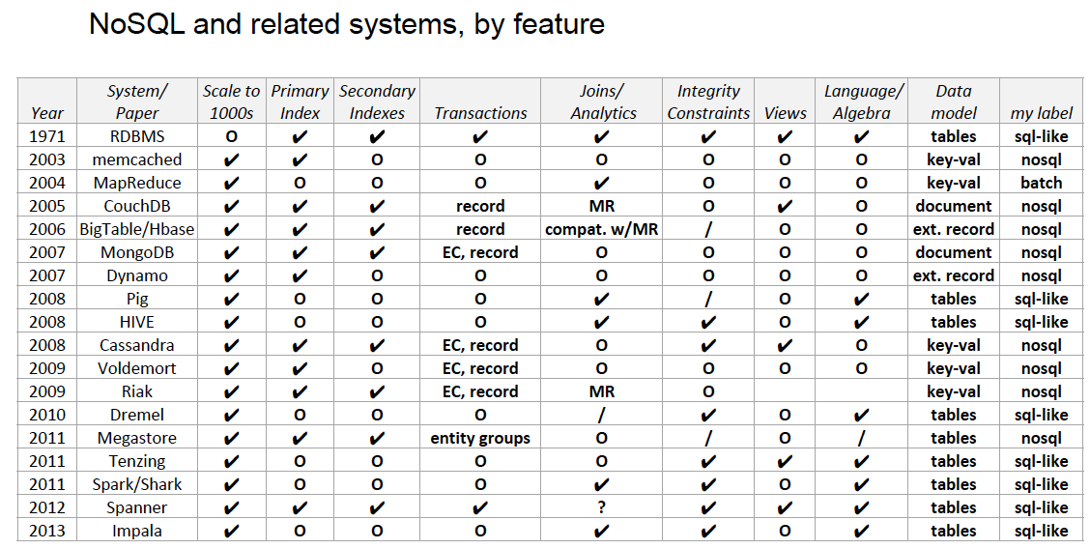
OVERVIEW
Notes:
From

Slide 57
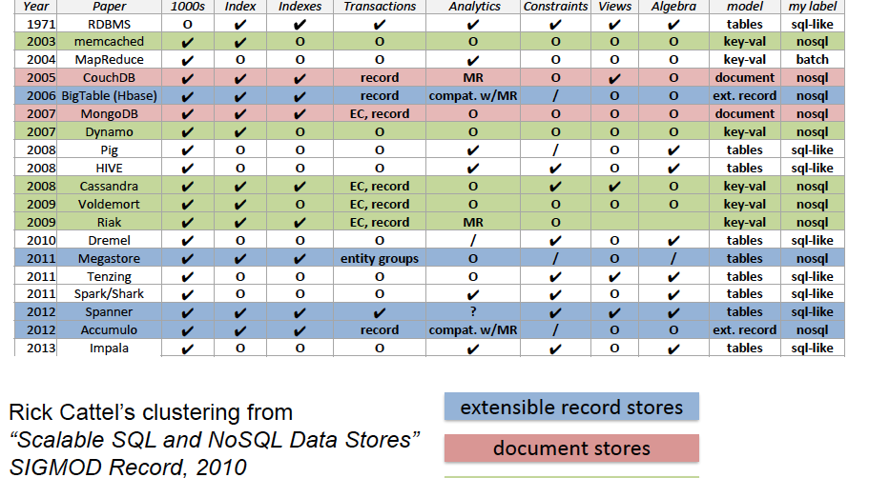
3 types

Slide 58
Examples
Key Value Store (DynamoDB)
Databases as a service
Created by Amazon (AWS)
Document Data Store (MongoDB)
One of leading databases for companies creating web applications
Created by 10-gen

Slide 59
DynamoDB
DynamoDB is a fast, fully managed NoSQL database service that makes it simple and cost-effective to store and retrieve any amount of data, and serve any level of request traffic. All data items are stored on Solid State Drives (SSDs), and are replicated across 3 Availability Zones for high availability and durability.
http://aws.amazon.com/dynamodb/
http://docs.aws.amazon.com/amazondynamodb/latest/developerguide/SampleTablesAndData.html

Slide 60
DynamoDB
While Amazon DynamoDB tackles the core problems of database scalability, management, performance, and reliability, it does not have all the functionality of a relational database. It does not support complex relational queries (e.g. joins) or complex transactions. If your workload requires this functionality, or you are looking for compatibility with an existing relational engine, you may wish to run a relational engine on Amazon RDS or Amazon EC2.

Slide 61
MongoDB
Mongo tries to achieve the performance of traditional key-value data stores while maintaining functionality of RDMS
Documents stored in BSON (binary JSON)
Schema-less; means that database structure can be changed as needed
Built in map-reduce (will talk about later)

Slide 62
RDMS vs. MongoDB
RDMS (MySQL, Postgres) | MongoDB
Tables | Collections
Records/rows | Documents/objects
Queries return records (s) | Queries return a cursor (???)

Slide 63
MongoDB
Queries return “cursors” instead of collections
A cursor allows you to iterate through the results set
Improves performance (more efficient than loading all objects into memory)

