Slide 1
Technology Fundamentals for Analytics
Jason Kuruzovich

Slide 2
Kaggle Assignment 1
See Class Wiki
Be sure to update with project you have selected

Slide 3
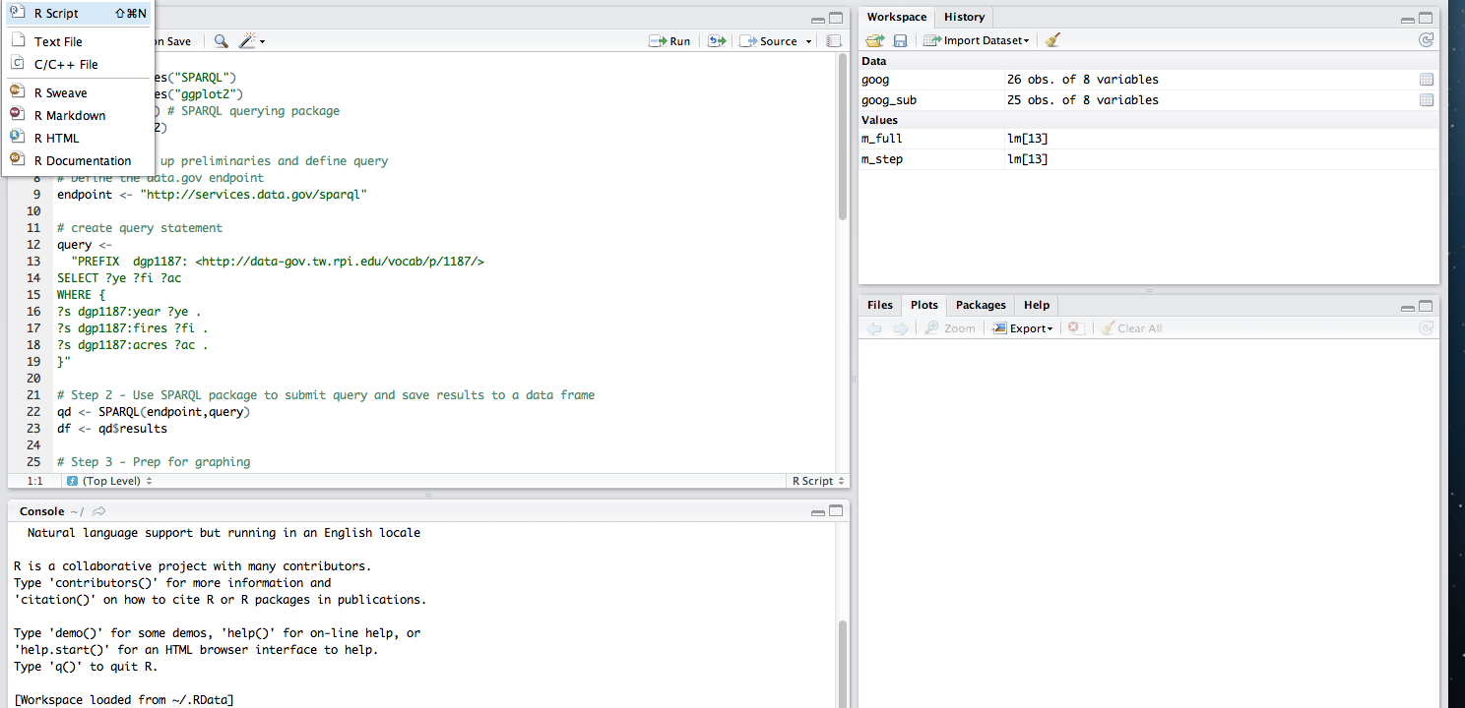
Working with RSTUDIO
Scripts
RObjects
Browser/Plot/Help/Packages
Console

Slide 4
Tips
Always work in a script
Highlight just a few lines and run those when debugging, writing code
Double click on objects
When not sure, try gui menu (stwd) or help(command)

Slide 5
General Strategies
Split, Apply, Combine
Sometimes it is relevant to use the above strategy to manage large data transformations
http://www.jstatsoft.org/v40/i01
Train, Test
Data is often spit into a component used for training and another used for testing

Slide 6
Object Storage
All Values in R stored as Objects (some types)
Vector: A one-dimensional array of arbitrary length. Subsets of the vector may be referenced. All elements of the vector must be of the same type--numerical, character, etc.
Matrix: A two-dimensional array with an arbitrary number of rows and columns. Subsets of the matrix may be referenced, and individual rows and columns of the matrix may be handled as vectors. All elements of the matrix must be of the same type.
Data frame: A set of data organized similarly to a matrix. However each column of the data frame may contain its own type of data. Columns typically correspond to variables in a statistical study, while rows correspond to observations of these variables. A data frame may be handled similarly to a matrix, and individual columns of the data frame may be handled as vectors.
List: An arbitrary collection of other R objects (which may include other lists).

Slide 7
Variables
Numeric: Standard number
Integer: No decimals
String: Free text
Factor: Levels/Groups (Easily translate to dummy variables)
Boolean: (TRUE or FALSE)
Date (or DateTime): Date
AFTER IMPORTING DATA MAKE SURE DATA
IS OF CORRECT TYPE

Slide 8
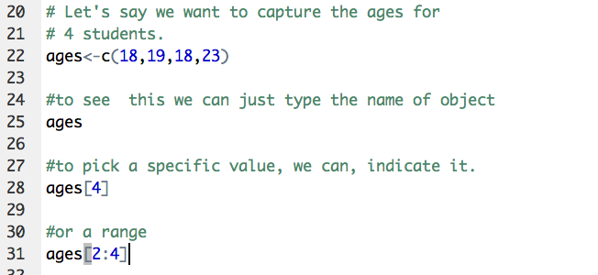
Vector Examples
Create vector with concatenate (c) and then refer to specific position with vector[position]

Slide 9
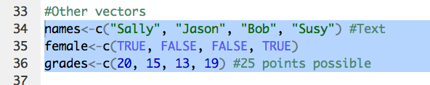
Vectors Examples
Can also create vectors of different types

Slide 10
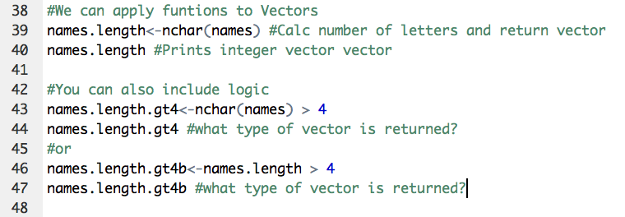
Vector Examples
We can apply functions to vectors

Slide 11
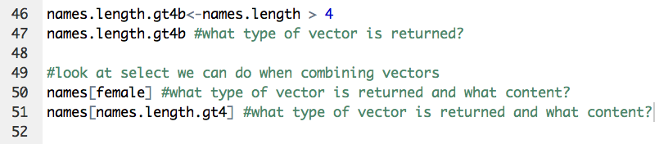
Combining Vectors
Combining Boolean with other vectors can be used for filtering

Slide 12
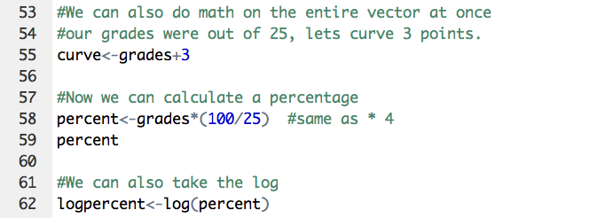
Vector Examples
Often it is very useful to apply a function on an entire vector at once

Slide 13
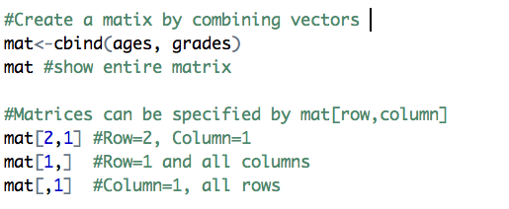
Matrix Example
A Matrix is similar to a vector, but in 2 dimensions
matrixname[row, column]

Slide 14
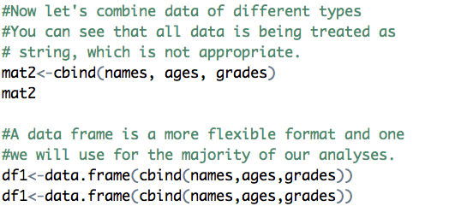
Matrix Limitations
A matrix must be of all one data type.
A data frame is more flexible and can have multiple data types, so usually we will use data frames.

Slide 15
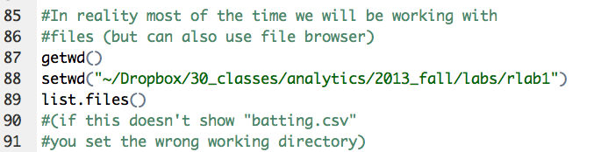
Working with Files/Scripts
When working with data, it is relevant to understand the consoles current working directory, where it is looking for files

Slide 16
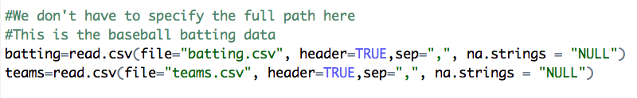
Working with Files
Note: This was pulled from a database download, so had to specify the na.strings
Because working directory is specified, no need to indicate full path

Slide 17
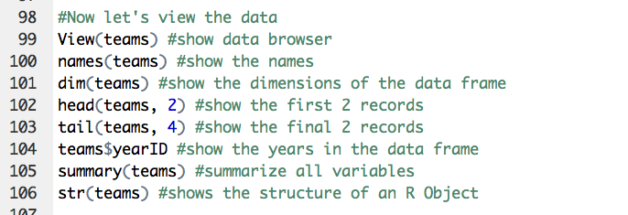
Viewing Data

Slide 18
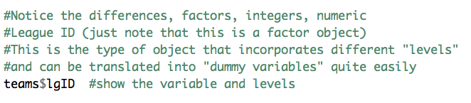
Factors and “Dummy Variables”
Factors correspond with different groups or categories

Slide 19
Dummy Coding/R
R takes care of the process of dummy coding variables automatically
Dummy coding is necessary for categorical and (usually) ordinal variables
Assigns a binary indicator (dummy variable) to indicate group membership
For n exclusive categories (i.e., you can only be member of 1 category), you need n-1 dummy variables

Slide 20
Dummy Coding Example
Color | C1 | C2
Red | 1 | 0
Blue | 0 | 1
Red | 1 | 0
Yellow | 0 | 0
Yellow | 0 | 0
Blue | …. | ….
Here 3 colors are coded into 2 dummy variables, which then can be incorporated into a regression

Slide 21
Working with Data Frames
Changing Data Type
Subseting Data
Recoding Data
Calculating new fields

Slide 22
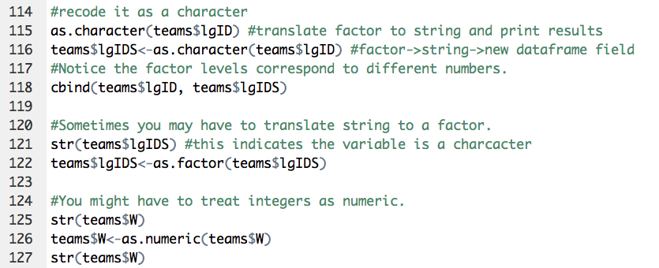
Recoding Data
Often necessary to change type of data

Slide 23
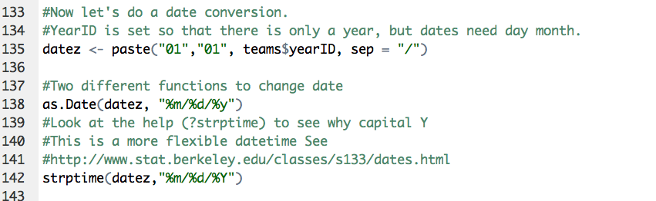
Recoding Data
When working with time series data, dates must be specified as dates
How would you add the recoded date to the data frame?

Slide 24
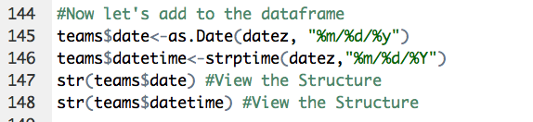
Recoding Data

Slide 25
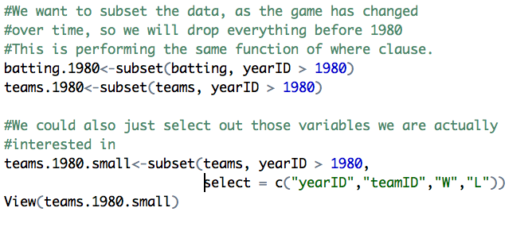
Subset Data
Subset enables selection of specific rows and columns
← ROWS
Columns

Slide 26
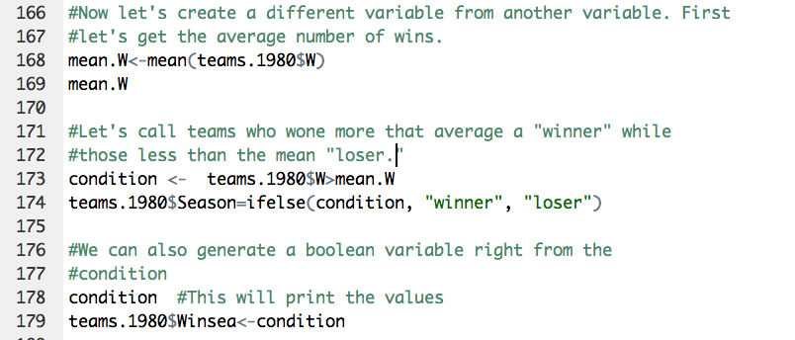
Recoding Data
Often we need to recode data -> Making one variable from another
For Loops (Recoding data)

Slide 27
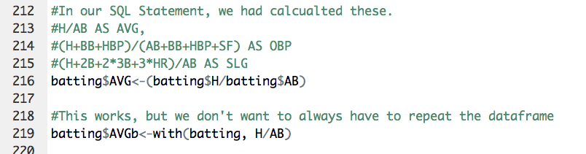
Recoding Data
You can do calculations either by fully specifying the variables with the data frame or by using the “with” command

Slide 28
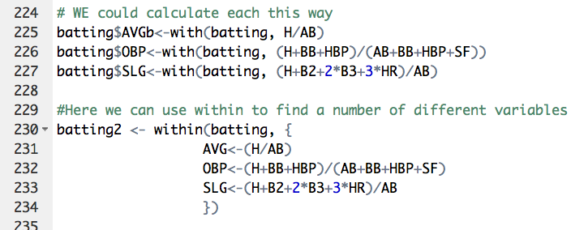
Recoding Multiple Variables
“with” can calculate one variable while “within” can calculate multiple variables.

Slide 29
Dealing with Missing Values
Often missing values can be quite important, and “why” they are missing should be investigated
Fill Out Satisfaction Survey
In this case the reason why the values are missing may lead to a bias in the results. This is known as selection bias.
Happy?
Skip Satisfaction Survey

Slide 30
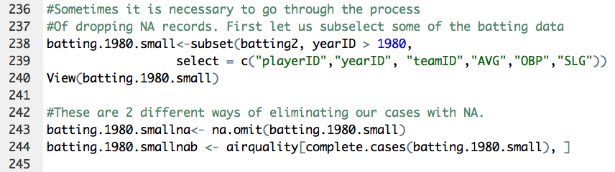
Dealing with Missing Values

Slide 31
Aggregating Data
Many times data must be aggregated so that it can be included in an analysis
(SQL -> Group by)
TEAM LEVEL DATA (team year)
(WINS, PLAYOFFS, ATTENDENCE)
AVG PLAYER by (team/year)
(mean(AVG, OBP, SLG) )
Aggregate()/ddply()
PLAYER LEVEL DATA
(AVG, OBP, SLG )

Slide 32
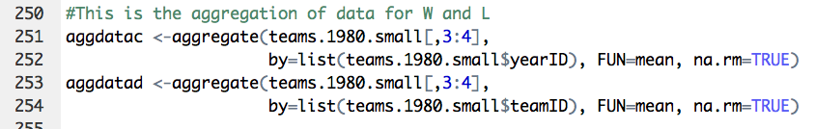
Aggregating Data
Notice how we are specifying columns using specifically using 3:4 (this is W/L)

Slide 33
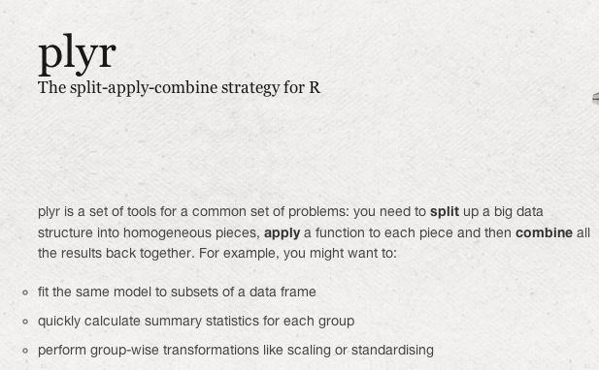
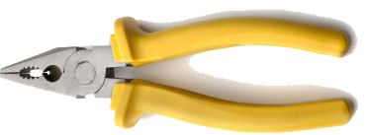
Aggregate Data
Alternative to standard function:

Slide 34
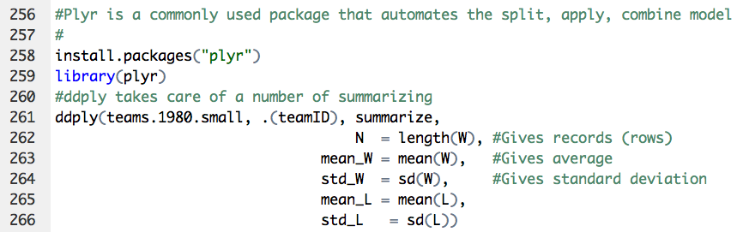
Aggregate Data

Slide 35
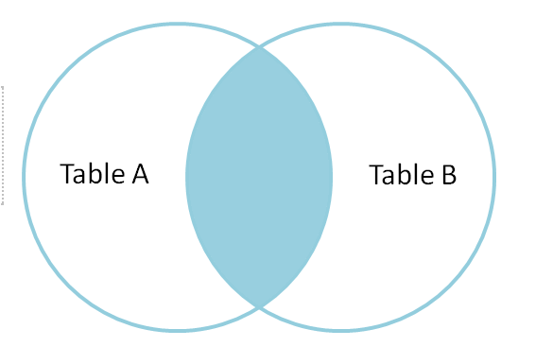
Join Datasets
Inner or Natural Join (only intersection)

Slide 36
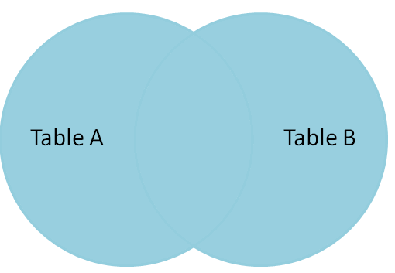
Join Datasets
FULL Outer Join

Slide 37
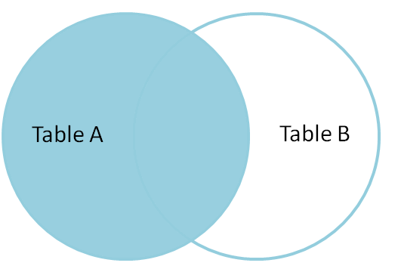
Join Datasets
Left Outer Join

Slide 38
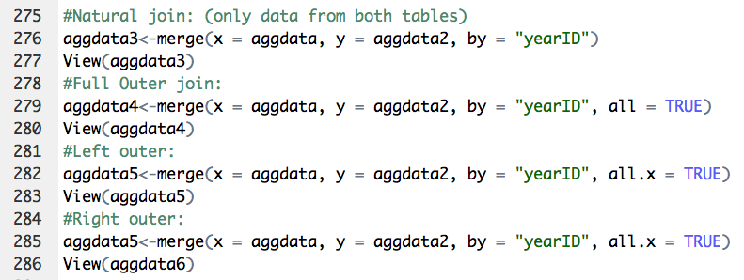
Join = Merge

Slide 39
for Loops (Recoding data)
There is a saying that if you are using for loops in R, you are doing something wrong. Why?
There is probably a function to do what you need to do
For loops will be much slower
However, for small/moderate size data they can be very effective and easy for beginning programmer to implement

Slide 40
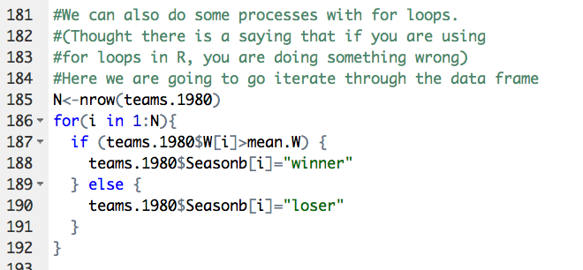
for Loops (Recoding data)
The direct way
for Loop

Slide 41
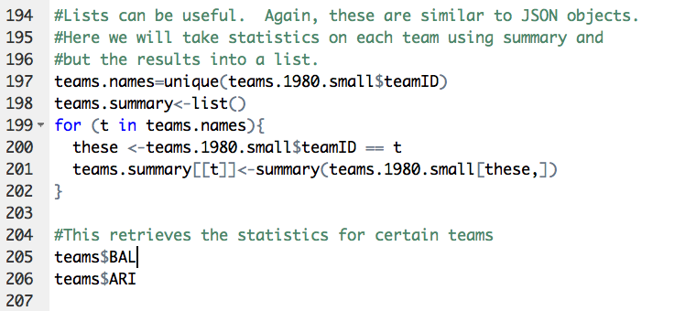
for Loop (Reorganize Data)
This changes a data frame to a list:

Slide 42
Functions
Functions are a useful way to organize calculations
Similar to a method in programming

Slide 43
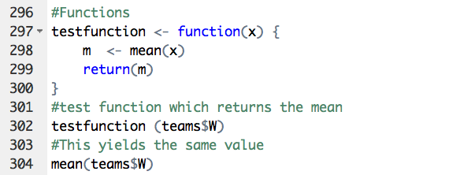
Functions

Slide 44
Analysis

Slide 45
Review: The Role of Analysis
What are the steps to answering a business question?
Clarify the question
Analysis
Identify alternative solutions
Access alternative solutions
Choose one solution
Implement solutions
Examine to what extent your solution answered the question
Data
Analysis
Information

Slide 46

Basic Statistics
Center
Mean
Median -The middle number or item in a set of numbers or objects arranged from least to greatest
Spread
Variance/Standard Deviation
Density curves/Distribution curve/Histogram
Center and spread

Slide 47

Review: Sample Variance s²
Deviation from mean: the difference between an observation and the sample mean:
Sample Variance s²: the average of the squares of the deviations of the observations from their mean.
Sample Standard Deviation s: the square root of the sample variance.

Slide 48
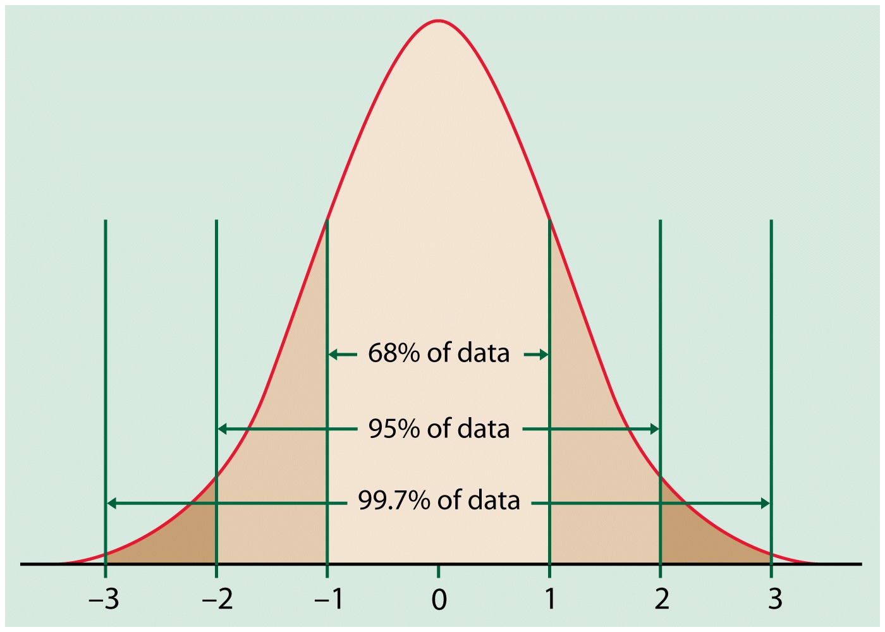
Review: 68-95-99.7 Rule w/Normal Distributions

Slide 49
Standardizing and z-Scores
an observation x comes from a distribution with mean
and standard deviation
The standardized value of x is defined as
which is also called a z-score.
A z-score indicates how many standard deviations the original observation is away from the mean, and in which direction.
The mean of the z-score is always equal to 0.

Slide 50
Correlation
It can also be defined as the average product of z-scores because the two equations are identical.
The correlation, r, is a quantitative index of the association between two variables. It is the average of the products of the z-scores.
When this average is positive, there is a positive correlation; when negative, a negative correlation

Slide 51
Causation
The only way to conclude that X->Y is:
X must precede Y
Y must not occur when X does not occur
Y must occur whenever X occurs
Difficult to fully test causation with statistical methods

Slide 52
Causation
In social sciences research, you argue for causation based on your knowledge of the world, you support this through data analysis
You cannot conclude causation through statistical analysis

Slide 53
Causation
If X and Y are correlated…
X
Y
It could be that X causes Y.
X
Y
It could be that Y causes X.
X
W
Y
It could be that X causes W and W causes Y.
W
X&Y
It could be that W causes X&Y.

Slide 54
Monty Python
http://www.youtube.com/watch?v=yp_l5ntikaU

Slide 55
Causation
If you extend your logic analysis
Wood
Floats
Duck
Floats
Weight Equal to duck
Witches

Slide 56
Causation
If you extend your logic analysis
Burn
Witches
Burn
Wood
Therefore
Witches
Wood

Slide 57
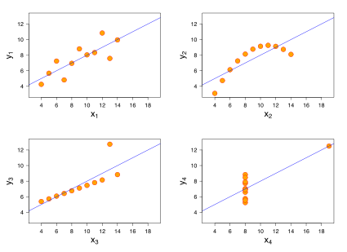
What do each of these graphs indicate?
All 4 sets for variables have the same mean, standard deviation, and correlation, and regression line

Slide 58
It is important to visualize data

Slide 59
Next Time
Regression

