Slide 1
Technology Fundamentals for Analytics
Jason Kuruzovich

Slide 2
What is the Significance of 10,000 Hours???

Slide 3

Outliers
Throughout the publication, Gladwell repeatedly mentions the "10,000-Hour Rule", claiming that the key to success in any field is, to a large extent, a matter of practicing a specific task for a total of around 10,000 hours.

Slide 4
Article
How to hire data scientists and get hired as one
SQL,
Statistics,
Predictive modeling and
Programming (probably Python)

Slide 5
Course Wiki [Canvas -> Pages]
Tons of things to learn out there and many more free resources than ever before in the history of the world
Help me by adding good resources that you find.

Slide 6
Last Time
Overview of Semester
What does it mean to be a data scientist?
What do we mean by analytics?
What we we mean by big data?
QUIZ: WHAT ARE THE 3 PRIMARY AREAS OF EXPERTISE FOR A DATA SCIENTIST?

Slide 7
Key Tools of the Data Scientist
Data Munging - parsing, scraping, and formatting data
Math and Statistics - traditional analysis you're used to thinking about
Business Expertise – Knowledge of the business domain

Slide 8
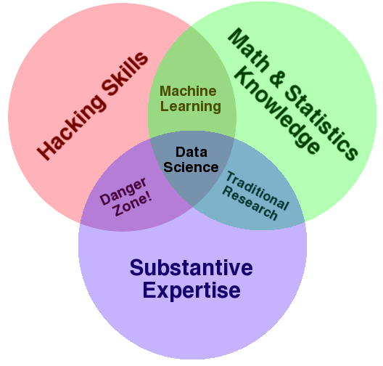
Data Science Venn Diagram
Source: http://drewconway.com/zia/2013/3/26/the-data-science-venn-diagram

Slide 9
Background
What is R?
R is a system for statistical computation and graphics. It consists of a language plus a run-time environment with graphics, a debugger, access to certain system functions, and the ability to run programs stored in script files.
What is CRAN?
The “Comprehensive R Archive Network” (CRAN) is a collection of sites which carry identical material, consisting of the R distribution(s), the contributed extensions, documentation for R, and binaries.

Slide 10
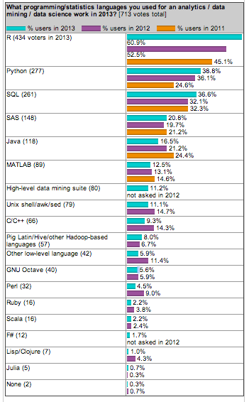
R is Top Language for Data Mining / Data Science Work

Slide 11
R is Top Language for Data Mining / Data Science Work

Slide 12
Lab, What we are Doing
RMySQL Package
Extract via SQL
Lab – Foundations and Key Ideas
MYSQL DATA
(.SQL file with Table Structures and Data)
RSTUDIO
BASEBALL DATA
(.SQL file with Table Structures and Data)
ANALYSES

Slide 13
R and Packages
Packages are collections of R functions, data, and compiled code in a well-defined format.
R comes with a standard set of packages.
Others are available for download and installation.
External packages only have to be installed once, but they have to be loaded each time they are used.
You can create your own packages and contribute them back to the ecosystem

Slide 14
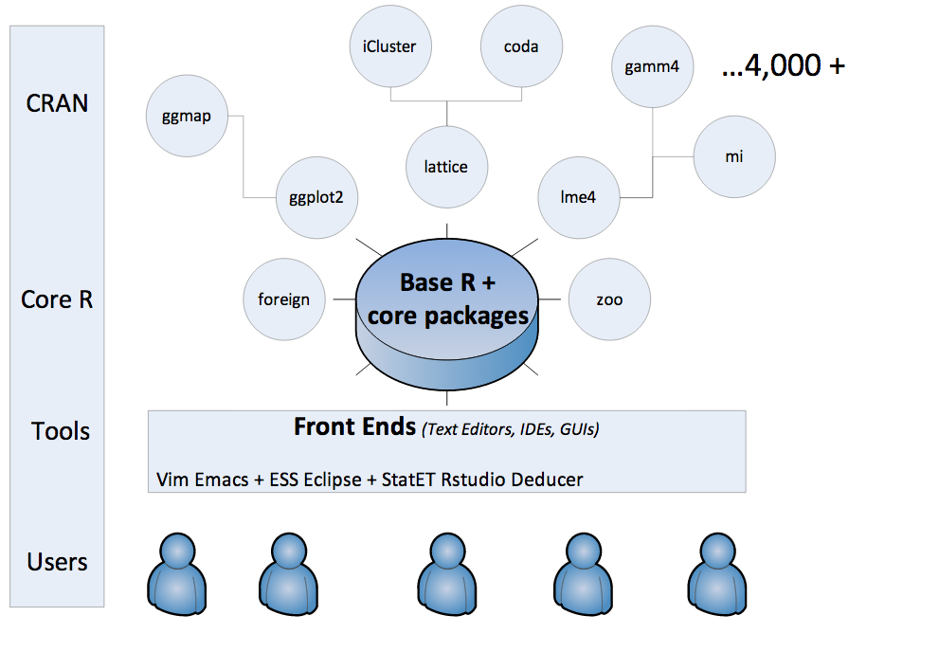
R

Slide 15
Understanding How is Data Organized: Key Terms and Technologies
Database: A single table or a collection of related tables
Database management systems (DBMS): Sometimes called “database software”; software for creating, maintaining, and manipulating data
Structured query language (SQL): A language used to create and manipulate databases
Database administrator (DBA): Job title focused on directing, performing, or overseeing activities associated with a database or set of databases
Includes database design, creation, implementation, maintenance, backup and recovery, policy setting and enforcement, and security

Slide 16
Understanding How is Data Organized: Key Terms and Technologies
Table or file: A list of data, arranged in columns (fields) and rows (records)
Column or field: A column in a database table. Columns represent each category of data contained in a record (e.g., first name, last name, ID number, data of birth)

Slide 17
Understanding How is Data Organized: Key Terms and Technologies
Row or record or tuple: A row in a database table. Records represent a single instance of whatever the table keeps track of (e.g., student, faculty, course title)
Key: A field or combination of fields used to uniquely identify a record, and to relate separate tables in a database. Examples include social security number, customer account number, or student ID
Relational database: The most common standard for expressing databases, whereby tables (files) are related based on common keys

Slide 18
Where Does Data Come From?
For organizations that sell directly to their customers, transaction processing systems represent a fountain of potentially insightful data
Transaction processing systems (TPS): A system that records a transaction (some form of business-related exchange), such as a cash register sale, ATM withdrawal, or product return
Transaction: Some kind of business exchange
The cash register is the primary source that feeds data to the TPS
TPS can generate a lot of bits, it’s sometimes tough to match this data with a specific customer

Slide 19
Where Does Data Come From?
Enterprise software (CRM, SCM, and ERP)
Firms set up systems to gather additional data beyond conventional purchase transactions or Web site monitoring
CRM or customer relationship management systems are used to empower employees to track and record data at nearly every point of customer contact
Supply chain management (SCM) and enterprise resource planning (ERP) systems touch every aspect of the value chain

Slide 20
Where Does Data Come From?
Surveys
Firms supplement operational data with additional input from surveys and focus groups
Direct surveys can tell you what your cash register can’t
Many CRM products have survey capabilities that allow for additional data gathering at all points of customer contact

Slide 21
Where Does Data Come From?
External sources
If your firm has partners that sell products for you, then you’ll likely rely heavily on data collected by others
Data bought from sources available to all might not yield competitive advantage on its own. But it can provide key operational insight for increased efficiency and cost savings

Slide 22
Data Rich, Information Poor
Many organizations are data rich but information poor
Factors holding back information advantage
Legacy system: Older information systems that are often incompatible with other systems, technologies, and ways of conducting business
Most transactional databases aren’t set up to be simultaneously accessed for reporting and analysis

Slide 23
Understanding How Data is Organized
What is a table and what does it look like?
Composed of records which are composed of fields/attributes.
Field
Fields
Last Name SS# DOB Major
Smith 100201122 06/11/84 IS
Kim 200202222 1/1/85 FIN
Davis 300201232 12/31/81 MKT
Pat 999132212 3/3/88 ACC
Field
value
Record
Table

Slide 24
Example: Database for Amazon
What are important “things” that Amazon needs to keep track of?

Slide 25
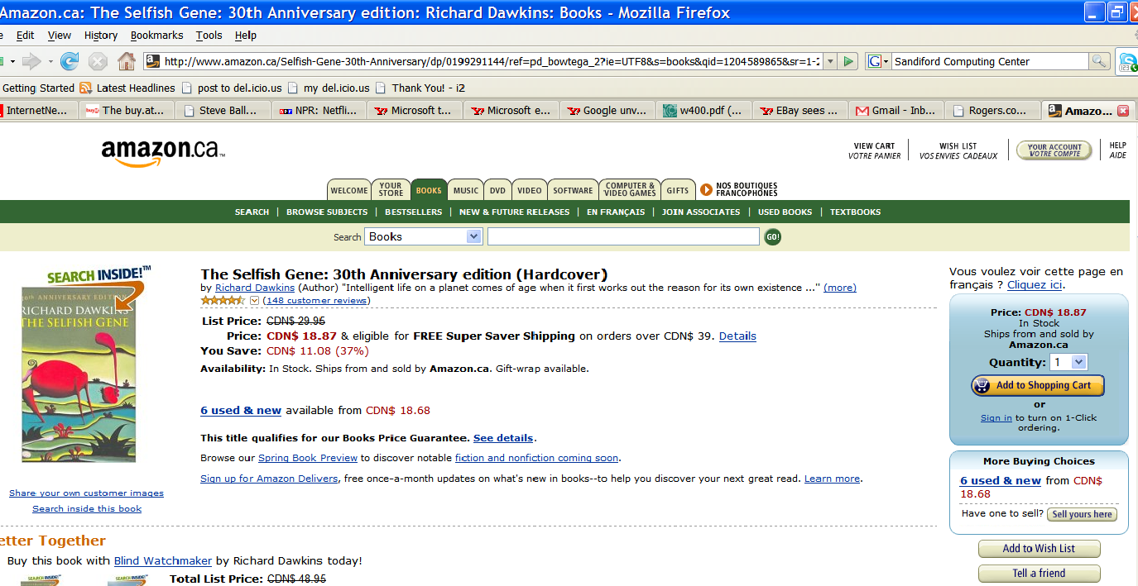
Let’s focus on tracking information about books
Price: $15
ISBN: 1001
Note: ISBN number shown here for this book is not real (it is a made up number to make example simple)

Slide 26
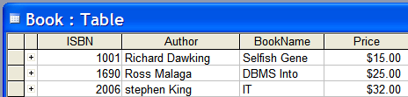
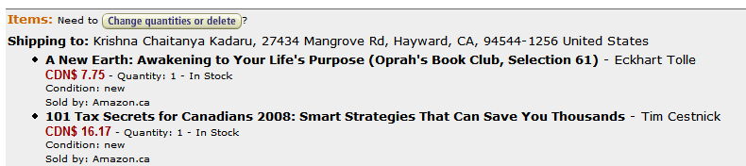
How would you store book related data if you were using Excel?
What if we also want to track “orders” placed by customers?
A sample order

Slide 27
Very Simplified Order Form
Order # ___
Send to:
Customer’s name
Date: _____
Phone
Detail:
ISBN
Book Name
Author
Price

Slide 28
Recap: Information that we want to track
Order related
Order Number, Date
Customer related
Customer ID, Name, Phone
Books related
ISBN, Name, Author, Price
How would you store such data if you were using Excel?

Slide 29
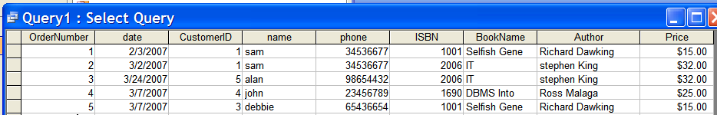
Organizing Order Information in Excel
Problems?
1. Adding a potential customer who has not ordered yet
Adding a book recently received from supplier (i.e., it has not been ordered by any customer)
2. Deleting an order (such as order # 4 or order # 5)
3. Modifying an attribute (Changing price of book named “selfish gene”)
Cause?
Data is not structured properly (i.e., un-normalized)

Slide 30
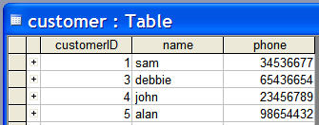
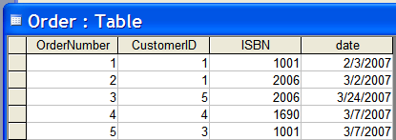
Relational Database Approach
Create a series of logically related two-dimensional tables to store their information
We have 3 tables – a table for book related data, another for customer related data, and finally a table for order related data
How are these “logically” related?

Slide 31
Connecting tables together
1. Each Table should have a Primary Key
Primary keys
A field/attribute (or group of fields/attributes in some cases) that uniquely identify each record/entity in a table
Examples: Customer ID, ISBN, Order#
2. Tables are connected using Foreign Keys
Foreign keys
A field that is a primary key in one table and appears in a different table (may appear as a part of the primary key)
Examples: Customer ID in Orders table
Another example: ???
Note: Primary Key (PK) is identified by underlining appropriate field/s.

Slide 32
Logical Structure of the database:
Each Table should have a Primary Key
Primary Key
Primary Key
Primary Key

Slide 33
Logical Structure of the database:
Tables are connected using Foreign Keys
Primary Key
Primary Key
Foreign Key
Foreign Key
Primary Key
Text Representation of Tables
Customer (CustomerID, Name, Phone)
Book (ISBN, Author, BookName, Price)
Order (OrderNumber, CustomerID, ISBN, Date)

Slide 34
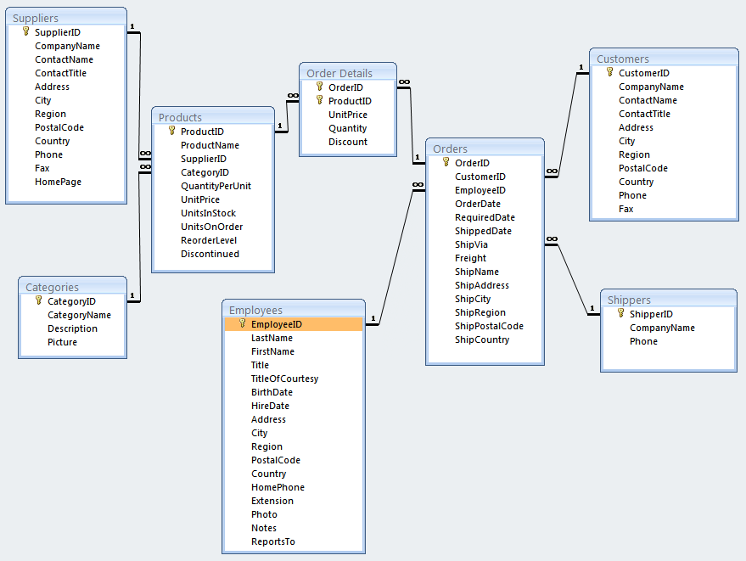
Tables are connected by creating relationships
Each primary key - foreign key pair represents a relationship.

Slide 35
Normalization
Problems/Anomalies arise if data is not structured properly (i.e., un-normalized)
Normalization is a method for analyzing and reducing a relational database to its most streamlined form for:
Minimum redundancy
Maximum data integrity
Best processing performance
Normalized data is when attributes in the table depend only on the primary key.
How to create normalized tables is beyond the scope of this course (covered in INSY 333 and INSY 437).

Slide 36
Normalization
Un-Normalized Table
Normalized
Tables
Customer (CustomerID, name, phone)
Book (ISBN, Author, BookName, Price)
Order (OrderNumber, date, CustomerID, ISBN)

Slide 37
Data Scientists and Relational Databases
Data scientists need to be able to:
Look at a relational database and understand how data is organized
Select and extract data from multiple tables using SQL
Perform in database calculations using SQL

Slide 38
Abstraction: SQL Enables Relational Algebra Calculations
Operations always create new relations
Operations (filter, refine)
Selection
Projection
Cartesian product (join)
Set union
Set Difference
Rename
Notes:
Five primitive operators of Codd's algebra are the selection, the projection, the Cartesian product (also called the cross product or cross join), the set union, and the set difference. Another operator, rename was not noted by Codd, but the need for it is shown by the inventors of ISBL.

Slide 39
Different Select Statements
Basic Selection
SELECT * FROM batting;
Basic Selection of Big Table
SELECT * FROM batting limit 50;

Slide 40
Different Select Statements
Basic Selection of Different Columns
SELECT H, AB, 2B, 3B FROM batting;
Basic Selection of Specific Rows (here from a specific year)
SELECT * FROM batting where yearID=1950;
Basic Selection of Specific Rows (here from a specific year)
SELECT * FROM batting where yearID=1950 and teamID = “KCA”;

Slide 41
Different Select Statements
Calculate a new field
SELECT *, H/AB AS AVG
, (H+BB+HBP)/(AB+BB+HBP+SF) AS OBP
FROM batting;

Slide 42
Different Select Statements
Calculate a new field
SELECT playerid year from batting where HR > 60;
SELECT count(playerID) from batting where HR >60;
SELECT count(DISTINCT playerID) from batting where HR >60;

Slide 43
Different Select Statements
Aggregation
select teamid, yearID, SUM(salary) from Salaries group by teamid, yearid;
select yearID, SUM(salary) from Salaries group by yearid;
select yearID, AVG(salary) from Salaries group by yearid;
Note how you have to perform aggregations on some variables

Slide 44
Select with SQL
The product of any selection is another relation
This means that relations can be nested (subselect).
RELATION
RELATION

Slide 45
Different Select Statements
Subselect
SELECT playerID, yearID, teamID, HR FROM batting where exists (SELECT playerID,IPOuts/3 as IP from pitching where IPOuts >300) order by HR desc;
Here we are looking for pitchers who also can hit!

Slide 46
Different Select Statements
Joins
SELECT p.playerID, m.nameFirst, m.nameLast, p.W p.L FROM pitching p, master m WHERE p.playerID = m.playerID;
Here we are including the first and last name

Slide 47
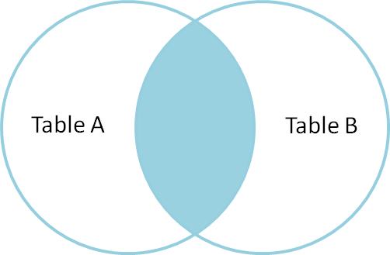
Joins, Visually
INNER JOIN
Notes:
http://www.codinghorror.com/blog/2007/10/a-visual-explanation-of-sql-joins.html

Slide 48
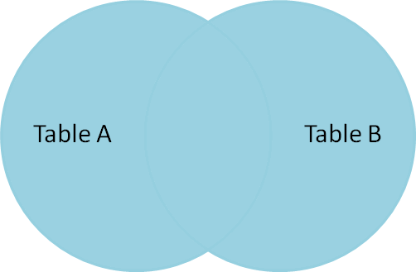
Joins, Visually
Full Outer Join
Notes:
http://www.codinghorror.com/blog/2007/10/a-visual-explanation-of-sql-joins.html

Slide 49
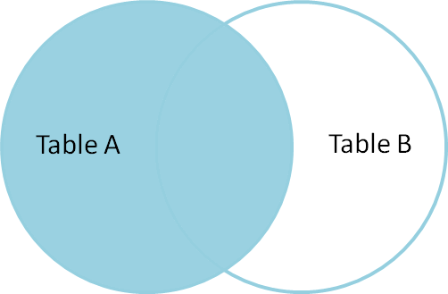
Joins, Visually
Left Outer Join
Notes:
http://www.codinghorror.com/blog/2007/10/a-visual-explanation-of-sql-joins.html

Slide 50
More advanced SQL Continued in SQL Lab

Slide 51
Level of Analysis and Aggregation
If you were going to try to analyze those factors that drive team success, why couldn’t you include information directly from the batting table?

Slide 52
Level of Analysis and Aggregation
Easier to include higher level factors in lower levels of analysis than the opposite
Leagues
Division
Team
Players
To include player level variables in team level analyses you have to aggregate them

Slide 53
Level of Analysis and Aggregation
Salary Analysis
In a player analysis of it would be relevant and appropriate to include “dummy variables” indicating the teams they are playing for
Yankees are likely to earn more than Pirates

