Slide 1
TECHNOLOGY FUNDAMENTALS FOR ANALYTICS
Jason Kuruzovich

Slide 2



Slide 3
What does data driven entrepreneurship mean to you?

Slide 4
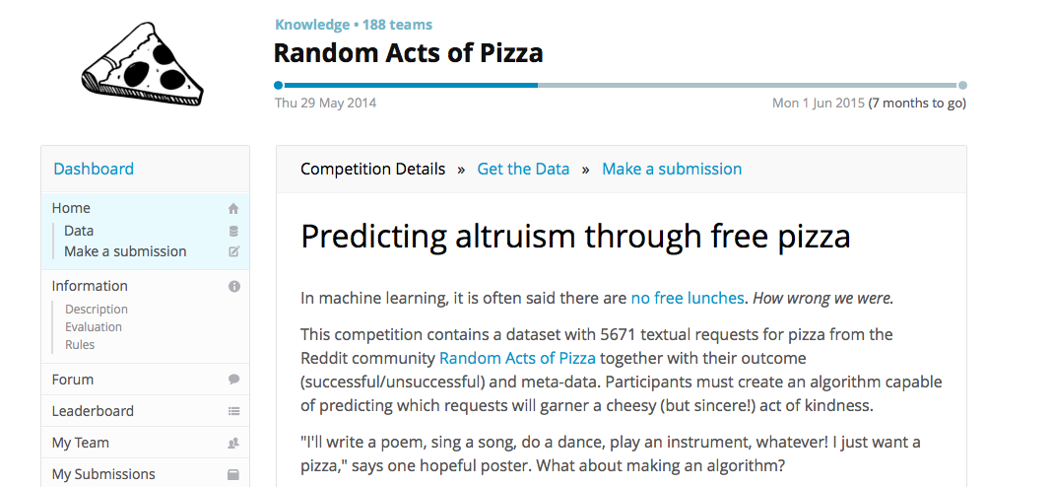
Kaggle Assignment 2
Advanced students can have their choice of assignments or one of industry projects

Slide 5
Info
Data fields
"giver_username_if_known": Reddit username of giver if known, i.e. the person satisfying the request ("N/A" otherwise).
"number_of_downvotes_of_request_at_retrieval": Number of downvotes at the time the request was collected.
"number_of_upvotes_of_request_at_retrieval": Number of upvotes at the time the request was collected.
"post_was_edited": Boolean indicating whether this post was edited (from Reddit).
"request_id": Identifier of the post on Reddit, e.g. "t3_w5491".
"request_number_of_comments_at_retrieval": Number of comments for the request at time of retrieval.
"request_text": Full text of the request.
"request_text_edit_aware": Edit aware version of "request_text". We use a set of rules to strip edited comments indicating the success of the request such as "EDIT: Thanks /u/foo, the pizza was delicous”.

Slide 6
Info
Data fields
"request_title": Title of the request.
"requester_account_age_in_days_at_request": Account age of requester in days at time of request.
"requester_account_age_in_days_at_retrieval": Account age of requester in days at time of retrieval.
"requester_days_since_first_post_on_raop_at_request": Number of days between requesters first post on RAOP and this request (zero if requester has never posted before on RAOP).
"requester_days_since_first_post_on_raop_at_retrieval": Number of days between requesters first post on RAOP and time of retrieval.
"requester_number_of_comments_at_request": Total number of comments on Reddit by requester at time of request.
"requester_number_of_comments_at_retrieval": Total number of comments on Reddit by requester at time of retrieval.
"requester_number_of_comments_in_raop_at_request": Total number of comments in RAOP by requester at time of request.
"requester_number_of_comments_in_raop_at_retrieval": Total number of comments in RAOP by requester at time of retrieval.
"requester_number_of_posts_at_request": Total number of posts on Reddit by requester at time of request.

Slide 7
Info
Data fields
"requester_received_pizza": Boolean indicating the success of the request, i.e., whether the requester received pizza.
"requester_subreddits_at_request": The list of subreddits in which the author had already posted in at the time of request.
"requester_upvotes_minus_downvotes_at_request": Difference of total upvotes and total downvotes of requester at time of request.
"requester_upvotes_minus_downvotes_at_retrieval": Difference of total upvotes and total downvotes of requester at time of retrieval.
"requester_upvotes_plus_downvotes_at_request": Sum of total upvotes and total downvotes of requester at time of request.
"requester_upvotes_plus_downvotes_at_retrieval": Sum of total upvotes and total downvotes of requester at time of retrieval.
"requester_user_flair": Users on RAOP receive badges (Reddit calls them flairs) which is a small picture next to their username. In our data set the user flair is either None (neither given nor received pizza, N=4282), "shroom" (received pizza, but not given, N=1306), or "PIF" (pizza given after having received, N=83).
"requester_username": Reddit username of requester.
"unix_timestamp_of_request": Unix timestamp of request (supposedly in timezone of user, but in most cases it is equal to the UTC timestamp -- which is incorrect since most RAOP users are from the USA).
"unix_timestamp_of_request_utc": Unit timestamp of request in UTC.

Slide 8
Deliverable
Your data is goal is to deliver at least 6 entries to the competition, comparing the performance of each.
3 entries should make some type of adjustment in the data used to train the algorithm
3 entries should make some type of adjustment in the model used
CLEARLY show the results in a table.

Slide 9
Advanced Students
Can do another assignment with instructor permission. There won’t be as much of a guide though.

Slide 10
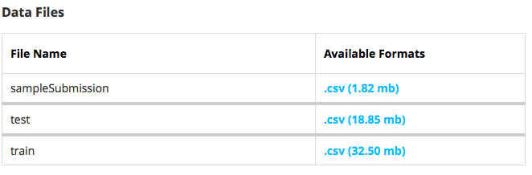
Data Files

Slide 11
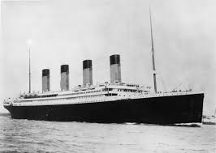
Raising the Titanic

Slide 12

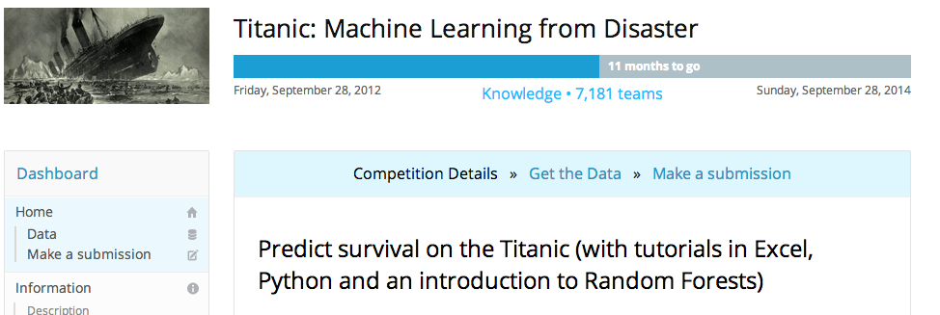
https://www.kaggle.com/wiki/Tutorials

Slide 13
Titanic – The Data
VARIABLE DESCRIPTIONS:
survival Survival (0 = No; 1 = Yes)
pclass Passenger Class (1 = 1st; 2 = 2nd; 3 = 3rd)
name Name
sex Sex
age Age
sibsp Number of Siblings/Spouses Aboard
parch Number of Parents/Children Aboard
ticket Ticket Number
fare Passenger Fare
cabin Cabin
embarked Port of Embarkation (C = Cherbourg; Q = Queenstown; S = Southampton)

Slide 14
Titanic
Python
http://nbviewer.ipython.org/urls/raw.github.com/agconti/kaggle-titanic/master/Titanic.ipynb
R
https://www.kaggle.com/c/titanic-gettingStarted/forums/t/3702/basic-r-code

Slide 15
LOTS to Learn Through this Example
Dealing with Missing Values
Generating Features
Resampling Methods
Different Models (Random Forest, Neural Networks, etc.)
Measuring success…

Slide 16
Dealing with Missing Data
Replace with the median
# For missing Fares, just use the median value
df.train$Fare[is.na(df.train$Fare)] <- median(df.train$Fare, na.rm = TRUE)
df.train$Fare <- as.numeric(df.train$Fare)
Try to predict data based on other features
m.age <- lm(Age ~ Fare + Sex + SibSp, data = df.full)
df.train$missing.age <- is.na(df.train$Age)
df.train$Age[is.na(df.train$Age)] <- predict(m.age, newdata = df.train)[is.na(df.train$Age)]
Notes:
# Impute Age for missing values
m.age <- lm(Age ~ Fare + Sex + SibSp, data = df.full)
df.train$missing.age <- is.na(df.train$Age)
df.test$missing.age <- is.na(df.test$Age)
df.train$Age[is.na(df.train$Age)] <- predict(m.age, newdata = df.train)[is.na(df.train$Age)]
df.test$Age[is.na(df.test$Age)] <- predict(m.age, newdata = df.test)[is.na(df.test$Age)]
# For missing Fares, just use the median value
df.train$Fare[is.na(df.train$Fare)] <- median(df.train$Fare, na.rm = TRUE)
df.test$Fare[is.na(df.test$Fare)] <- median(df.test$Fare, na.rm=TRUE)
df.train$Fare <- as.numeric(df.train$Fare)
df.test$Fare <- as.numeric(df.test$Fare)

Slide 17
Generating Features…
Features (using within)
df <- within(df,{
has.cabin <- as.numeric((Cabin != ""))
irish <- grepl("Mc", Name) | grepl("O\'", Name)
married <- grepl("Mrs", Name)
name.length <- nchar(as.character(Name))
ship.loc <- ifelse(region %in% c("A", "B", "C", "D", "E", "F"), region, "Other")
})

Slide 18
Generate Dummy Value
grepl returns a logical vector (match or not for each element of x).
grepl(pattern, x, ignore.case = FALSE, perl = FALSE, fixed = FALSE, useBytes = FALSE)
married <- grepl("Mrs", Name)
This generates a dummy variable for Mrs, indicating.

Slide 19
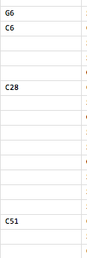
Recoding
gsub perform replacement of all matches respectively.
gsub(pattern, replacement, x, ignore.case = FALSE, perl = FALSE, fixed = FALSE, useBytes = FALSE)
1 <- gsub("[0-9]", "", cabin)
This replaces all Numeric [0-9] with blanks

Slide 20
Sampling Procedures [Cross Validation]
Used to prevent overfitting of model
Many Different Types
Holdout Method
K-fold Cross Validation
Repeated random sub-sampling validation (small n)
Leave-one-out cross-validation (small n)

Slide 21
2 Fold Cross Validation/Holdout Method
For each fold, we randomly assign data points to two sets d₀ and d₁, so that both sets are equal size (this is usually implemented by shuffling the data array and then splitting it in two). We then train on d₀ and test on d₁, followed by training on d₁ and testing on d₀.
This has the advantage that our training and test sets are both large, and each data point is used for both training and validation on each fold.

Slide 22
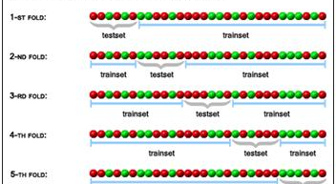
5 Fold Cross Validation

Slide 23
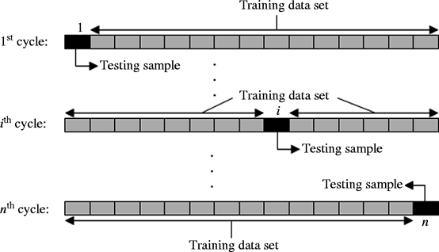
Leave-one-out cross-validation

Slide 24

Prediction and Cross Validation in R

Slide 25
Caret
Model Training and Parameter Tuning
The caret package has several functions that attempt to streamline the model building and evaluation process.
The train function can be used to evaluate, using resampling, the effect of model tuning parameters on performance choose the "optimal" model across these parameters estimate model performance from a training set

Slide 26
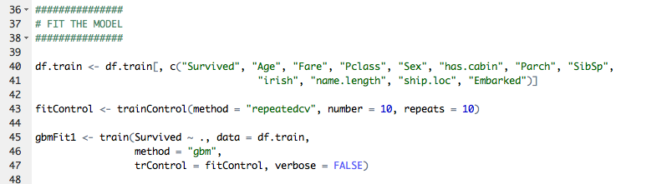
Caret Model and Cross Validation
Caret must have an associated model to use
http://caret.r-forge.r-project.org/modelList.html

Slide 27
Assess
predictionsvm <- predict(modelsvm,testsvm[,-1])
table(predictionsvm, test$survived)
predictionsvm 0 1
0 77 10
1 9 38
> xsvm<-table(predictionsvm, test$survived)
> correctsvm<-(xsvm[1,1]+xsvm[2,2])/(sum(xsvm))
> print(correctsvm)
[1] 0.858209 # this is the total correct, an indicator of performance of your classifier

Slide 28
Titantic
http://rstudio-pubs-static.s3.amazonaws.com/24346_54ea29a59de34034acb3ddbbc4a191f9.html

Slide 29
All State
See the following
https://github.com/justmarkham/kaggle-all
state

Slide 30
Next Week
1. Planning for Big Data [O’Reilly Media]
2. Mining Massive Datasets (Chapters 1-2)
3. “Data Jujitsu” DJ Patil

