Slide 1
Pitfall of Prediction-oriented Machine Learning Models and Economic Value of Statistical Efficiency in On-farm Precision Experimentation
Taro Mieno¹, Xiaofei Li², David S. Bullock³
1. University of Nebraska Lincoln, tmieno2@unl.edu
2. Mississippi State University, xiaofei.li@msstate.edu
3. University of Illinois, dsbulloc@illinois.edu

Slide 2
Introduction
Prediction-oriented Machine Learning (ML) methods have swept the field of optimal input management in precision agriculture.
Yield prediction is usually the ultimate goal.
Big success.
But it is unclear whether good yield prediction translates into farming profitability.

Slide 3
Objective of This Study
Compare the performance of prediction-oriented ML methods and traditional linear regression approaches in terms of the profitability of estimated site-specific nitrogen recommendation.
Monte Carlo simulations
On-farm precision experimental data

Slide 4
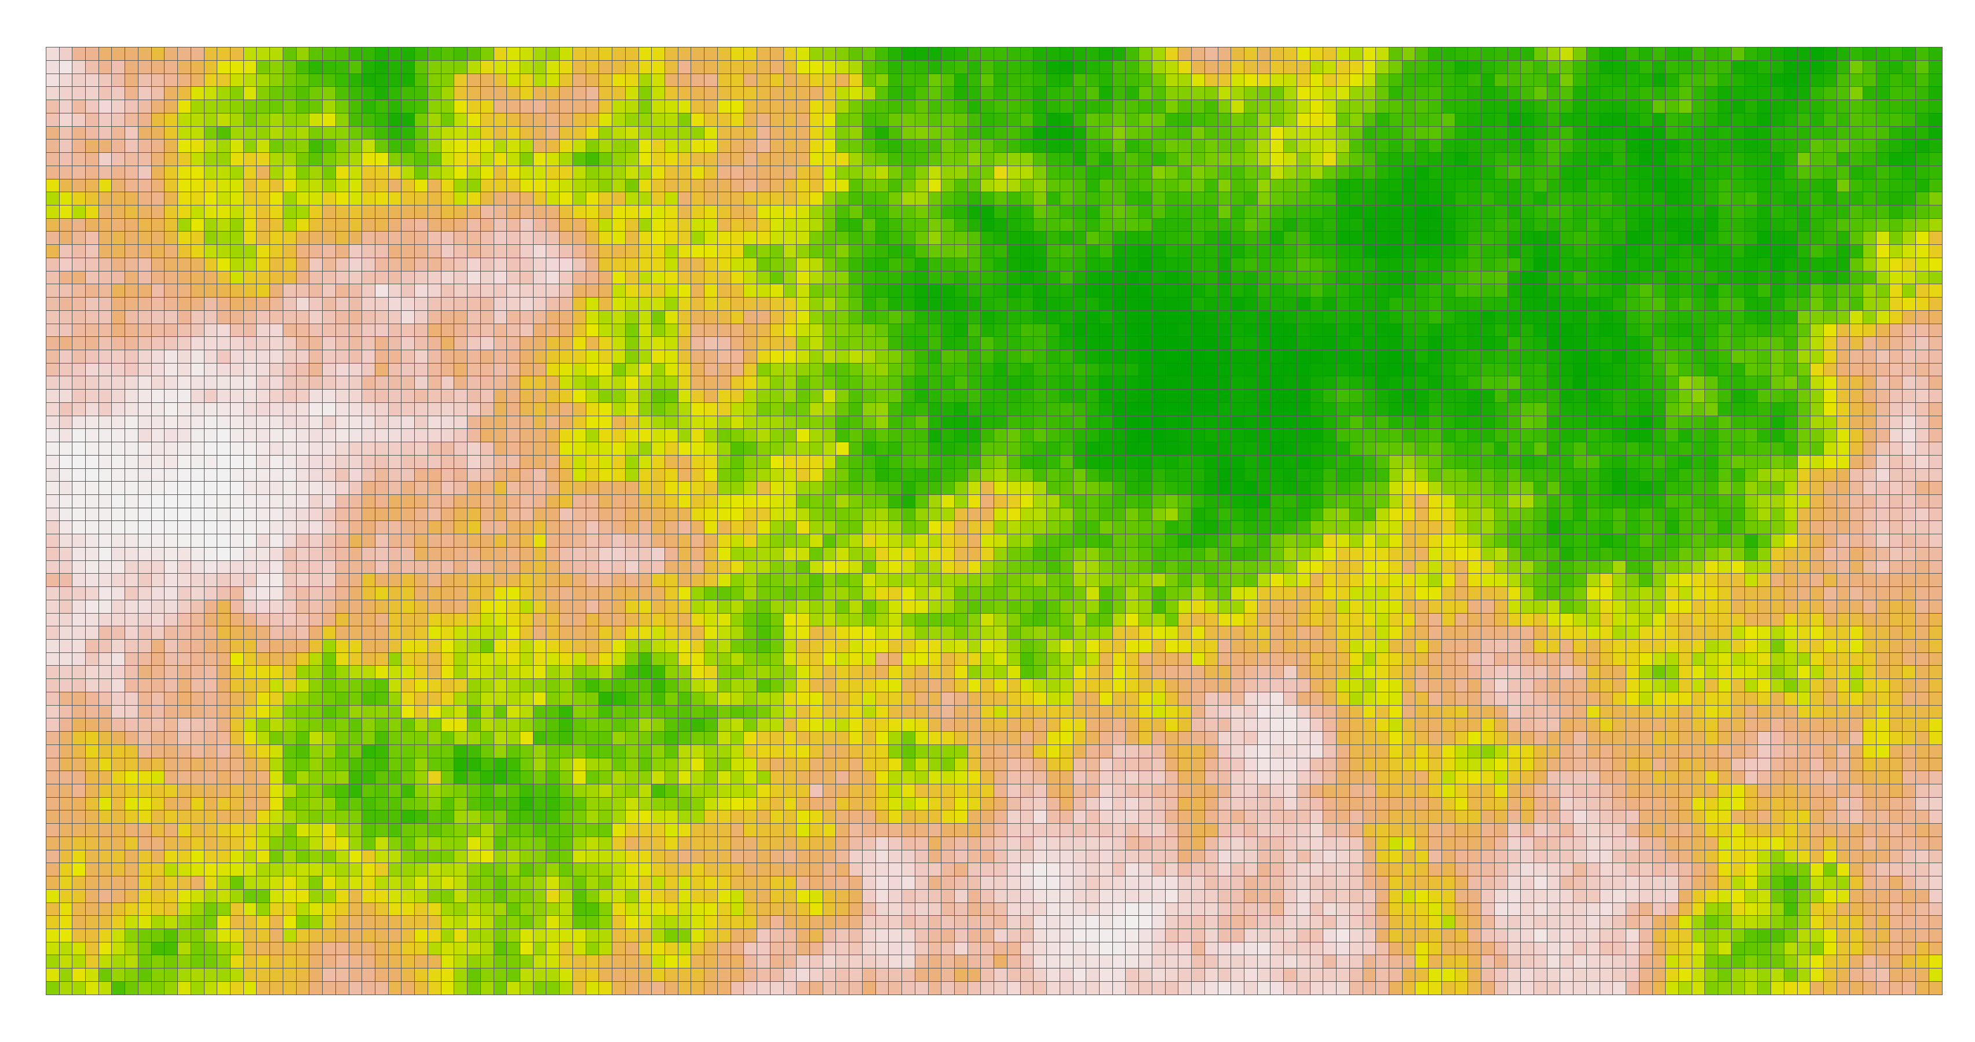
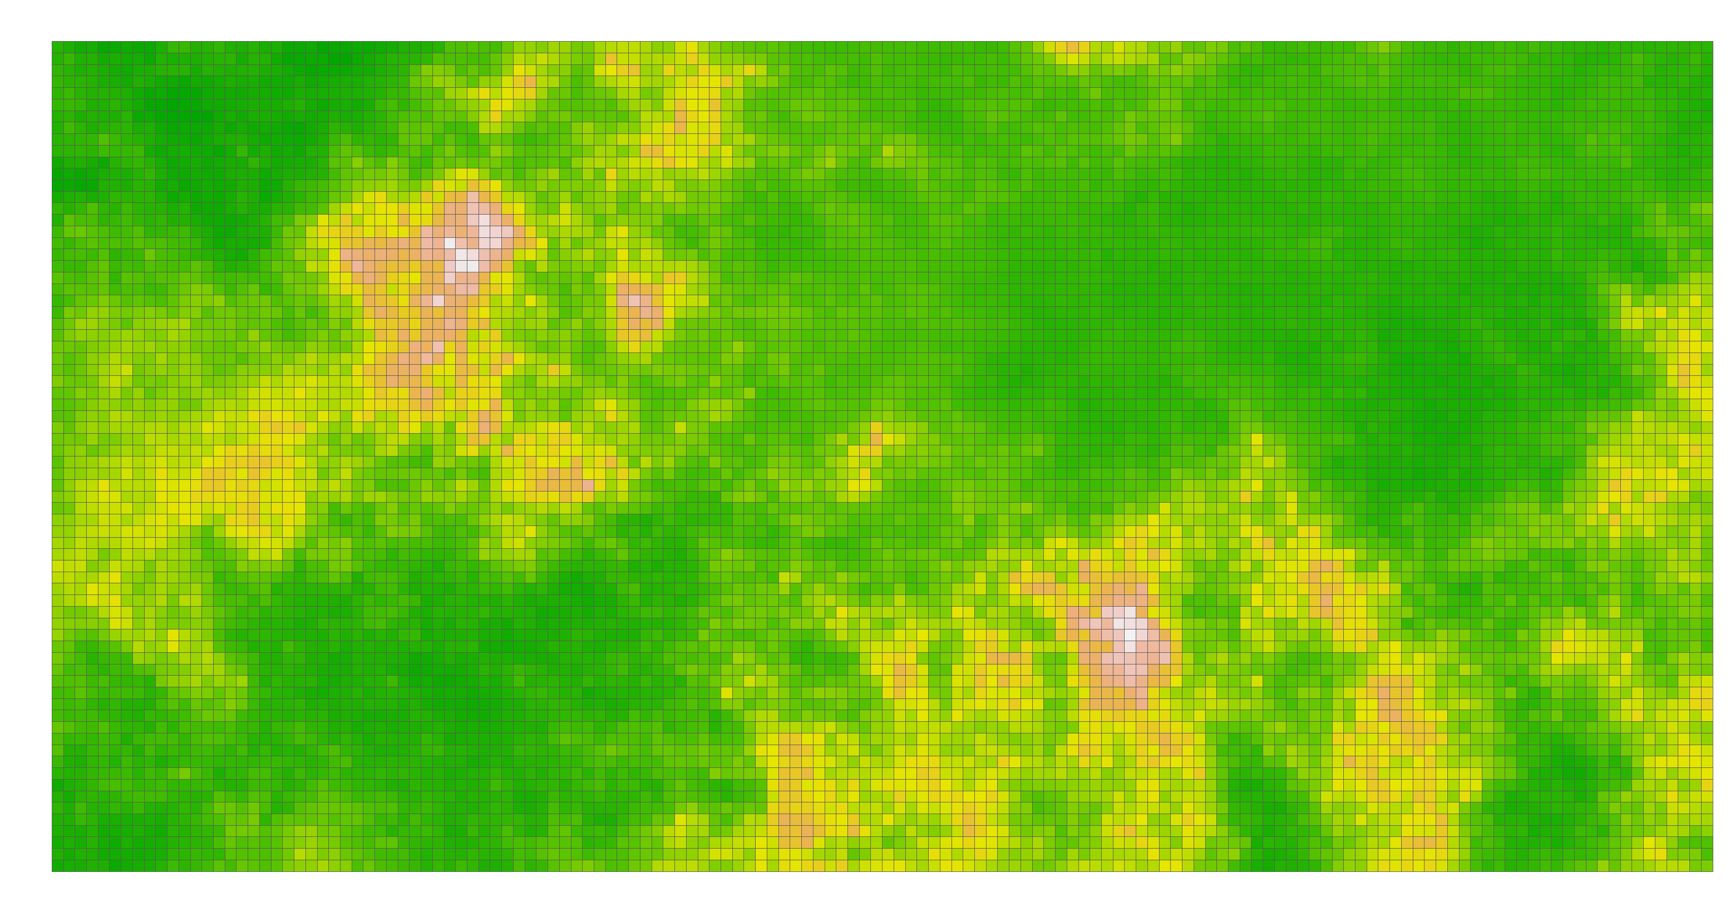
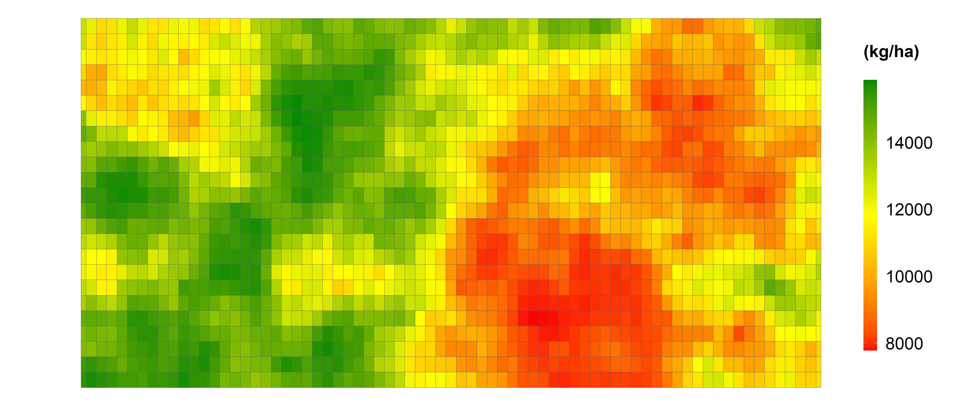
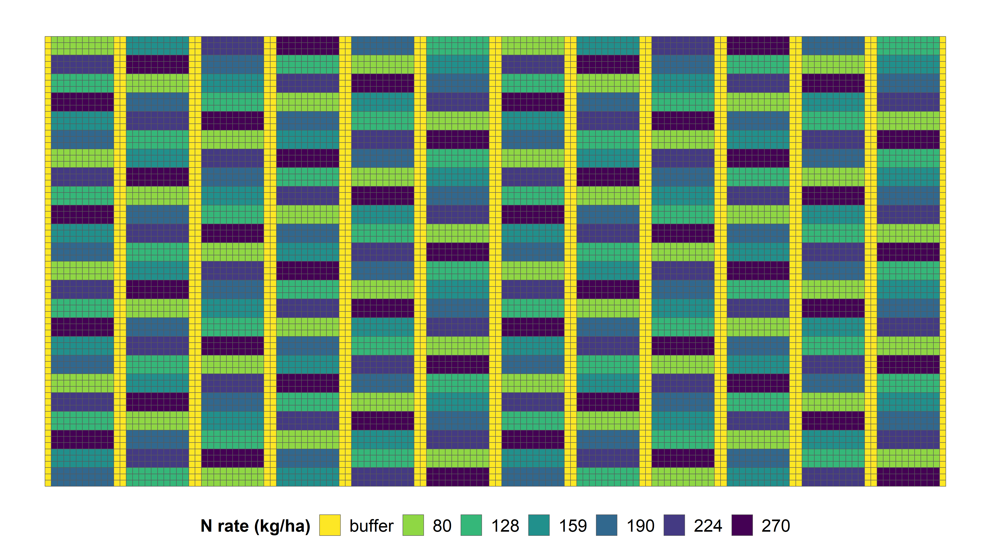
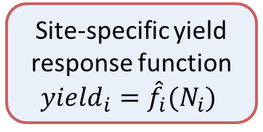
Simulation Setting
Performances?
Site-specific yield response function $yield_{i}={\hat{f}}_{i}(N_{i})$
Observed field characteristics
Estimation models
True field parameters
Observed yield
Nitrogen trial rate

Slide 5
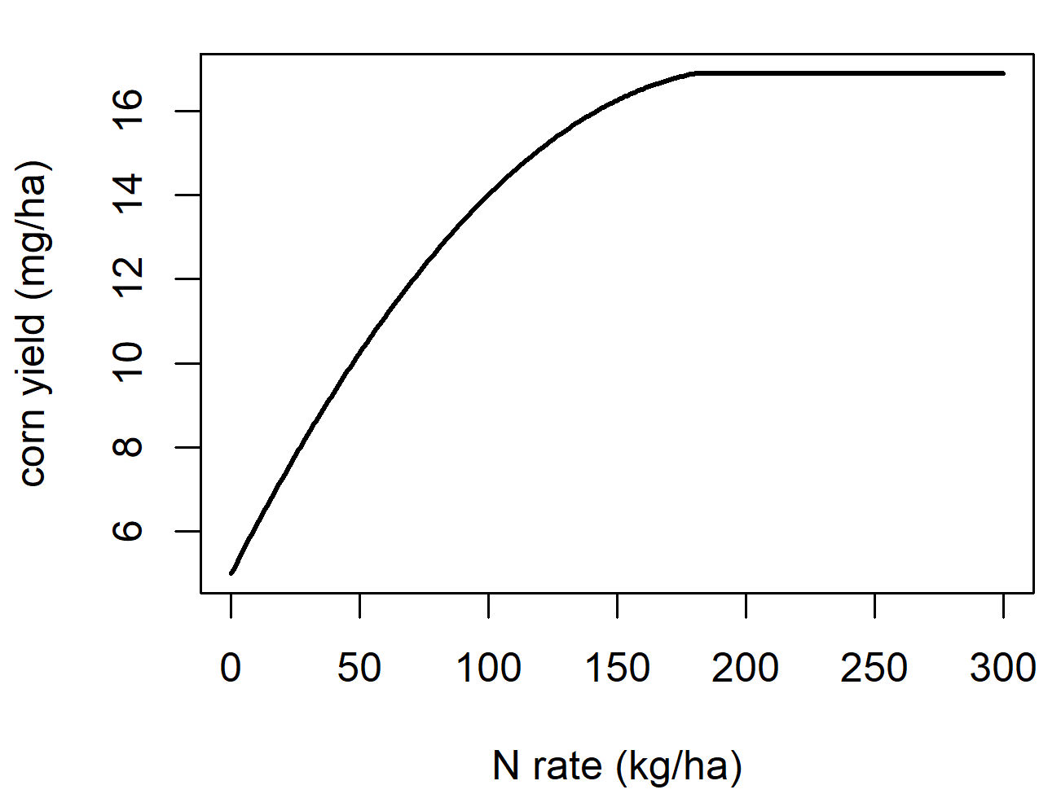

True Yield Generation
Corn yield response to nitrogen (N) fertilizer at each location $i$
- Quadratic-plateau function:
$$\begin{matrix}y_{i}=\left\{\begin{matrix}α_{i}+β_{i}N+γ_{i}N^{2}+ε_{i}, & N<τ_{i} \\ η_{i}, & N≥τ_{i}\end{matrix}\right.\end{matrix}$$
- $η_{i}$: yield plateau
- $τ_{i}$: the N rate where yield reaches plateau

Slide 6
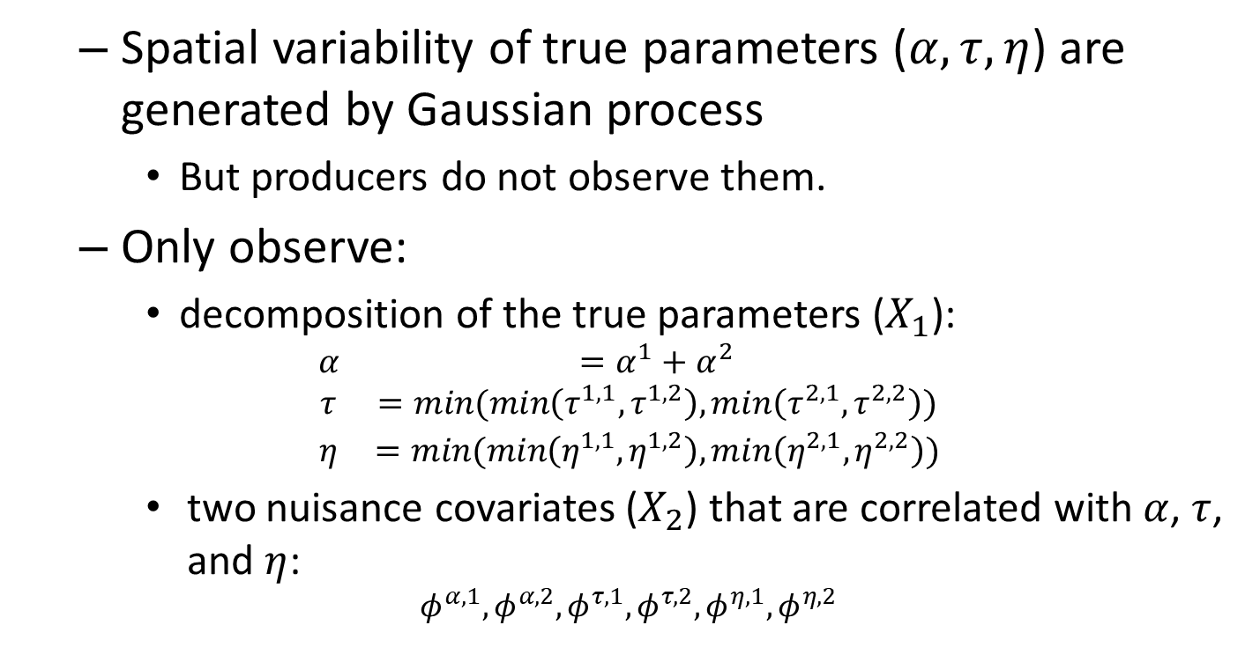
Field Characteristics Data
Spatial variability of true parameters ($α,τ,η$) are generated by Gaussian process
But producers do not observe them.
Only observe:
decomposition of the true parameters ($X_{1}$):
$$\begin{matrix}α & =α^{1}+α^{2} \\ τ & =min(min\left(τ^{1,1},τ^{1,2}\right),min\left(τ^{2,1},τ^{2,2}\right)) \\ η & =min(min\left(η^{1,1},η^{1,2}\right),min\left(η^{2,1},η^{2,2}\right))\end{matrix}$$
two nuisance covariates ($X_{2}$) that are correlated with $α$, $τ$, and $η$:
$$φ^{α,1},φ^{α,2},φ^{τ,1},φ^{τ,2},φ^{η,1},φ^{η,2}$$

Slide 7
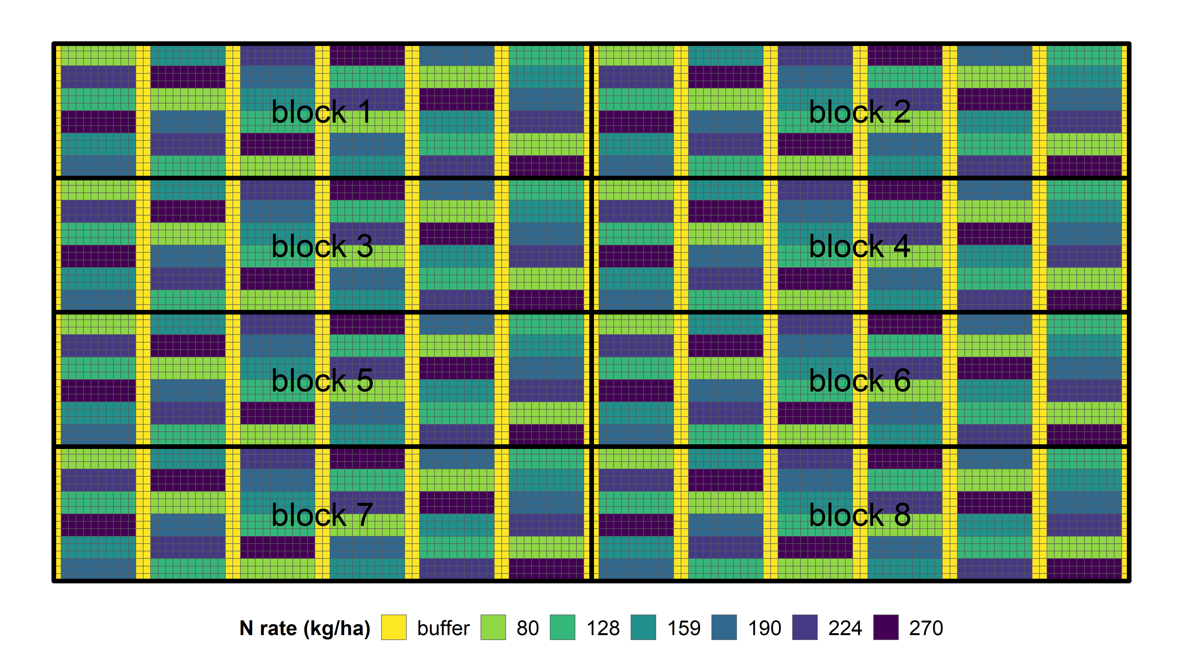
On-Farm Nitrogen Experiment
Five (5) nitrogen trial rates
Latin Square experimental design

Slide 8
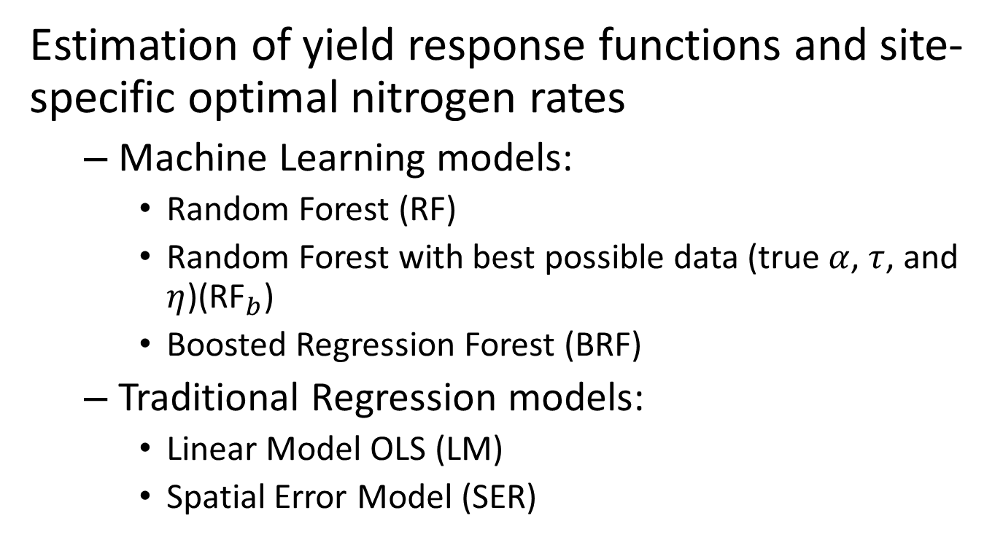
Estimation Models
Estimation of yield response functions and site-specific optimal nitrogen rates
Machine Learning models:
Random Forest (RF)
Random Forest with best possible data (true $α$, $τ$, and $η$)(RF$​_{b}$)
Boosted Regression Forest (BRF)
Traditional Regression models:
Linear Model OLS (LM)
Spatial Error Model (SER)

Slide 9
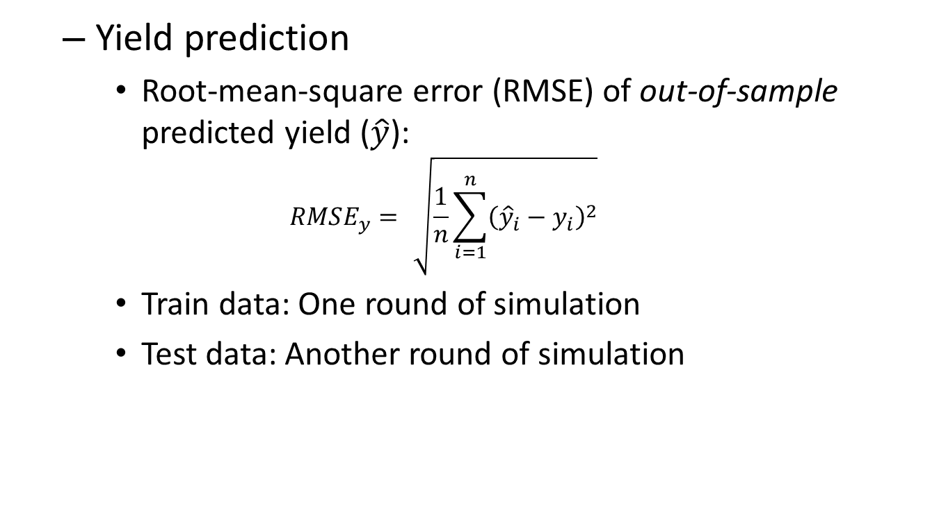
Performance Measurements (1)
Yield prediction
Root-mean-square error (RMSE) of out-of-sample predicted yield ($\hat{y}$):
$$\begin{matrix}RMSE_{y}=\sqrt{\frac{1}{n}\sum_{i=1}^{n}{{\left({\hat{y}}_{i}−y_{i}\right)}^{2}}}\end{matrix}$$
Train data: One round of simulation
Test data: Another round of simulation

Slide 10
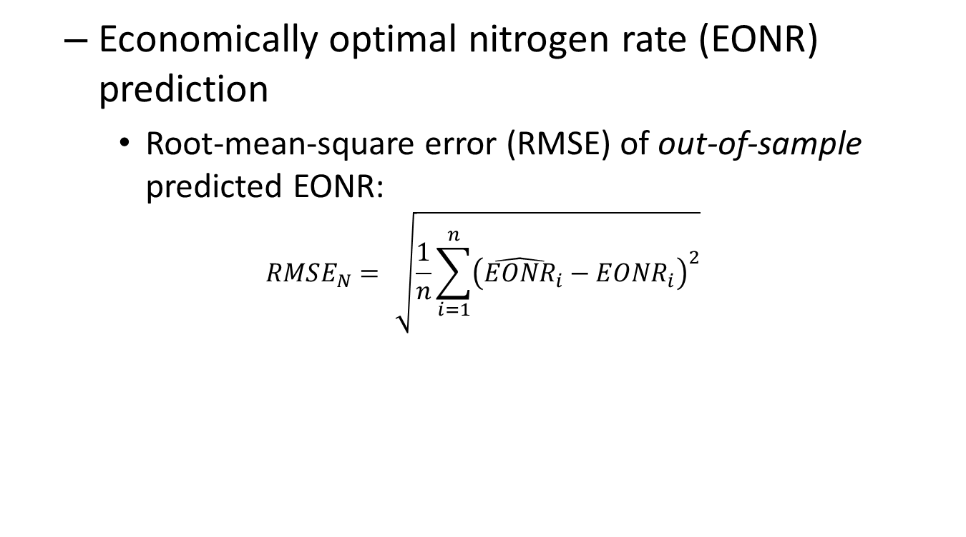
Performance Measurements (2)
Economically optimal nitrogen rate (EONR) prediction
Root-mean-square error (RMSE) of out-of-sample predicted EONR:
$$\begin{matrix}RMSE_{N}=\sqrt{\frac{1}{n}\sum_{i=1}^{n}{{\left({\hat{EONR}}_{i}−EONR_{i}\right)}^{2}}}\end{matrix}$$

Slide 11

Performance Measurements (3)
Production profit
Generated by applying the estimated EONR
$$\begin{matrix}π_{i}=p_{corn}f_{i}\left({\hat{EONR}}_{i}\right)−p_{N}N_{i}−C\end{matrix}$$
$\begin{matrix}f_{i}\left(\right)\end{matrix}$: true yield response function

Slide 12
Results
Machine learning models perform well in yield prediction,
but poor in EONR prediction
Traditional SER model generates the highest profit

Slide 13
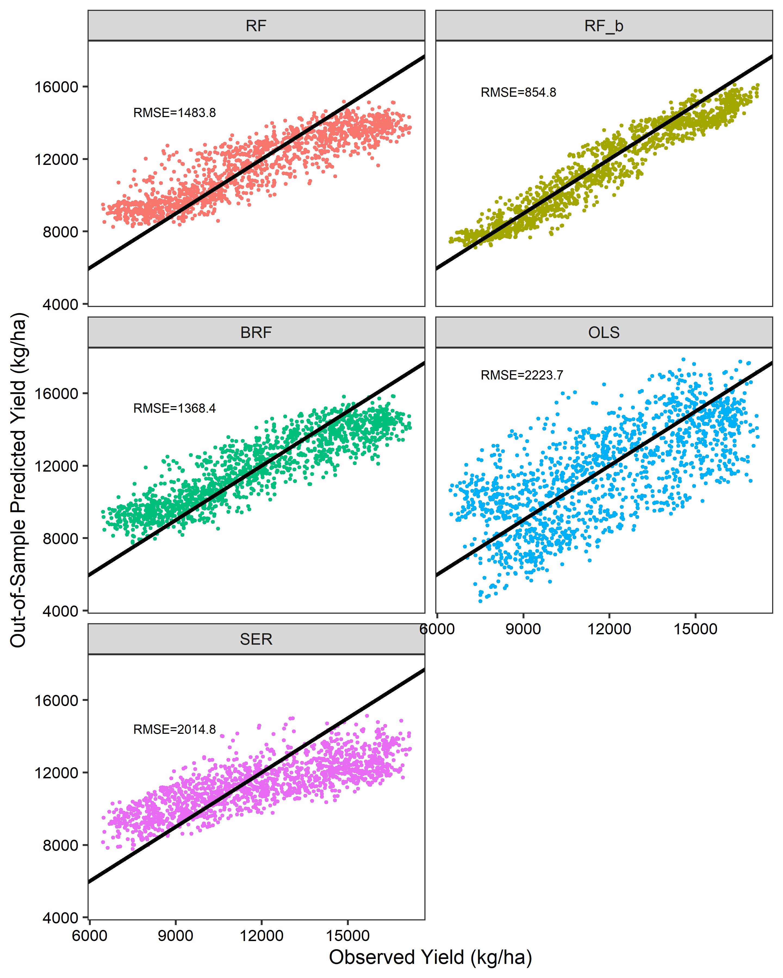
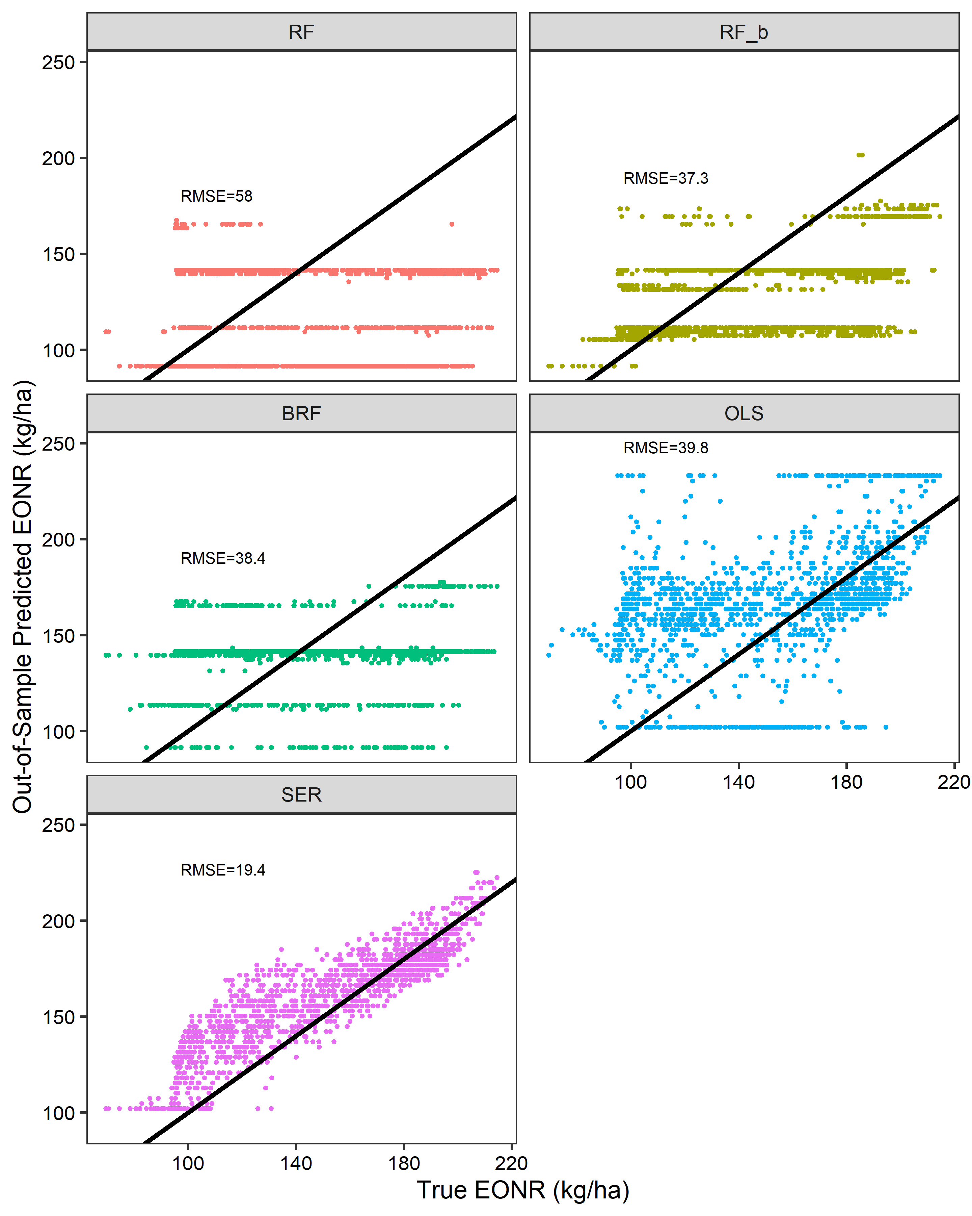
An Example Simulation

Slide 14
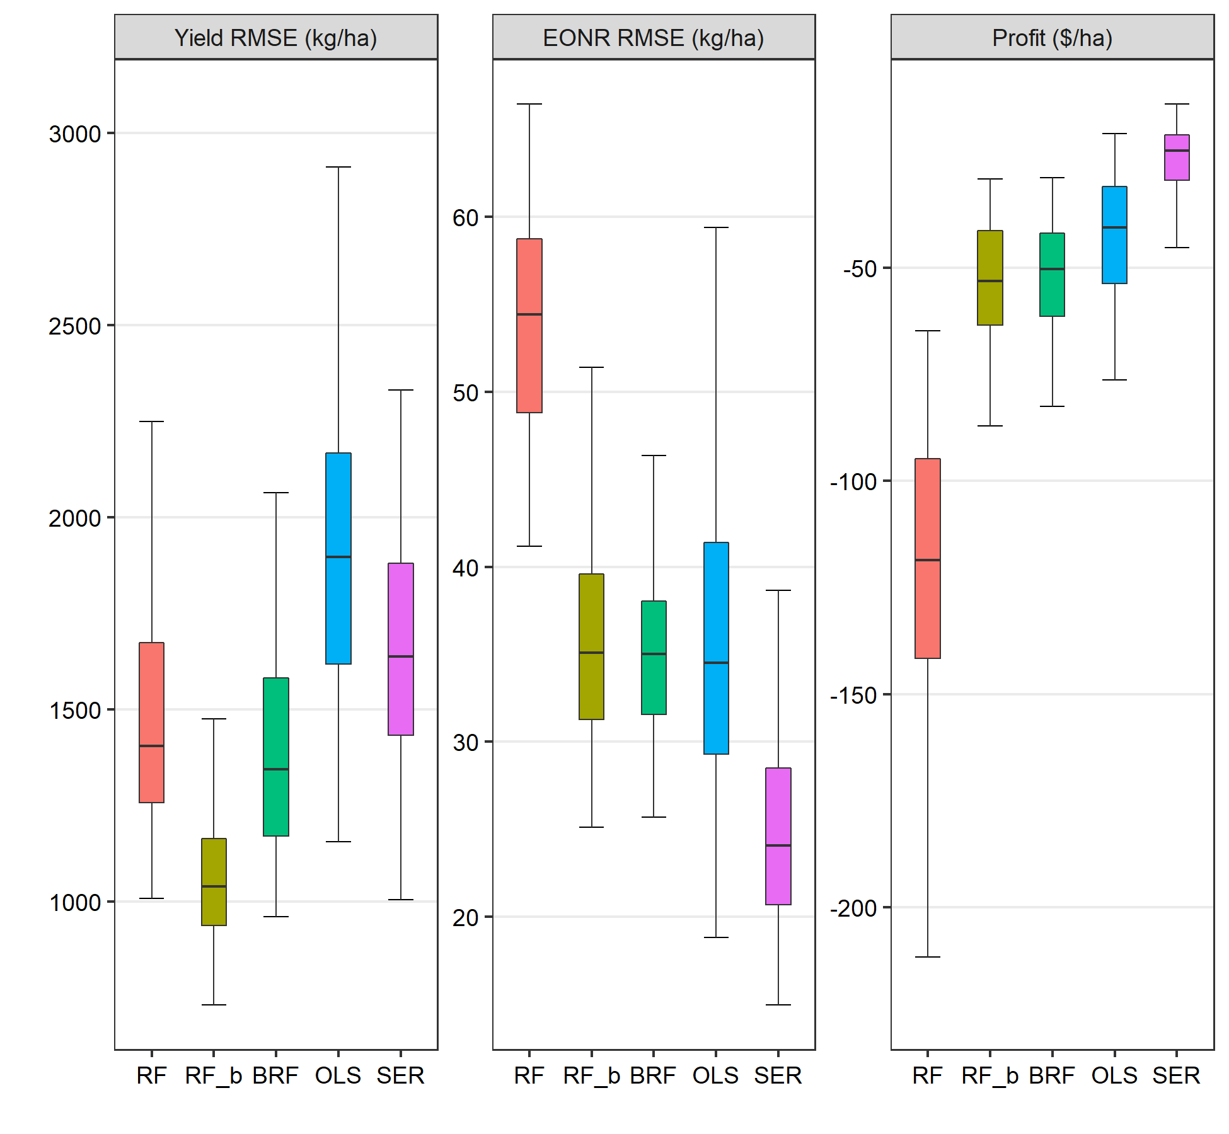
1,000 Simulations

Slide 15
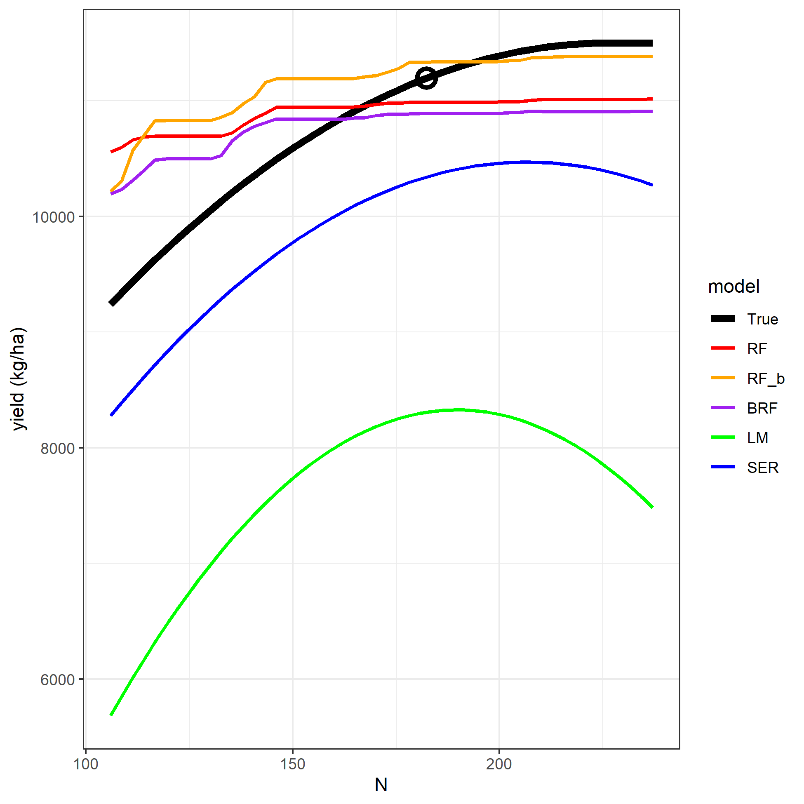
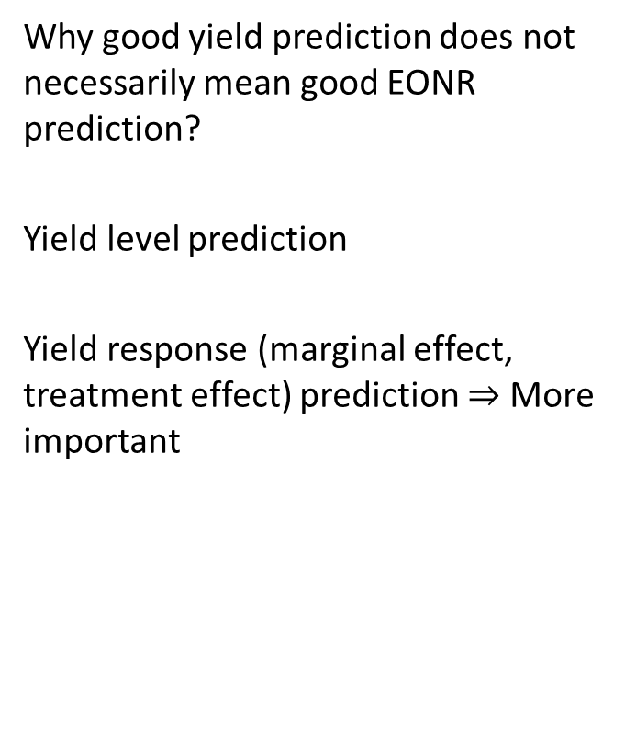
Illustrative Explanation
Why good yield prediction does not necessarily mean good EONR prediction?
Yield level prediction
Yield response (marginal effect, treatment effect) prediction $⇒$ More important
Estimated yield response curves at a specific location

Slide 16
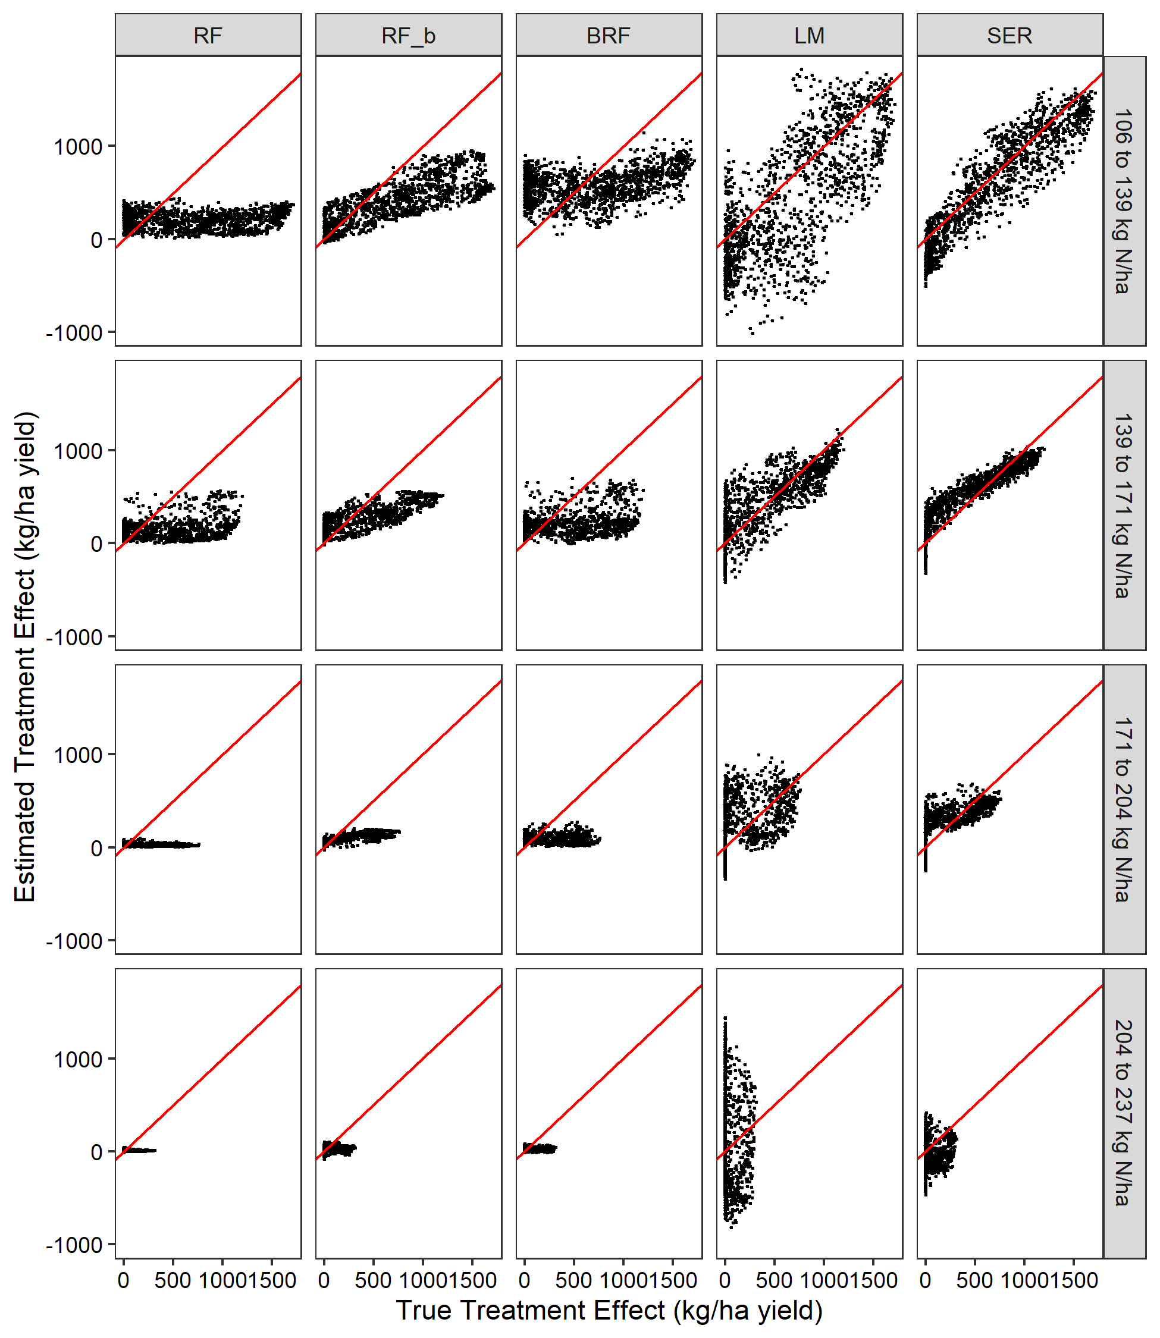
Illustrative Explanation (cont’d)
Estimated vs. True treatment effects in a single simulation
Treatment effect = yield(N2) – yield(N1)

Slide 17
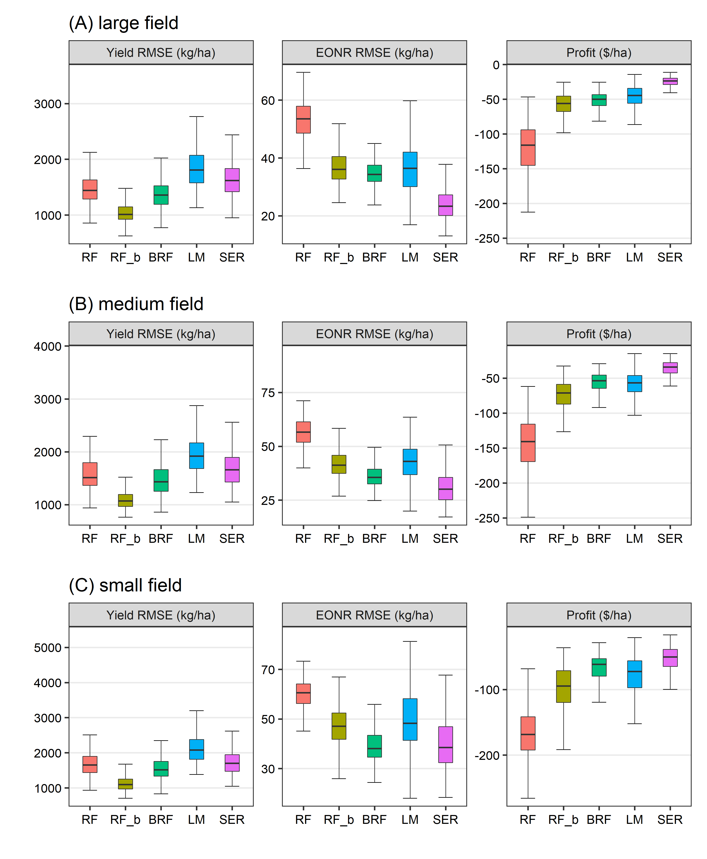
Field Sizes
Machine learning models’ performances catch up when field sizes decrease
BRF beats LM, and shrinks gaps with SER, for smaller fields
Performances of Traditional regression models are more sensitive to field sizes
=> Machine learning models are more suitable for small fields

Slide 18
Efficiency is Money
Well known:
SER model improve efficiency of LM estimates at the presence of unknown data spatial autocorrelation
But it is only treated as a statistical property
Our simulation evidence: Statistical efficiency means more profitable EONR recommendations

Slide 19
Conclusions
Machine learning (ML) models perform poor in EONR prediction compared to traditional regression models, despite their better yield prediction.
Be cautious when applying ML in EONR recommendations
What matters more is estimating yield responses, not yield levels.
SER model can generate the most profitable EONR recommendations for normal-sized fields.
Machine learning models are more useful for small fields.
More actively use SER model compared to LM in yield response estimation.

