Slide 1
Do’s and Don’ts

Slide 2
Wilke –
Breakdown into categories of type of visualization we will have …

Slide 3
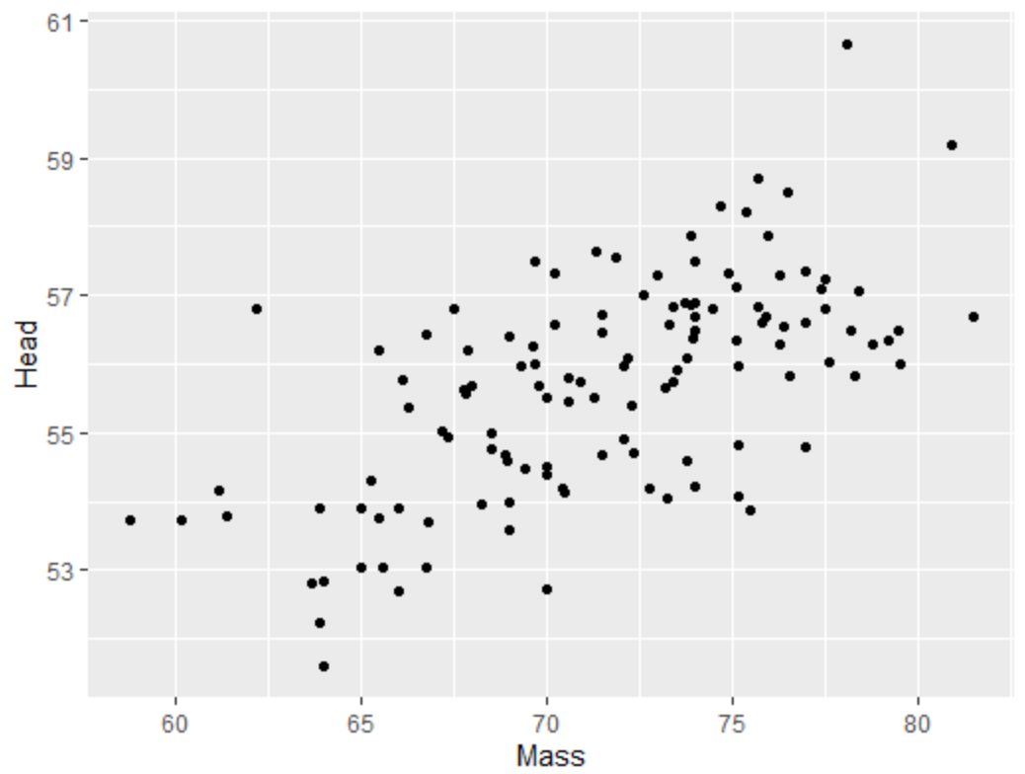
Scatterplots

Slide 4
Scatterplots in ggplot2
Whenever you use ggplot, you should load tidyverse at the very top of your script. You need to do it once for every script.
library(tidyverse)
ggplot(df, aes(x=x, y=y)) + geom_point()
Name of dataframe
Y column name
X column name

Slide 5
To change color of all points
library(tidyverse)
ggplot(df, aes(x=x, y=y)) + geom_point()
ggplot(df, aes(x=x, y=y)) + geom_point(color=΄red΄)
Insert color name inside single quotes,
or double quotes

Slide 6
To change color according to a categorical variable
library(tidyverse)
ggplot(df, aes(x=x, y=y)) + geom_point()
ggplot(df, aes(x=x, y=y, color=var)) + geom_point()
Insert name of column you wish to color by with no quotes

Slide 7
To change size of points
library(tidyverse)
ggplot(df, aes(x=x, y=y)) + geom_point(size = 2)
ggplot(df, aes(x=x, y=y)) +
geom_point(color=΄red΄,size = 2)
Enter a size by number
Separate color and size by comma

Slide 8
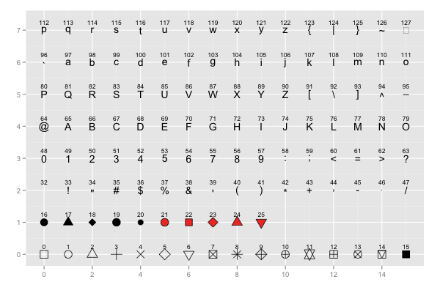
Change the type of point you plot
pch =

Slide 9
Customizing Plots - adding axis and main titles
library(tidyverse)
ggplot(df, aes(x=x, y=y)) +
geom_point() +
xlab("write a x title here") +
ylab("write a y title here") +
ggtitle("write a main title here")
X-axis title
Y-axis title
Main title

Slide 10
Customizing Plots - changing background themes
library(tidyverse)
ggplot(df, aes(x=x, y=y)) +
geom_point() +
theme_minimal()
library(tidyverse)
ggplot(df, aes(x=x, y=y)) +
geom_point() +
theme_bw()
Minimal theme
White & Gray theme

Slide 11
Customizing Plots - built-in themes
theme_bw()
a variation on theme_grey() that uses a white background and thin grey grid lines.
theme_linedraw()
A theme with only black lines of various widths on white backgrounds, reminiscent of a line drawing.
theme_light()
similar to theme_linedraw() but with light grey lines and axes, to direct more attention towards the data.
theme_dark()
the dark cousin of theme_light(), with similar line sizes but a dark background. Useful to make thin colored lines pop out.
theme_minimal()
A minimalistic theme with no background annotations.
theme_classic()
A classic-looking theme, with x and y axis lines and no gridlines.
theme_void()
A completely empty theme.
https://ggplot2-book.org/

Slide 12
Some common errors when coding…
Make sure your cases match, i.e. make sure name of dataframes/columns match exactly
Make sure you close brackets
Look for other typos, e.g. commas/periods in wrong place
Make sure don’t end code with a plus +
Make sure each row of ggplot2 code has a plus at end, except for last row

Slide 13
Some common errors when coding…
Each time you restart your work opening Rstudio:
Make sure you loaded the dataset in
Make sure you are using the correct name for the dataset
Make sure you ran library(tidyverse) again – you have to do this each time you restart

Slide 14
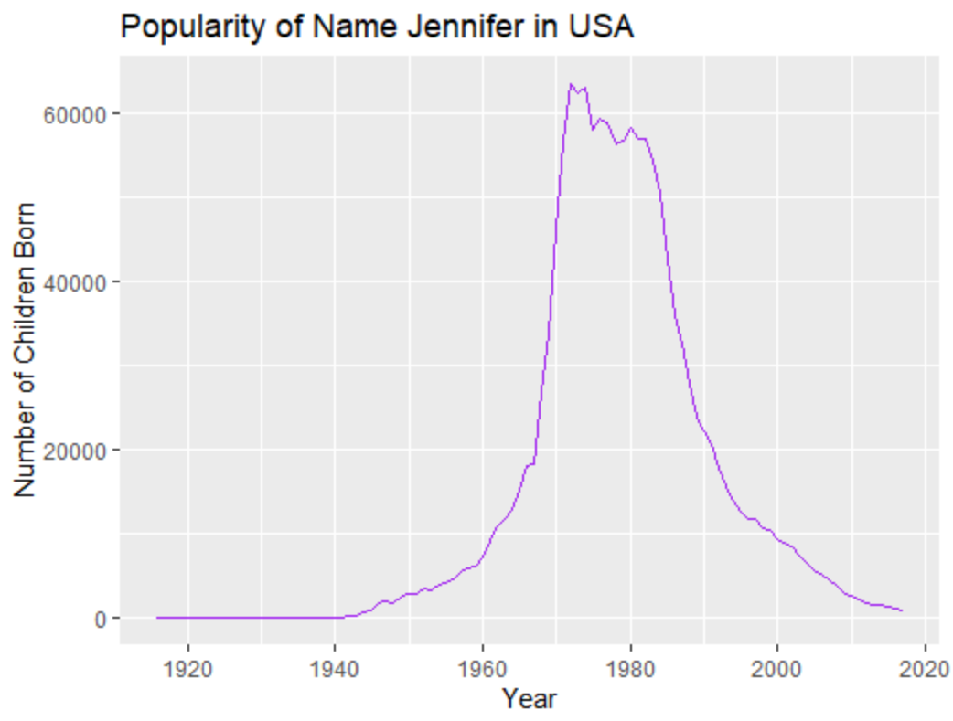
Linegraphs
Visualizing a continuous variable (y-axis) over time (x-axis)

Slide 15
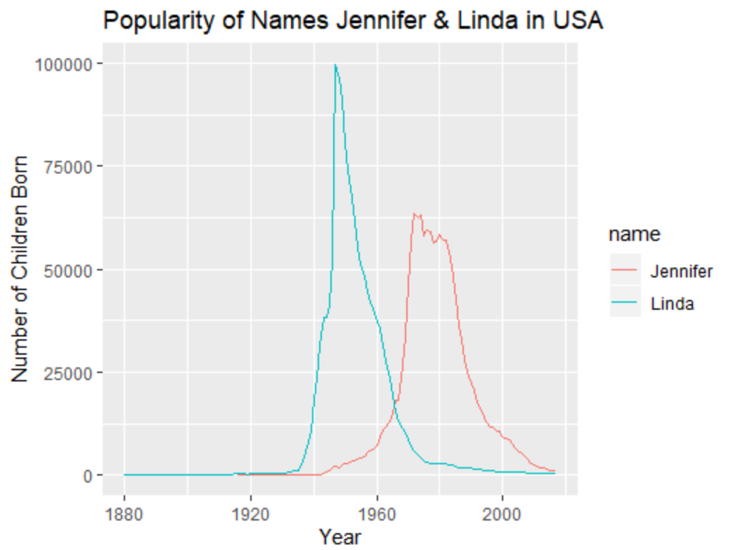
Visualizing multiple lines

Slide 16
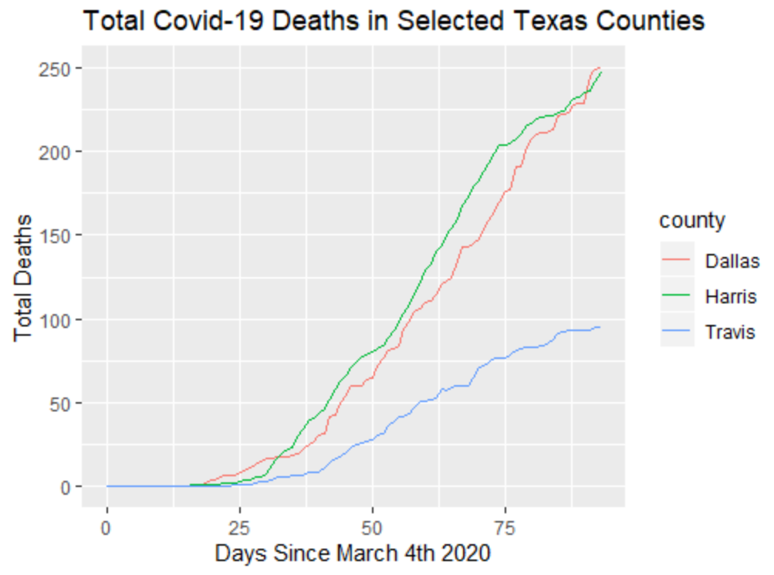
Linegraphs
Visualizing a cumulative continuous variable (y-axis) over time (x-axis)

Slide 17
Line graphs in ggplot2
library(tidyverse)
ggplot(df, aes(x=x, y=y)) + geom_line()
Name of dataframe
Y column name
X column name

Slide 18
To change color of line
library(tidyverse)
ggplot(df, aes(x=x, y=y)) + geom_line()
ggplot(df, aes(x=x, y=y)) + geom_line(color=΄purple΄)
Insert color name inside single quotes,
or double quotes.

Slide 19
To plot multiple lines – and have different colors for each line
library(tidyverse)
ggplot(df, aes(x=x, y=y)) + geom_line()
ggplot(df, aes(x=x, y=y, group=var)) + geom_line()
Insert name of column you wish to color by with no quotes
Separate lines for each group in that column will be made.

Slide 20
To change width of lines
Enter a width by number
library(tidyverse)
ggplot(df, aes(x=x, y=y)) + geom_line(lwd = 2)
ggplot(df, aes(x=x, y=y)) +
geom_line(color=΄purple΄, lwd = 2)
Separate color and width by comma

Slide 21
To change style of lines
Enter a style type by number
library(tidyverse)
ggplot(df, aes(x=x, y=y)) + geom_line(lty = 3)
ggplot(df, aes(x=x, y=y)) +
geom_line(color=΄purple΄, lwd = 1, lty = 3)
Separate color, style and width by commas

Slide 22
Plotting multiple lines/groups by color
library(tidyverse)
ggplot(df, aes(x=x, y=y)) + geom_line()
ggplot(df, aes(x=x, y=y, color=var)) + geom_line()
Insert name of column that you wish to plot different lines by with no quotes

Slide 23
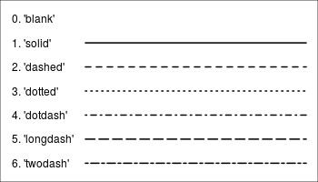
Different linetypes
lty =

Slide 24
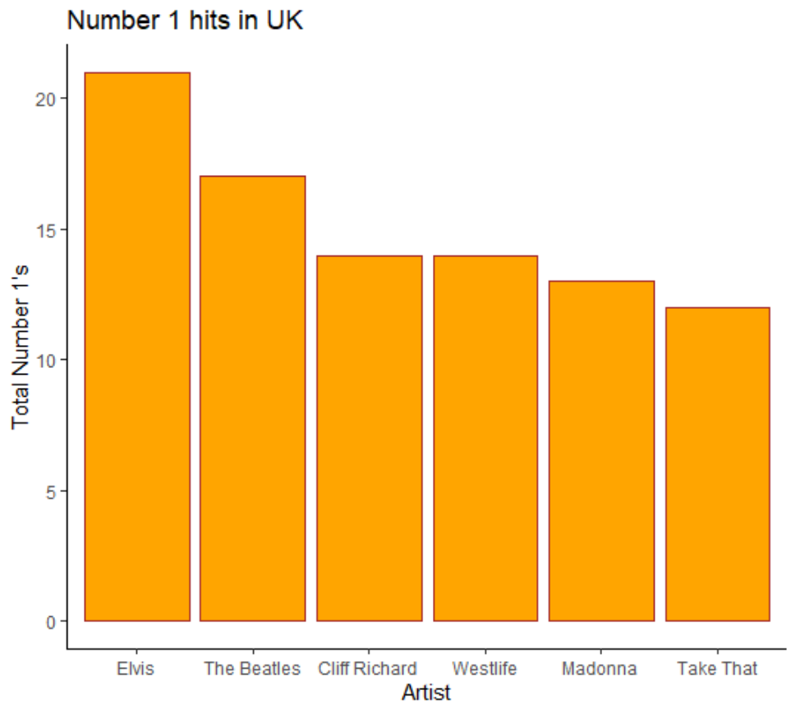
Bar Graphs
Visualizing amounts - a continuous variable (y-axis) against a categorical variable (x-axis)

Slide 25
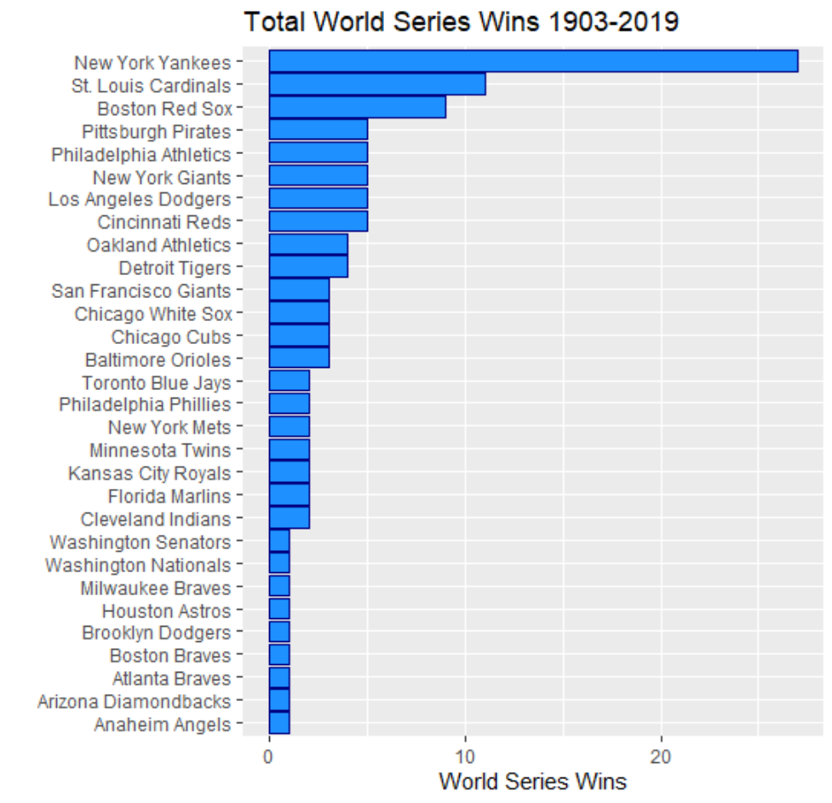
Bar Graphs
Visualizing amounts - a continuous variable (y-axis) against a categorical variable (x-axis)
…. Although the axes can be ‘flipped’ to improve readability…

Slide 26
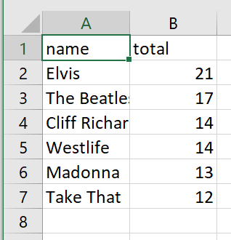
Data already made into summary counts

Slide 27
Bar Graphs in ggplot2
Whenever you use ggplot, you should load tidyverse at the very top of your script. You need to do it once for every script.
library(tidyverse)
ggplot(df, aes(x=x, y=y)) + geom_col()
Y column name – the continuous/count data
If you have data where you already have the exact number you wish to plot (i.e. the height of the bars), then use geom_col()
Name of dataframe
X column name
The categorical variable

Slide 28
To change fill and color of bars
Insert color name inside single quotes,
or double quotes
library(tidyverse)
ggplot(df, aes(x=x, y=y)) + geom_col(fill = "pink")
ggplot(df, aes(x=x, y=y)) +
geom_col(fill = "pink", color = "black")
‘fill’ refers to the color inside the bar shape.
‘color’ refers to the line border around the bar shape
Separate color, style and width by commas

Slide 29
To flip orientation of bars
library(tidyverse)
ggplot(df, aes(x=x, y=y)) + geom_col()
ggplot(df, aes(x=x, y=y)) +
geom_col() +
coord_flip()
You can flip the orientation of the bars using coord_flip()

Slide 30
To reorder order of categories on x-axis of bar graphs
Wrap reorder() around your x. Then put a comma and the column you wish to order by (usually the y column).
Be careful to close brackets.
library(tidyverse)
ggplot(df, aes(x=x, y=y)) + geom_col()
ggplot(df, aes(x=reorder(x, y), y=y)) + geom_col()
ggplot(df, aes(x=reorder(x, -y), y=y)) + geom_col()
Often you actually want to organize in descending order, so put the negative sign in front of the y axis name

Slide 33
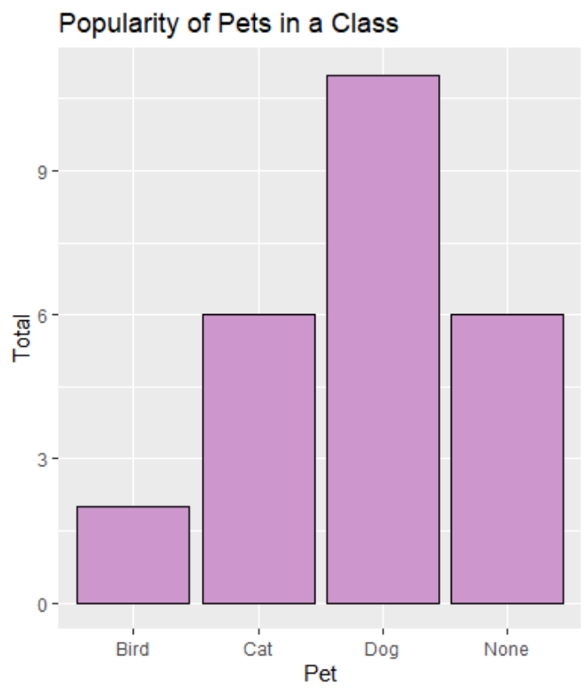
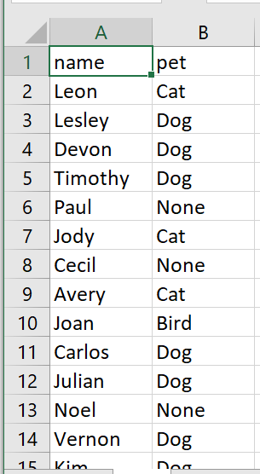
Data not yet made into summary counts

