Slide 1
Do’s and Don’ts

Slide 2
Wilke –
Breakdown into categories of type of visualization we will have …

Slide 3
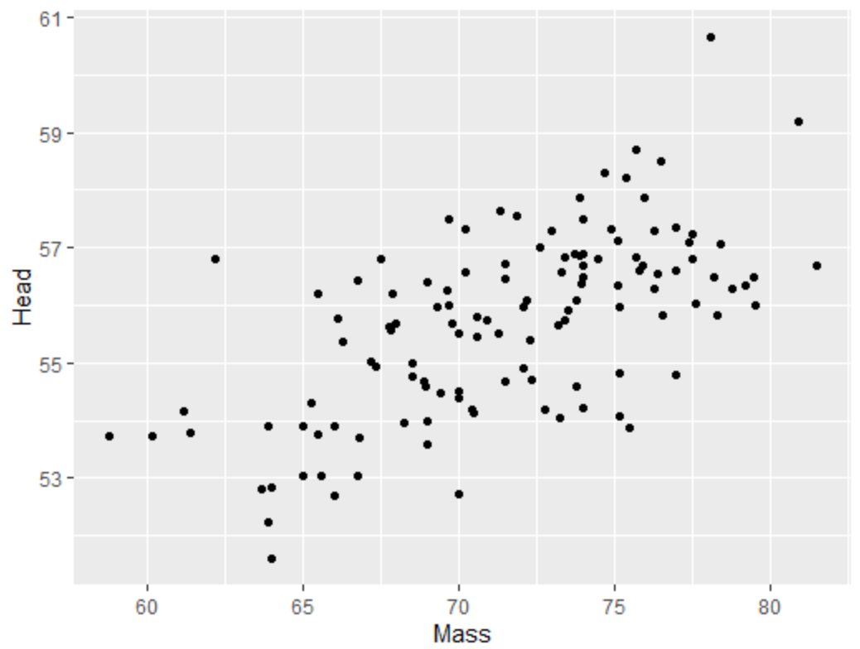
Scatterplots
Plotting one continuous variable on the x-axis against another continuous variable on the y-axis

Slide 4
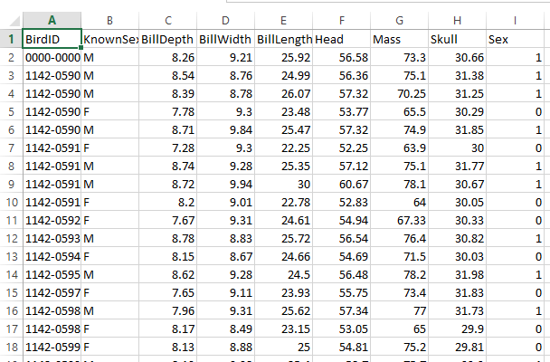
Scatterplots
Separate columns for the x-axis and y-axis values

Slide 5
Scatterplots in ggplot2
Whenever you use ggplot, you should load tidyverse at the very top of your script. You need to do it once for every script.
library(tidyverse)
ggplot(df, aes(x=x, y=y)) + geom_point()
Name of dataframe
Y column name
X column name

Slide 6
To change color of all points
library(tidyverse)
ggplot(df, aes(x=x, y=y)) + geom_point()
ggplot(df, aes(x=x, y=y)) + geom_point(color=΄red΄)
Insert color name inside single quotes,
or double quotes

Slide 7
To change color according to a categorical variable
library(tidyverse)
ggplot(df, aes(x=x, y=y)) + geom_point()
ggplot(df, aes(x=x, y=y, color=var)) + geom_point()
Insert name of column you wish to color by with no quotes

Slide 8
To change size of points
library(tidyverse)
ggplot(df, aes(x=x, y=y)) + geom_point(size = 2)
ggplot(df, aes(x=x, y=y)) +
geom_point(color=΄red΄,size = 2)
Enter a size by number
Separate color and size by comma

Slide 9
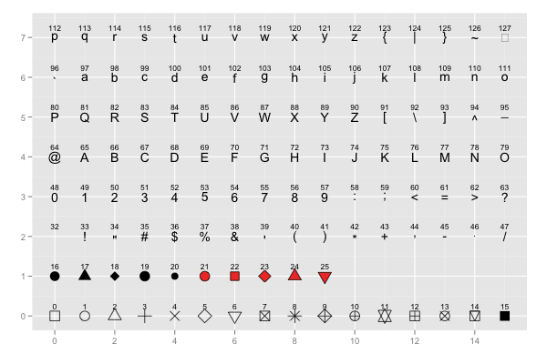
Change the type of point you plot
pch =

Slide 10
Customizing Plots - adding axis and main titles
library(tidyverse)
ggplot(df, aes(x=x, y=y)) +
geom_point() +
xlab("write a x title here") +
ylab("write a y title here") +
ggtitle("write a main title here")
X-axis title
Y-axis title
Main title

Slide 11
Customizing Plots - changing background themes
library(tidyverse)
ggplot(df, aes(x=x, y=y)) +
geom_point() +
theme_minimal()
library(tidyverse)
ggplot(df, aes(x=x, y=y)) +
geom_point() +
theme_bw()
Minimal theme
White & Gray theme

Slide 12
Customizing Plots - built-in themes
theme_bw()
a variation on theme_grey() that uses a white background and thin grey grid lines.
theme_linedraw()
A theme with only black lines of various widths on white backgrounds, reminiscent of a line drawing.
theme_light()
similar to theme_linedraw() but with light grey lines and axes, to direct more attention towards the data.
theme_dark()
the dark cousin of theme_light(), with similar line sizes but a dark background. Useful to make thin colored lines pop out.
theme_minimal()
A minimalistic theme with no background annotations.
theme_classic()
A classic-looking theme, with x and y axis lines and no gridlines.
theme_void()
A completely empty theme.
https://ggplot2-book.org/

Slide 13
Some common errors when coding…
Make sure your cases match, i.e. make sure name of dataframes/columns match exactly
Make sure you close brackets
Look for other typos, e.g. commas/periods in wrong place
Make sure don’t end code with a plus +
Make sure each row of ggplot2 code has a plus at end, except for last row

Slide 14
Some common errors when coding…
Each time you restart your work opening Rstudio:
Make sure you loaded the dataset in
Make sure you are using the correct name for the dataset
Make sure you ran library(tidyverse) again – you have to do this each time you restart

Slide 15
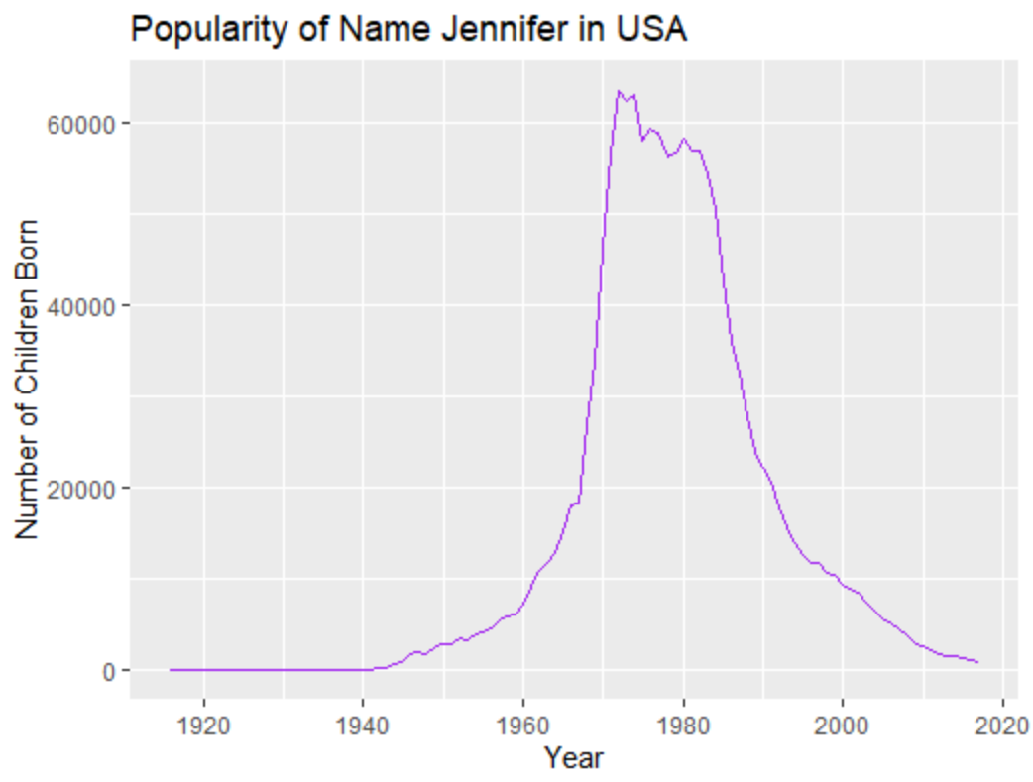
Linegraphs
Visualizing a continuous variable (y-axis) over time (x-axis)

Slide 16
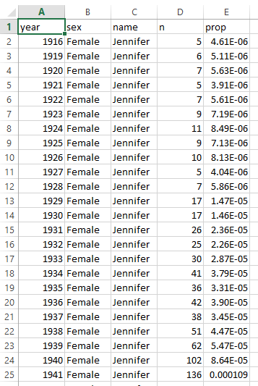
Separate columns for the x-axis and the y-axis

Slide 17
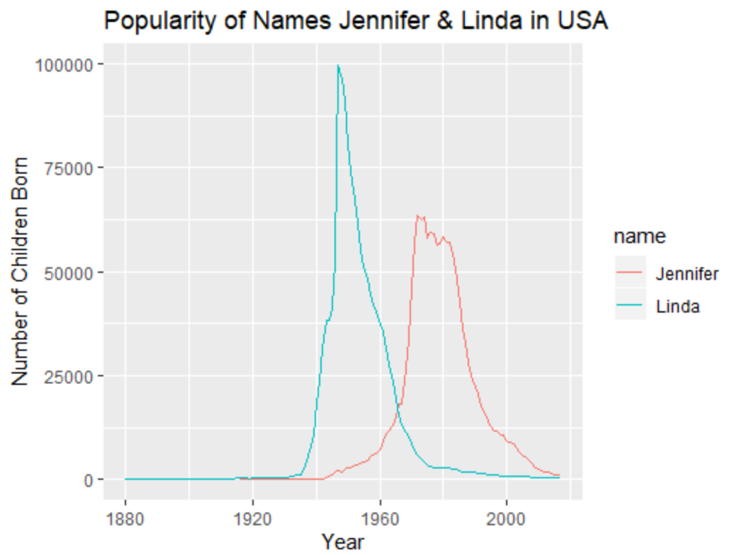
Visualizing multiple lines

Slide 18
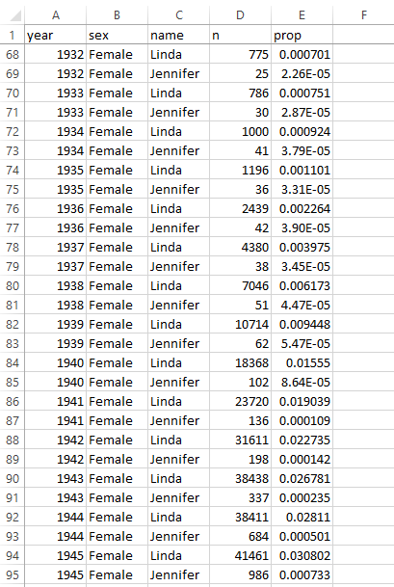
Separate columns for the x-axis, the y-axis, & the grouping variable (i.e. for separate lines)

Slide 19
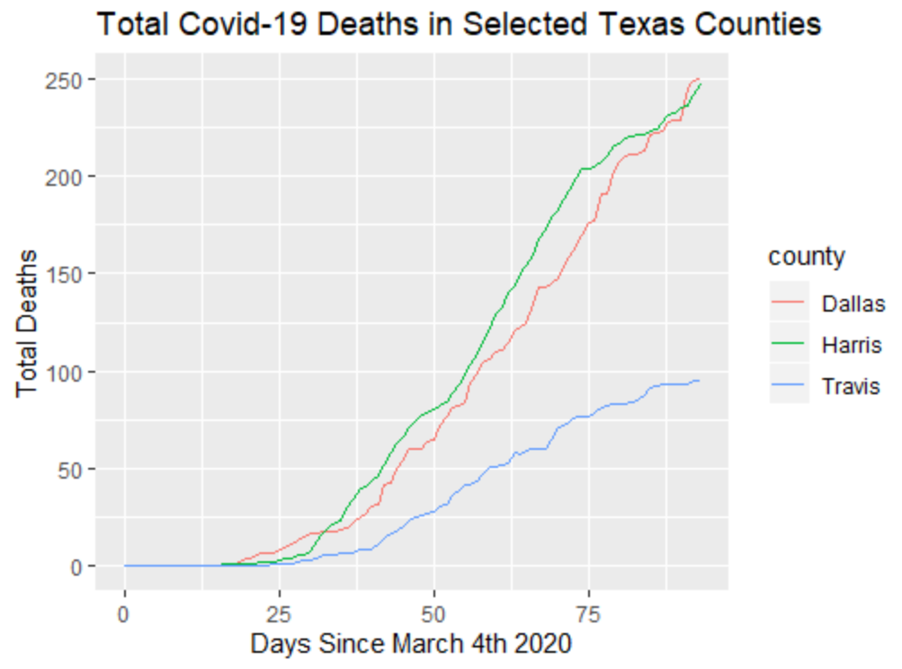
Linegraphs
Can also visualize a cumulative continuous variable (y-axis) over time (x-axis)

Slide 20
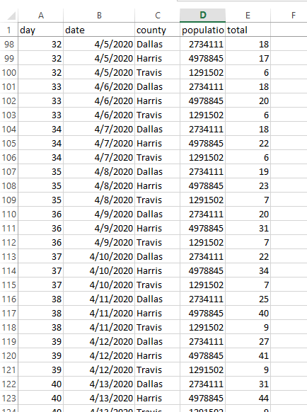
Separate columns for the x-axis, the y-axis, & the grouping variable (i.e. for separate lines)

Slide 21
Line graphs in ggplot2
library(tidyverse)
ggplot(df, aes(x=x, y=y)) + geom_line()
Name of dataframe
Y column name
X column name

Slide 22
To change color of line
library(tidyverse)
ggplot(df, aes(x=x, y=y)) + geom_line()
ggplot(df, aes(x=x, y=y)) + geom_line(color=΄purple΄)
Insert color name inside single quotes,
or double quotes.

Slide 23
To plot multiple lines – and have different colors for each line
library(tidyverse)
ggplot(df, aes(x=x, y=y)) + geom_line()
ggplot(df, aes(x=x, y=y, group=var)) + geom_line()
Insert name of column you wish to color by with no quotes
Separate lines for each group in that column will be made.

Slide 24
To change width of lines
Enter a width by number
library(tidyverse)
ggplot(df, aes(x=x, y=y)) + geom_line(lwd = 2)
ggplot(df, aes(x=x, y=y)) +
geom_line(color=΄purple΄, lwd = 2)
Separate color and width by comma

Slide 25
To change style of lines
Enter a style type by number
library(tidyverse)
ggplot(df, aes(x=x, y=y)) + geom_line(lty = 3)
ggplot(df, aes(x=x, y=y)) +
geom_line(color=΄purple΄, lwd = 1, lty = 3)
Separate color, style and width by commas

Slide 26
Plotting multiple lines/groups by color
library(tidyverse)
ggplot(df, aes(x=x, y=y)) + geom_line()
ggplot(df, aes(x=x, y=y, color=var)) + geom_line()
Insert name of column that you wish to plot different lines by with no quotes

Slide 27
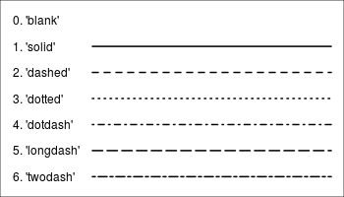
Different linetypes
lty =

Slide 28
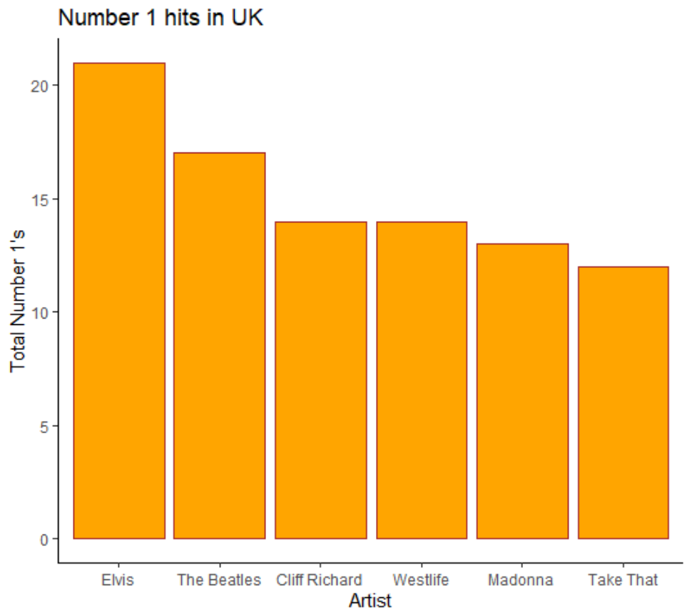
Bar Graphs
Visualizing amounts - a continuous variable (y-axis) against a categorical variable (x-axis)

Slide 29
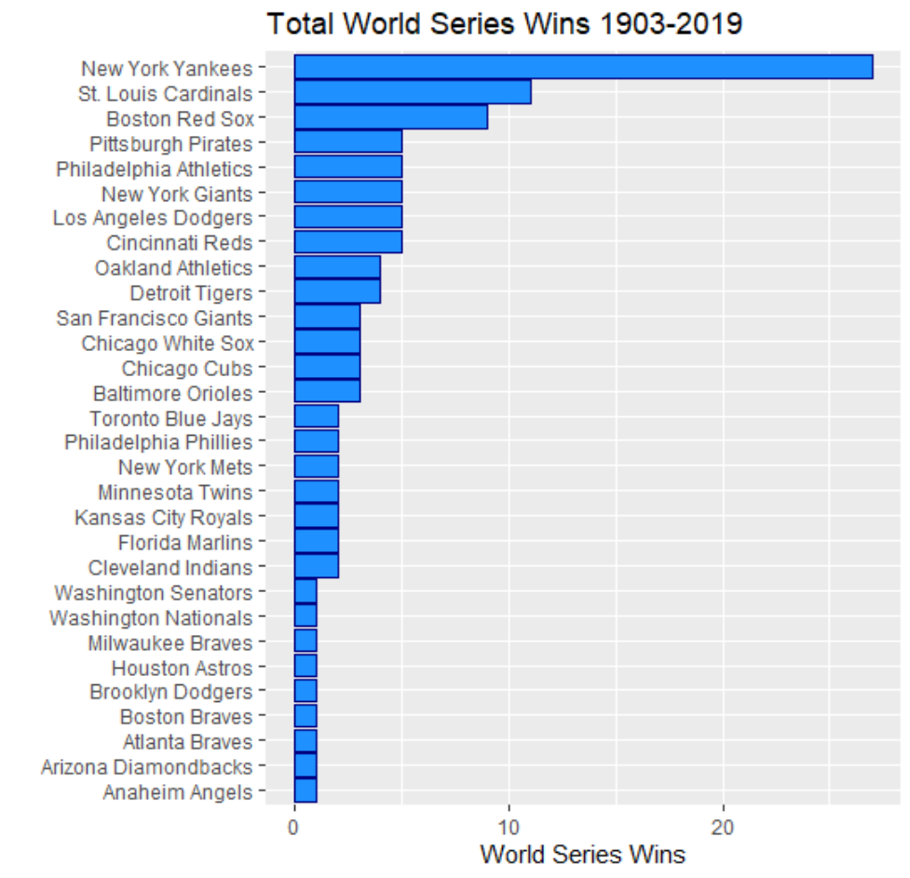
Bar Graphs
Visualizing amounts - a continuous variable (y-axis) against a categorical variable (x-axis)
…. Although the axes can be ‘flipped’ to improve readability…

Slide 30
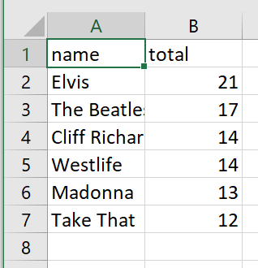
Data already made into summary counts

Slide 31
Bar Graphs in ggplot2
Whenever you use ggplot, you should load tidyverse at the very top of your script. You need to do it once for every script.
library(tidyverse)
ggplot(df, aes(x=x, y=y)) + geom_col()
Y column name – the continuous/count data
If you have data where you already have the exact number you wish to plot (i.e. the height of the bars), then use geom_col()
Name of dataframe
X column name
The categorical variable

Slide 32
To change fill and color of bars
Insert color name inside single quotes,
or double quotes
library(tidyverse)
ggplot(df, aes(x=x, y=y)) + geom_col(fill = "pink")
ggplot(df, aes(x=x, y=y)) +
geom_col(fill = "pink", color = "black")
‘fill’ refers to the color inside the bar shape.
‘color’ refers to the line border around the bar shape
Separate color, style and width by commas

Slide 33
To flip orientation of bars
library(tidyverse)
ggplot(df, aes(x=x, y=y)) + geom_col()
ggplot(df, aes(x=x, y=y)) +
geom_col() +
coord_flip()
You can flip the orientation of the bars using coord_flip()

Slide 34
To reorder order of categories on x-axis of bar graphs
Wrap reorder() around your x. Then put a comma and the column you wish to order by (usually the y column).
Be careful to close brackets.
library(tidyverse)
ggplot(df, aes(x=x, y=y)) + geom_col()
ggplot(df, aes(x=reorder(x, y), y=y)) + geom_col()
ggplot(df, aes(x=reorder(x, -y), y=y)) + geom_col()
Often you actually want to organize in descending order, so put the negative sign in front of the y axis name

Slide 35
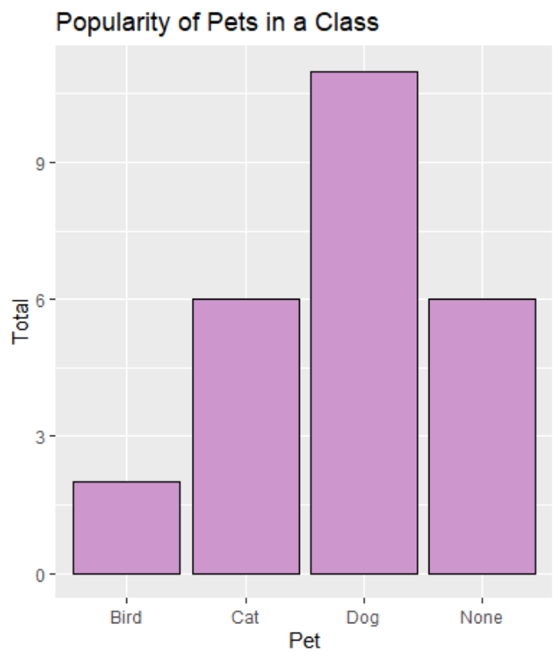
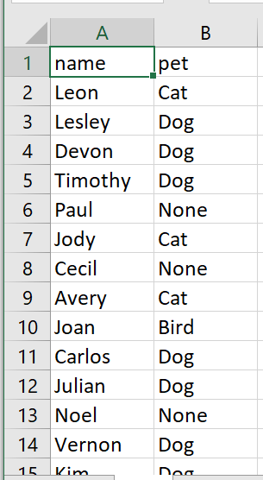
Data not yet made into summary counts

Slide 36
Making a bar chart when data not yet summarized into counts
library(tidyverse)
ggplot(df, aes(x=x)) + geom_bar()
Name of dataframe
If data are raw values, and not summarized into counts, then you use geom_bar()
X column name
The categorical variable
Note you don’t enter the y column as you don’t have summarized counts

Slide 37
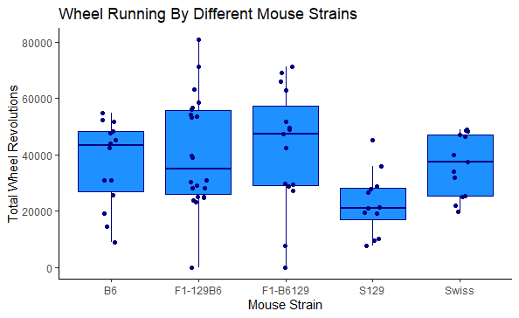
Boxplots
Visualizing distribution of data (y-axis) against grouping variable (x-axis).
…. Plotting raw data points over the top aids understanding as long as not too many data points

Slide 38
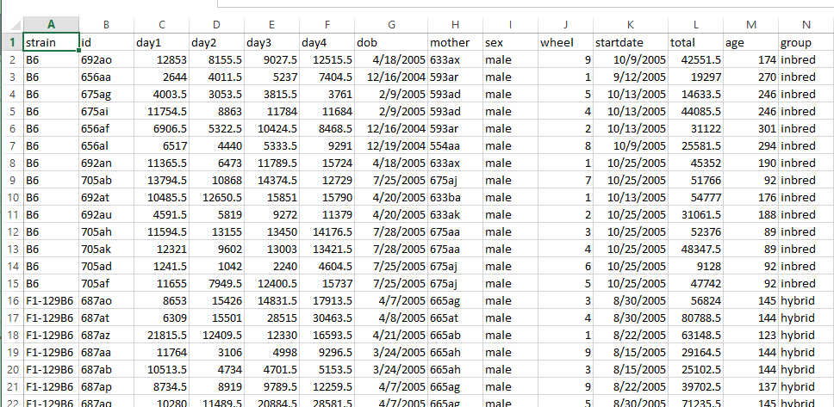
Boxplots
Categorical grouping variable (x-axis) should be in one column, and in another column should be the raw data values for the continuous variable (y-axis)

Slide 39
Boxplots in ggplot2
Whenever you use ggplot, you should load tidyverse at the very top of your script. You need to do it once for every script.
library(tidyverse)
ggplot(df, aes(x=x, y=y)) + geom_boxplot()
Name of dataframe
Y column name
X column name

Slide 40
Overlaying data points
Name of dataframe
library(tidyverse)
ggplot(df, aes(x=x, y=y)) +
geom_boxplot() +
geom_point()
X column name
Y column name
This will add points in a straight line

Slide 41
Overlaying jittered data points
Name of dataframe
library(tidyverse)
ggplot(df, aes(x=x, y=y)) +
geom_boxplot() +
geom_jitter()
X column name
Y column name
This will add points in a jittered, wobbly manner

Slide 42
Overlaying jittered data points
Name of dataframe
library(tidyverse)
ggplot(df, aes(x=x, y=y)) +
geom_boxplot() +
geom_jitter(width=.1)
X column name
Y column name
This will add points in a jittered, wobbly manner but constrained by a width of 0.1 . Play around with this number until the plots looks not too crazy

Slide 43
Overlaying jittered data points – be careful of outliers
When overlaying points on top of your boxplots it’s recommended to do this so that the auto-generated outliers made by the boxplot are removed – otherwise you’ll plot them each twice on the graph
library(tidyverse)
ggplot(df, aes(x=x, y=y)) +
geom_boxplot(outlier.shape=NA) +
geom_jitter(width=.1)

Slide 44
Changing color of boxplots
Enter a color name with single or double quotes
library(tidyverse)
ggplot(df, aes(x=x, y=y)) +
geom_boxplot(fill = "pink", color = "black")
Remember, ‘fill’ refers to the inside color of the boxplot, and ‘color’ refers to the lines around the boxplot.
Separate fill and color by comma

Slide 45
Changing the color of each category separately
library(tidyverse)
ggplot(df, aes(x=x, y=y, fill = x) +
geom_boxplot()
This will make each group of the x-axis have a separate color.
The name of the x-axis column, with no quotes around it.

Slide 46
Making your outliers more noticeable
Enter a color name with single or double quotes
library(tidyverse)
ggplot(df, aes(x=x, y=y)) +
geom_boxplot(outlier.size = 3, outlier.color= "red")
You can make outliers look more noticeable by changing the size and color of them.
Enter a number for outlier.size
Separate each command by a comma

Slide 47
Making violin plots instead
library(tidyverse)
ggplot(df, aes(x=x, y=y)) + geom_violin()
Some people prefer the shape of violin plots to boxplots. Just change the command to ‘geom_violin()’

Slide 48
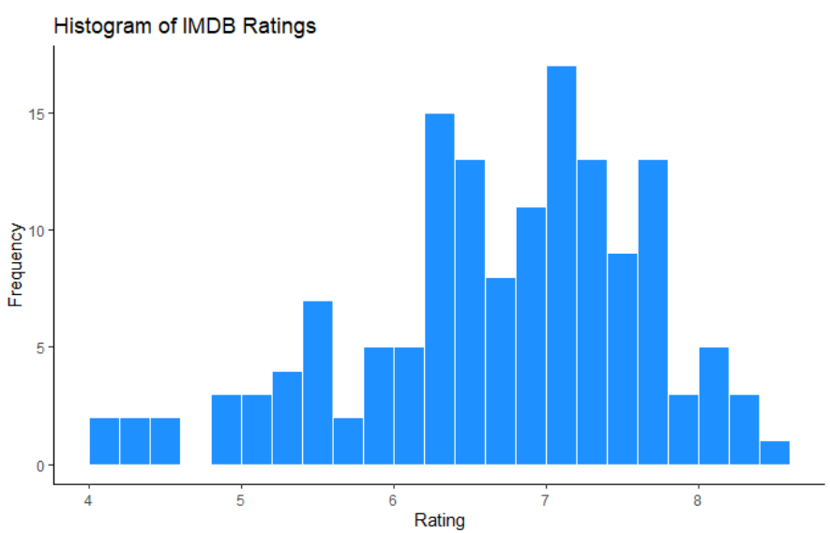
Histograms
Visualizing the frequency (y-axis) of a continuous variable (x-axis)

Slide 49
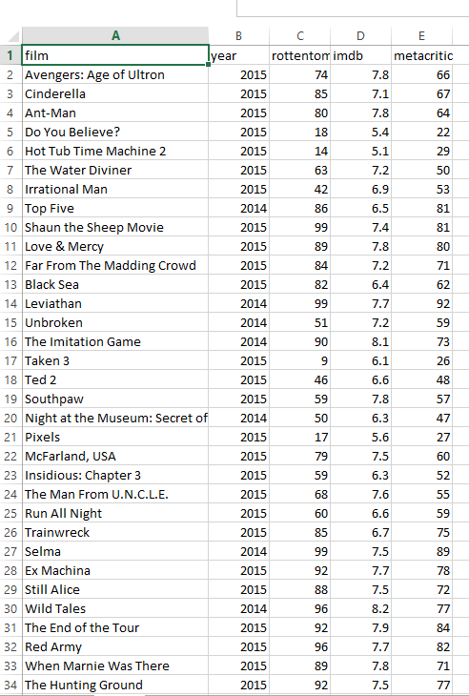
Histograms
To create a histogram you need all the data for one variable in a column. Each row is a separate observation.

Slide 50
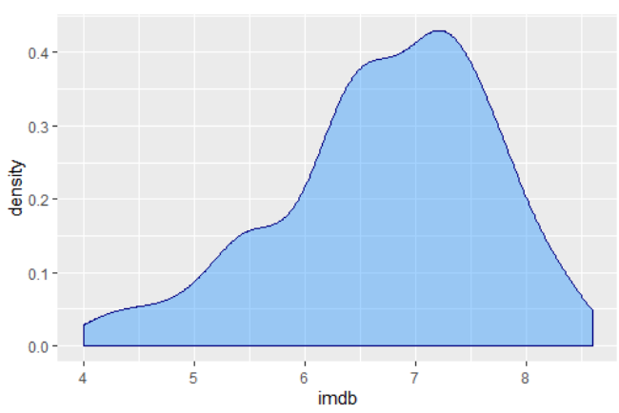
Histograms can also be represented as ‘density plots’

Slide 51
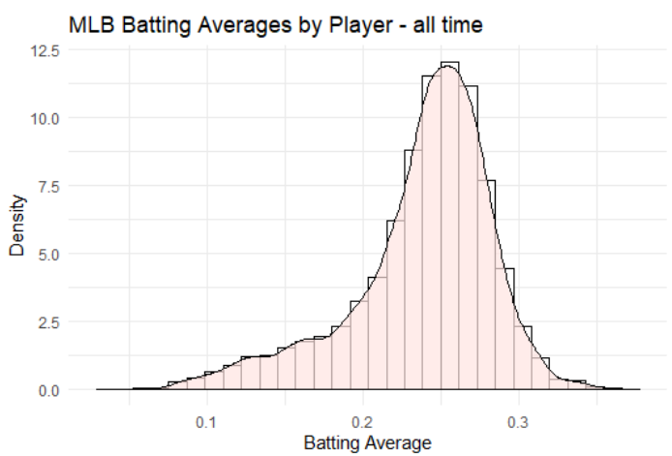
You can also overlay histograms with their density curve – especially if you have lots of data

Slide 52
Histogram Code information

Slide 53
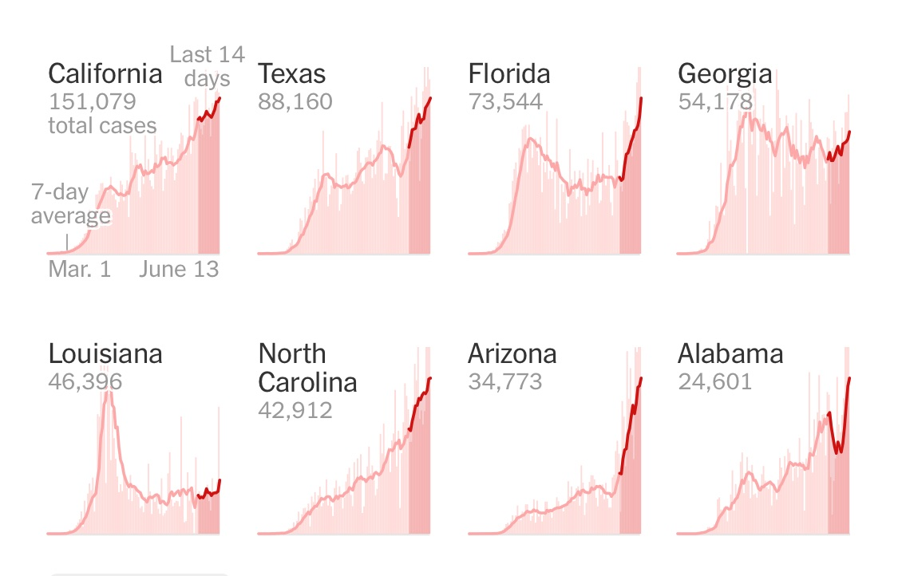
Small Multiples
Small multiples are when you plot the same chart several times, but each one is for a different ‘group’.
They can be histograms, line graphs, bar charts etc.
e.g. Covid19 cases over time in 8 selected states.

Slide 54
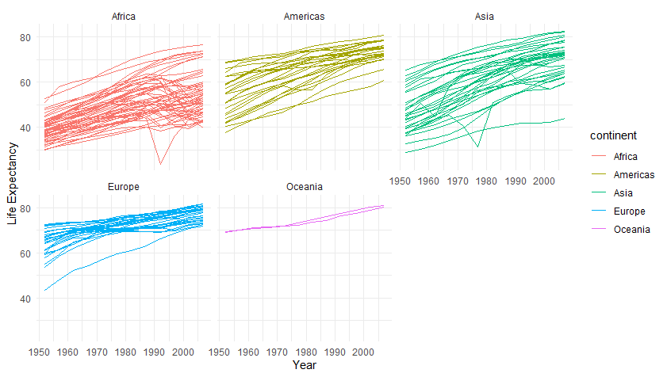
Small Multiples
This example shows the same relationship (x-axis = year; y-axis = life expectancy) for various countries (different lines) – but separated by continent (separate panels).
Small multiples enable you to plot a lot of information in a small space.

Slide 55
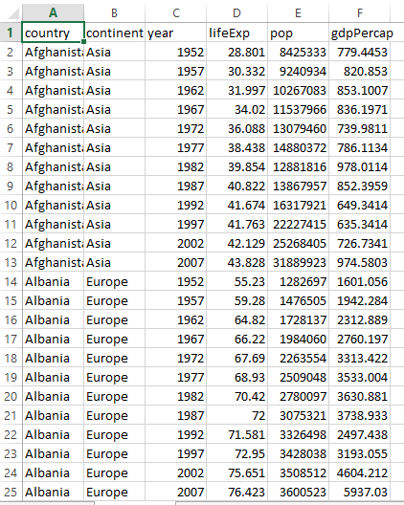
Small Multiples
For small multiples you identify the columns that make your regular plot (yellow)
But you also need a column/variable that is a ‘grouping variable’ which you will make separate plots by.

Slide 56
Small multiple code

Slide 57
Colors code

Slide 58
Saving plots code

Slide 59
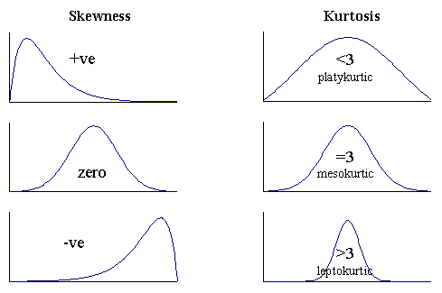

Slide 60
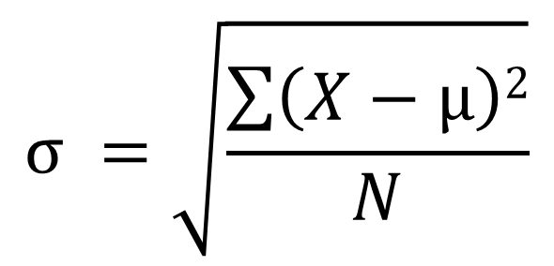
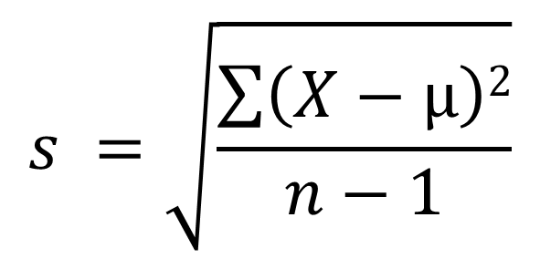
$$σ =\sqrt{\frac{\sum{\left(X−μ\right)2}}{N}}$$
$$s =\sqrt{\frac{\sum{\left(X−μ\right)2}}{n−1}}$$
Unbiased estimate of the population standard deviation
Population Standard Deviation

Slide 61
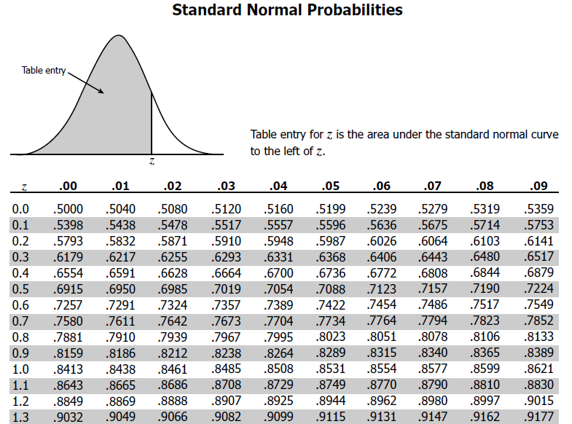
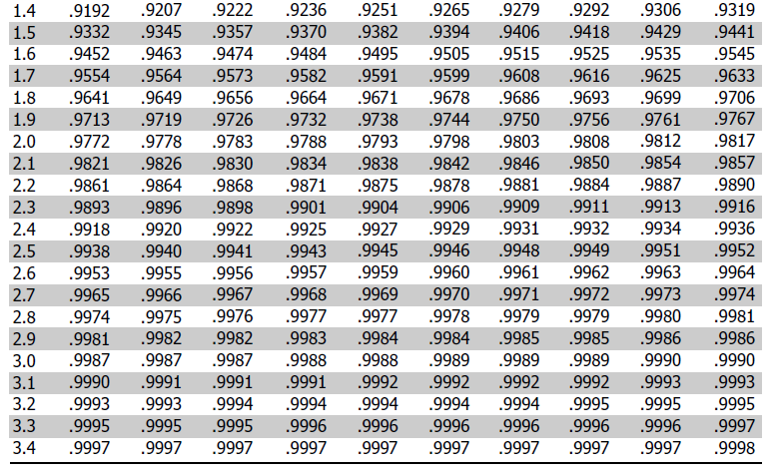
Z-table

Slide 62
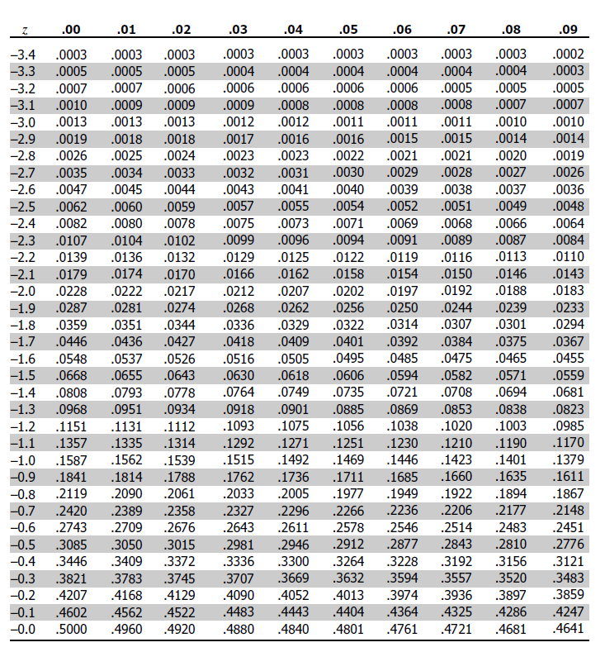
Z-table

Slide 63
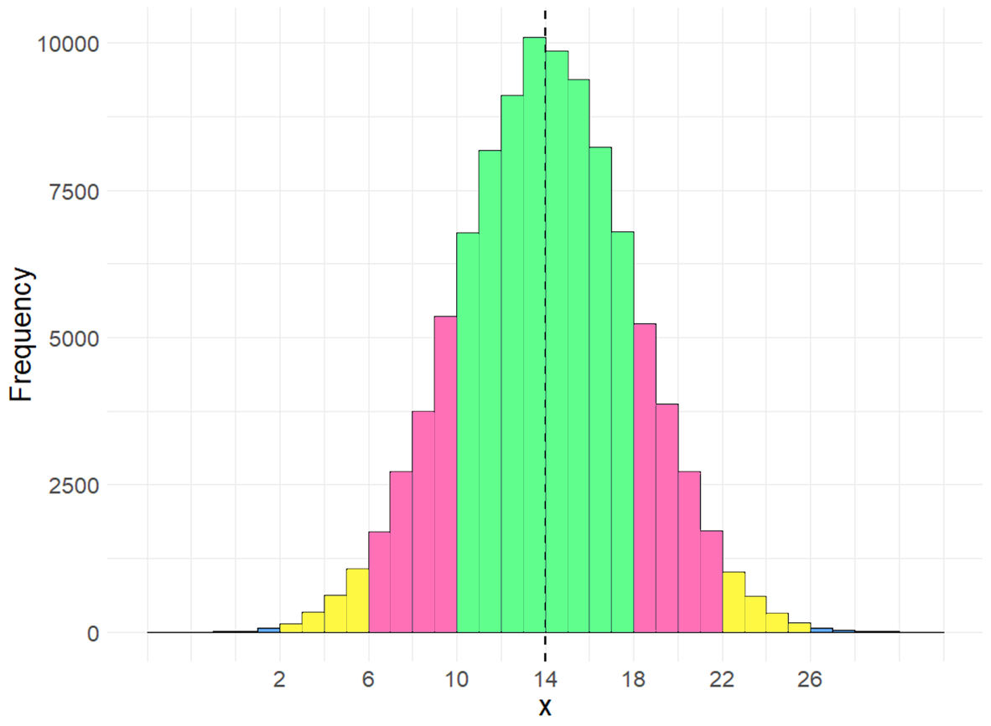
“Empirical Rule”
~99.7%
~95.4%
~68.2%
34.1
34.1
13.1
13.1
2.15
2.15
-3
-2
-1
0
1
2
3
Z

Slide 64
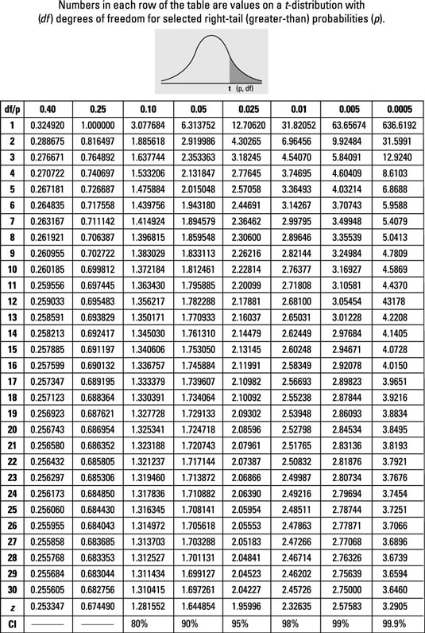
t-distribution table

