Slide 1
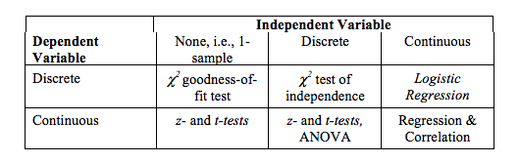
What test to use?

Slide 2
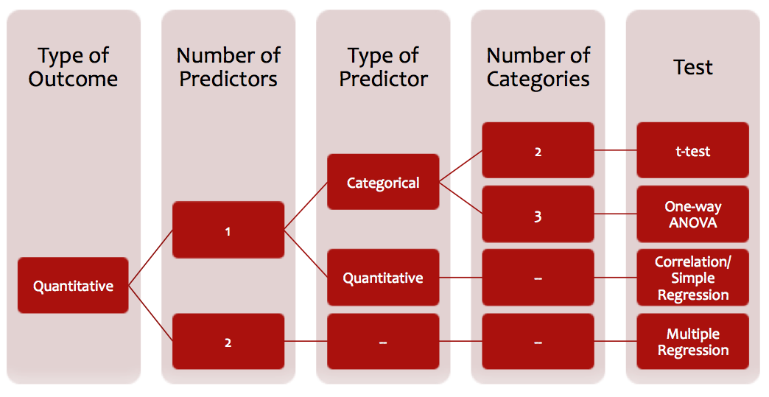
Quantitative Outcome Variable (DV)
* (or code as quant. (lm )

Slide 3
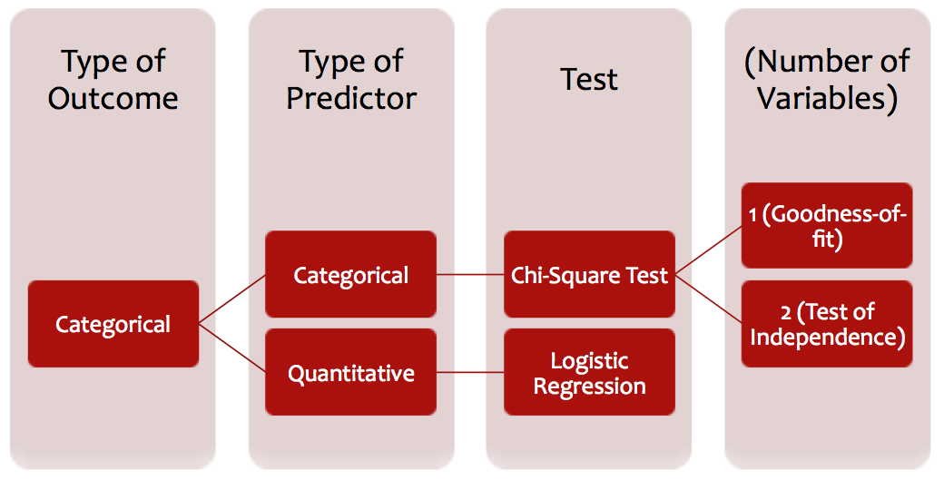
Categorical Outcome Variable (DV)

Slide 4
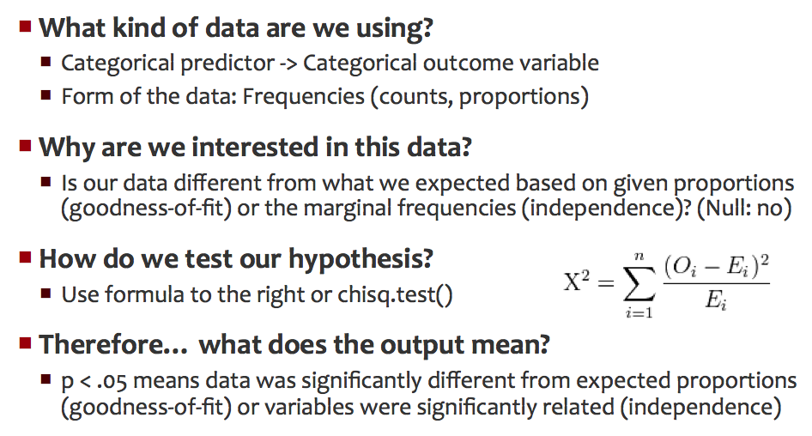
Chi-square test

Slide 5
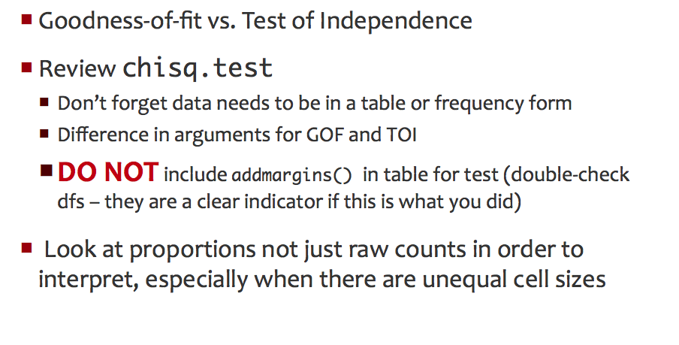
Chi-square test

Slide 6
Chi Square – what are we actually doing?
 | FREE | BIASED | VARIED | Row Totals
YES COMPLAINT | 10 | 10 | 10
NO COMPLAINT | 12 | 13 | 8
Column Totals

Slide 7
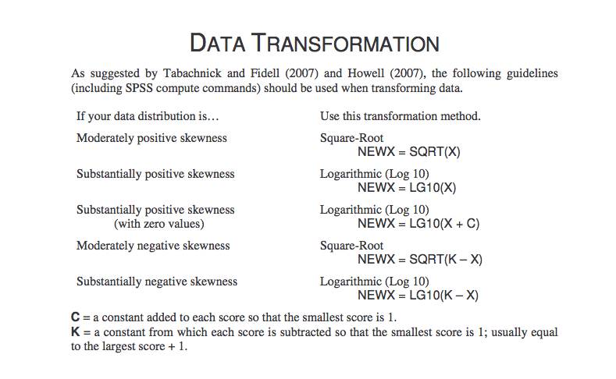
Data Transformation

Slide 8
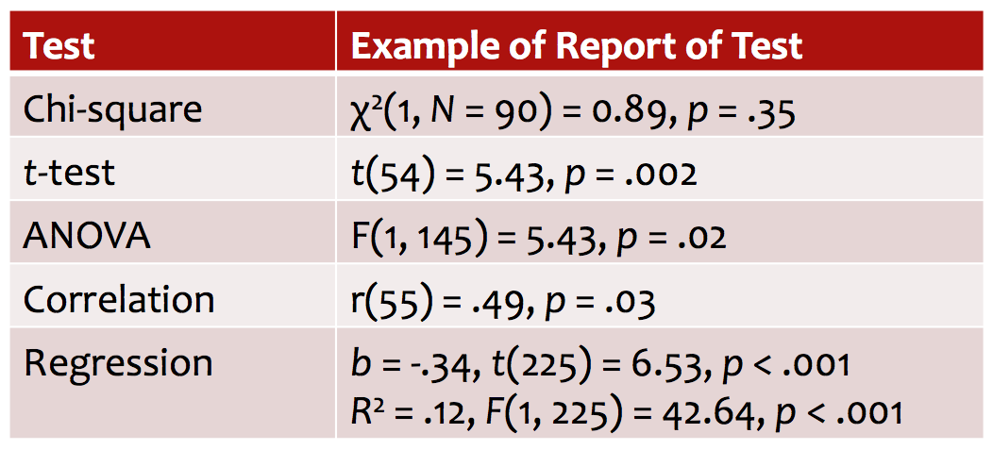
Reporting Statistics

Slide 9
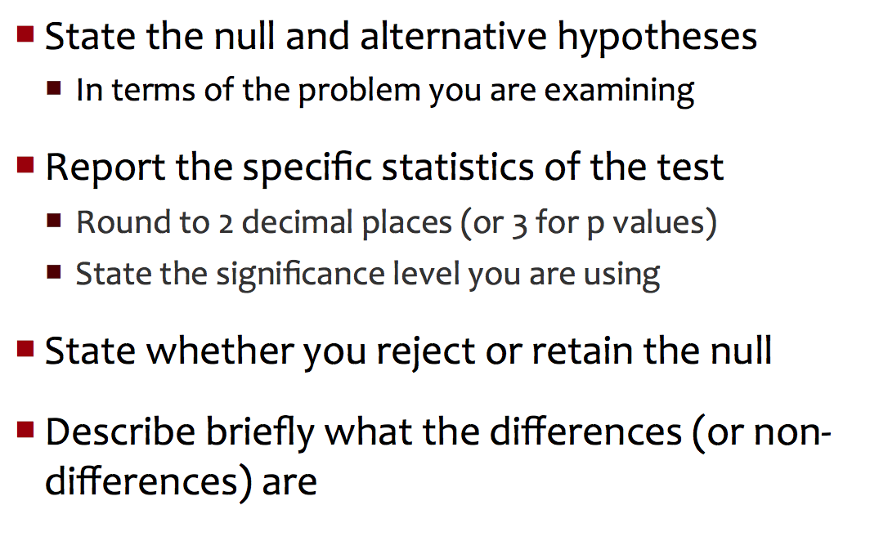
HW: Describing Results

Slide 10
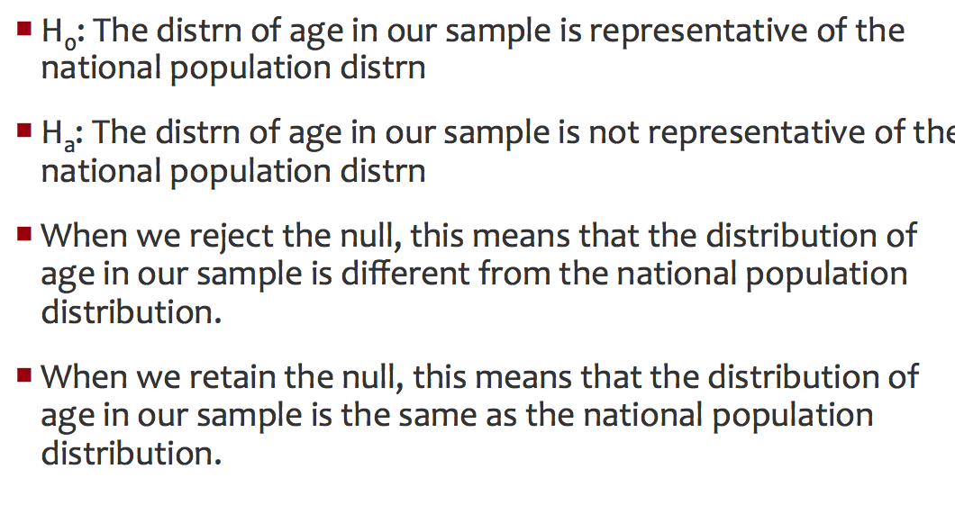
Example 1

Slide 11
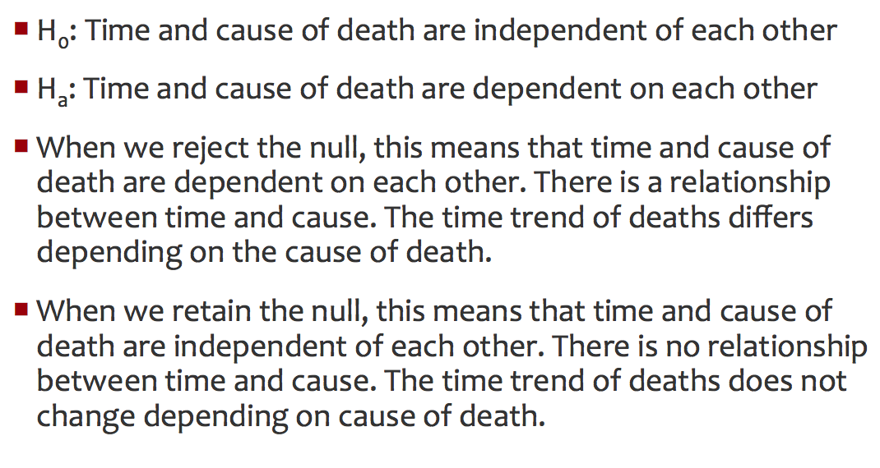
Example 2

