Slide 1
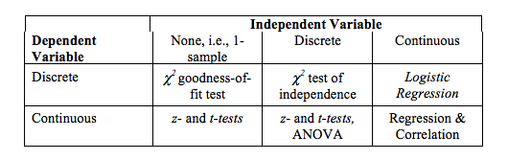
What test to use?

Slide 2
Chi Square – what are we actually doing?
 | FREE | BIASED | VARIED | Row Totals
YES COMPLAINT | 10 | 10 | 10
NO COMPLAINT | 12 | 13 | 8
Column Totals

Slide 3
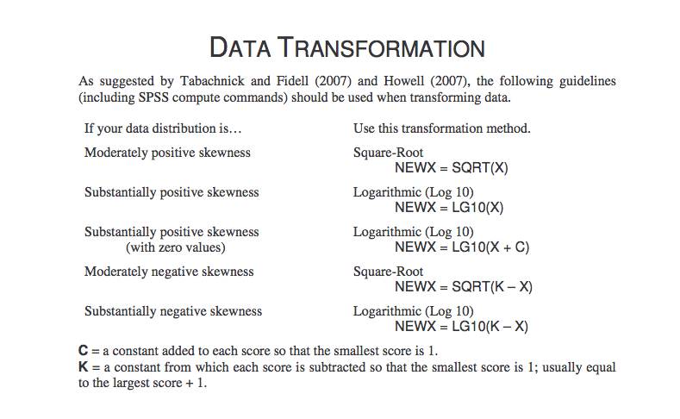
Data Transformation

Slide 4
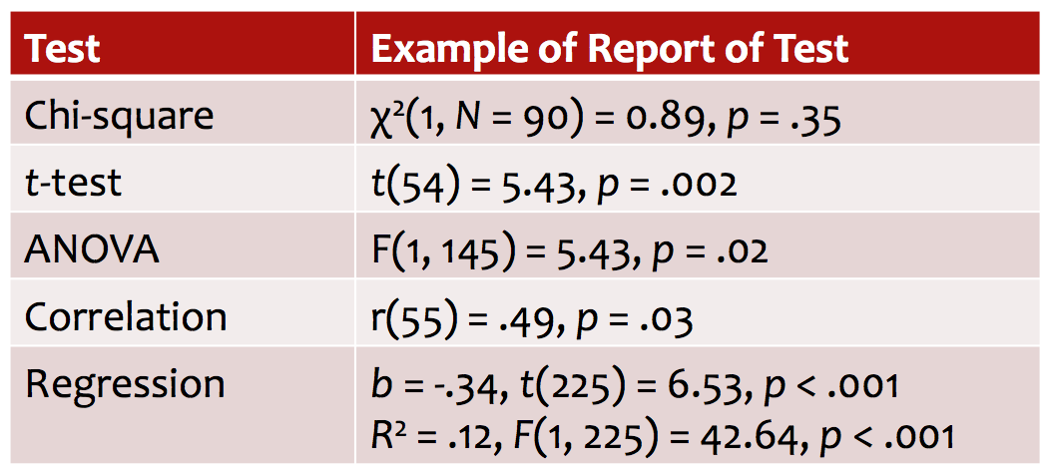
Reporting Statistics

Slide 5
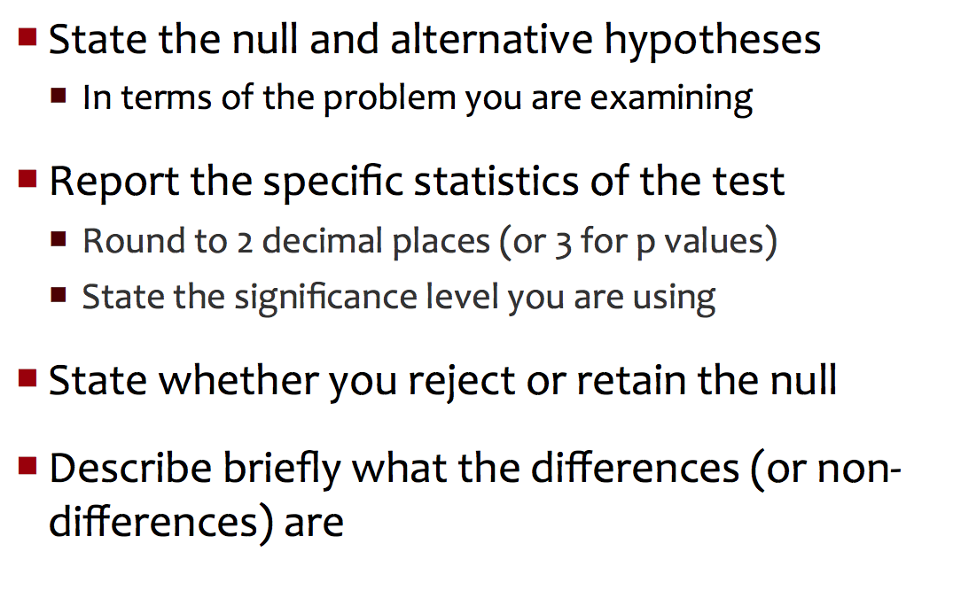
HW: Describing Results

Slide 6
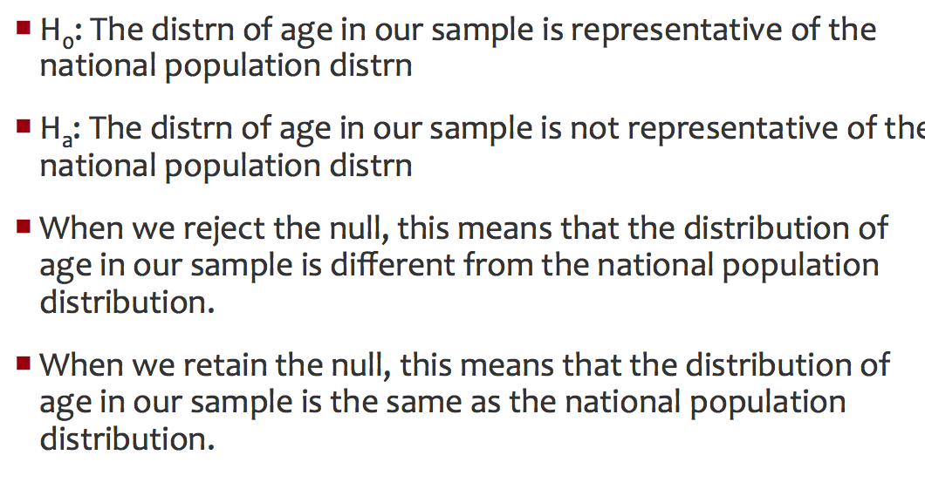
Example 1

Slide 7
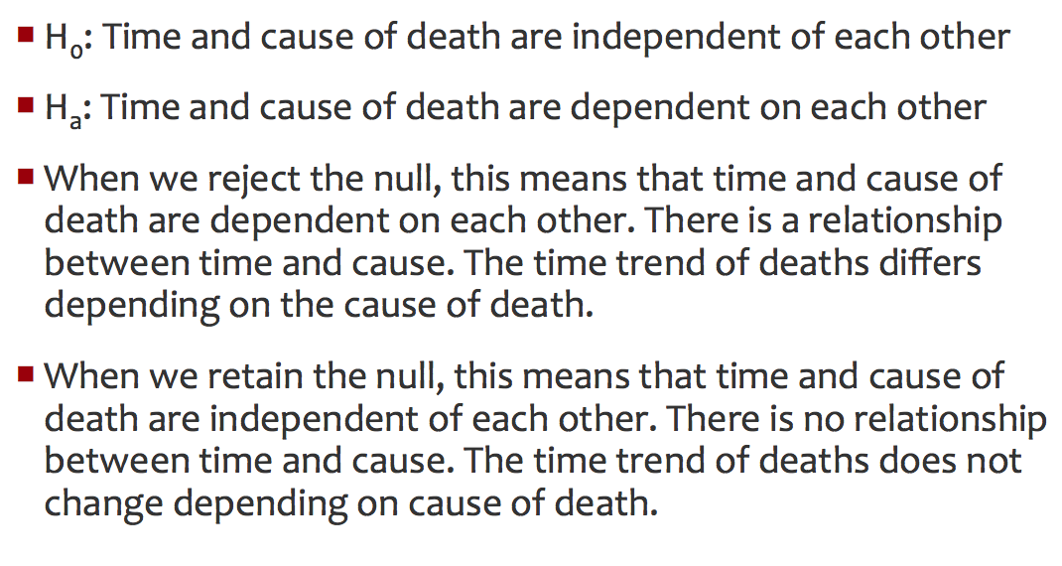
Example 2

