Slide 1
Comparing VBGF Models
Dr. Derek H. Ogle, Northland College
AFS, Kansas City
20 August 2016

Slide 2
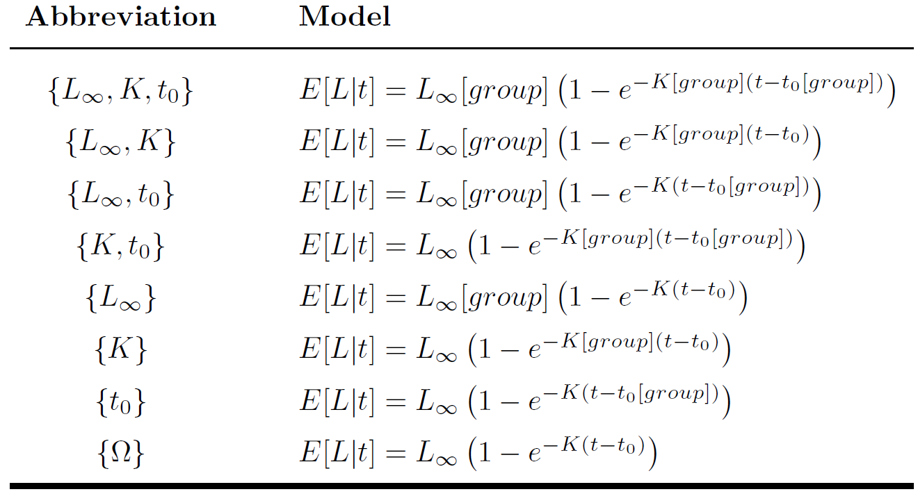
Suite of VBGF Models

Slide 3
Steps in Comparison
Fit {L∞,K,t₀} and assess assumptions
Examine Handout
Compare {L∞,K,t₀} to {Ω}
Non-significant (p>α) → no parameters differ between groups; Stop.
Significant (p<α) → some parameter(s) differ between groups; Continue.

Slide 4
Model Comparisons
Extra Sum-of-Squares Test
“Is RSS significantly reduced?”
F-test
Likelihood Ratio Test
“Is likelihood significantly increased?”
“Is negative log likelihood significantly decreased?”
Chi-square test
Functionally equivalent for large n.
Examine Handout

Slide 5
Steps in Comparison
Compare {L∞,K}, {L∞,t₀}, and {K,t₀} to {L∞,K,t₀}
Non-significant (p>α) → the common parameter does not differ between groups.
Significant (p<α) → the common parameter differs between groups.
All significant → all parameters differ between groups; Stop.
Some non-significant → choose model with lowest RSS, highest likelihood, or lowest negative log-likelihood as most parsimonious; Continue.
Examine Handout
*

Slide 6
Steps in Comparison
Compare two of {L∞}, {K}, or {t₀} to most parsimonious two-parameter model.
Non-significant (p>α) → the common parameter does not differ between groups.
Significant (p<α) → the common parameter differs between groups.
Examine Handout
*

Slide 7
Growth Comparisons Exercises
Complete Exercise

