Slide 1
Individual Growth (Size-at-Age Modeling
Dr. Derek H. Ogle, Northland College
AFS, Kansas City
20 August 2016

Slide 2
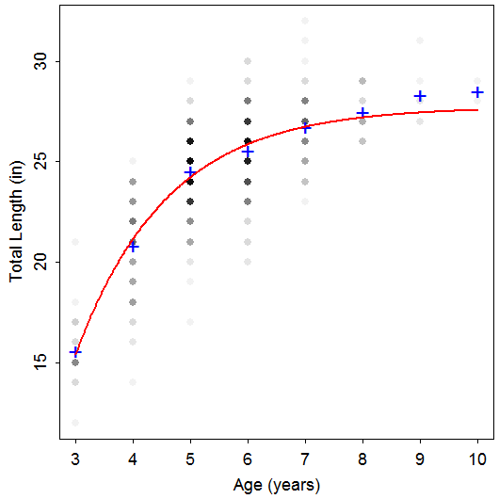
Length-At-Age Data
TL Age Species
24 6 Rainbow
26 8 Rainbow
23 5 Rainbow
25 5 Rainbow
24 4 Rainbow
24 5 Rainbow
23 4 Rainbow
25 5 Rainbow
20 4 Rainbow
23 4 Rainbow
26 6 Rainbow
29 10 Rainbow
20 4 Rainbow
29 8 Rainbow
24 6 Rainbow
26 6 Rainbow
23 5 Rainbow
24 4 Rainbow
Notes:
data(TroutBR)
rbt <- TroutBR[TroutBR$Species=="Rainbow",]
attach(rbt)
plot(jitter(TL,1)~jitter(Age,0.5),xlab="Age [jittered]",ylab="Total Length (in) [jittered]")

Slide 3
Length-At-Age Models
Purposes
Summarize growth with few parameters.
Compare growth parameters among populations.
Results used in key fisheries models, such as Beverton-Holt yield models.
Main models
Von Bertalanffy
Gompertz
Logistic
Schnute

Slide 4
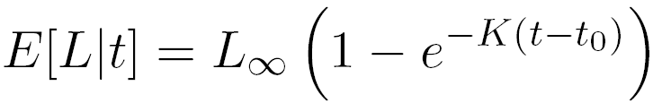
Von Bertalanffy – Typical
L∞ = asymptotic mean length
t_{o} = time when mean length is 0 (artifact)

Slide 5
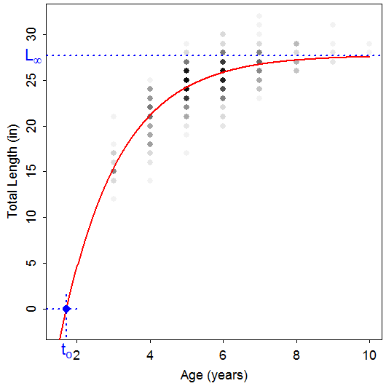
Von Bertalanffy – Typical

Slide 6
Von Bertalanffy – Typical
L∞ = asymptotic mean length
t_{o} = time when mean length is 0 (artifact)
K = Brody “growth” coefficient
Controls “curvature” of the model
Rate at which E[L|t] approaches L∞
log(2)/K is “half-life”

Slide 7
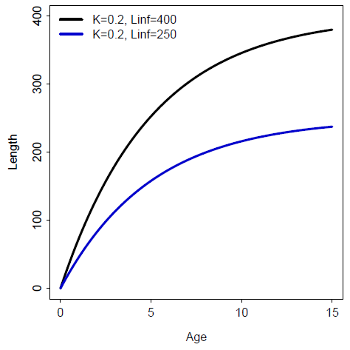
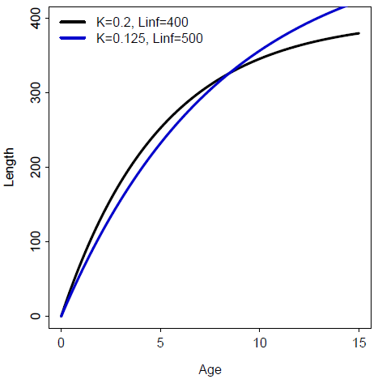
Von Bertalanffy – Typical

Slide 8
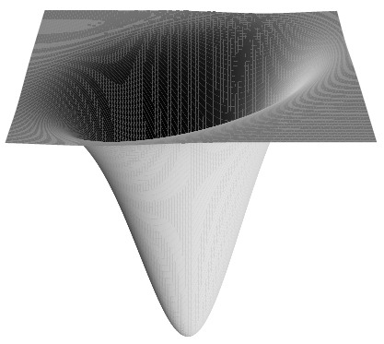
Non-Linear Modeling
VBGF is non-linear, in shape and parameters
Non-linear least-squares minimizes RSS
However, no closed-form solution
Algorithms require starting values
Iteratively search for minimum RSS

Slide 9
Non-Linear Modeling
Sampling distributions of parameter estimates tend NOT to be normally distributed.
Alternative CI #1 – Profile Likelihood Method
Use χ² and shape of likelihood function

Slide 10
Non-Linear Modeling
Sampling distributions of parameter estimates tend NOT to be normally distributed.
Alternative CI #2 – Bootstrapping
Construct a random sample (with replacement) of n “cases" of observed data.
Extract parameters from model fit to this (re)sample.
Repeat first two steps B times.
95% CI is values of ordered parameter estimates with 2.5% of values lesser and 2.5% of values greater.

Slide 11
Von Bertalanffy – Typical
Common Problems
Misinterpreted meanings
Difficulty modeling L∞
Few old fish
Difficulty modeling K
Few young fish
Model won’t converge, Poor parameter estimates
Much variability in length at each age
Highly correlated parameters
“Scale” of L∞ much different than K or t_{o}
Type of error structure (additive or multiplicative)

Slide 12
Examine Handout
Growth Fitting Exercises
Complete Lake Ontario Rock Bass
Note that this requires ages for ALL fish. Thus, source your script from the completed ALK exercise and use the combined data.frame that contains lengths and ages for ALL fish.

Slide 13
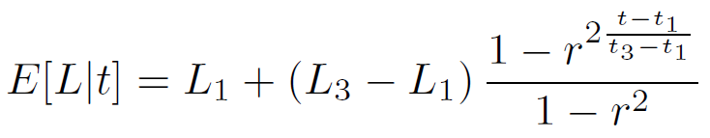
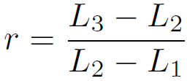
Von Bertalanffy – Francis
A reparameterization
where
Parameters
L₁ = mean length at chosen “young” age (t₁)
L₃= mean length at chosen “old” age (t₃)
L₂ = mean length at “intermediate” age (t₂)

Slide 14
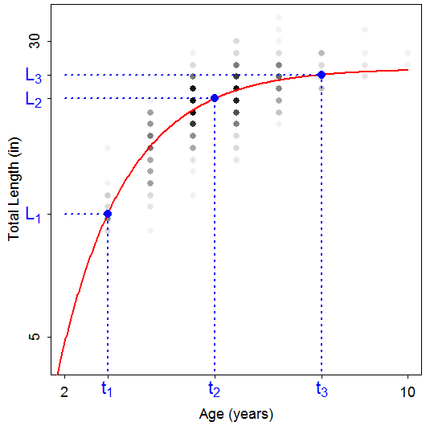
Von Bertalanffy – Francis

Slide 15
Von Bertalanffy – Francis
A reparameterization
Goals
Better model fitting
Reduce correlation among parameters & scale difference
Easier interpretation

