Slide 1
Age & Growth Analyses with R
Derek H. Ogle, Northland College

Slide 2


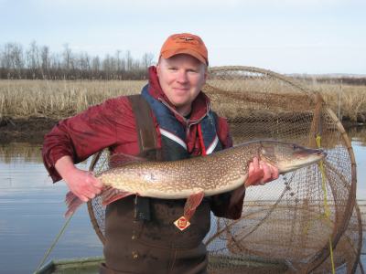
Derek
Professor of Mathematical Sciences and Natural Resources at Northland College
Ph.D. in Fisheries from University of Minnesota
Author of Introductory Fisheries Analyses with R

Slide 3
Workshop Outcomes
Construct and apply an age-length key (ALK).
Fit von Bertalanffy growth functions (VBGF) to length-age data.
Statistically compare VBGF parameters between two or more groups of fish.
Compute metrics and construct graphics to compare two sets of age estimates.

Slide 4

Fisheries Analyses in R
Website ... derekogle.com/fishR/.
Facebook … www.facebook.com/fishr00.
Twitter … @fishR_ogle.
IFAR book … derekogle.com/IFAR/

