Slide 1
Individual Growth (Size-at-Age Modeling)
Von Bertalanffy Models

Slide 2
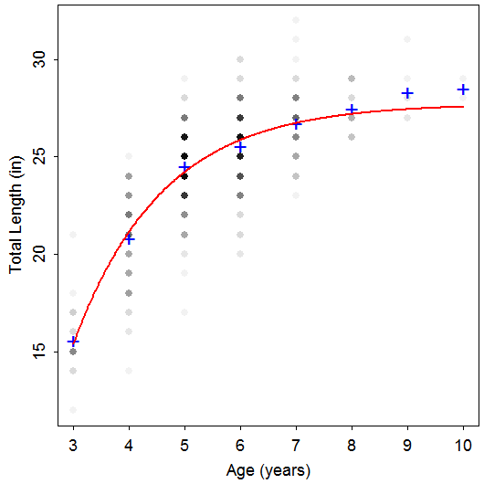
Length-At-Age Data
TL Age Species
24 6 Rainbow
26 8 Rainbow
23 5 Rainbow
25 5 Rainbow
24 4 Rainbow
24 5 Rainbow
23 4 Rainbow
25 5 Rainbow
20 4 Rainbow
23 4 Rainbow
26 6 Rainbow
29 10 Rainbow
20 4 Rainbow
29 8 Rainbow
24 6 Rainbow
26 6 Rainbow
23 5 Rainbow
24 4 Rainbow
Notes:
data(TroutBR)
rbt <- TroutBR[TroutBR$Species=="Rainbow",]
attach(rbt)
plot(jitter(TL,1)~jitter(Age,0.5),xlab="Age [jittered]",ylab="Total Length (in) [jittered]")

Slide 3
Length-At-Age Models
Purposes
Summarize growth with a few parameters.
Compare growth parameters among populations.
Used in key fisheries models, such as Beverton-Holt yield models.
Main models
Von Bertalanffy
Gompertz
Schnute

Slide 4
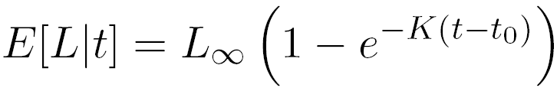
Von Bertalanffy – Typical
L∞ = asymptotic mean length
K = Brody “growth” coefficient
controls “curvature” of the model
log(2)/K is “half-life”
t_{o} = time when mean length is 0 (artifact)

Slide 5
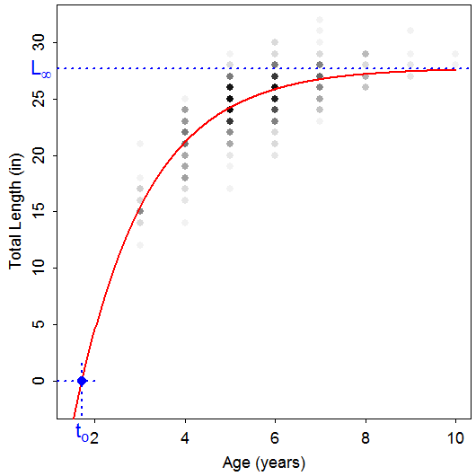
Von Bertalanffy – Typical

Slide 6
Von Bertalanffy – Typical
Common Problems
Misinterpreted meanings
Difficulty modeling L∞
Few old fish
Difficulty modeling K
Few young fish
Model won’t converge, Poor parameter estimates
Much variability in length at each age
Highly correlated parameters
“Scale” of L∞ much different than K or t_{o}
Type of error structure (additive or multiplicative)

Slide 7
Examine Handout
Growth Fitting Exercises
Complete Lake Ontario Rock Bass A
Note that this requires ages for ALL fish. Thus, source your script from the completed ALK exercise and use the combined data.frame that contains lengths and ages for ALL fish.
(Time Permitting) Complete Lake Ontario Rock Bass B

Slide 8
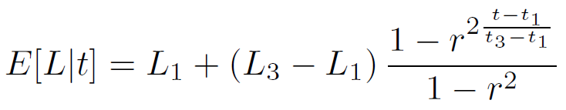
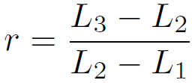
Von Bertalanffy – Francis
A reparameterization
where
Parameters
L₁ = mean length at chosen “young” age (t₁)
L₃= mean length at chosen “old” age (t₃)
L₂ = mean length at “intermediate” age (t₂)

Slide 9
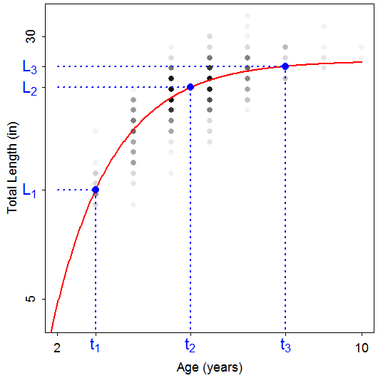
Von Bertalanffy – Francis

Slide 10
Von Bertalanffy – Francis
A reparameterization
Goals
Better model fitting
Reduce correlation among parameters & scale difference
Easier interpretation

