Slide 1

R for Fisheries Population Dynamcs
Midwest Fisheries & Wildlife Conference
28 January 2018

Slide 2

Who I Am?
Derek
Professor of Mathematical Sciences and Natural Resources at Northland College
Ph.D. in Fisheries with minor in Statistics from University of Minnesota

Slide 3

Who I Am?
Author: Introductory Fisheries Analyses with R
Maintainer: fishR website
Author & Maintainer: FSA and FSAdata R packages

Slide 4

TA – Joseph Mrnak
Joe
B.Sc. (2016) Northland College
M.Sc. (current) South Dakota Cooperative Fish and Wildlife Research Unit at South Dakota State
Interests: statistical modeling, population dynamics, management implications, and duck hunting

Slide 5
Workshop Objectives
Introduction to typical population dynamic rate functions, including
mortality rates
growth functions
weight-length relationships (and comparisons)
Methods to compare parameter estimates
Additional topics
Reproducible research documents

Slide 6
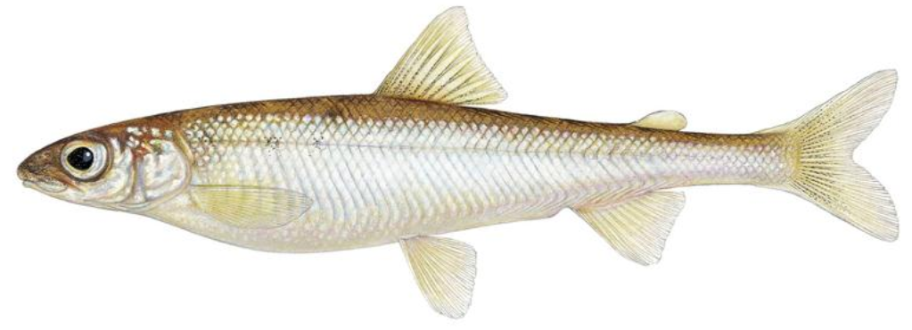
Workshop Data I
Pygmy Whitefish (Prosopium coulterii)

Slide 7
Workshop Data I
Pygmy Whitefish (Prosopium coulterii)
Sampled with a bottom trawl from 28 locations throughout Lake Superior
TL (mm) and region recorded for all fish
Weight (g) and age (from thin-sectioned otoliths) recorded for a length-stratified subsample
Modified from “Age, Growth, and Size of Lake Superior Pygmy Whitefish” (Stewart et al. 2016)

Slide 8
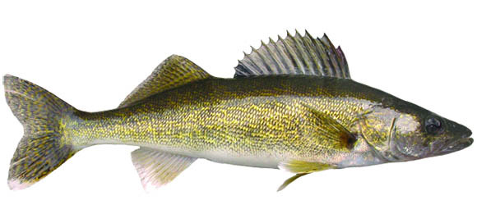
Workshop Data II
Walleye (Sander vitreus)

Slide 9
Workshop Data II
Walleye (Sander vitreus)
Escanaba Lake
Spring fyke net surveys
All fish measured and, five fish per 0.5-in length category weighed and aged (from scales (<20-in), fin rays (>20 in), and recapture knowledge).

Slide 10

Pygmy Whitefish Script
Demonstrate “Initial Preparations” and “Initial Data Wrangling (and Quick Summaries)”
Walleye Assignment
Do “Initial Preparation, Get Data, and Simple Summaries”

Slide 11
Age-Length Key – Concept
Full Sample
len age
22 1
24 NA
26 NA
27 2
30 1
32 NA
34 2
... ...
len age
32 NA
27 NA
36 NA
21 1
22 NA
30 NA
31 NA
... ...
Age Sample
len age
22 1
27 2
30 1
34 2
21 1
... ...

Slide 12
Age-Length Key – Development
Use 10-cm intervals for length categories
Make raw frequency table
Age
LCat 1 2 3
20
30
40
50
Convert to row-proportions table
Age
LCat 1 2 3
20
30
40
50
Age Sample
len age
22 1
24 1
26 2
27 2
30 1
32 2
34 2
39 3
40 1
44 2
46 3
49 3
52 2
53 2
55 3
56 3
LCat
20
20
20
20
30
30
30
30
40
40
40
40
50
50
50
50
2
2
0
1
2
1
1
1
2
0
2
2
0.50
0.50
0.00
0.25
0.50
0.25
0.25
0.25
0.50
0.00
0.50
0.50

Slide 13
Pygmy Whitefish Script
Demonstrate “Create Age-Length Key”
Walleye Assignment
Do “Create an Age-Length Key”

Slide 14
Age-Length Key – Concept
Full Sample
Modified Full Sample
len age
22 1
24 NA
26 NA
27 2
30 1
32 NA
34 2
... ...
len age
32 NA
27 NA
36 NA
21 1
22 NA
30 NA
31 NA
... ...
len age
22 1
24 1
26 2
27 2
30 1
32 2
34 2
... ...
len age
32 3
27 2
36 2
21 1
22 1
30 1
31 2
... ...
Length Sample
Modified Length
Age Sample
len age
24 NA
26 NA
32 NA
32 NA
27 NA
36 NA
22 NA
30 NA
31 NA
... ...
len age
24 1
26 2
32 3
32 2
27 2
36 2
22 1
30 1
31 2
... ...
len age
22 1
27 2
30 1
34 2
21 1
... ...
ALK

Slide 15
Age-Length Key – Assign Ages
Length Sample
len age
23
25
26
28
32
33
36
40
43
44
48
49
51
54
Create same length categories
Construct length distribution
LCat 20 30 40 50
Freq 4 3 5 2
LCat
20
20
20
20
30
30
30
40
40
40
40
40
50
50

Slide 16
Age-Length Key – Assign Ages
Length distribution (as a reminder)
LCat 20 30 40 50
Freq 4 3 5 2
Age-Length Key (as a reminder)
LCat 1 2 3
20 0.50 0.50 0.00
30 0.25 0.50 0.25
40 0.25 0.25 0.50
50 0.00 0.50 0.50
Identify number in each length category to be assigned each age
20-cm → 4*0.5 = 2 age-1
→ 4*0.5 = 2 age-2
→ 4*0 = 0 age-3
Randomly assign these ages
Length Sample
len age
23
25
26
28
32
33
36
40
43
44
48
49
51
54
LCat
20
20
20
20
30
30
30
40
40
40
40
40
50
50
1
2
2
1

Slide 17
Age-Length Key – Assign Ages
Length distribution (as a reminder)
LCat 20 30 40 50
Freq 4 3 5 2
Age-Length Key (as a reminder)
LCat 1 2 3
20 0.50 0.50 0.00
30 0.25 0.50 0.25
40 0.25 0.25 0.50
50 0.00 0.50 0.50
Identify number in each length category to be assigned each age
30-cm → 3*0.25 = 0.75 age-1
→ 3*0.5 = 1.5 age-2
→ 3*0.25 = 0.75 age-3
What to do now?
Length Sample
len age
23
25
26
28
32
33
36
40
43
44
48
49
51
54
LCat
20
20
20
20
30
30
30
40
40
40
40
40
50
50
1
2
2
1

Slide 18
Age-Length Key – Fractionation
Round all values down to integers.
30-cm → 3*0.25 = 0.75 = 0 age-1
→ 3*0.5 = 1.5 = 1 age-2
→ 3*0.25 = 0.75 = 0 age-3
For remaining two fish ...
Choose two ages such that age-1 has a 25%, age-2 has a 50%, and age-3 has a 25% chance of being selected.
e.g., 2, 1 were chosen
Thus, assign 1 age-1, 2 age-2, & 0 age-3

Slide 19
Age-Length Key – Assign Ages
Length distribution (as a reminder)
LCat 20 30 40 50
Freq 4 3 5 2
Age-Length Key (as a reminder)
LCat 1 2 3
20 0.50 0.50 0.00
30 0.25 0.50 0.25
40 0.25 0.25 0.50
50 0.00 0.50 0.50
Identify number in each length category to be assigned each age
30-cm → 3*0.25 = 0.75 age-1
→ 3*0.5 = 1.5 age-2
→ 3*0.25 = 0.75 age-3
Randomly assign these ages
Length Sample
len age
23
25
26
28
32
33
36
40
43
44
48
49
51
54
LCat
20
20
20
20
30
30
30
40
40
40
40
40
50
50
1
2
2
1
2
1
2
➔ 1
➔ 2
➔ 0

Slide 20
Age-Length Key – Assign Ages
Length distribution (as a reminder)
LCat 20 30 40 50
Freq 4 3 5 2
Age-Length Key (as a reminder)
LCat 1 2 3
20 0.50 0.50 0.00
30 0.25 0.50 0.25
40 0.25 0.25 0.50
50 0.00 0.50 0.50
Identify number in each length category to be assigned each age
40-cm → 5*0.25 = 1.25 = 1 age-1
→ 5*0.25 = 1.25 = 1 age-2
→ 5*0.5 = 2.5 = 2 age-3
Extra fish was chosen to be age-3
Randomly assign these ages
Length Sample
len age
23
25
26
28
32
33
36
40
43
44
48
49
51
54
LCat
20
20
20
20
30
30
30
40
40
40
40
40
50
50
1
2
2
1
2
1
2
3
1
2
3
➔ 1
3
➔ 1
➔ 3

Slide 21
Age-Length Key – Concept
Length distribution (as a reminder)
LCat 20 30 40 50
Freq 4 3 5 2
Age-Length Key (as a reminder)
LCat 1 2 3
20 0.50 0.50 0.00
30 0.25 0.50 0.25
40 0.25 0.25 0.50
50 0.00 0.50 0.50
Identify number in each length category to be assigned each age
50-cm → 2*0.5 = 1 age-2
→ 2*0.5 = 1 age-3
Randomly assign these ages.
Length Sample
len age
23
25
26
28
32
33
36
40
43
44
48
49
51
54
LCat
20
20
20
20
30
30
30
40
40
40
40
40
50
50
1
2
2
1
2
1
2
3
1
2
3
3
3
2

Slide 22
Pygmy Whitefish Script
Demonstrate “Apply Age-Length Key”
Walleye Assignment
Do “Apply Age-Length Key (assign ages to unaged fish)”

Slide 23
Catch-at-Age Data
Follow 2010 cohort (i.e., year-class) assuming …
10,000 fish hatched
sampled immediately with 2 units of effort and 1% catchability
20% annual mortality
Capture Year
Age 2010 2011 2012 2013 2014 2015 2016 2017
0
1
2
3
4
5
200
160
128
102
82
66
Notes:
Recall that Ct = qEtNt
Nt+1=(1-A)*Nt

Slide 24
Catch-at-Age Data
Follow 2010 cohort (i.e., year-class)
Follow 2011 cohort (i.e., year-class) assuming …
same as for 2010 cohort
Capture Year
Age 2010 2011 2012 2013 2014 2015 2016 2017
0
1
2
3
4
5
200
200
160
160
128
128
102
102
82
82
66
66
Notes:
Recall that Ct = qEtNt
Nt+1=(1-A)*Nt

Slide 25
Catch-at-Age Data
Follow 2010 cohort (i.e., year-class)
Follow 2011 cohort (i.e., year-class
Remaining cohorts assuming the same
Capture Year
Age 2010 2011 2012 2013 2014 2015 2016 2017
0
1
2
3
4
5
200
200
200
200
200
200
200
200
160
160
160
160
160
160
160
160
128
128
128
128
128
128
128
128
102
102
102
102
102
102
102
102
82
82
82
82
82
82
82
82
66
66
66
66
66
66
66
66
Notes:
Recall that Ct = qEtNt
Nt+1=(1-A)*Nt

Slide 26
Catch-at-Age Data
Under the assumptions of
Constant recruitment
Constant mortality (between ages and years)
Constant catchability (between ages and years)
Longitudinal = cross-sectional catch-curve
Capture Year
Age 2010 2011 2012 2013 2014 2015 2016 2017
0
1
2
3
4
5
200
200
200
200
200
200
200
200
160
160
160
160
160
160
160
160
128
128
128
128
128
128
128
128
102
102
102
102
102
102
102
102
82
82
82
82
82
82
82
82
66
66
66
66
66
66
66
66
Notes:
Recall that Ct = qEtNt
Nt+1=(1-A)*Nt

Slide 27
Catch Curve Model
Note that
C_{t} = qE_{t}N_{t} and thus CPE_{t} = qN_{t}
N_{t} = N₀(1-A)^{t}
N_{t} = N₀e^{-Zt}
Substituting N_{t} = N₀e^{-Zt} into CPE_{t} = qN_{t} gives …
CPE_{t} = qN₀e^{-Zt}
Notes:
No = initial population size
Nt = population size at time t
q = catchability coefficient
Ct = catch at time t
Et = effort expended at time t
A = Annual mortality rate
Z = instantaneous mortality rate (1-e-Z)

Slide 28
Catch Curve Model
CPE_{t} = qN₀e^{-Zt}
Can this be linearized?
200
160
CPE
120
80
0
1
2
3
4
5
Age / Time

Slide 29
Catch Curve Model
Transformed model: log(CPE_{t}) = log(qN₀)-Zt
4.0
3.5
3.0
2.5
log(CPE)
2.0
-Z
1.5
1
1.0
-Z
0.5
Asc
Dome
Descending
1
0
2
4
6
8
10
Age / Time

Slide 30
Mortality Estimates
Z
Instantaneous total mortality rate
Annual decline in natural log of CPE
Uninterpretable
A
A=1-e^{-Z}
Total annual mortality rate
Proportional decline in CPE
Easily interpretable

Slide 31
Catch Curve Decisions
Descending limb
Include age with peak catch
Use all ages where C_{t}>0
though some argue for various right truncation rules
Weighted regression
Reduced effect of ages with low CPE
Demonstrated with R script
Chapman-Robson method
Generally preferred over regression method
Demonstrated in R script
Notes:
No = initial population size
Nt = population size at time t
q = catchability coefficient
Ct = catch at time t
Et = effort expended at time t
A = Annual mortality rate
Z = instantaneous mortality rate (1-e-Z)

Slide 32
Pygmy Whitefish Script
Demonstrate “Estimate Mortality Rates”
Walleye Assignment
Do “Estimate Mortality Rates”

Slide 33
Comparing Mortality Rates
If catch curve slopes differ, then Z differs.
i.e., mortality rates differ.
Test for different slopes using dummy variable regression (aka indicator variable regression or ANCOVA).

Slide 34
Dummy/Indicator Variables
Numerical representation of a dichotomous factor variable
Indicator variable called countryUSA
countryUSA = 1 if from USA
countryUSA = 0 otherwise (i.e., from CANADA)
Named after “1” group
“0” group does not have characteristic
called the “reference” group

Slide 35
Interaction Variables
The product of two (or more) explanatory variables
Used to determine if the effect of one explanatory variable on the response variable is influenced by the value of another explanatory variable
Catch curve example
Interaction between age and countryUSA
Is the effect of age on logfreq affected by country?

Slide 36
Ultimate Full Model
For catch curve example …
μ_{logfreq} = α + βage + δ₁countryUSA + γ₁countryUSA*age
Order of explanatory variables:
Quantitative covariate
Individual indicator variables
Interaction between indicators and covariate
Coefficients are …
α is an intercept
β is on the covariate
δ_{i} are on the indicator variables
γ_{i} are on the interaction variables

Slide 37
Submodels
μ_{logfreq} = α + βage + δ₁countryUSA + γ₁countryUSA*age
Reductions of the ultimate full model
represent each group in data
What happens when countryUSA = 0?
μ_{logfreq} = α + βage
What happens when countryUSA = 1?
μ_{logfreq} = α + βage + δ₁ + γ₁age
= (α+δ₁) + (β+ γ₁)age

Slide 38
Comparing Mortality Rates
not USA: μ_{logfreq} = α + βage
USA: μ_{logfreq} = (α+δ₁) + (β+γ₁)age
If catch curve slopes differ, then Z differs
Test if the interaction variable is significant or not (i.e., is γ₁=0).

Slide 39
Pygmy Whitefish Script
Demonstrate “Compare Mortality Rates”
Walleye Assignment
Do “Compare Mortality Rates”

Slide 40
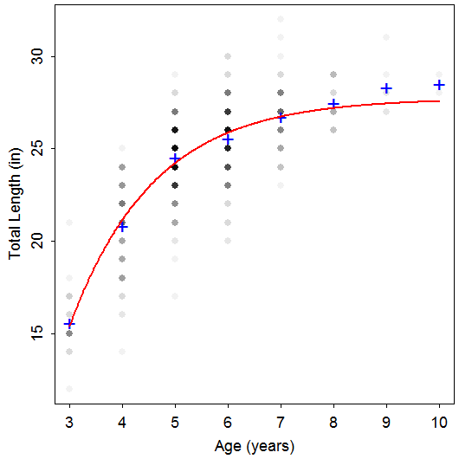
Length-At-Age Data
TL Age Species
24 6 Rainbow
26 8 Rainbow
23 5 Rainbow
25 5 Rainbow
24 4 Rainbow
24 5 Rainbow
23 4 Rainbow
25 5 Rainbow
20 4 Rainbow
23 4 Rainbow
26 6 Rainbow
29 10 Rainbow
20 4 Rainbow
29 8 Rainbow
24 6 Rainbow
26 6 Rainbow
23 5 Rainbow
24 4 Rainbow
Notes:
data(TroutBR)
rbt <- TroutBR[TroutBR$Species=="Rainbow",]
attach(rbt)
plot(jitter(TL,1)~jitter(Age,0.5),xlab="Age [jittered]",ylab="Total Length (in) [jittered]")

Slide 41
Length-At-Age Models
Purposes
Summarize growth with few parameters.
Compare growth parameters among populations.
Use results in key fisheries models, such as Beverton-Holt yield models.
Main models
von Bertalanffy
Gompertz
Logistic
Richards

Slide 42
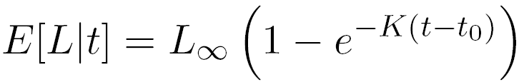
Von Bertalanffy – Typical
L∞ = asymptotic mean length
t_{o} = time when mean length is 0 (artifact)

Slide 43
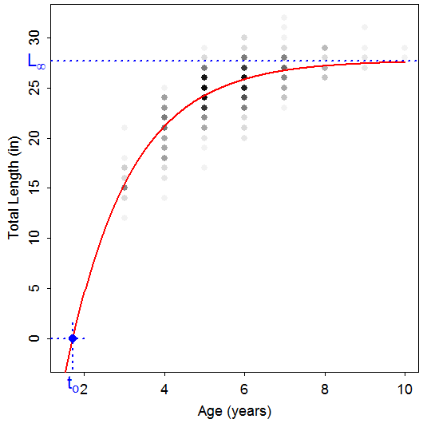
Von Bertalanffy – Typical

Slide 44
Von Bertalanffy – Typical
L∞ = asymptotic mean length
t_{o} = time when mean length is 0 (artifact)
K = Brody “growth” coefficient
Controls “curvature” of the model
Rate at which E[L|t] approaches L∞
log(2)/K is “half-life”

Slide 45
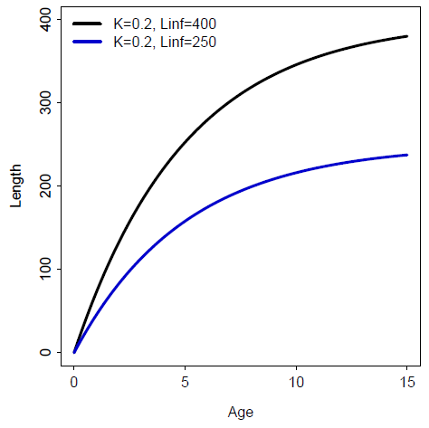
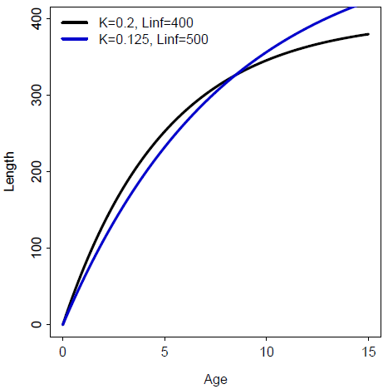
Von Bertalanffy – Typical

Slide 46
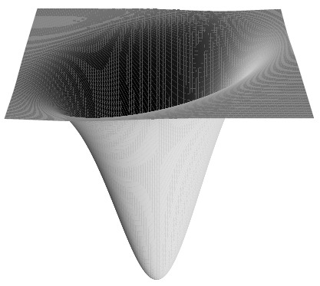
Non-Linear Modeling
VBGF is non-linear, in shape and parameters
Non-linear least-squares minimizes RSS
However, no closed-form solution
Algorithms require starting values
Iteratively search for minimum RSS

Slide 47
Non-Linear Modeling
Sampling distributions of parameter estimates tend NOT to be normally distributed.
Alternative CI #1 – Profile Likelihood Method
Use χ² and shape of likelihood function

Slide 48
Non-Linear Modeling
Sampling distributions of parameter estimates tend NOT to be normally distributed.
Alternative CI #2 – Bootstrapping
Construct a random sample (with replacement) of n “cases" of observed data.
Extract parameters from model fit to this (re)sample.
Repeat first two steps B times.
95% CI is values of ordered parameter estimates with 2.5% of values lesser and 2.5% of values greater.

Slide 49
Von Bertalanffy – Typical
Common Problems
Misinterpreted meanings
Difficulty modeling L∞
Few old fish
Difficulty modeling K
Few young fish
Model won’t converge, Poor parameter estimates
Much variability in length at each age
Highly correlated parameters
“Scale” of L∞ much different than K or t_{o}
Type of error structure (additive or multiplicative)
For a thorough description see Ogle, D.H., T.O. Brenden, and J.L. McCormick. 2018. Growth Estimation: Growth Models and Statistical Inference. In Quist, M.C. and D. Isermann, editors. Age and Growth of Fishes: Principles and Techniques. American Fisheries Society.

Slide 50
Pygmy Whitefish Script
Demonstrate “Fit Growth Model”
Walleye Assignment
Do “Fit Growth Model”

Slide 51
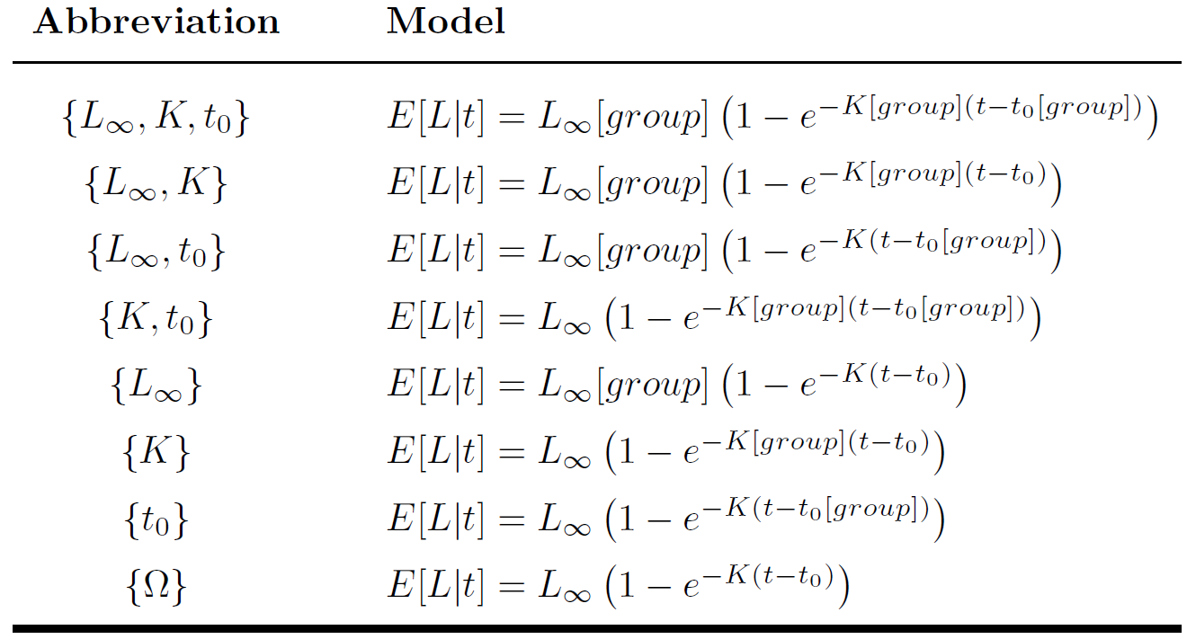
Suite of VBGF Models

Slide 52
Steps in Comparison
Fit {L∞,K,t₀} and assess assumptions
Pygmy Whitefish Script
Start “Compare Growth Model Parameters”
Ogle ● Midwest ● Jan 2018

Slide 53
Steps in Comparison
Fit {L∞,K,t₀} and assess assumptions
Compare {L∞,K,t₀} to {Ω}
Non-significant (p>α) → no parameters differ between groups; Stop.
Significant (p<α) → some parameter(s) differ between groups; Continue.

Slide 54
Model Comparisons
Extra Sum-of-Squares Test
“Is RSS significantly reduced?”
F-test
Likelihood Ratio Test
“Is likelihood significantly increased?”
“Is negative log likelihood significantly decreased?”
Chi-square test
ESST and LRT are functionally equivalent for large n.
Pygmy Whitefish Script
Continue “Compare Growth Model Parameters”

Slide 55
Steps in Comparison
Compare {L∞,K}, {L∞,t₀}, and {K,t₀} to {L∞,K,t₀}
Non-significant (p>α) → the common parameter does not differ between groups.
Significant (p<α) → the common parameter differs between groups.
All significant → all parameters differ between groups; Stop.
Some non-significant → choose model with lowest RSS, highest likelihood, or lowest negative log-likelihood as most parsimonious; Continue.
Examine Script
*

Slide 56
Steps in Comparison
Compare two of {L∞}, {K}, or {t₀} to most parsimonious two-parameter model.
Non-significant (p>α) → the common parameter does not differ between groups.
Significant (p<α) → the common parameter differs between groups.
Examine Script
*

Slide 57
Pygmy Whitefish Script
Finish “Compare Growth Model Parameters”
Walleye Assignment
Do “Compare Growth Model Parameters”

Slide 58
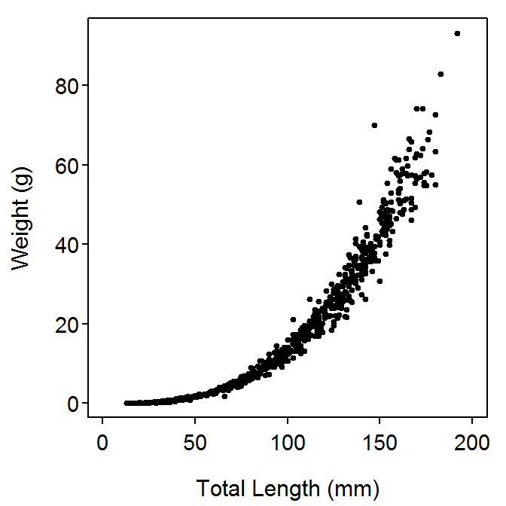
Weight-Length Relationship
Usually non-linear (in shape) and heteroscedastic

Slide 59
Weight-Length Relationship
Usually non-linear (in shape) and heteroscedastic
Can be represented by a power function with multiplicative errors
Examine natural logarithm of this function

Slide 60



Weight-Length Relationship
if b≠3 then fish growth is allometric
if b<3 then fish gets more fusiform with time
if b>3 then fish gets more plump with time

Slide 61
Pygmy Whitefish Script
“Compute Weight-Length Relationship”
Walleye Assignment
Do “Compute Weight-Length Relationship”

Slide 62
Pygmy Whitefish Script
“Compare Weight-Length Model Parameters”
Walleye Assignment
Do “Compare Weight-Length Model Parameters”

Slide 63
Workshop Data II
Walleye (Sander vitreus)

Slide 64
Workshop Data II
Walleye (Sander vitreus)
Adult (age-5 and older) abundance from mark-recapture (captured in fyke nets, tagged, recaptured in a compulsory creel census)
Age-0 abundance from mark-recapture (captured with boat AC electrofishing in autumn on three consecutive nights, fin-clipped each night)
Modified from “Factors affecting recruitment of Walleyes in Escanaba Lake, Wisconsin, 1958-1996 (Hansen et al. 1998)

Slide 65
Walleye Script
Initial Preparations
Initial Data Wrangling (and Quick Summaries)

Slide 66


Stock-Recruit Models
Density-Independent Model
R/S is a constant of S
a is “density independent” parameter
Recruits
Recruits-per-Spawner
Spawning Stock
Spawning Stock

Slide 67

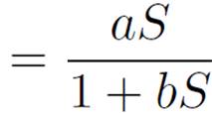
Stock-Recruit Models
Beverton-Holt Model
Recruits
Recruits-per-Spawner
Spawning Stock
Spawning Stock

Slide 68
Stock-Recruit Models
Beverton-Holt Model
a has same meaning
b is “density-dependent” parameter
What happens if b=0?
Peak recruitment (R_{p}) is at asymptote
R_{p} equals a/b
What does “more density dependence” do to R_{p}?
What does “more density independence” do to R_{p}?

Slide 69


Stock-Recruit Models
Ricker Model
Recruits
Recruits-per-Spawner
Spawning Stock
Spawning Stock

Slide 70
Stock-Recruit Models
Ricker Model
a, b have same meaning
What happens if b=0?
Peak recruitment (R_{p}) is a/be, occurs at S_{p}=1/b
What does “more density dependence” do to R_{p}? S_{p}?
What does “more density independence” do to R_{p}? S_{p}?

Slide 71
Other Models
Shepherd Model (modifies Beverton-Holt)
Third parameter (c) allows modeling Beverton-Holt, Ricker, and power functions shapes.
Saila-Lorda Model (modifies Ricker)
Third parameter (c) allows modeling depensation and over-compensation.
Sigmoidal Beverton-Holt
Third parameter similar to purpose in Saila-Lorda.
MANY others

Slide 72
Other Models
Shepherd Model (modifies Beverton-Holt)
Saila-Lorda Model (modifies Ricker)
Sigmoidal Beverton-Holt
MANY others
For good reviews and discussion, see
Needle, C.L. 2002. Recruitment models:diagnosis and prognosis. Reviews in Fish Biology and Fisheries. 11:95-111.
Subbey, S. et al. 2014. Modelling and forecasting stock-recruitment: current and future perspectives. ICES Journal of Marine Science. 71:2307-2322.

Slide 73
Walleye Script
Fit Stock-Recruitment Models

