Slide 1
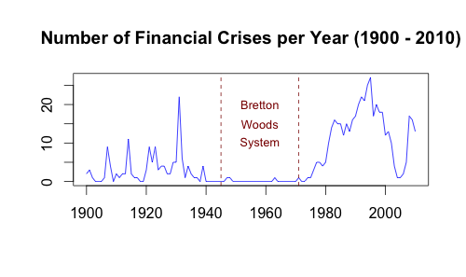
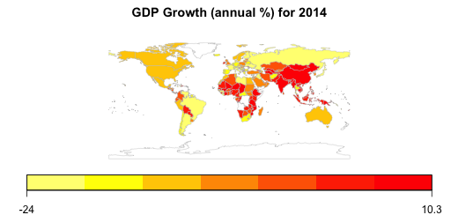
Can We Predict The Next Global Financial Crisis?
Data Source: https://www.kaggle.com/worldbank/world-development-indicators
Predict Crises With Data & Tech
The Effects Of Financial Crises
Problem: Global financial crises plunge the world into chaos with noticeable impact for every human.
Solution: Using the exponentially growing technological possibilities and the vast amounts of collected data future financial crises can be prevented.
Global financial crises have devastating consequences for the economic development of each country in the world.
These crises generating a wide range of mostly negative short, medium and long term effects that affect the economic growth and output, and thus, ultimately, the quality of life of each individual.
After financial crises an econmoic downward spiral can be observed. Lack of liquidity leads to insufficient investments in businesses, which in turn directs to the missing tax revenues and unemployment. Overall, the gross domestic product decreases significantly.
Detecting Influencing Factors
In order to to prevent the world from the negative effects of financial crises in the future, of course it is important to identify the factors that destabilize and stabilize the global financial system.

