Slide 1
MS251C: Sports Analytics Lecture 1: What is sports and statistics?

Slide 2
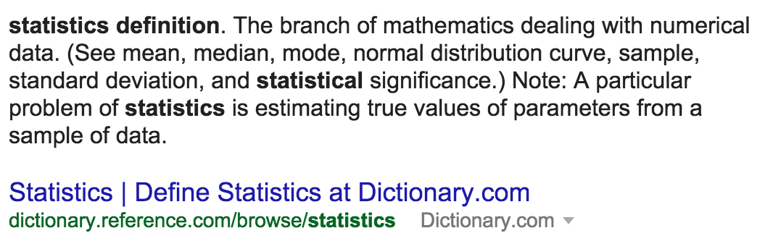
What is statistics?
Bad definition:
ii) Better definition:
‘Science of learning from data’ – Marie Davidian

Slide 3
What is statistics in sports?
‘Science of learning from data’ in sports
1) Wrangle & visualize data
2) Statistical tool
- Ex: Regression, t-test, etc
3) Measure uncertainty
- Practical vs. statistical significance
4) Communicate results
- Appropriate generalizability

Slide 4
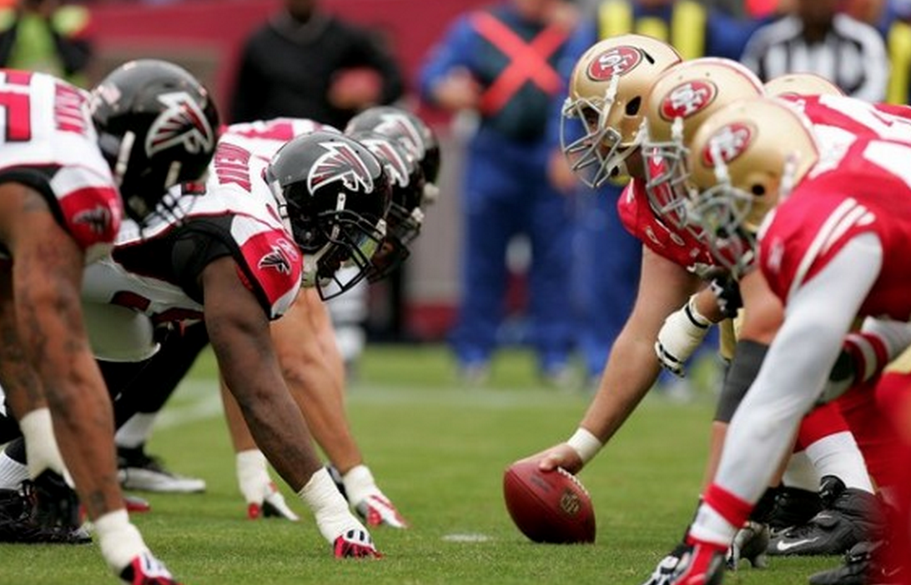
Wrangle data
Start with:

Slide 5
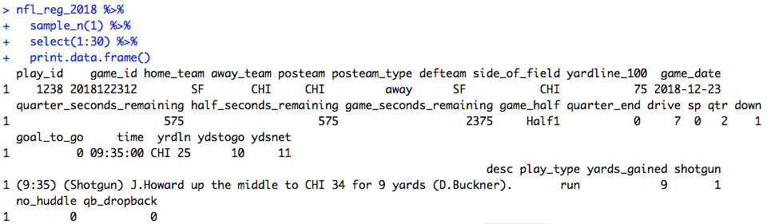
Wrangle data
Code:
Output:

Slide 6
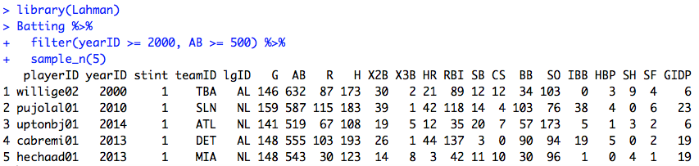
What does data look like?

Slide 7
Properties of tidy data

Slide 8
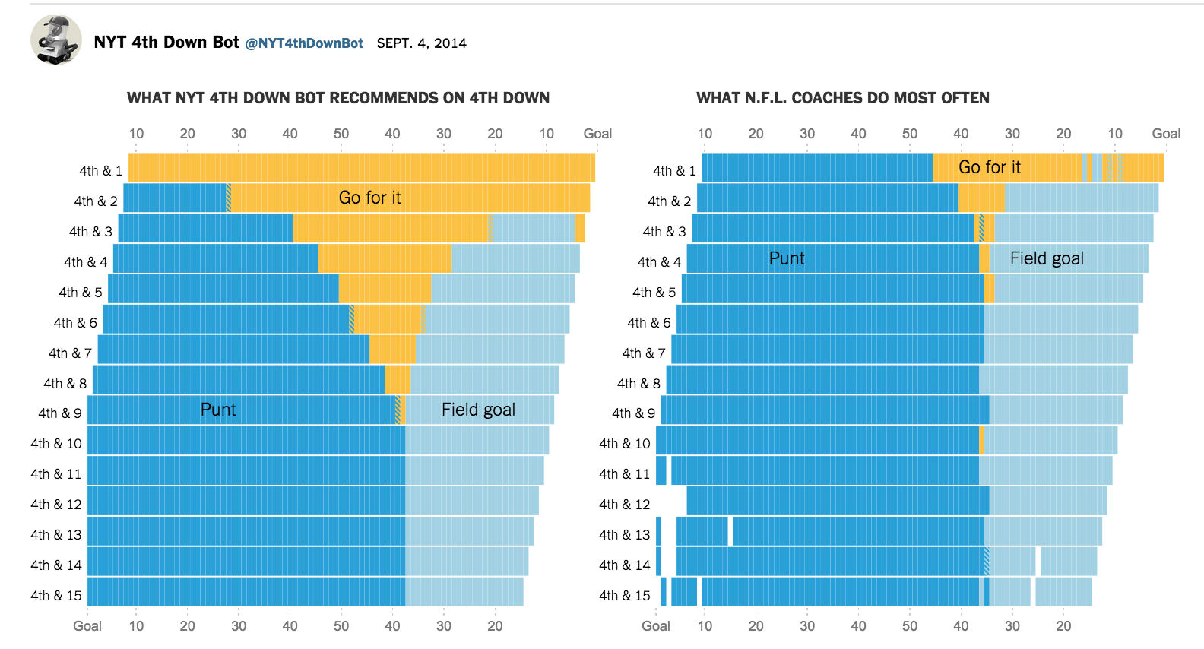
Visualizing data

Slide 9
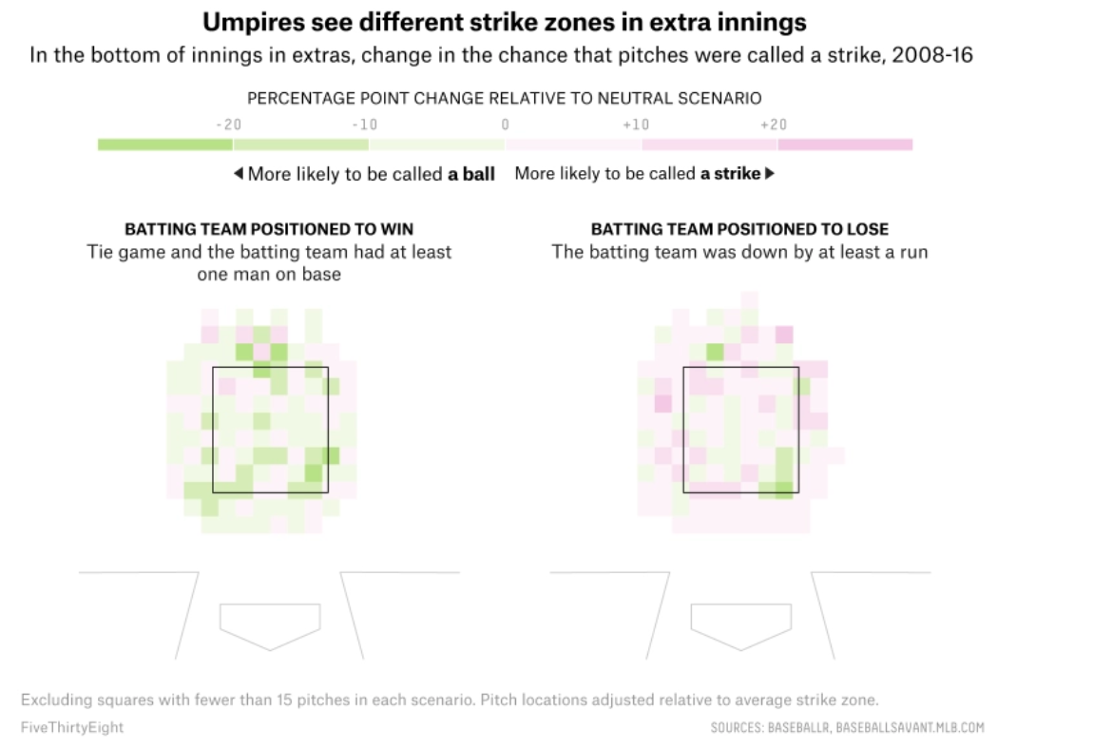
Visualizing data

Slide 10
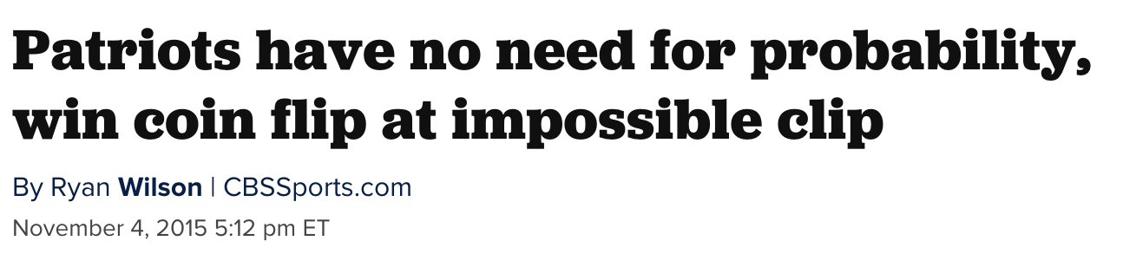
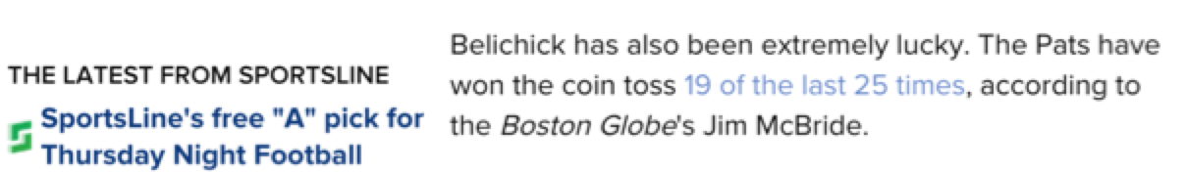
Statistical tool – need for uncertainty
www.cbssports.com/nfl/eye-on-football/25363570/patriots-have-no-need-for-probability-win-coin-flip-at-impossible-clip

Slide 11
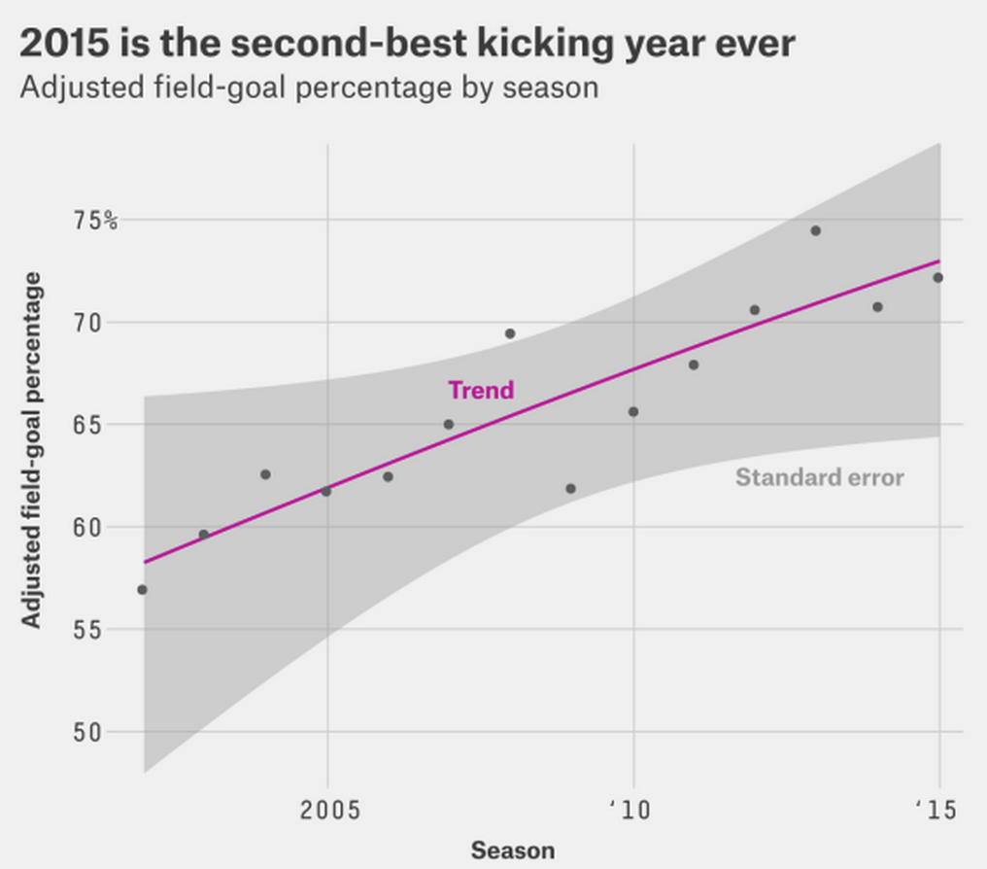
Statistical tool, account for uncertainty
http://fivethirtyeight.com/features/the-haters-are-losing-the-war-on-nfl-kickers/

Slide 12
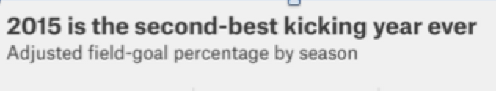
Significance: statistical? practical?

Slide 13
Generalizability? Who? Where? When?

Slide 14
Definitions
Statistical significance: Could the results have happened by chance?
Practical significance: Is this useful information that decision makers can act upon?
Generalizability: Who is the larger population that our work refers to?

Slide 15
Rough history of statistics in sports
Jamesian era (1970’s – 2004ish)
- Hey, you can apply statistics to sports!
Modern era (2004ish – current)
- Get more data, do cool stuff
- Get more data, do really cool stuff, get hired
- Call ourselves sports analytics because it’s sexier
Future (Current - ????)
- Get more data only if you work for a sports team
- Holy shit, now there may be too much data

Slide 16

Jamesian era
Bill James Baseball Abstract, 1977
“Stein’s Paradox in Statistics” – 1977, Efron and Morris
“On the optimal time to pull the goalie” – 1976, Morrisonn
“Operations research in football” – Carter & Machol, 1971

Slide 17

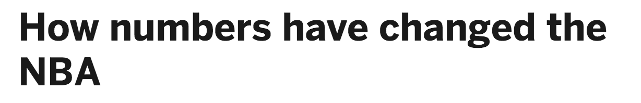
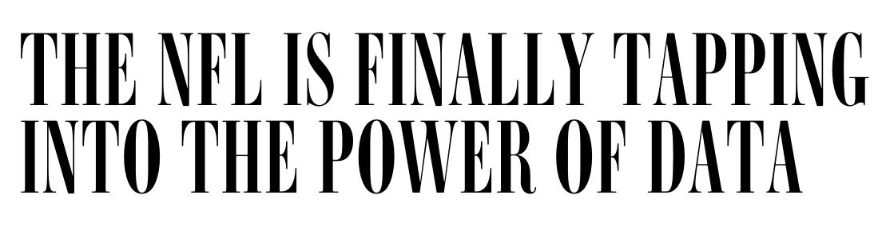
Modern era
“Get more data, do cool stuff”

Slide 18
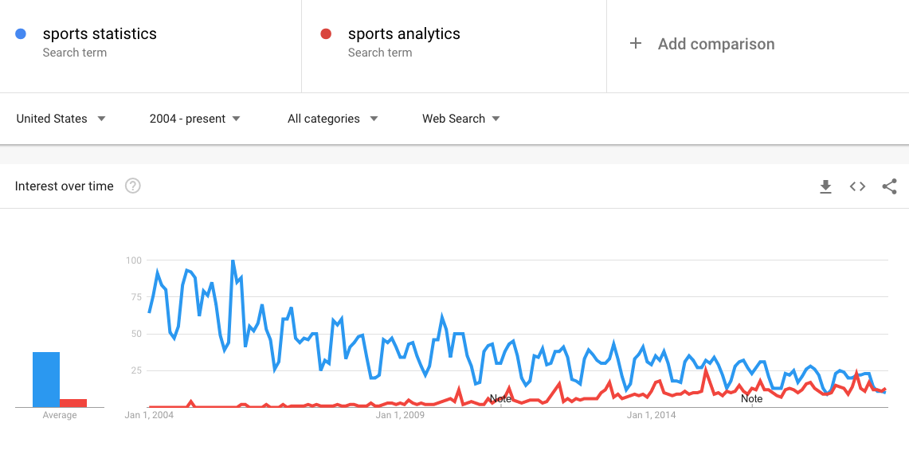
Modern era
Sports and statistics becomes sports analytics

Slide 19
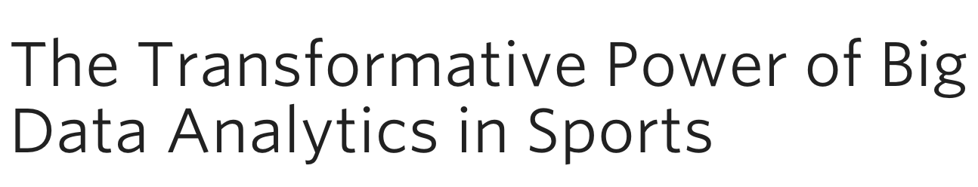
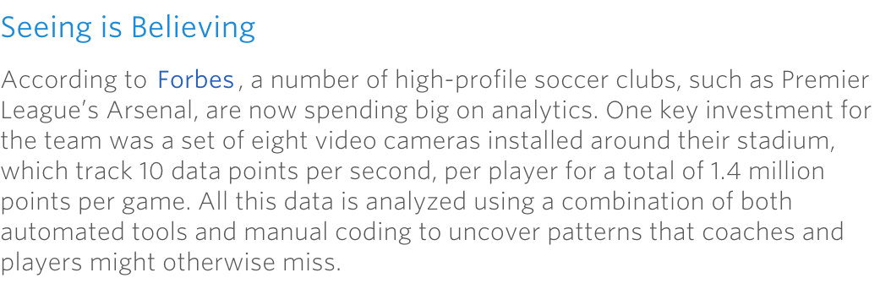
Future era

Slide 20
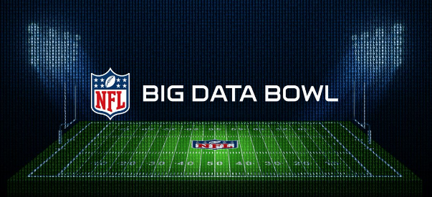
Future era
https://github.com/nfl-football-ops/Big-Data-Bowl

Slide 21
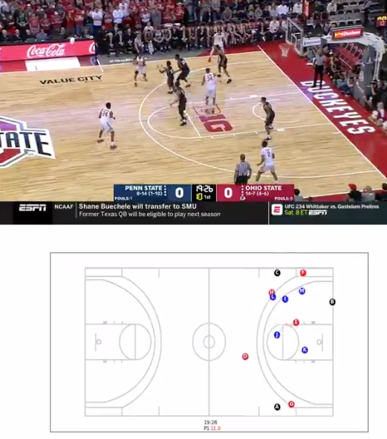
Future era

Slide 22
Where do we fit in?
-Gain an understanding of how statistical tools have been applied in the sports world
-Learn methods for analysis, visualization, and implementation
-Gain familiarity statistical tools
-Skills for communication and problem solving
-How can we handle player tracking data?
https://twitter.com/neilmjohnson/status/1168941581757558784

