Slide 1


Network and Spatial Analyses 26. February 2020
Seminar:
Intro network exercise in R
Network data
Random network creation
Bi-partite network creation
Network measures
Node measures
Exercise: the global airline network
Course Github page: https://github.com/bokae/anet_course

Slide 2
1. Network data
Store in matrices
BUT: matrices cannot store node characteristics
matrices are often sparse, which makes data-management inefficient
Store in two files
Node list: ID (must correspond to IDs in edgelist), node characteristics
Edge list: ID1, ID2, edge characteristics
Edges are usually not repeated: if there is A-B link, no need for B-A
Rational for repeated edges:
Directed edges: A-B is different from B-A
Data is stored in many files -> table operations are needed

Slide 3

Introduction to the ‘igraph’ package
‘sand’ package: integration
Codes by chapters: https://github.com/kolaczyk/sand

Slide 4
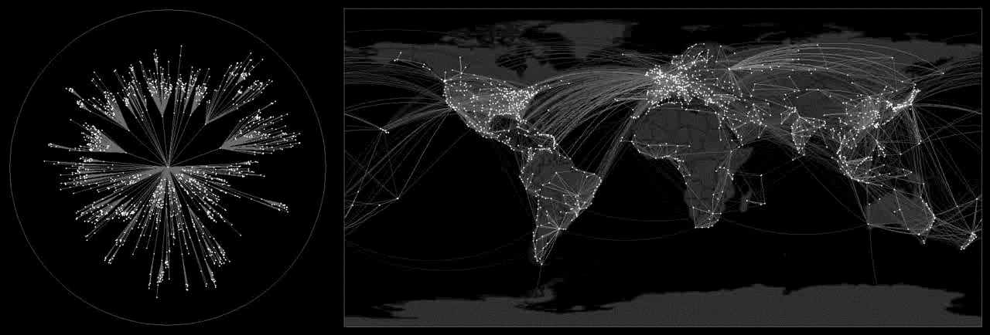
Exercise: the global airline network
Brockman D., Helbing D (2013)The hidden geometry in complex, network-driven contagion phenomena. Science 342 (6164) pp. 1337-1342.

