Slide 1




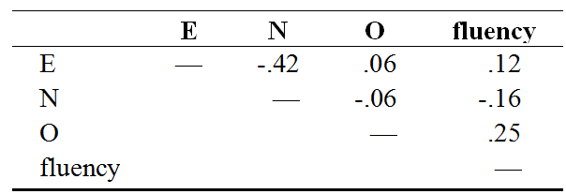
E
0
N
0
fluency
0
0
O

Slide 2
E
0
N
0
fluency
0
0
O

Slide 3



E
0
N
0
0
0
O

Slide 4

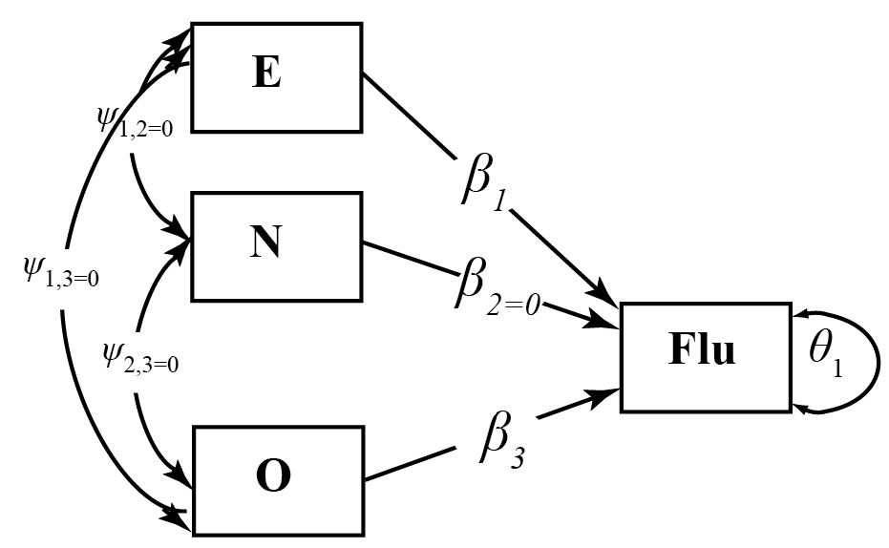
E
0
N
0
0
0
O

Slide 5
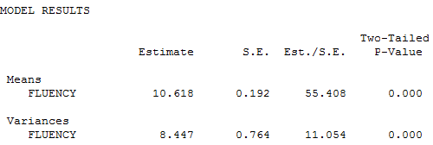
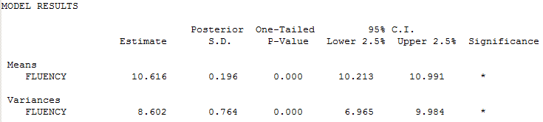
(Robust) Maximum Likelihood
Bayes

Slide 6
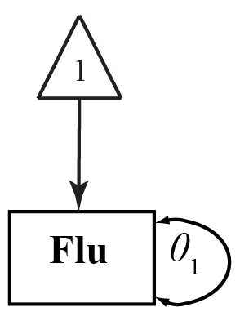

Slide 7


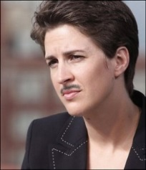
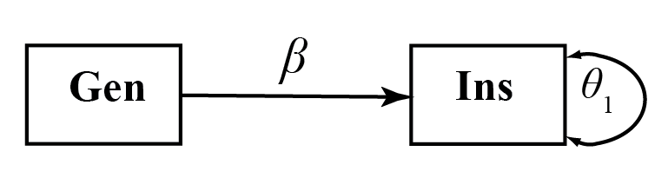

Slide 8
(Robust) Maximum Likelihood
Bayes
MODEL RESULTS
Two-Tailed
Estimate S.E. Est./S.E. P-Value
INSIGHT ON
GENDER 0.994 0.268 3.708 0.000
Intercepts
INSIGHT 2.665 0.373 7.153 0.000
Residual Variances
INSIGHT 3.539 0.264 13.403 0.000
MODEL RESULTS
Posterior One-Tailed 95% C.I.
Estimate S.D. P-Value Lower 2.5% Upper 2.5% Significance
INSIGHT ON
GENDER 0.992 0.253 0.000 0.407 1.376 *
Intercepts
INSIGHT 2.654 0.372 0.000 2.040 3.379 *
Residual Variances
INSIGHT 3.613 0.343 0.000 2.980 4.285 *
STANDARDIZED MODEL RESULTS
STDYX Standardization
Posterior One-Tailed 95% C.I.
Estimate S.D. P-Value Lower 2.5% Upper 2.5% Significance
INSIGHT ON
GENDER 0.234 0.059 0.000 0.094 0.333 *
STDYX Standardization
Two-Tailed
Estimate S.E. Est./S.E. P-Value
INSIGHT ON
GENDER 0.238 0.063 3.787 0.000

Slide 9
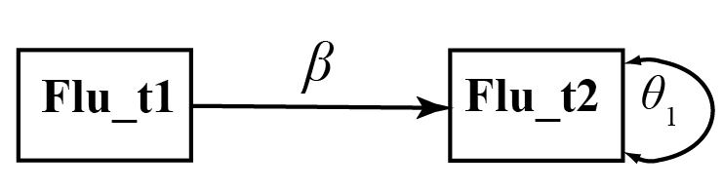

Slide 10
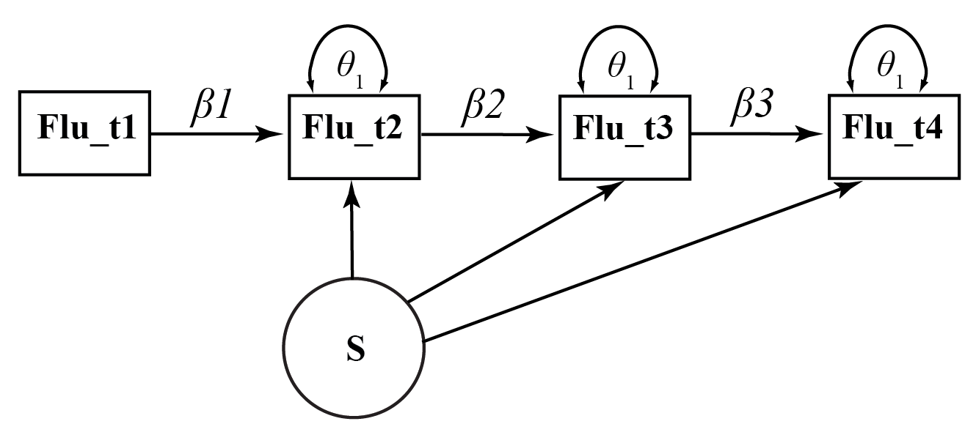
+
+
+

Slide 11
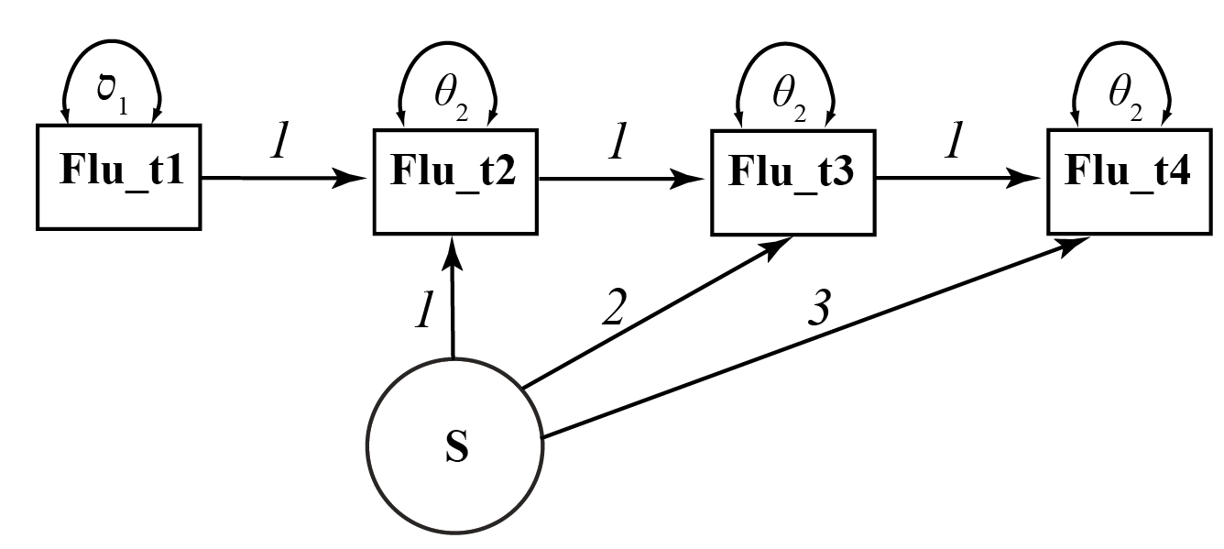
i+s
i+2s
i+3s

Slide 12
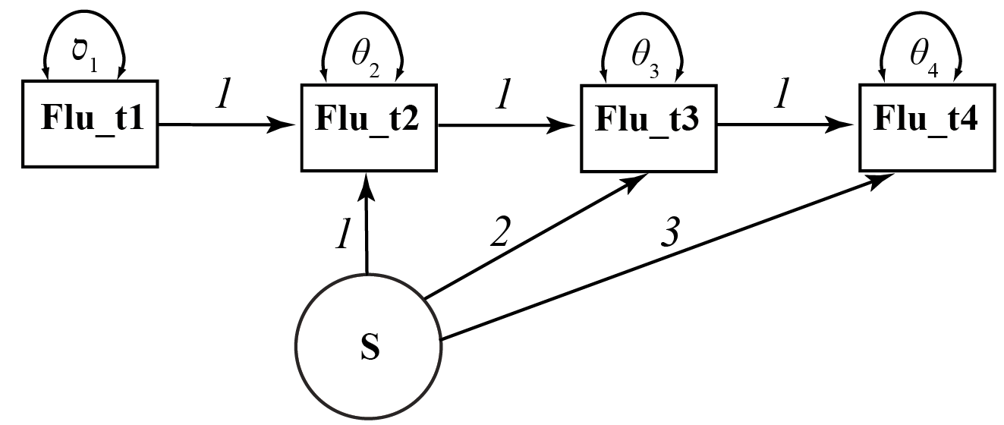

Slide 13
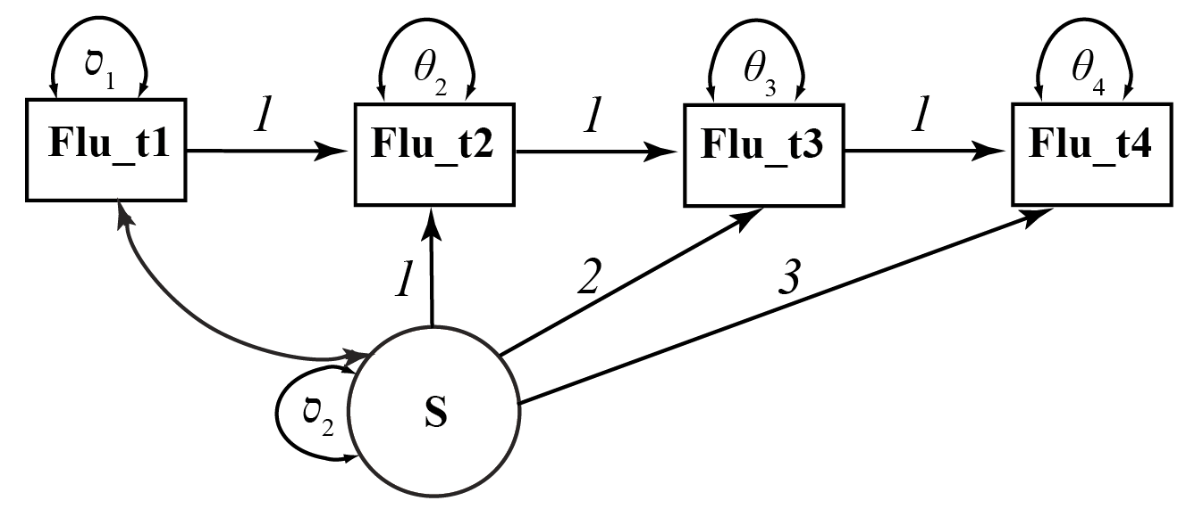

Slide 14





