Slide 1
Annotation and enrichment analysis
Genes and genomic regions
Mikhail Dozmorov
Department of Biostatistics, VCU
mdozmorov@vcu.edu

Slide 2
Overview
Why annotation/enrichment?
Gene ontology
Enrichment analysis
GENE ontology enrichment analysis
GENOMIC REGIONS enrichment analysis
Converting gene IDs
Enrichment analysis of everything in the genome

Slide 3
Why annotation/enrichment?
Understanding the biology behind gene expression and genomic differences
Summarizing changes of hundreds/thousands of differentially expressed genes/differential genomic regions into a few biological processes

Slide 4
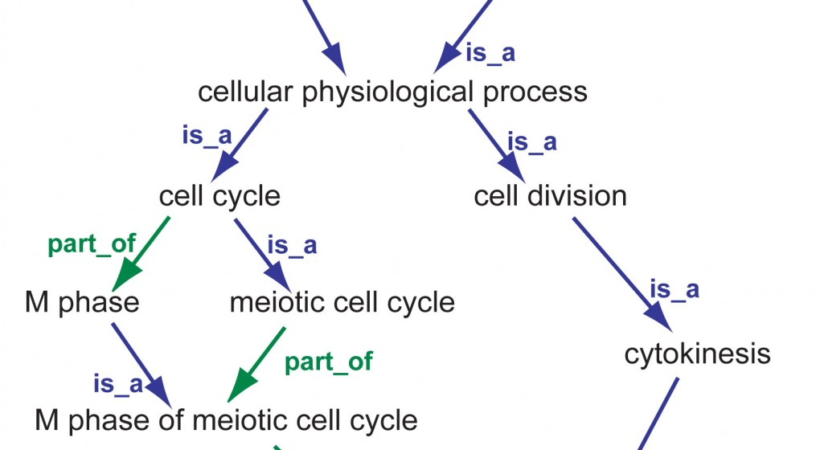
Gene ontology
An ontology is a formal (hierarchical) representation of concepts and the relationships between them.

Slide 5
Gene ontology
Gene ontology – controlled vocabulary of gene and gene product attributes
Represented as a Directed Acyclic Graph
Three domains (graphs):
cellular component, where a gene or gene product is located;
molecular function, what is a gene’s molecular role within a cell;
biological process, what is a gene function on operating of a living unit (cell, tissue, organ …).

Slide 6
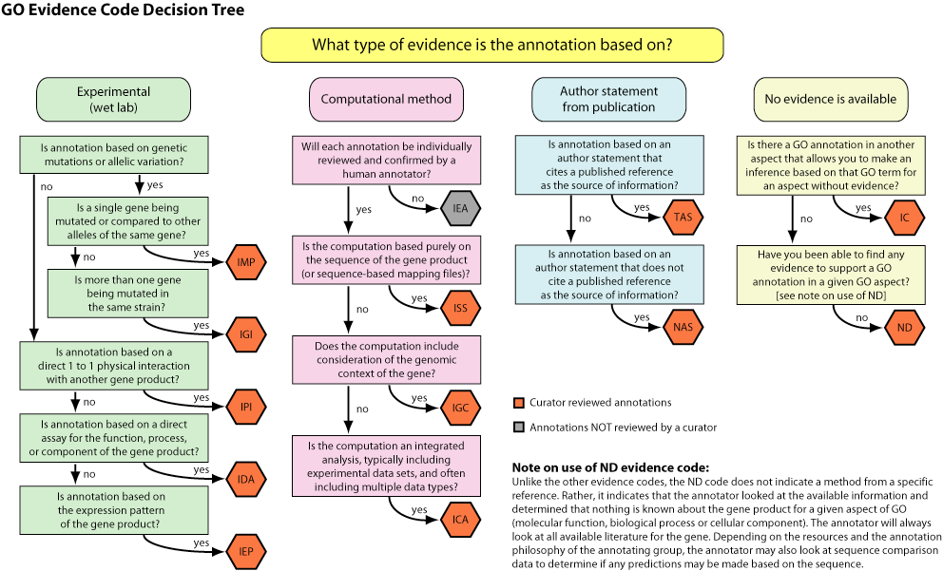
Gene Ontologies are not created equal
http://geneontology.org/page/evidence-code-decision-tree

Slide 7
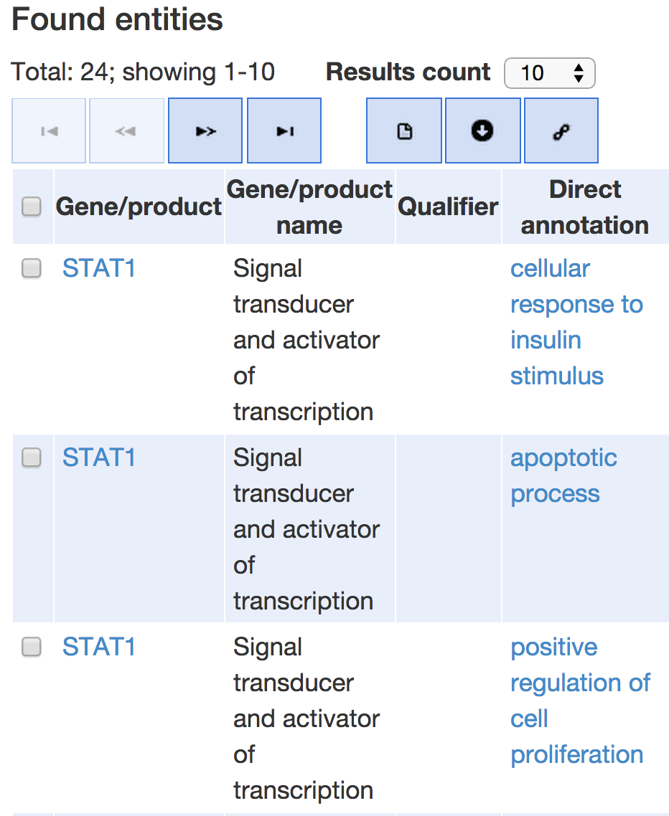
Genes and their ontologies
Each gene has multiple ontologies
In three domains (CC, BP, and MF)
With different evidence codes

Slide 8
Enrichment analysis of genes
Hypothesis: A process/function is more likely to be affected if multiple genes within it are changed.
Example:
Out of 12,350 genes, 185 are involved in “Angiogenesis”.
In our experiment, out of 200 differentially expressed genes 35 are annotated with “Angiogenesis” function
How significant is it?

Slide 9
Enrichment analysis of genes
Sampling without replacement from a finite population
Each element in a population is classified into two mutually exclusive categories
Genes
Population – all genes
Two categories – genes annotated, or not annotated, with a process
Sampling – identification of differentially expressed genes

Slide 10
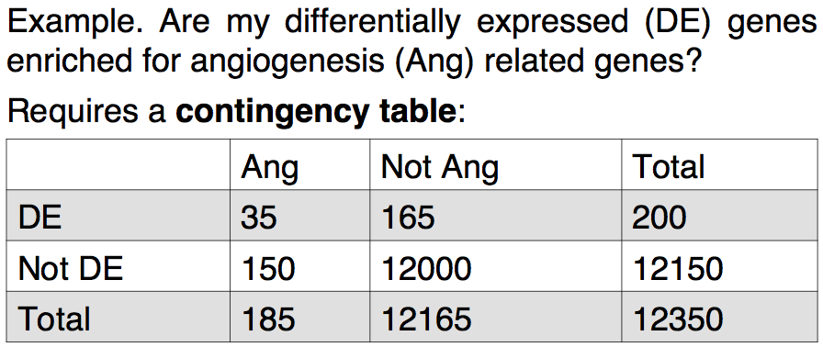
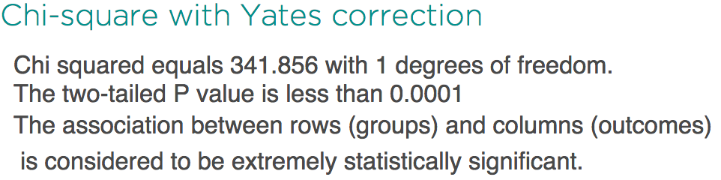
Enrichment analysis of genes
Fisher's Exact test, using hypergeometric distribution
http://graphpad.com/quickcalcs/contingency1/

Slide 11
Enrichment analysis of genomic regions
Genes cover only ~2% of the human genome
Many regulatory regions, such as differentially methylated regions, are located outside of genes
How to understand their biological role(s)?

Slide 12
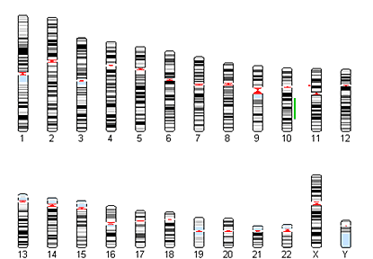
Orienting within genome: Genomic coordinates
Gene/exon boundaries
SNPs
TFBS
Methylation marks
DNAse hypersensitive regions
CpG islands
Each genomic features has coordinates:
Chromosome
Start
End

Slide 13
Enrichment analysis of genomic regions
Common approach
Map genomic regions to the nearby genes
Do enrichment analysis on the genes
Better approach
Map genomic regions to regulatory regions
Do enrichment analysis on the regulatory regions

Slide 14
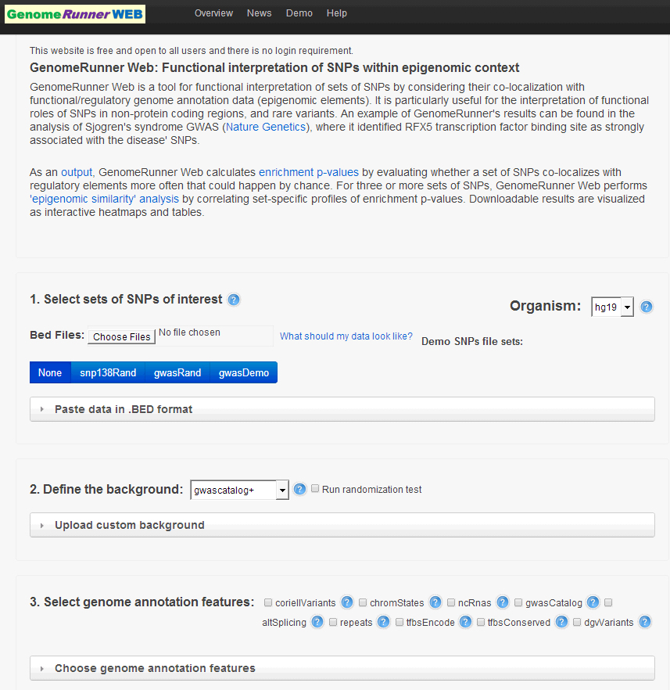
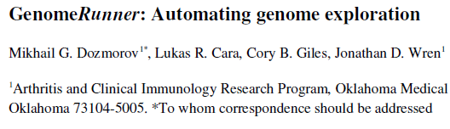
Enrichment analysis of everything in the genome
GenomeRunner – finds statistically significant associations within the genome and regulatory data
http://www.genomerunner.org

Slide 15
Enrichment analysis finds statistically significant genomic-regulatory associations
Selected SNPs
DNA
Regulatory elements
All SNPs
6 out of 7 disease-associated SNPs overlap with regulatory elements
How likely this to be observed by chance? (Fisher’s exact test)
Notes:
Figure idea from https://www.sciencedirect.com/science/article/pii/S095279151200101X

Slide 16
Shortcuts
DAVID (http://david.abcc.ncifcrf.gov/) Enrichment analysis of genes
GSEA (https://www.broadinstitute.org/gsea/index.jsp) Better way of doing enrichment analysis
PeakAnnotator (http://www.bioinformatics.org/peakanalyzer/wiki/Main/Download) Annotate peaks with nearby genes
bioDBnet (http://biodbnet.abcc.ncifcrf.gov/db/db2db.php#biodb) gene ID conversion
GenomeRunner (http://genomerunner.org/) regulatory enrichment analysis

