Slide 1

Global Impact Detection from Emitted Light, Onset of COVID, and NO2
Snapshot
GIDEON is an integrated public policy information portal that aims to measure the impact of COVID on various countries and its effect in economic and environmental terms. The countries that are able to contain COVID while keeping their economy afloat with minimal impact to the environment stand the best chance of sustainably bouncing back after this crisis.
Philippines
Risk: High
GDP: -5%
Covid Growth: +20%
Pollution: Low
Philippines
Risk: High
GDP: -5%
Covid Growth: +20%
Pollution: Low
Philippines
Risk: High
GDP: -5%
Covid Growth: +20%
Pollution: Low
COVID Situation
Economy
Environment
Meet the Team
Philippines
Risk: High
GDP: -5%
Covid Growth: +20%
Pollution: Low
Philippines
Risk: High
GDP: -5%
Covid Growth: +20%
Pollution: Low
Team GIDEON

Slide 2
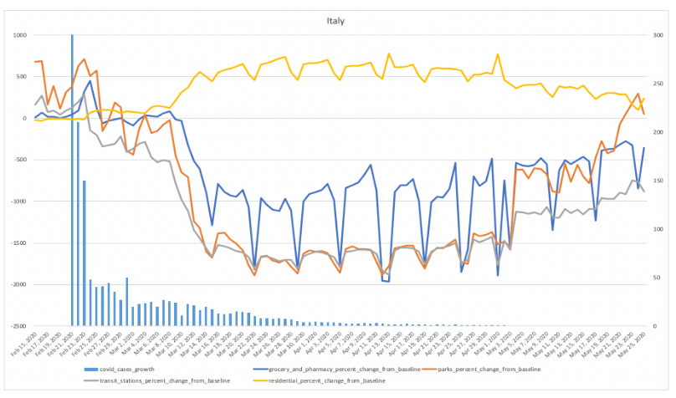
Global Impact Detection from Emitted Light, Onset of COVID, and NO2
Snapshot
COVID Situation
COVID Situation
Select Country
Headline The yellow lines indicate the onset of lockdown in Italy and the bars show the actual number of covid growth cases in the country at the time the mobility data was captured.
Economy
The yellow lines indicate the onset of lockdown in Italy and the bars show the actual number of covid growth cases in the country at the time the mobility data was captured. The slightly increasing activity at the parks indicate that lives are slowly going back to normal for Italians by May 2020 compared to its low during March and April.
Environment
Headline The yellow lines indicate the onset of lockdown in Italy and the bars show the actual number of covid growth cases in the country at the time the mobility data was captured.
Meet the Team
Headline The yellow lines indicate the onset of lockdown in Italy and the bars show the actual number of covid growth cases in the country at the time the mobility data was captured.
Team GIDEON

Slide 3
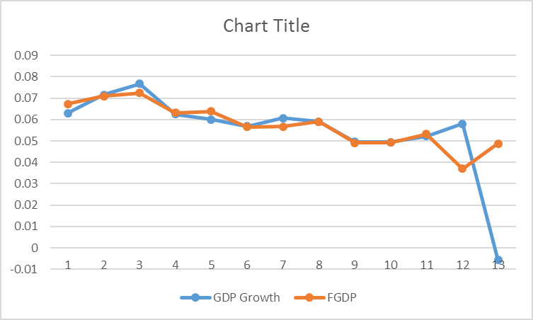
Global Impact Detection from Emitted Light, Onset of COVID, and NO2
Snapshot
Economic Forecast
COVID Situation
Select Country
Economy
The yellow lines indicate the onset of lockdown in Italy and the bars show the actual number of covid growth cases in the country at the time the mobility data was captured. The slightly increasing activity at the parks indicate that lives are slowly going back to normal for Italians by May 2020 compared to its low during March and April.
Environment
Meet the Team
Team GIDEON

Slide 4
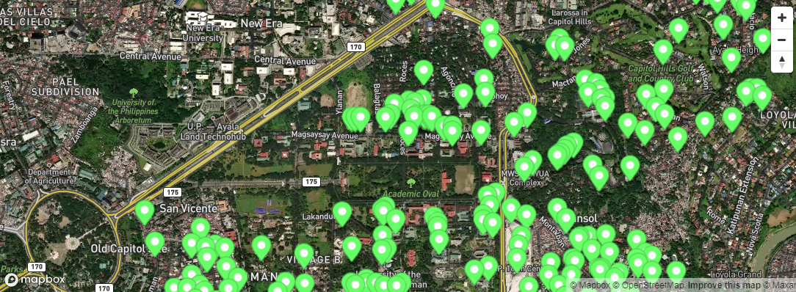
Global Impact Detection from Emitted Light, Onset of COVID, and NO2
Snapshot
Environment Assessment
COVID Situation
Select Country
Economy
The yellow lines indicate the onset of lockdown in Italy and the bars show the actual number of covid growth cases in the country at the time the mobility data was captured. The slightly increasing activity at the parks indicate that lives are slowly going back to normal for Italians by May 2020 compared to its low during March and April.
Environment
Meet the Team
Team GIDEON

Slide 5





Global Impact Detection from Emitted Light, Onset of COVID, and NO2
Snapshot
Meet The Team
COVID Situation
The yellow lines indicate the onset of lockdown in Italy and the bars show the actual number of covid growth cases in the country at the time the mobility data was captured. The slightly increasing activity at the parks indicate that lives are slowly going back to normal for Italians by May 2020 compared to its low during March and April.
Economy
Environment
Meet the Team
Team GIDEON

