Slide 1

Global Impact Detection from Emitted Light, Onset of COVID, and NO2
Using a combination of Earth Observation data (VIIRS and Sentinel-5p) to predict GDP growth and air pollution levels, Google mobility data, and COVID infection data from Johns Hopkins University, GIDEON ranks 5 observed countries on a risk-based scale on their ability to recover economic activity while managing COVID infections and air pollution.
Low Risk – Singapore and Japan
Moderate – Philippines
Moderate-High – Sweden
High - Italy
GIDEON is an integrated public policy information portal that aims to measure the impact of COVID on various countries and its effect in economic, health and environmental terms. The countries that are able to contain COVID while keeping their economy afloat with minimal impact to the environment stand the best chance of sustainably bouncing back after this crisis.
Snapshot
Italy
Risk: High
GDP Change: +12.37%
Covid Growth: +212%
Pollution: Low
Lockdown Index: 26
Philippines
Risk: Moderate
GDP Change: +5%
Covid Growth: +171%
Pollution: Low
Lockdown Index : 33
Singapore
Risk: Low
GDP: +2.17%
Covid Growth: +400%
Pollution: Moderate
Lockdown Index: 41
COVID Situation
Economy
Environment
Meet the Team
Japan
Risk: Low
GDP Change: -0.51%
Covid Growth: +248%
Pollution: Low
Lockdown Index: 13
Sweden
Risk: Moderate-High
GDP Change: +0.33%
Covid Growth: +223%
Pollution: Low
Lockdown Index: 9
Team GIDEON – Visit us at https://opendata.org.ph/projectgideon/

Slide 2
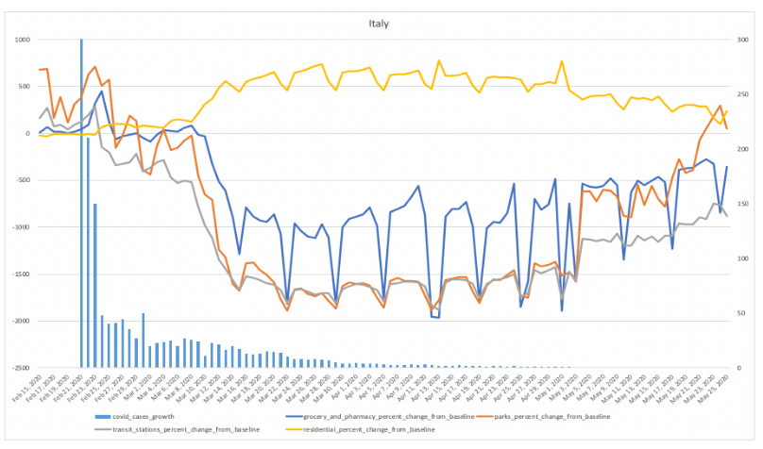
Global Impact Detection from Emitted Light, Onset of COVID, and NO2
GIDEON also crawls COVID pandemic news on each country with a set of headlines and URL links listed on the dashboard.
GIDEON also provides a snapshot of a country situation on the mobility of its inhabitants in relation to the infection growth rates. Google Mobility data shows Singapore with the highest lockdown index and therefore lowest mobility. Meanwhile, Sweden, which did not impose a lockdown, has the highest mobility.
Snapshot
COVID Situation
COVID Situation
Select Country
Residential Mobility Plateau The yellow line indicates that the lockdown protocol has reached its plateau and cases have gone down after it.
Economy
The yellow lines indicate the pattern of residential mobility before and after the onset of lockdown in Italy. The slightly increasing activity at the parks indicate that lives are slowly going back to normal for Italians by May 2020 compared to its low during March and April.
Environment
Covid-19 Cases Stabilizing The pandemic has eased a bit on its attack on Italy and the growth rate has decreased compared to the earlier months of March and April.
Meet the Team
Grocery Activity Remains Lowered Groceries and pharmacies remain at a lower range compared to baseline data from before Covid-19.
Team GIDEON – Visit us at https://opendata.org.ph/projectgideon/

Slide 3
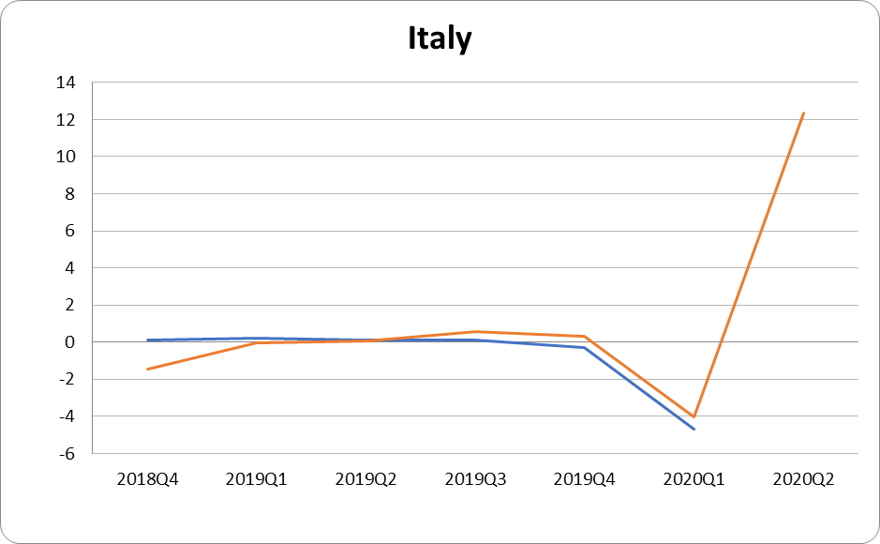
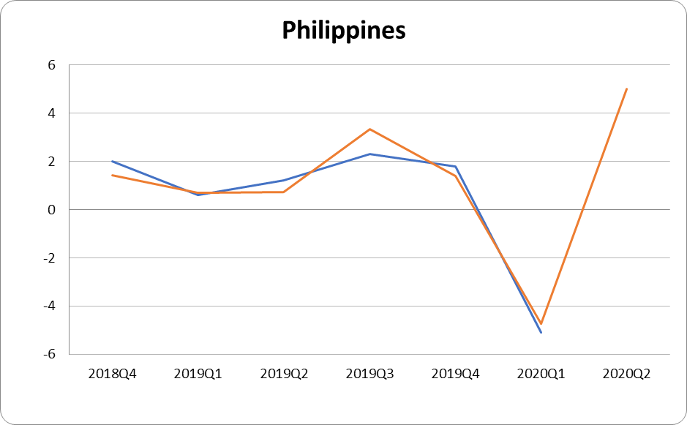
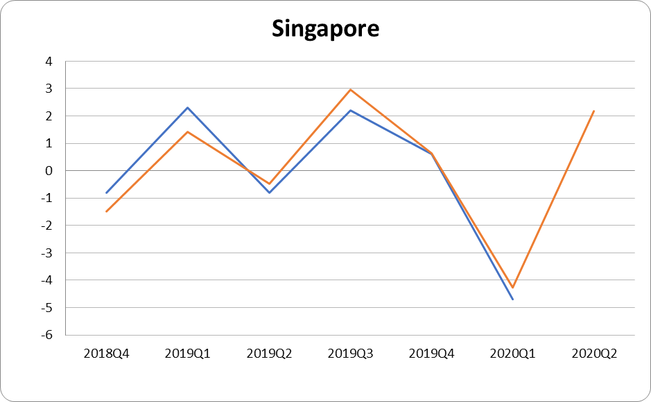
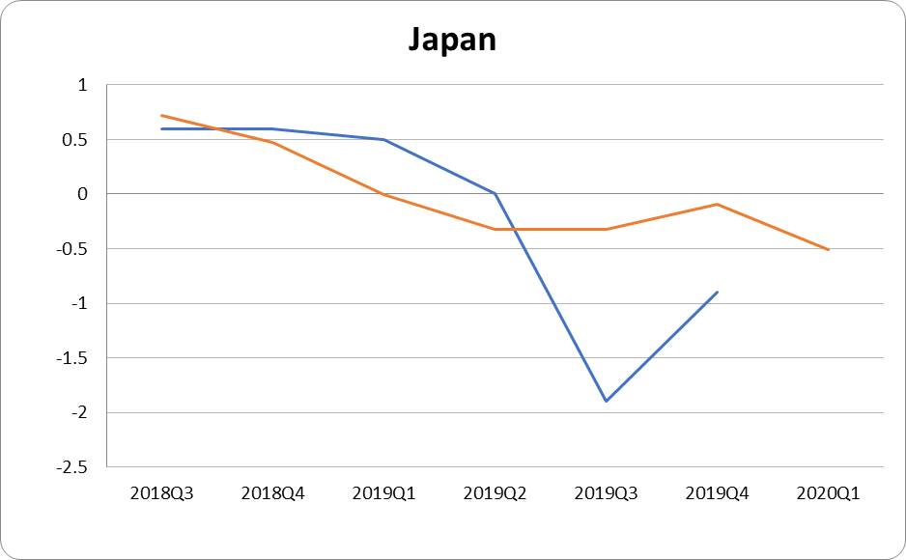
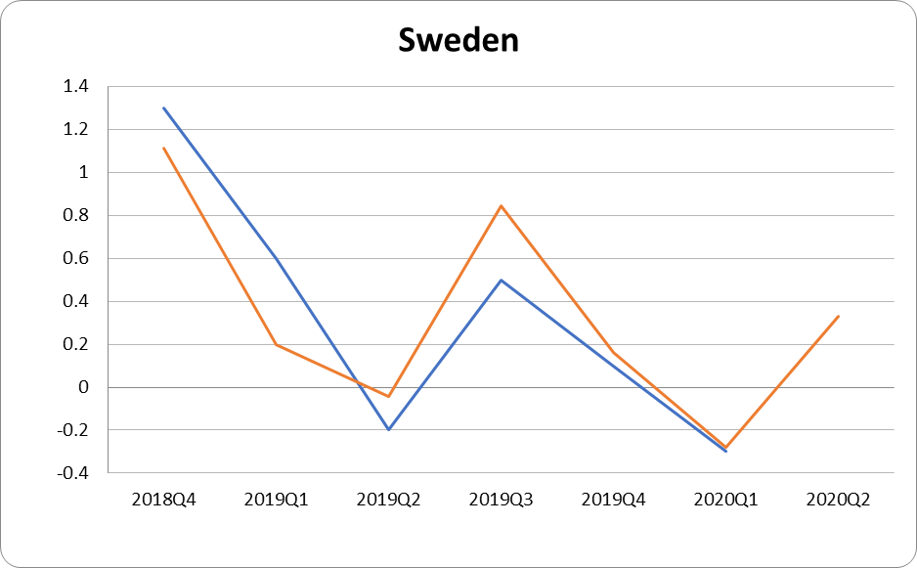
Global Impact Detection from Emitted Light, Onset of COVID, and NO2
The key feature of GIDEON is a nowcast of GDP growth. It models GDP growth on change in night lights and Nitrogen Dioxide levels.* This provides a leading indicator of activity ahead of the usual quarterly announcements. GIDEON enables its primary audience – government policymakers – to quickly respond and calibrate strategies to safely navigate through the pandemic.
*Nightlights data – VIIRS; NO2 – Sentinel-5p
Snapshot
Economic Forecast
COVID Situation
The forecasted GDP is relatively close to the actual GDP growth of the country. An R^2 value of XX has been observed in the modeling of the data.
A projected increase in GDP is expected.
Economy
Environment
Meet the Team
Current
Predicted GDP
Team GIDEON – Visit us at https://opendata.org.ph/projectgideon/

Slide 4
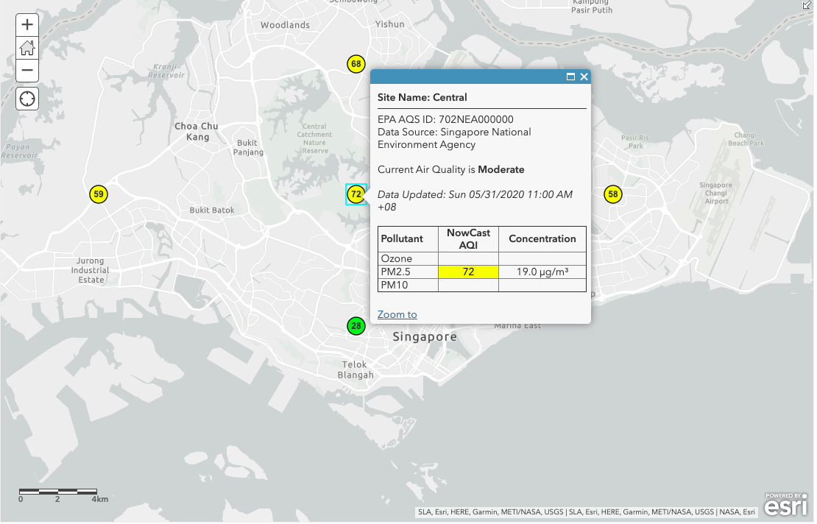
Global Impact Detection from Emitted Light, Onset of COVID, and NO2
GIDEON leverages ArcGIS API to provide an interactive global map of pollution. It also provides a time series of Sentinel-5p NO2 level in the target countries.
Countries under strict lockdown such as the Philippines show low levels of NO2 during the pandemic. Meanwhile, Singapore shows spikes in NO2 levels.
Snapshot
Environment Assessment
COVID Situation
Select Country
Economy
Air quality in Singapore from all its air quality monitoring stations indicate Good to Moderate pollution levels at this time. The map updates from the globally stationed air monitoring sites every 48 hours and can be studied more closely to understand environmental contribution to the impact assessment of covid-19.
Environment
Meet the Team
Team GIDEON – Visit us at https://opendata.org.ph/projectgideon/

Slide 5





Global Impact Detection from Emitted Light, Onset of COVID, and NO2
Snapshot
Team Gideon
COVID Situation
Team GIDEON is comprised of the following members (clockwise from top left) : Nick Tobia, Kristel Zapata, Theresa Tan, Miguel Oscar Castelo and Helen Mary Labao-Barrameda.
They are colleagues and data consultants from a private research firm based in Metro Manila, Philippines.
The team name is inspired by Gideon, a warrior and prophet, who led a small army and triumphed in the face of tremendous odds. Team Gideon aims to enable policymakers, especially those from countries with the longest odds, with the integrative knowledge to understand and overcome the pandemic.
Economy
Environment
Meet the Team
Team GIDEON – Beat the odds with data. - https://opendata.org.ph/projectgideon/

