Slide 1

Global Impact Detection from Emitted Light, Onset of COVID, and NO2
Snapshot
Italy
Risk: High
GDP Change: +12.37%
Covid Growth: +212%
Pollution: Low
Lockdown Index: 26
Philippines
Risk: Moderate
GDP Change: +5%
Covid Growth: +171%
Pollution: Low
Lockdown Index : 33
Singapore
Risk: Low
GDP: +2.17%
Covid Growth: +400%
Pollution: Moderate
Lockdown Index: 41
COVID Situation
Economy
Environment
Meet the Team
Japan
Risk: Low-Moderate
GDP Change: -0.51%
Covid Growth: +248%
Pollution: Low
Lockdown Index: 13
Sweden
Risk: Moderate-High
GDP Change: +0.33%
Covid Growth: +223%
Pollution: Low
Lockdown Index: 9
GIDEON is an integrated public policy information portal that aims to measure the impact of COVID on various countries and its effect in economic and environmental terms. The countries that are able to contain COVID while keeping their economy afloat with minimal impact to the environment stand the best chance of sustainably bouncing back after this crisis.
Team GIDEON – Visit us at projectgideon.co

Slide 2
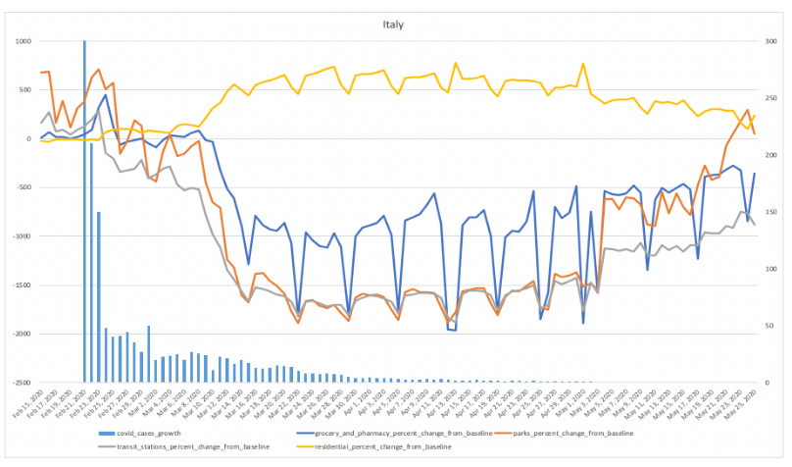
Global Impact Detection from Emitted Light, Onset of COVID, and NO2
Snapshot
COVID Situation
COVID Situation
Select Country
Residential Mobility Plateau The yellow line indicates that the lockdown protocol has reached its plateau and cases have gone down after it.
Economy
The yellow lines indicate the onset of lockdown in Italy and the bars show the actual number of covid-19 growth cases in the country at the time the mobility data was captured. The slightly increasing activity at the parks indicate that lives are slowly going back to normal for Italians by May 2020 compared to its low during March and April.
Environment
Covid-19 Cases Stabilizing The pandemic has eased a bit on its attack on Italy and the growth rate has decreased compared to the earlier months of March and April.
Meet the Team
Grocery Activity Remains Lowered Groceries and pharmacies remain at a lower range compared to baseline data from before Covid-19.
Team GIDEON – Visit us at projectgideon.co

Slide 3
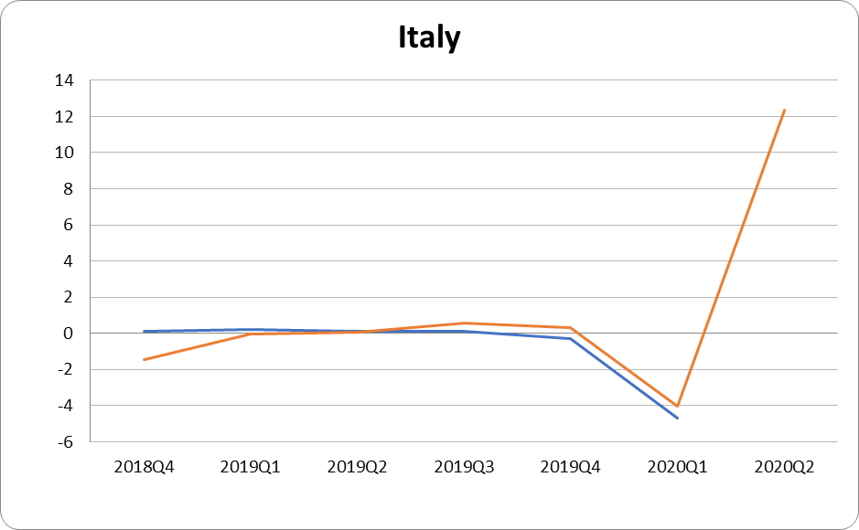
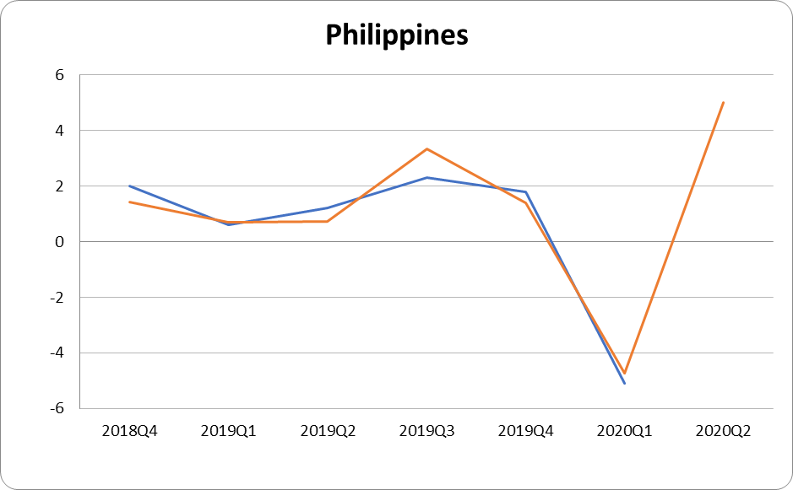
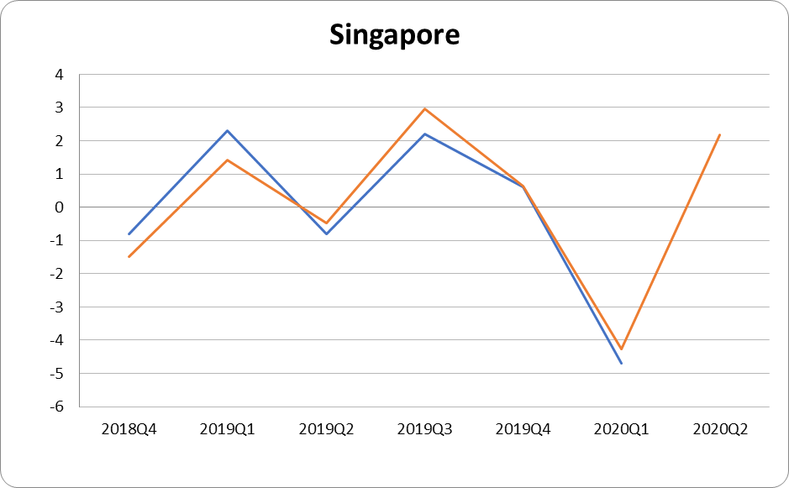
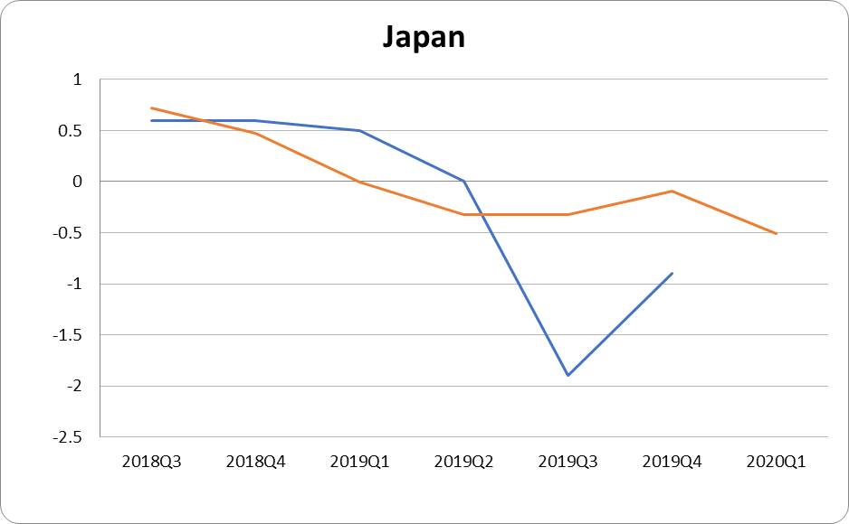
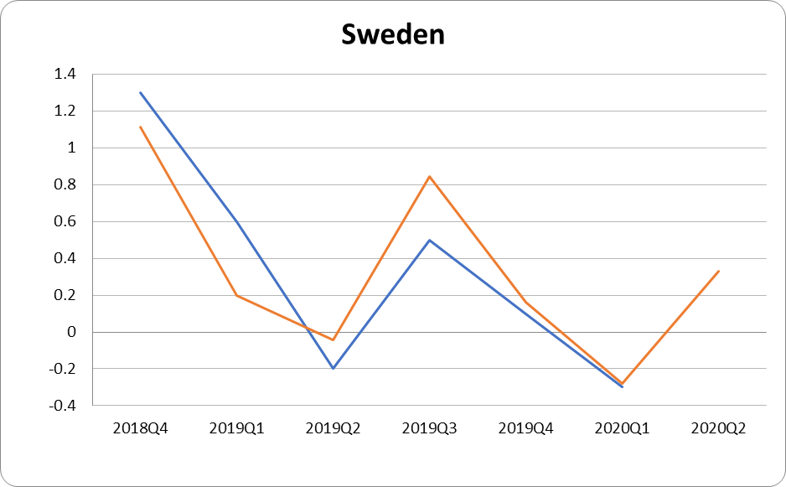
Global Impact Detection from Emitted Light, Onset of COVID, and NO2
Snapshot
Economic Forecast
COVID Situation
The forecasted GDP is relatively close to the actual GDP growth of the country. An R^2 value of XX has been observed in the modeling of the data.
A projected increase in GDP is expected.
Economy
Environment
Meet the Team
Current
Predicted GDP
Team GIDEON – Visit us at projectgideon.co

Slide 4
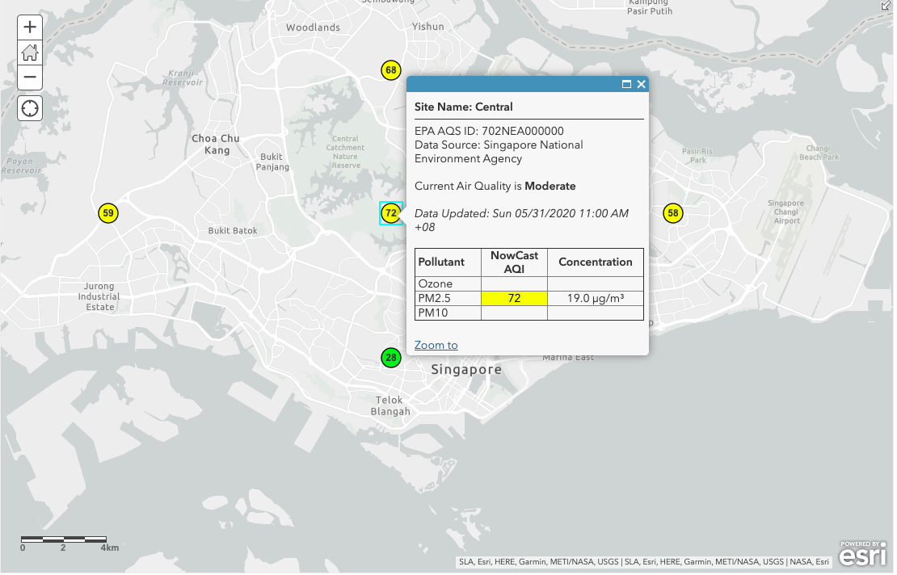
Global Impact Detection from Emitted Light, Onset of COVID, and NO2
Snapshot
Environment Assessment
COVID Situation
Select Country
Economy
Air quality in Singapore from all its air quality monitoring stations indicate Good to Moderate pollution levels at this time. The map updates from the globally stationed air monitoring sites every 48 hours and can be studied more closely to understand environmental contribution to the impact assessment of covid-19.
Environment
Meet the Team
Team GIDEON – Visit us at projectgideon.co

Slide 5





Global Impact Detection from Emitted Light, Onset of COVID, and NO2
Snapshot
Team Gideon
COVID Situation
Team GIDEON is comprised of the following members (clockwise from top left) : Nick Tobia, Kristel Zapata, Theresa Tan, Miguel Oscar Castelo and Helen Mary Labao-Barrameda.
They are colleagues and data consultants from a private research firm based in Metro Manila, Philippines.
Apart from the acronym, the team name is inspired by the story of Gideon in the book of Judges in the Bible which beat the odds in warfare against Midianites with 3 symbolic items: trumpet (noise of human activity), clay jar (the isolation caused by Covid-19), and the torch (night light NASA data).
Economy
Environment
Meet the Team
Team GIDEON – Beat the odds with data. - https://projectgideon.co/

