Slide 1
GIDEON – Global Impact Detection from Emitted Light, Onset of COVID, and NO2
Snapshot
Philippines
Risk: High
GDP: -5%
Covid Growth: +20%
Pollution: Low
Philippines
Risk: High
GDP: -5%
Covid Growth: +20%
Pollution: Low
Philippines
Risk: High
GDP: -5%
Covid Growth: +20%
Pollution: Low
Mobility
Economy
Environment
Meet the Team
Philippines
Risk: High
GDP: -5%
Covid Growth: +20%
Pollution: Low
Philippines
Risk: High
GDP: -5%
Covid Growth: +20%
Pollution: Low
Team GIDEON

Slide 2
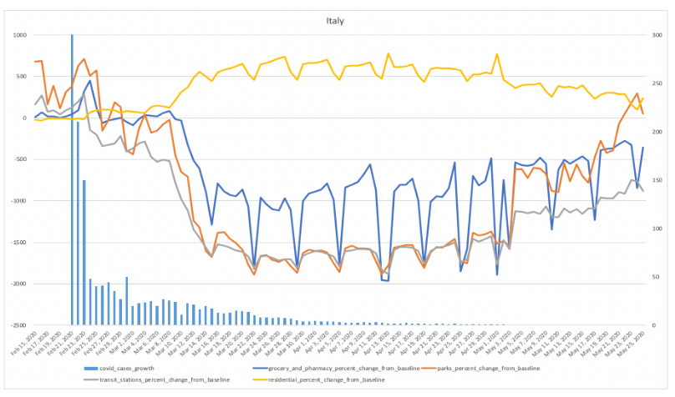
GIDEON – Global Impact Detection from Emitted Light, Onset of COVID, and NO2
Snapshot
COVID Cases and Mobility
Mobility
Select Country
Economy
The yellow lines indicate the onset of lockdown in Italy and the bars show the actual number of covid growth cases in the country at the time the mobility data was captured. The slightly increasing activity at the parks indicate that lives are slowly going back to normal for Italians by May 2020 compared to its low during March and April.
Environment
Meet the Team
Team GIDEON

Slide 3
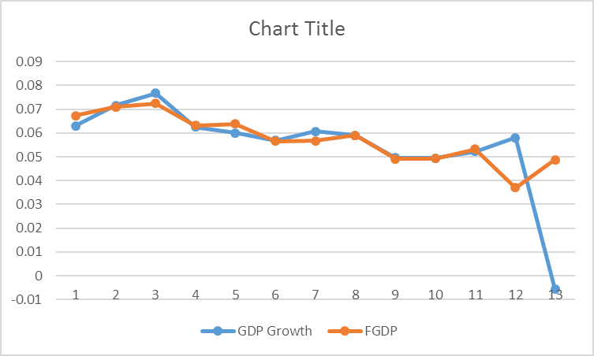
GIDEON – Global Impact Detection from Emitted Light, Onset of COVID, and NO2
Snapshot
Economic Forecast
Mobility
Select Country
Economy
The yellow lines indicate the onset of lockdown in Italy and the bars show the actual number of covid growth cases in the country at the time the mobility data was captured. The slightly increasing activity at the parks indicate that lives are slowly going back to normal for Italians by May 2020 compared to its low during March and April.
Environment
Meet the Team
Team GIDEON

Slide 4
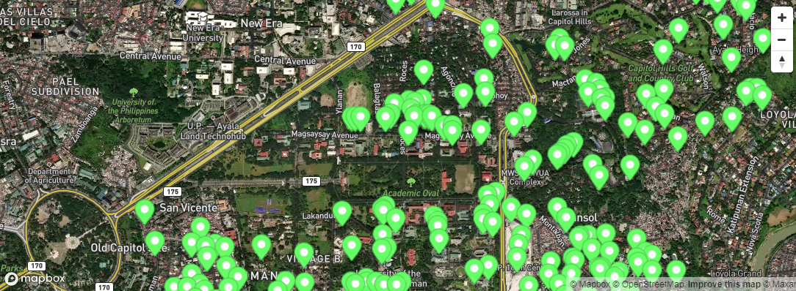
GIDEON – Global Impact Detection from Emitted Light, Onset of COVID, and NO2
Snapshot
Environment Assessment
Mobility
Select Country
Economy
The yellow lines indicate the onset of lockdown in Italy and the bars show the actual number of covid growth cases in the country at the time the mobility data was captured. The slightly increasing activity at the parks indicate that lives are slowly going back to normal for Italians by May 2020 compared to its low during March and April.
Environment
Meet the Team
Team GIDEON

Slide 5





GIDEON – Global Impact Detection from Emitted Light, Onset of COVID, and NO2
Snapshot
Meet The Team
Mobility
The yellow lines indicate the onset of lockdown in Italy and the bars show the actual number of covid growth cases in the country at the time the mobility data was captured. The slightly increasing activity at the parks indicate that lives are slowly going back to normal for Italians by May 2020 compared to its low during March and April.
Economy
Environment
Meet the Team
Team GIDEON

