Slide 1
Consumption Basics
MICROECONOMICS
Principles and Analysis
Frank Cowell

Slide 2
Overview
Consumption: Basics
The setting
The environment for the basic consumer optimisation problem
Budget sets
Revealed Preference
Axiomatic Approach

Slide 3
A method of analysis
Some treatments of micro-economics handle consumer analysis first
But we have gone through the theory of the firm first for a good reason:
We can learn a lot from the theory of firm:
ideas
methodology
techniques
We can reuse a lot the analysis

Slide 4
Reusing results from the firm
What could we learn from the way we analysed the firm?
How to set up the description of the environment
How to model optimisation problems
How solutions may be carried over from one problem to the other

Slide 5
Notation
Quantities
x_{i}
a “basket of goods
amount of commodity i
x = (x₁, x₂ , …, x_{n})
commodity vector
X
consumption set
x ∈ X denotes feasibility
Prices
p_{i}
price of commodity i
p = (p₁ , p₂ ,…, p_{n})
price vector
y
income

Slide 6
Things that shape the consumer's problem
The set X and the number y are both important
But they are associated with two distinct types of constraint
We'll save y for later and handle X now
(And we haven't said anything yet about objectives)

Slide 7
The consumption set
The set X describes the basic entities of the consumption problem
Not a description of the consumer’s opportunities
that comes later
Use it to make clear the type of choice problem we are dealing with; for example:
discrete versus continuous choice (refrigerators vs. contents of refrigerators)
is negative consumption ruled out?
“x ∈ X ” means “x belongs the set of logically feasible baskets”

Slide 8
The set X: standard assumptions
Axes indicate quantities of the two goods x₁ and x₂
x₂
Usually assume that X consists of the whole non-negative orthant
Zero consumptions make good economic sense
But negative consumptions ruled out by definition
no points here…
Consumption goods are (theoretically) divisible…
…and indefinitely extendable
But only in the ++ direction
x₁
…or here

Slide 9
Rules out this case…
x₂
Consumption set X consists of a countable number of points
Conventional assumption does not allow for indivisible objects
But suitably modified assumptions may be appropriate
x₁

Slide 10
… and this
x₂
Consumption set X has holes in it
x₁

Slide 11
… and this
x₂
Consumption set X has the restriction x₁ < x
ˉ
Conventional assumption does not allow for physical upper bounds
But there are several economic applications where this is relevant
x₁
ˉ
x

Slide 12
Overview
Consumption: Basics
The setting
The Setting
Budget constraints: prices, incomes and resources
Budget sets
Revealed Preference
Axiomatic Approach
Axiomatic Approach

Slide 13
The budget constraint
x₂
A typical budget constraint
Slope determined by price ratio
“Distance out” of budget line fixed by income or resources
Two important cases determined by
… amount of money income y
…vector of resources R
p₁
– __
p₂
x₁

Slide 14
Case 1: fixed nominal income
x₂
y . .__
p₂
Budget constraint determined by the two end-points
■
Examine the effect of changing p₁ by “swinging” the boundary thus:
Budget constraint is
n
Σ p_{i}x_{i} ≤ y
i=1
y . .__
p₁
■
x₁

Slide 15
Case 2: fixed resource endowment
Budget constraint determined by “resources” endowment R
x₂
Examine the effect of changing p₁ by “swinging” the boundary thus:
n
y = Σ p_{i}R_{i}
i=1
Budget constraint is
n n
Σ p_{i}x_{i} ≤ Σ p_{i}R_{i}
i=1 i=1
R
x₁
Notes:
This is an interesting approach. It comes back when we consider general equilibrium

Slide 16
Budget constraint: Key points
Slope of the budget constraint given by price ratio
There is more than one way of specifying “income”:
Determined exogenously as an amount y
Determined endogenously from resources
The exact specification can affect behaviour when prices change
Take care when income is endogenous
Value of income is determined by prices

Slide 17
Overview
Consumption: Basics
The setting
Deducing preference from market behaviour?
Budget sets
Revealed Preference
Axiomatic Approach
Axiomatic Approach

Slide 18
A basic problem
The Firm
In the case of the firm we have an observable constraint set
input requirement set
We can reasonably assume an obvious objective function
profits
The Consumer
For the consumer it is more difficult
We have an observable constraint set
budget set
But what objective function?

Slide 19
What is the consumer maximising? the Axiomatic Approach
We could “invent” an objective function
This is more reasonable than it may sound:
the standard approach
later in this presentation
But some argue that we should only use what we can observe:
test from market data?
“revealed preference” approach
deal with this now
Could we develop a coherent theory on this basis alone?

Slide 20
What is the consumer maximising? the Axiomatic Approach … Using observables only
Model the opportunities faced by a consumer
Introduce some minimal “consistency” axioms →Use them to derive testable predictions about consumer behaviour
Observe the choices made

Slide 21
“Revealed Preference”
x₂
Let market prices determine a person's budget constraint
Suppose the person chooses bundle x
x is revealed preferred to all these points
Use this to introduce Revealed Preference
For example x is revealed preferred to x′
x′
x
x₁

Slide 22
Axioms of Revealed Preference
Axiom of Rational Choice
Consumer always makes a choice and selects the most preferred bundle that is available
Essential if observations are to have meaning
Weak Axiom of Revealed Preference (WARP)
If x RP x' then x' not-RP x
If x was chosen when x' was available then x' can never be chosen whenever x is available
WARP is more powerful than might be thought

Slide 23
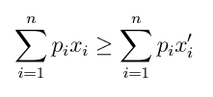
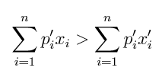
WARP in the market
Suppose that x is chosen when prices are p
If x' is also affordable at p then:
Now suppose x' is chosen at prices p'
This must mean that x is not affordable at p':
Otherwise it would violate WARP

Slide 24
WARP in action
x₂
Take the original equilibrium
Could we have chosen x° on Monday? x° violates WARP; x does not
Now let the prices change…
WARP rules out some points as possible solutions
Tuesday's prices
Tuesday's choice:
On Monday we could have afforded Tuesday’s bundle
x°
x′
Monday's prices
Clearly WARP induces a kind of negative substitution effect
But could we extend this idea…?
Monday's choice:
x
x₁

Slide 25
Trying to extend WARP
x₂
x″ is revealed preferred to all these points
Take the basic idea of revealed preference
Invoke revealed preference again
Invoke revealed preference yet again
Draw the “envelope”
x''
x' is revealed preferred to all these points
x'
x is revealed preferred to all these points
x
Is this an “indifference curve”…?
No. Why?
x₁

Slide 26
Limitations of WARP
WARP rules out this pattern
Is RP to
…but not this
x
x′
WARP does not rule out cycles of preference
You need an extra axiom to progress further on this:
the strong axiom of revealed preference
x″
x″′

Slide 27
Revealed Preference: is it useful?
You can get a lot from just a little:
You can even work out substitution effects
WARP provides a simple consistency test:
Useful when considering consumers en masse
WARP will be used in this way later on
You do not need any special assumptions about consumer's motives:
But that's what we're going to try right now
It’s time to look at the mainstream modelling of preferences

Slide 28
Overview
Consumption: Basics
The setting
The Setting
Standard approach to modelling preferences
Budget sets
Revealed Preference
Axiomatic Approach

Slide 29
The Axiomatic Approach
An a priori foundation for consumer preferences
provide a basis for utility analysis
axioms explain clearly what we mean
Careful! (1): axioms can’t be “right” or “wrong”
they could be inappropriate or over-restrictive
depends on what you want to model
Careful! (2): we blur some important distinctions
psychologists distinguish between…
decision utility – explains choices
experienced utility – “enjoyment”
Let’s start with the basic relation…

Slide 30
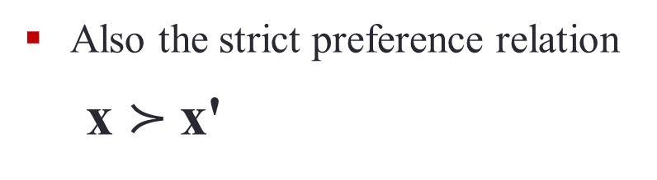
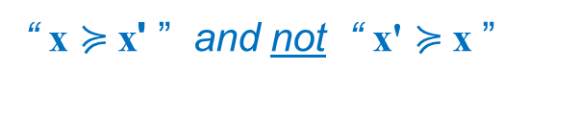
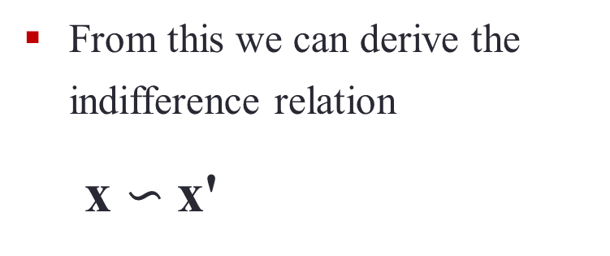

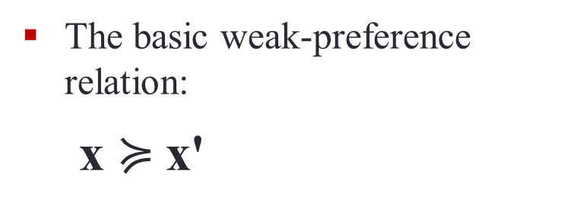
The (weak) preference relation
The basic weak-preference relation:
x $≽$x'
"Basket x is regarded as at least as good as basket x' "
From this we can derive the indifference relation
x $∽$x'
“ x $≽$x' ” and “ x' $≽$x ”
Also the strict preference relation
x $≻$x'
“ x $≽$x' ” and not “ x' $≽$x ”

Slide 31
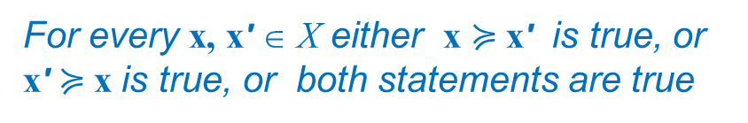
Fundamental preference axioms
Completeness
Transitivity
Continuity
Greed
(Strict) Quasi-concavity
Smoothness
For every x, x' ∈ X either x $≽$x' is true, or x' $≽$x is true, or both statements are true

Slide 32
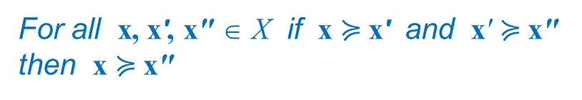
Fundamental preference axioms
Completeness
Transitivity
Continuity
Greed
(Strict) Quasi-concavity
Smoothness
For all x, x', x" ∈ X if x $≽$x' and x' $≽$x" then x $≽$x"

Slide 33
Fundamental preference axioms
Completeness
Transitivity
Continuity
Greed
(Strict) Quasi-concavity
Smoothness
For all x' ∈ X the not-better-than-x' set and the not-worse-than-x' set are closed in X

Slide 34
Continuity: an example
x₂
Take consumption bundle x°
Construct two other bundles, x^{L} with Less than x°, x^{M} with More
Better than x° ?
There is a set of points like x^{L} and a set like x^{M}
Draw a path joining x^{L} , x^{M}
x^{M}
If there’s no “jump”…
x°
The indifference curve
But what about the boundary points between the two?
Do we jump straight from a point marked “better” to one marked “worse"?
x^{L}
Worse than x°?
x₁

Slide 35
Utility function
Representation Theorem:
given completeness, transitivity, continuity
preference ordering ≽ can be represented by a continuous utility function
In other words there exists some function U such that
x ≽ x‘ implies U(x) ≥ U(x')
and vice versa
U is purely ordinal
defined up to a monotonic transformation
So we could, for example, replace U(•) by any of the following
log( U(•) )
√( U(•) )
φ( U(•) ) where φ is increasing
All these transformed functions have the same shaped contours

Slide 36
A utility function
υ
Take a slice at given utility level
Project down to get contours
U(x₁,x₂)
The indifference curve
x₂
0
x₁

Slide 37
Another utility function
υ
By construction U* = φ(U)
Again take a slice…
U*(x₁,x₂)
Project down …
The same indifference curve
x₂
0
x₁

Slide 38
Assumptions to give the U-function shape
Completeness
Transitivity
Continuity
Greed
(Strict) Quasi-concavity
Smoothness

Slide 39
The greed axiom
x₂
Pick any consumption bundle in X
increasing
preference
Greed implies that these bundles are preferred to x'
Increasing
preference
Gives a clear “North-East” direction of preference
Bliss!
B
What can happen if consumers are not greedy
Increasing
preference
increasing
preference
Greed: utility function is monotonic
increasing
preference
x'
x₁

Slide 40
A key mathematical concept
We’ve previously used the concept of concavity:
Shape of the production function
But here simple concavity is inappropriate:
The U-function is defined only up to a monotonic transformation
U may be concave and U² non-concave even though they represent the same preferences
So we use the concept of “quasi-concavity”:
“Quasi-concave” is equivalently known as “concave contoured”
A concave-contoured function has the same contours as a concave function (the above example)
Somewhat confusingly, when you draw the IC in (x₁, x₂)-space, common parlance describes these as “convex to the origin”

Slide 41
Conventionally shaped indifference curves
x₂
Slope well-defined everywhere
Pick two points on the same indifference curve
Draw the line joining them
A
Any interior point must line on a higher indifference curve
ICs are smooth…
and strictly concaved-contoured
I.e. strictly quasiconcave
C
increasing
preference
B
(-) Slope is the Marginal Rate of Substitution
U₁(x) .
—— .
U₂(x) .
x₁
sometimes assumptions can be relaxed

Slide 42
Other types of IC: Kinks
x₂
Strictly quasiconcave
But not everywhere smooth
A
C
MRS not defined here
B
x₁

Slide 43
Other types of IC: not strictly quasiconcave
x₂
Slope well-defined everywhere
Not quasiconcave
Quasiconcave but not strictly quasiconcave
utility here lower than at A or B
A
C
B
Indifference curves with flat sections make sense
But may be a little harder to work with…
Indifference curve follows axis here
x₁

Slide 44
Summary: why preferences can be a problem
Unlike firms there is no “obvious” objective function
Unlike firms there is no observable objective function
And who is to say what constitutes a “good” assumption about preferences…?

Slide 45
Review: basic concepts
Consumer’s environment
How budget sets work
WARP and its meaning
Axioms that give you a utility function
Axioms that determine its shape

Slide 46
What next?
Setting up consumer’s optimisation problem
Comparison with that of the firm
Solution concepts

