Slide 1
How R reads a script without loops
How R reads a script with a loop
Do the first thing
Do the first thing
Do another thing
Oh hey a loop!
Do another thing
nope
Do a different thing
etc
Are we done looping?
yep

Slide 2
Set x = 0
Oh hey a loop!
Is x > 1000?
yes
no
Add 179 to x
Go to top of the loop
Print x

Slide 3
Create words vector
Oh hey a loop!
Set this_word to the next word
ok
Count the letters in this_word
I can’t, that was the last one
Make an upper case word
Print a message to the console
Go back to the top of the loop
Stop

Slide 4
Oh hey an if statement!
Is the condition true?
yep
nope, skipping this part
Okay, do the thing
Continue with rest of script

Slide 5
Oh hey an if-else pair!
Is the condition true?
yes
no
Do this thing…
Do this other thing…
Continue with rest of script

Slide 6
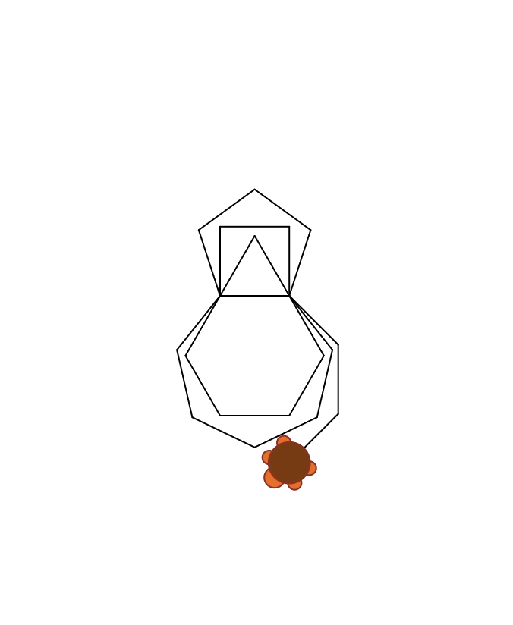
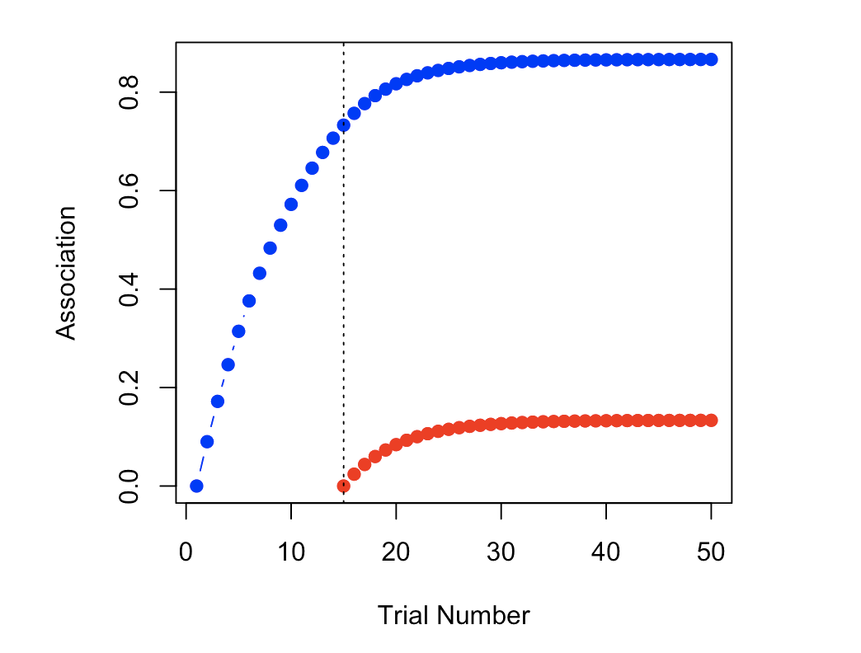
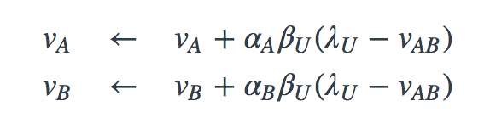
Fun with programming a turtle!
Fun with modelling animal learning?

