Slide 1
More on Communicating with R

Slide 2
Task 1: Go get something for you

Slide 3
RStudio – Working directory (Default Place)
Your working directory is the folder on your computer in which you are currently working. When you ask R to open a certain file, it will look in the working directory for this file, and when you tell R to save a data file or figure, it will save it in the working directory.

Slide 4
RStudio – Working directory
# Set your working directory to a folder called ec5023 on your desktop
setwd("C:/users/[your user name]/Desktop/ec5023/")
setwd("C:\\users\\[your user name]\\Desktop\\ec5023/")
# Check the wd is correct
getwd()
# List the folders in your directory
dir
# Create a new folder in your directory
dir.create()
Notice the forward slashes. You can also use double back slashes “\\”

Slide 5
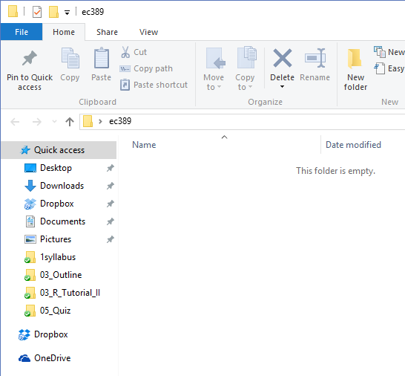
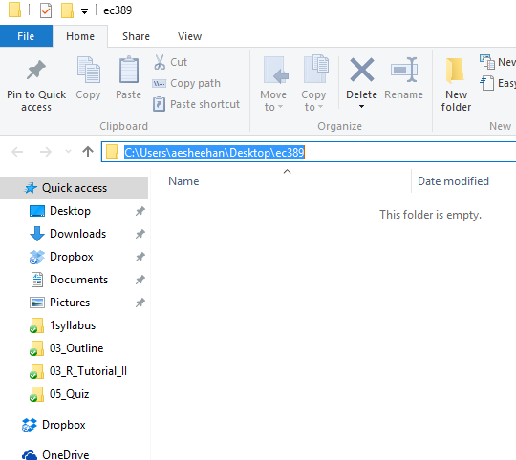
Quick trick to find file location...
Open the folder you created (double click on it)
Click here once and the file’s location will appear highlighted
use Ctrl+c to copy then past into your RStudio code

Slide 6
Let’s look at an example of how to organize your folders.
teaching_folder_organization_template.R (online)

Slide 7
Later we will introduce how to read various forms of data.

Slide 8
Task 2: Do something for you

Slide 9
Conduct Analysis for you.
Two things:
Packages or Libraries, Where you store your tools or weapons (Functions!)
Your tools -- Functions

Slide 10
What is function?
What is package or library?
How to get help?

Slide 11
Question: What exactly is a function??

Slide 12
Function:
incorporate sets of instructions that we want to use repeatedly or that, because of their complexity, are better self-contained in a sub program and called when needed.

Slide 13
RStudio - Functions
R and RStudio has many functions – these are things that you may do often and are automated into functions. So far, we have used
rnorm() – is a standard R function which creates random samples from a normal distribution.
mean() – to compute the mean of a vector
sum() – to sum the values of a vector
length() – to calculate the number of observations in a vector

Slide 14
R-Studio - Plots
# Again, use the dataset called “cars”
attach(cars)
# We also know how to create a histogram
hist(speed)
# Now, create a plot of the variable
plot(speed)

Slide 15
Question: What exactly is a package or library??

Slide 16
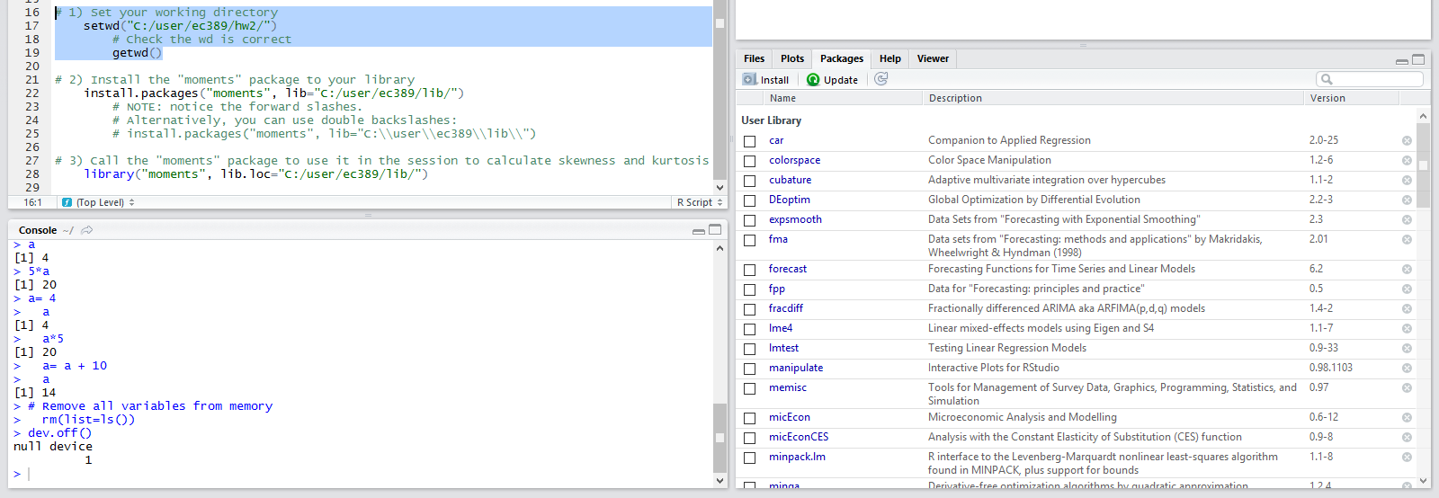
RStudio – Libraries
R can do many statistical and data analyses. They are organized in so-called packages or libraries. With the standard installation, most common packages are installed.

Slide 17
What does this mean?
Try the following example

Slide 18
RStudio – Libraries
# With the common packages we can find mean, median, mode etc. Try it!
# I use a dataset that comes with the base installation of R, called “cars”, and # put it in the memory.
attach(cars)
# Calculate the mean (average) of one of the variables called “speed”
mean(speed)
# Now try to calculate Skewness and Kurtosis (We will use these A LOT later!)
skewness(speed)

Slide 19
How can you find what package/library –skewness()- belong to?

Slide 20
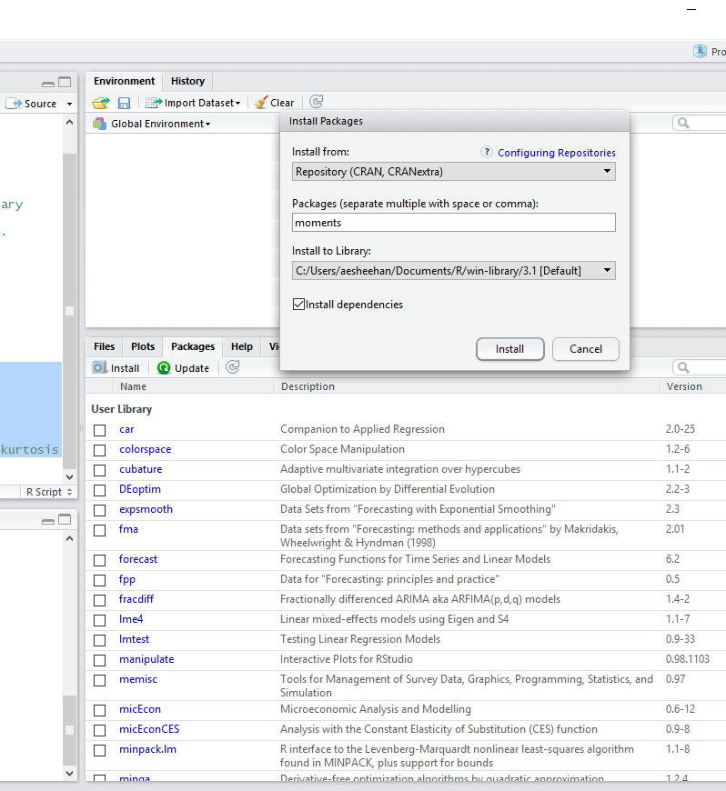
RStudio – Libraries
The easiest way to install new packages is to use the RStudio install option
Under packages, install the moments package

Slide 21
install.packages(moments)

Slide 22
RStudio – Libraries
Alternatively, you can use code to install packages into your ec5023 folder
# Create a lib folder in your ec5023 folder then type the following to
# install a different package called fpp:
install.packages("fpp", lib="C:/users/[username]/Desktop/ec5023/")
# Once installed, we must tell R we want it to use the package
library("moments", lib.loc="C:/user/ec5023/lib/")

Slide 23
RStudio – Libraries
# Now that you have the moments package installed and in use, try again!
library("moments“)
skewness(x)
# Now install the package quantmod

Slide 24
Later we will use functions in some packages/libraries that are NOT in base packages/libraries. You need to know:
1. How to install the packages that such functions belong to
2. How to load the packages so that you could use such functions
3. How to call this function.

Slide 25
Let’s look at one example first:
Calculate the mean of a vector of values

Slide 26
Examples
Start by typing in a vector
oklahoma <- c(69.7, 48.7, 84.2, 56.0, 71.4, 74.1, 68.2, 84.4, 74.2, 70.6, 45.0, 68.0, 63.4)
To manually calculate the mean
# Sum up the values and divide by the number of observations
sum(oklahoma)/length(oklahoma)
#Notice, instead of counting the number of scores, just use the length command to do it for you!
Use the R function, mean(oklahoma), to check!

Slide 27
Just like a mathematical function (or more rigorously, mapping)
A function is a piece of code written to carry out a specified task
1. it may accept arguments or parameters (or not) and
2. it may return one or more values (or not!).
Input (could be multiple) → Function (arguments) → Output (could be multiple)

Slide 28
Question: How can I find help with a particular function??

Slide 29
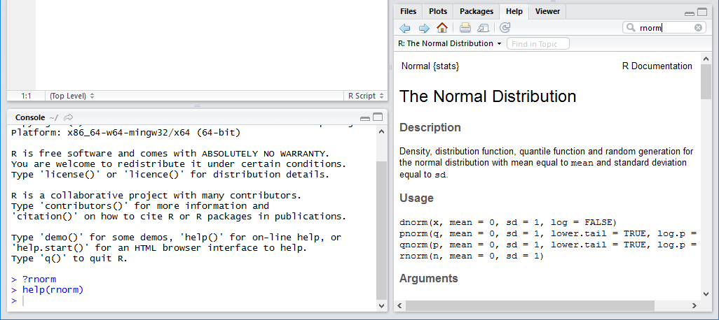
RStudio – Help and documentation
There is a large amount of (free) documentation and help available. Some help is automatically installed. Typing in the console window the command
In the console:
?rnorm
help(rnorm)

Slide 30
The Usage section of the documentation includes two versions of the mean() function; What’s the difference? The first function
mean(x,...)
is the most general definition of the mean function. This section also shows you what the default values for each argument are. This is a very important piece to pay attention. Sometimes the default behaviors are not what you want to happen.
mean(x, trim = 0, na.rm = FALSE, ...)
In the Arguments section the help file defines what each argument does.
x is the object that you want to take the mean of
trim is a number from 0 to 0.5 that defines the fraction of observations to be excluded from each side before the mean is calculated.
na.rm is a logical value (TRUE/FALSE) that tells R whether NA values should be stripped before the computation proceeds.
... is called the ellipsis, and it is a way for R to pass arguments to or from other methods without the function having to name them explicitly.

Slide 31
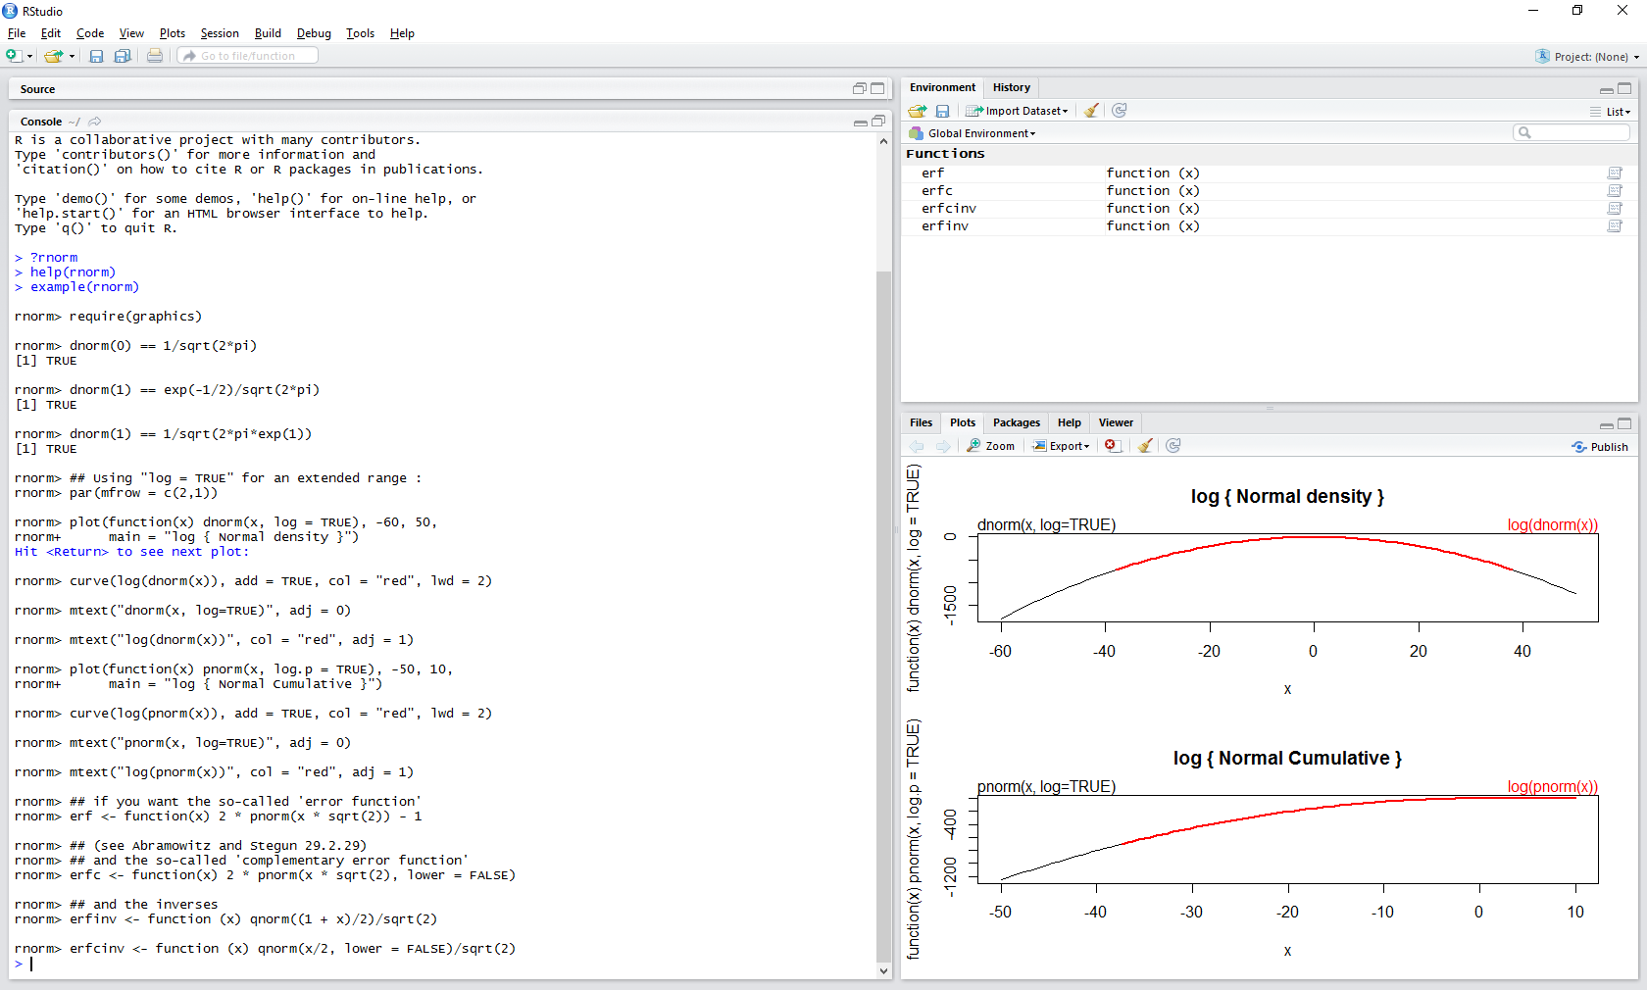
RStudio – Help and documentation
# You can also get examples of how to use a function:
example(rnorm)

Slide 32
Exercise
# Find the help for the sqrt function.
# What other function do they also give information in the same help file?

Slide 33
Common R problems
You will be running into problems,
Don’t Worry!!!!
I will write code that doesn’t work (almost every day)!

Slide 34
Step 1:
Carefully compare the code that you are running to the code in my examples or the code that you find online.
R is extremely picky, and a misplaced character can make all the difference
Make sure that every ( is matched with a ), and every “ is paired with another “.
Sometimes you’ll run the code and nothing happens. Check the left-hand side of your console: if it’s a +, it means that R doesn’t think you’ve typed a complete expression and its waiting for you to finish it. Press Esc to abort processing the current command and restart!

Slide 35
Step 2.
If you are still stuck, try the help. Get help about any R function by running ?function_name in the console, or selecting the function name and pressing F1 in Rstudio.
Don’t worry if the help doesn’t seem that helpful – instead skip down to the examples an look for code that matches what you’re trying to do.

Slide 36
Stage 3
Carefully read the error message. Sometimes the answer will be buried there!
Try to understand it. For example, such variable does not exist in the data… That means that it does not exist! Or, at least R does not recognize it!
Try to google it by copying and pasting the same error message with “…..”. Leave out any case-specific things in the search. For example, a particular variable name is useless in this case.

