Slide 1
Markov Chain Monte Carlo
MU HE & ANGELA WANG

Slide 2
Outline
Introduction to MCMC
Basic concepts
Markov chain
Monte Carlo
Bayesian inference
MCMC
Two sampling algorithms
Metropolis-Hastings Algorithm
Gibbs Sampler

Slide 3
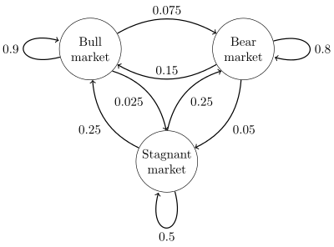
Basic Concepts – Markov Chain
Markov Chain: a stochastic process that in which future states are independent of past states given the present state.
Example:

Slide 4
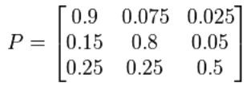

Basic Concepts – Markov Chain
Transition Matrix:
Stationary State:

Slide 5
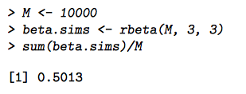
Basic Concepts – Monte Carlo
Monte Carlo Method: a broad class of computational algorithms that rely on repeated random sampling to obtain numerical results.
Example: Beta (3,3)
Analytically, we can calculate the expected value of the above distribution, which equals to 0.5.
Numerically,

Slide 6
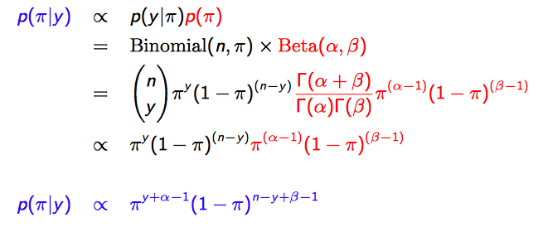
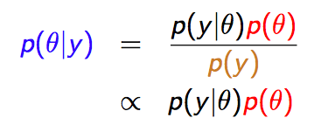
Basic Concepts – Bayesian Statistics
Bayesian Inference:
Example: Toronto Raptors play a total of 82 games during 2014-2015 season, and they won 65 games. Suppose that Raptors win each game with probability π.
Each game is a Bernoulli trial.
We use beta distribution as a prior for π since it has support over [0,1].
Posterior Likelihood × Prior

Slide 7
Basic Concepts – Bayesian Statistics
We can see that the posterior distribution is a Beta (y+α, n-y+β) distribution.

Slide 8
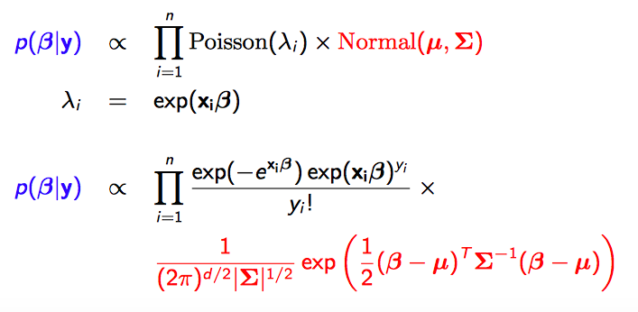
A more complicated model
Consider a Poisson regression model with Normal priors on a parameter β.

Slide 9
Basic Concepts - MCMC
Goal: produce random draws from our posterior distribution through simulation and summarize information (mean, standard deviation, etc.) on the posterior distribution based on these draws.
In Bayesian statistics, we will be interested in constructing Markov Chains whose stationary state is the posterior distribution.

Slide 10
Basic Concepts – Markov Chain Revisited
However, Markov Chain is positive recurrent, aperiodic, and irreducible, it will converge to a unique stationary distribution.
Positive recurrent: For any set A, the expected number of steps required for the chain to return to A is finite.
Aperiodic: for any set A, the number of steps required to return to A must not always be a multiple of some value k.
Irreducible: any set A can be reached from any other set B with nonzero probability.

Slide 11
Basic Concepts - MCMC
Essentially, we will use a Markov Chain to generate a sequence of θ values, denoted (θ₀, θ₁, θ₂…), in such a way that as n->∞, θ_{n} ~ P(θ).
In Bayesian statistics, there are generally two MCMC algorithms that we use to set up a Markov Chain with this property:
Metropolis-Hastings algorithm
Gibbs sampler

Slide 12
Metropolis-Hastings algorithm
Step 1. Choose a starting value of θ⁽⁰⁾

Slide 13
Metropolis-Hastings algorithm
Step 1. Choose a starting value of θ⁽⁰⁾
Step 2. At iteration t=1,2,.., draw a candidate θ* from a jumping distribution (proposal distribution) J(θ*|θ^{(t-1)}).

Slide 14
Step 2. Draw θ* from J(θ*|θ^{(t-1)})
The jumping distribution determines where we move to in the next iteration of the Markov Chain (analogous to the transition matrix).
The jumping distribution can be anything you like (however, a better selection of jumping distribution will be more efficient).
Random Walk Metropolis-Hastings Algorithm (Metropolis Algorithm)
The jumping distribution is symmetric, which is
J(θ*|θ^{(t-1)})=J(θ^{(t-1)}|θ*).
Independent Metropolis-Hastings Algorithm
The jumping distribution does not depend on θ^{(t-1)}, which is
J(θ*|θ^{(t-1)})=J(θ*).
θ* is drawn from the same distribution at every iteration, regardless of where the previous draw was.

Slide 15
Metropolis-Hastings algorithm
Step 1. Choose a starting value of θ⁽⁰⁾
Step 2. At iteration t=1,2,.., draw a candidate θ* from a jumping distribution (proposal distribution) J(θ*|θ^{(t-1)}).
Step 3. Compute acceptance ratio (probability)
p(θ*|y)/J(θ*|θ^{(t-1)})
p(θ^{(t-1)}|y)/J(θ^{(t-1)}|θ*)
r =

Slide 16

Metropolis-Hastings algorithm
Step 1. Choose a starting value of θ⁽⁰⁾
Step 2. At iteration t=1,2,.., draw a candidate θ* from a jumping distribution (proposal distribution) J(θ*|θ^{(t-1)}).
Step 3. Compute acceptance ratio (probability)
Step 4. Accept θ* as θ^{(t)} with probability min(r,1). If θ* is not accepted, then θ^{(t)} = θ^{(t-1)}.

Slide 17
Step 4. Decide whether to accept θ*
Accept θ* as θ(t) with probability min(r,1).
For each θ*, draw a value u from the Uniform (0,1) distribution
If u ≤ r, accept θ* as θ(t) .
Otherwise, use θ^{(t-1)} as θ^{(t)}.

Slide 18
Metropolis-Hastings algorithm
Step 1. Choose a starting value of θ⁽⁰⁾
Step 2. At iteration t=1,2,.., draw a candidate θ* from a jumping distribution (proposal distribution) J(θ*|θ^{(t-1)}).
Step 3. Compute acceptance ratio (probability)
Step 4. Accept θ* as θ^{(t)} with probability min(r,1). If θ* is not accepted, then θ^{(t)} = θ^{(t-1)}.
Step 5. Repeat 2-4 M times to get M draws from p(θ|y).

Slide 19
Burn-in and Thinning
Burn-in: in practice, some people throw out a certain number of first draws (known as the burn-in).
Thinning: some people only keep every kth draw of the chain.

Slide 20
Gibbs Sampler
Suppose we have a joint distribution of p(θ₁,…θ_{k}) that we want to sample from (this joint distribution can be our posterior distribution).
We can use Gibbs sampler to sample from the joint distribution if we know the full conditional distribution for each parameter, θ₁,…θ_{k}.
For each parameter, the full conditional distribution is the distribution of the parameter conditioned on the known information and all the other parameters.

Slide 21
Gibbs Sampler
Suppose we are interested in sampling from a posterior distribution p(θ|y), where θ is a vector of three parameters: θ₁, θ₂, θ₃.
Step 1. Choose a starting value of θ⁽⁰⁾

Slide 22
Gibbs Sampler
Suppose we are interested in sampling from a posterior distribution p(θ|y), where θ is a vector of three parameters: θ₁, θ₂, θ₃.
Step 1. Choose a starting value of θ⁽⁰⁾

Slide 23
Gibbs Sampler
Suppose we are interested in sampling from a posterior distribution p(θ|y), where θ is a vector of three parameters: θ₁, θ₂, θ₃.
Step 1. Choose a starting value of θ⁽⁰⁾
Step 2. Draw a value θ₁⁽¹⁾ from the full conditional p(θ₁|θ₂^{(0),} θ₃⁽⁰⁾,y).

Slide 24
Gibbs Sampler
Suppose we are interested in sampling from a posterior distribution p(θ|y), where θ is a vector of three parameters: θ₁, θ₂, θ₃.
Step 1. Choose a starting value of θ⁽⁰⁾
Step 2. Draw a value θ₁⁽¹⁾ from the full conditional p(θ₁|θ₂^{(0),} θ₃⁽⁰⁾,y).
Step 3. Draw a value θ₂⁽¹⁾ from the full conditional p(θ₂|θ₁^{(1),} θ₃⁽⁰⁾,y).

Slide 25
Gibbs Sampler
Suppose we are interested in sampling from a posterior distribution p(θ|y), where θ is a vector of three parameters: θ₁, θ₂, θ₃.
Step 1. Choose a starting value of θ⁽⁰⁾
Step 2. Draw a value θ₁⁽¹⁾ from the full conditional p(θ₁|θ₂^{(0),} θ₃⁽⁰⁾,y).
Step 3. Draw a value θ₂⁽¹⁾ from the full conditional p(θ₂|θ₁^{(1),} θ₃⁽⁰⁾,y).
Step 4. Draw a value θ₃⁽¹⁾ from the full conditional p(θ₃|θ₁^{(1),} θ₂⁽¹⁾,y).

Slide 26
Gibbs Sampler
Suppose we are interested in sampling from a posterior distribution p(θ|y), where θ is a vector of three parameters: θ₁, θ₂, θ₃.
Step 1. Choose a starting value of θ⁽⁰⁾
Step 2. Draw a value θ₁⁽¹⁾ from the full conditional p(θ₁|θ₂^{(0),} θ₃⁽⁰⁾,y).
Step 3. Draw a value θ₂⁽¹⁾ from the full conditional p(θ₂|θ₁^{(1),} θ₃⁽⁰⁾,y).
Step 4. Draw a value θ₃⁽¹⁾ from the full conditional p(θ₃|θ₁^{(1),} θ₂⁽¹⁾,y).
Step 5. Repeat until we get M draws, with each draw being a vector θ^{(t)}.

Slide 27

Conclusion
How do we determine when we reach the stationary state for our chains?
COMING SOON
THANK YOU

