Slide 1
Approximate Bayesian Computation
Kai Liu & Kavitha N.

Slide 2


Why ABC ?
Bayesian statistics:
The likelihood is intractable

Slide 3

How does ABC work?
Step 1: construct a generative model M that produces the same type of data as your observed data
Step 2: sample tentative parameter values from the prior distributions, plug these into the generative model and simulate a dataset

Slide 4



How does ABC work?
Step 3: check if the simulated data set/summary statistics matches the actual data/actual summary statistics, if yes, keep them, if no, throw them away. i.e. or
Step 4: repeat Step 2-3 a large number of times building up the list of probable parameter values
Step 5: the distribution of the probable parameter values represents the posterior information

Slide 5

Other ABC algorithms
ABC MCMC
ABC partial rejection control (ABC PRC)
ABC population Monte Carlo (ABC PMC)
ABC sequential Monte Carlo (ABC SMC)

Slide 6


ABC MCMC
acceptance probability:
if

Slide 7
Pros and cons of ABC MCMC
Pros: very efficient even the prior distribution differs substantially from the posterior distribution
Cons: chains are in danger of getting stuck in the low probability regions of posterior distribution if proposal distribution is poorly chosen

Slide 8
ABC PRC
Step 1: generate a pool of N candidate values for (called particles) from the prior distribution

Slide 9




ABC PRC
Step 2: choose the distribution of a random variable (i.e. ) to perturb to , that is . is called forward transition kernel and is called backward transition kernel

Slide 10


ABC PRC
Step 3: simulate data given the perturbed particles. If the simulated data satisfies the condition that , keep the particle, otherwise, discard it and repeat Step 2 until we obtain N particles with weights

Slide 11
ABC PRC
Step 4: repeat Step 1-3 by sampling particles with probabilities of normalized weights in last iteration.

Slide 12
Pros and cons of ABC PRC
Pros: discard particles from the pool in low- probability regions and increase the number of particles in high-probability regions
Cons: the efficiency of the sampler relies heavily on the choice of the transition kernels and prior

Slide 13





ABC PMC
Given the weight for particle on iteration , the new weight for particle on iteration is given by
where is a Gaussian kernel and

Slide 14

ABC SMC
The weights in ABC SMC are given by

Slide 15
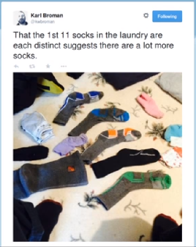
Question: Given the tiny dataset of eleven unique socks, how many socks does Karl Broman have in his laundry in total?

Slide 16
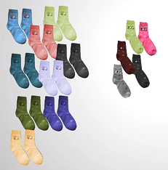
Lets assume we have some pairs of socks, say 9 and some odd socks, say 5.

Slide 17
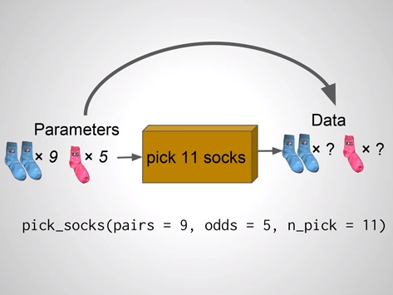
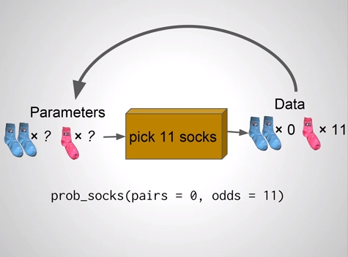
Criteria.

Slide 18
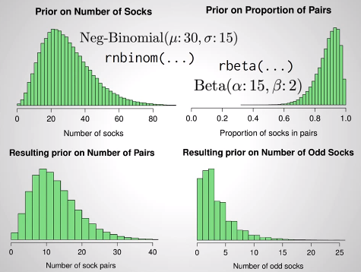
Choosing the priors.

Slide 19
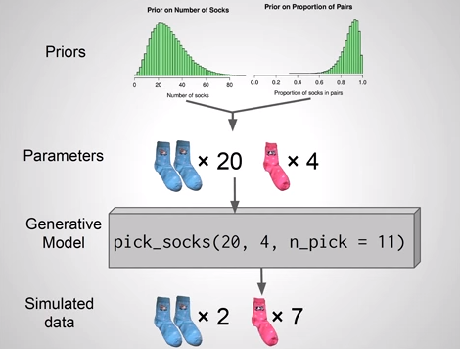
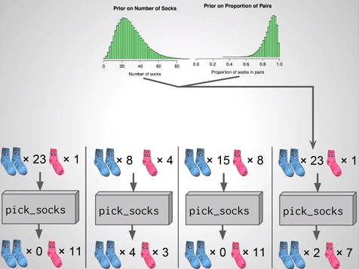
Simulation

Slide 20
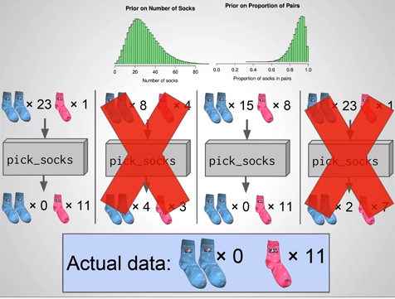

Slide 21
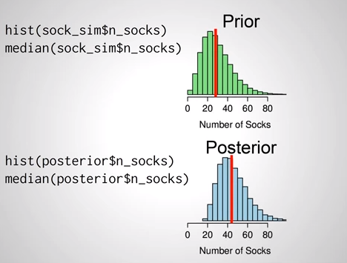

Slide 22
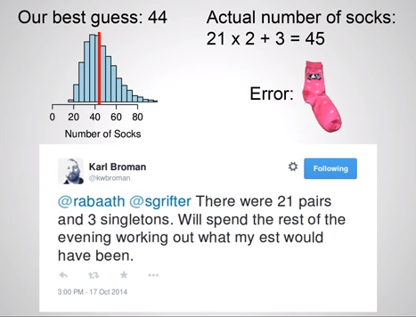

Slide 23
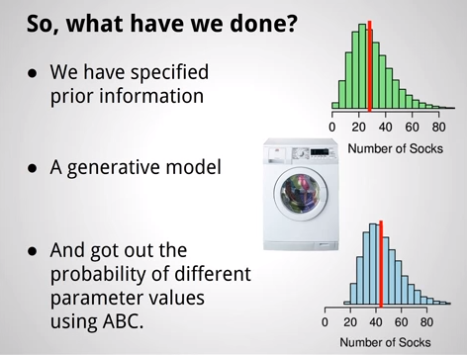
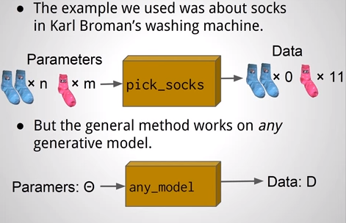
What have we done?

Slide 24
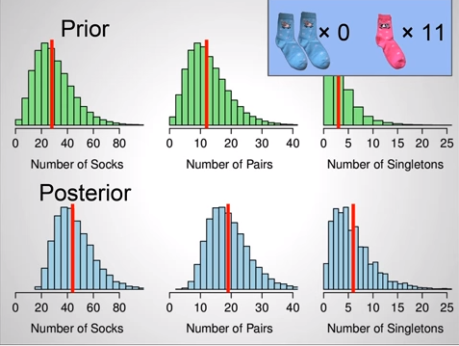
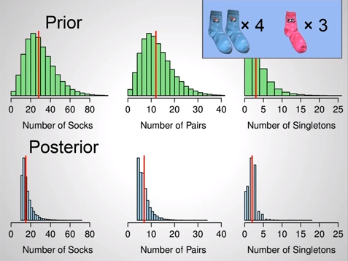
Do we need a prior?
Using prior.
Without using prior.

Slide 25



The Exponential model

Slide 26
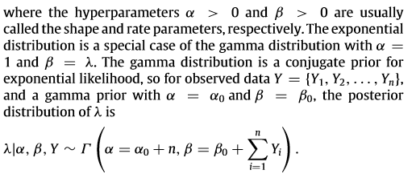


Slide 27
Estimating the posterior using ABC PMC
We face two problems at this point.
1. Y is continuous.
2. The proposal distribution may be very far from the posterior.
How can we solve them?

Slide 28
Solution for the problems.
1. Rather that taking the exact match, we can take some amount of tolerance threshold, ϵ_{t}.
2. Gradually reduce the value of ϵ_{t} , so that we “move” efficiently from the prior(proposal) to the desired posterior.

Slide 29
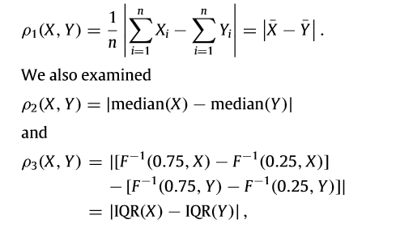
The distance function.

Slide 30
Tolerance
To generate the data, we took n = 500 samples from Exp( λ = 0.1), so the observation ranged from 0 to 70, with mean = 10, sd = 10 and IQR approximately 11.
Decreasing set of tolerance is
ϵ = {3, 1, 10⁻¹, 10⁻³, 10⁻⁴, 10⁻⁵}
Ultimately, only the smallest element of ϵ matters.

Slide 31
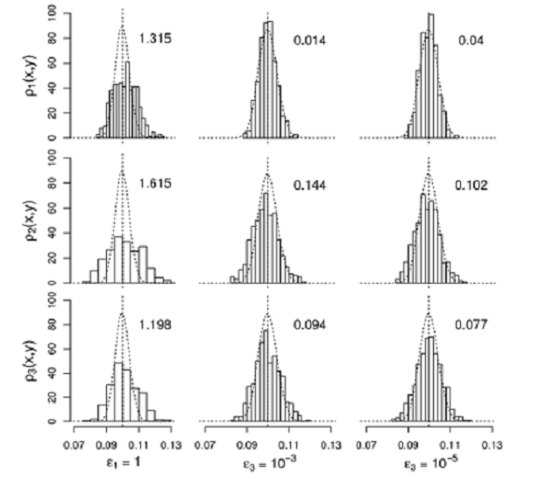
Results

Slide 32
Interpretation.
The dashed curves shows the true posterior and the histogram show the estimated posterior obtained using ABC PMC.
As ϵ_{t} decreases, the accuracy of the posterior increases.
If further reduction in ϵ_{t} do not produce changes, then the estimate has converged to its final target.

Slide 33
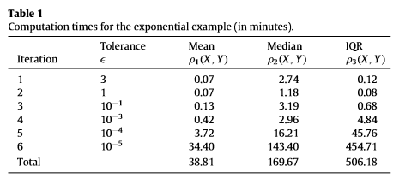
Computation time.

Slide 34
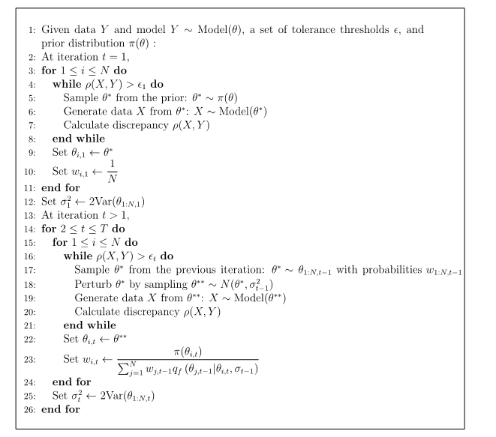
Algorithm of ABC PMC

Slide 35
Reference
Brandon, M. Turner and Trisha Van Zandt (2012). A tutorial on approximate Bayesian computation. Journal of Mathematical Psychology. 56, 69-85

Slide 36
THE END

