Slide 1
Introduction to Statistics for Ecology and Evolutionary Biology More Multilevel Modeling Week 14 29 April 2019
Notes:
The goal for this lecture to communicate the “when” and “why” of multilevel modeling
Notes regarding model-fitting with Stan:
variable names with dots
divergent iterations
extracting samples from the model

Slide 2
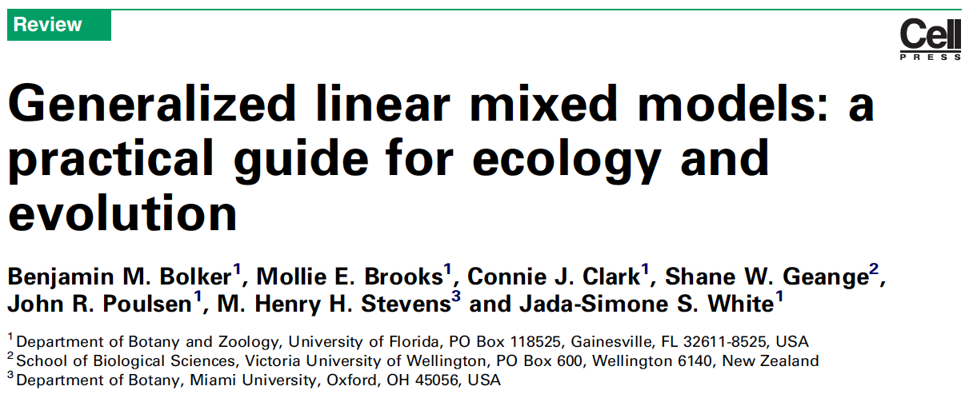
Bolker et al. 2009, Trends in Ecology & Evolution
Notes:
This paper serves as a good introduction to the topic and lays out much of the terminology for those interested

Slide 3
What are Varying (i.e., Random) Effects?
“Where basic statistical methods try to quantify the exact effects of each predictor variable, EE problems often involve random effects, whose purpose is instead to quantify the variation among units. The most familiar types of random effect are the blocks in experiments or observational studies that are replicated across sites or times. Random effects also encompass variation among individuals (when multiple responses are measured per individual, such as survival of multiple offspring or sex ratios of multiple broods), genotypes, species and regions or time periods.”
Bolker et al. 2009, Trends in Ecology & Evolution
Notes:
All of the variable described here could be construed as “clusters” of data

Slide 4
What are Varying (i.e., Random) Effects?
“Random effects: factors whose levels are sampled from a larger population, or whose interest lies in the variation among them rather than the specific effects of each level. The parameters of random effects are the standard deviations of variation at a particular level (e.g. among experimental blocks). The precise definitions of ‘fixed’ and ‘random’ are controversial; the status of particular variables depends on experimental design and context [16,53].”
Bolker et al. 2009, Trends in Ecology & Evolution
Notes:
Note that variation is mentioned again as central to the definition
But also, the definition is controversial

Slide 5
What are Varying (i.e., Random) Effects?
“It is important to distinguish between random effects as a nuisance (as in classical blocked experimental designs) and as a variable of interest (as in many evolutionary genetic studies, or in ecological studies focused on heterogeneity).”
Bolker et al. 2009, Trends in Ecology & Evolution
Notes:
So the “importance” of a variable for interpretation is not really a strong way to distinguish random from fixed effects; random effects can be either a “nuisance” or a “variable of interest”
Thus, for this class we’ll prefer to say that varying/random effects are those that are explicitly constructed in our models such that they are derived from a population of effects

Slide 6
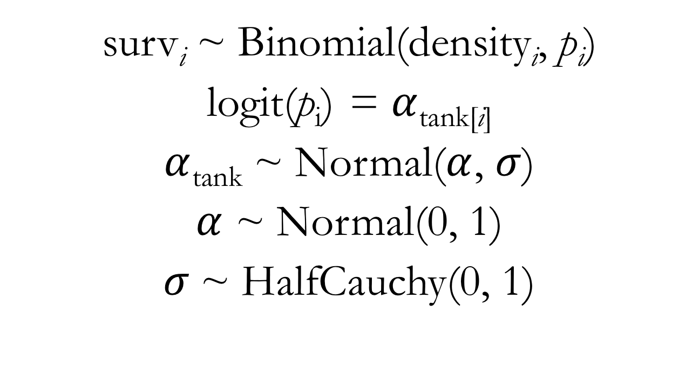
Binomial GLMM for Reed Frog Survival Predictors: Tank (with an indexing approach)
surv_{i} ~ Binomial(density_{i}, $\text{p}\text{i}$)
logit(p_{i}) = $α$_{tank[i]}
$α$_{tank} ~ Normal($α$, $σ$)
$α$ ~ Normal(0, 1)
$σ$~ HalfCauchy(0, 1)

Slide 7
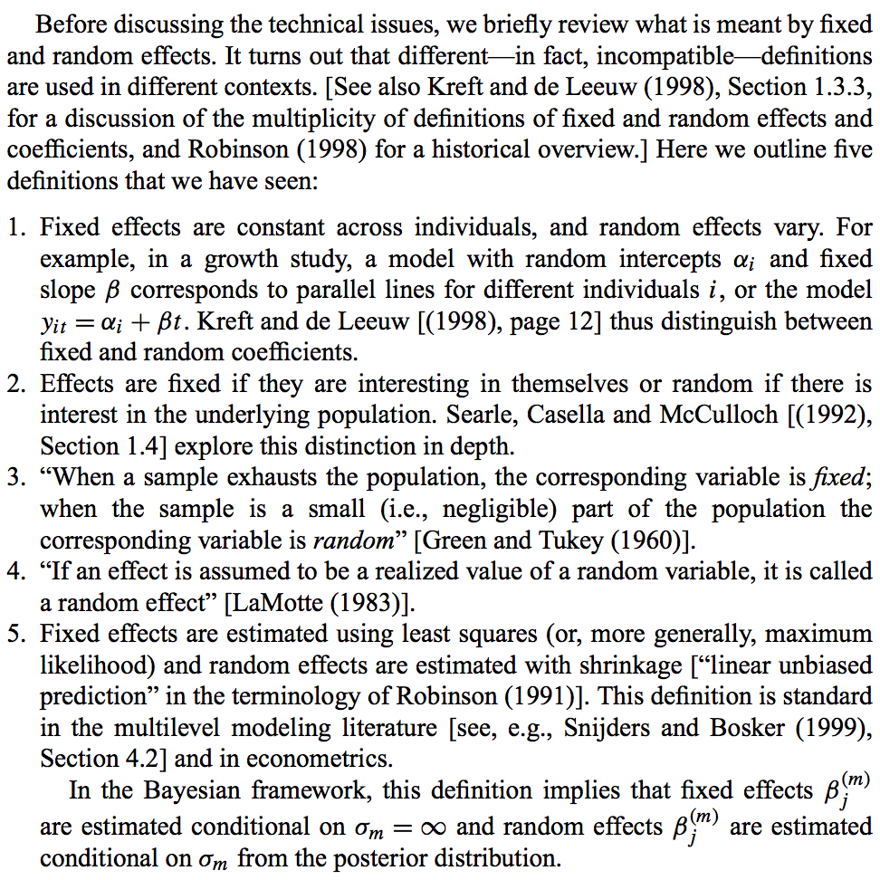
Gelman 2005, The Annals of Statistics
Notes:
The random effects terminology is inconsistent and confusing
Note that with definition 2, the exact same set of estimates from a model would be fixed or random depending upon your interest as an investigator

Slide 8
Benefits of Multilevel Models
Improved estimates for repeated sampling
Simpler, traditional models maximally overfit or underfit data in this context
Improved estimates for imbalanced sampling
If ignored, over-sampled units in the data will dominate inference
Estimating variation
Multilevel models are explicitly focused on variation
Avoid averaging

Slide 9
Conceptualizing Multilevel Models
Can be viewed as a form of adaptive regularization
In these models, the amount of regularization is learned from the data itself
Help to navigate the risk of overfitting and underfitting
If we use completely independent parameters (no pooling), we risk overfitting. If we ignore variation in the variable of interest (complete pooling), we risk underfitting
The multilevel strategy represents partial pooling of information

Slide 10
The Magic of Shrinkage
Shrinkage in parameter estimates manifests from the regularization inherent in multilevel models
It is the pulling of the multilevel estimates (i.e., shrinkage) towards the estimated global average across clusters
Could be thought of as a form of regression to the mean
The effects of shrinkage tend to be greatest when:
Sample sizes for a cluster are small
The empirical estimate for a cluster’s parameter value are extreme
Notes:
Show lecture code illustrating shrinkage

Slide 11
Binomial GLMM for Reed Frog Survival Predictors: Tank (with an indexing approach)
surv_{i} ~ Binomial(density_{i}, $\text{p}\text{i}$)
logit(p_{i}) = $α$_{tank[i]}
$α$_{tank} ~ Normal($α$, $σ$)
$α$ ~ Normal(0, 1)
$σ$~ HalfCauchy(0, 1)

Slide 12
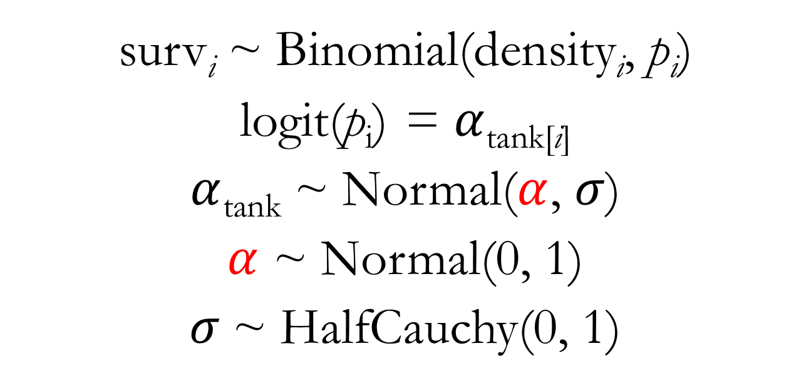
Binomial GLMM for Reed Frog Survival: Movin’ Around the Mean Predictors: Tank (with an indexing approach)
surv_{i} ~ Binomial(density_{i}, $\text{p}\text{i}$)
logit(p_{i}) = $α$_{tank[i]}
$α$_{tank} ~ Normal($α$, $σ$)
$α$ ~ Normal(0, 1)
$σ$~ HalfCauchy(0, 1)

Slide 13
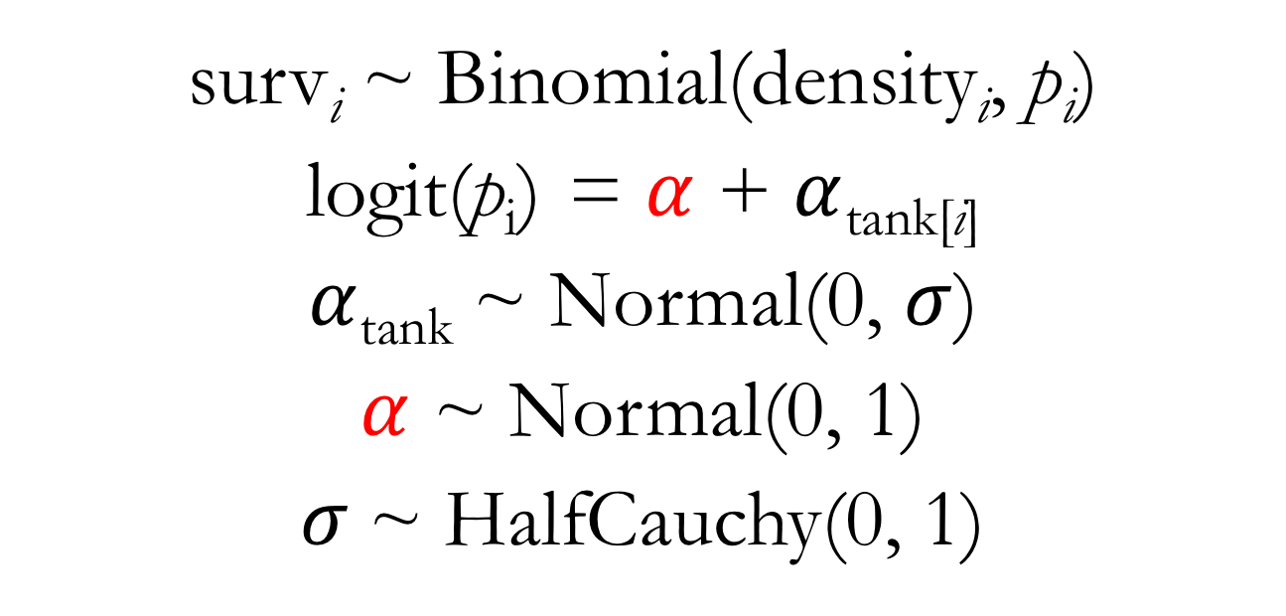
Binomial GLMM for Reed Frog Survival: Movin’ Around the Mean Predictors: Tank (with an indexing approach)
surv_{i} ~ Binomial(density_{i}, $\text{p}\text{i}$)
logit(p_{i}) = $α$ + $α$_{tank[i]}
$α$_{tank} ~ Normal(0, $σ$)
$α$ ~ Normal(0, 1)
$σ$~ HalfCauchy(0, 1)
Notes:
Note that this modeling strategy is critical for the inclusion of multiple varying effects in our models
Show lecture code on fitting the model with this alternate parameterization

Slide 14
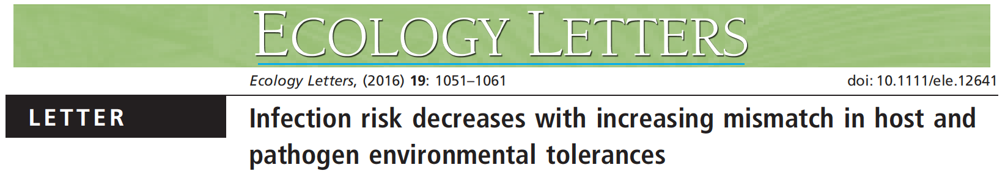
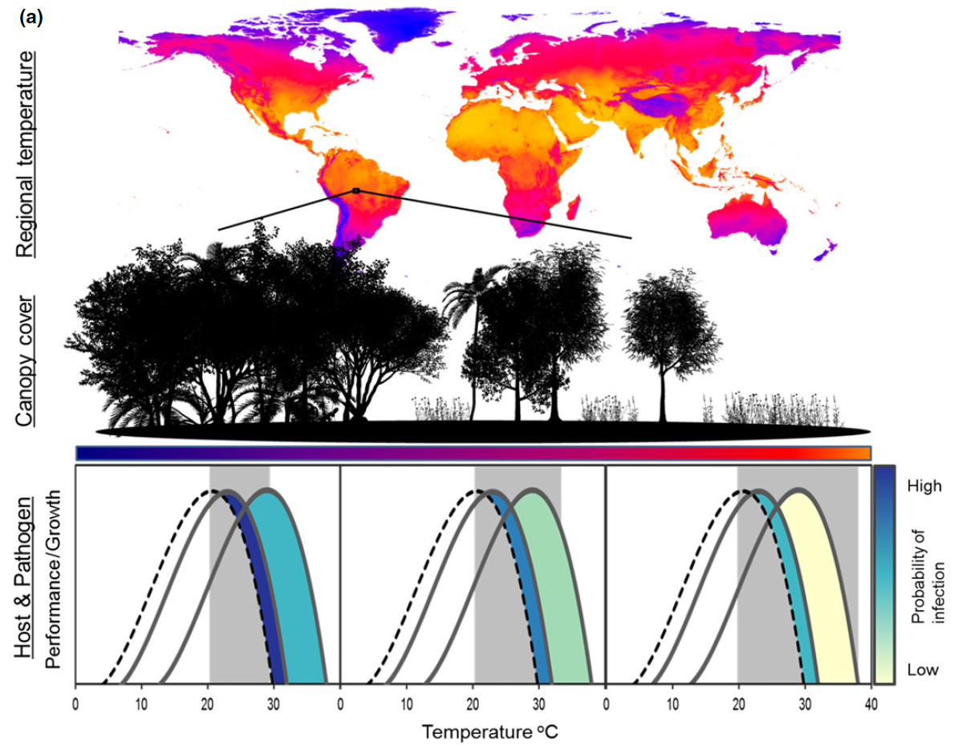

Slide 15
Multilevel Models in the Wild
“The response consisted of the number of infected and uninfected individuals at a given sample location (1,240 total sample locations) for a given species (53 total species); observations, therefore, represented species-by-site prevalence records (n = 1,645) weighted in the model by the number of Bd assays conducted for each species-by-site record (11,435 total assays). We fit all models with varying intercepts among contributing studies and among species nested within families and compared models fit with competing fixed effects structures.”
Nowakowski et al. 2016, Ecology Letters
Notes:
So we used aggregated binomial data here

Slide 16
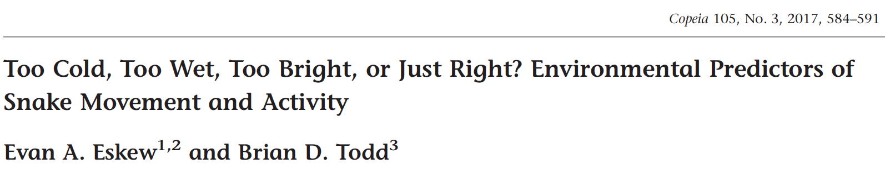
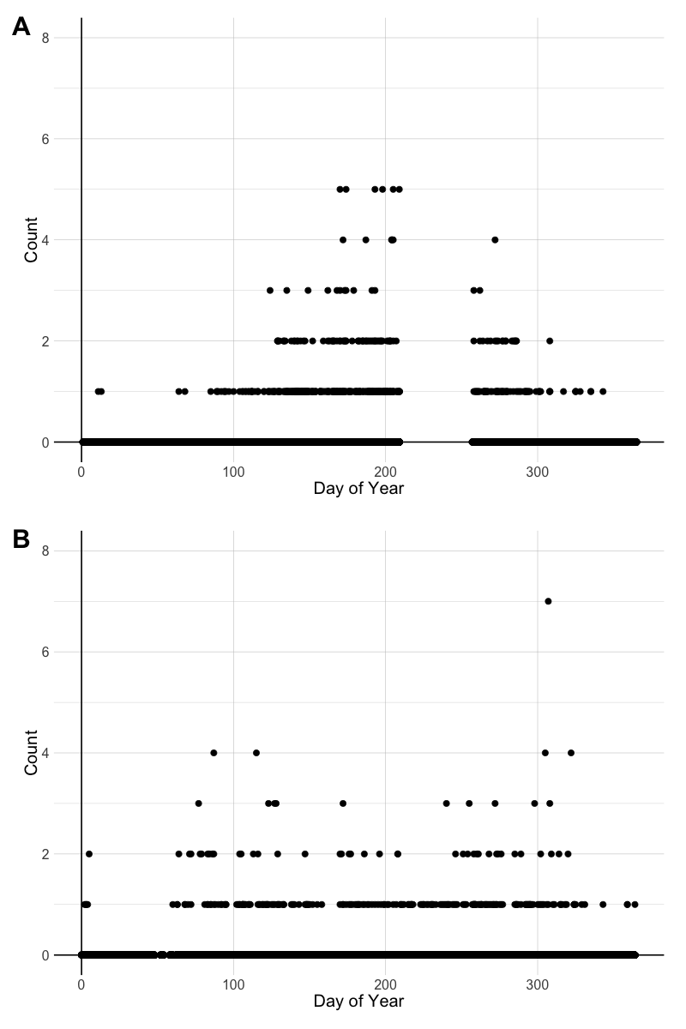

Slide 17
Multilevel Models in the Wild
“We also wanted to control for variability in counts that could be attributed to snake species identity and sampling location. Thus, all LEAP models included varying intercepts (i.e., random effects) by snake species and sampling location, whereas Ellenton Bay models only included varying intercepts by snake species since all these data came from a single location. Critically, the inclusion of varying effects by species helps to make our inferences generalizable across the entire snake assemblage rather than being species-specific since inherent differences in activity among species are being accounted for…”
Eskew and Todd 2017, Copeia

Slide 18
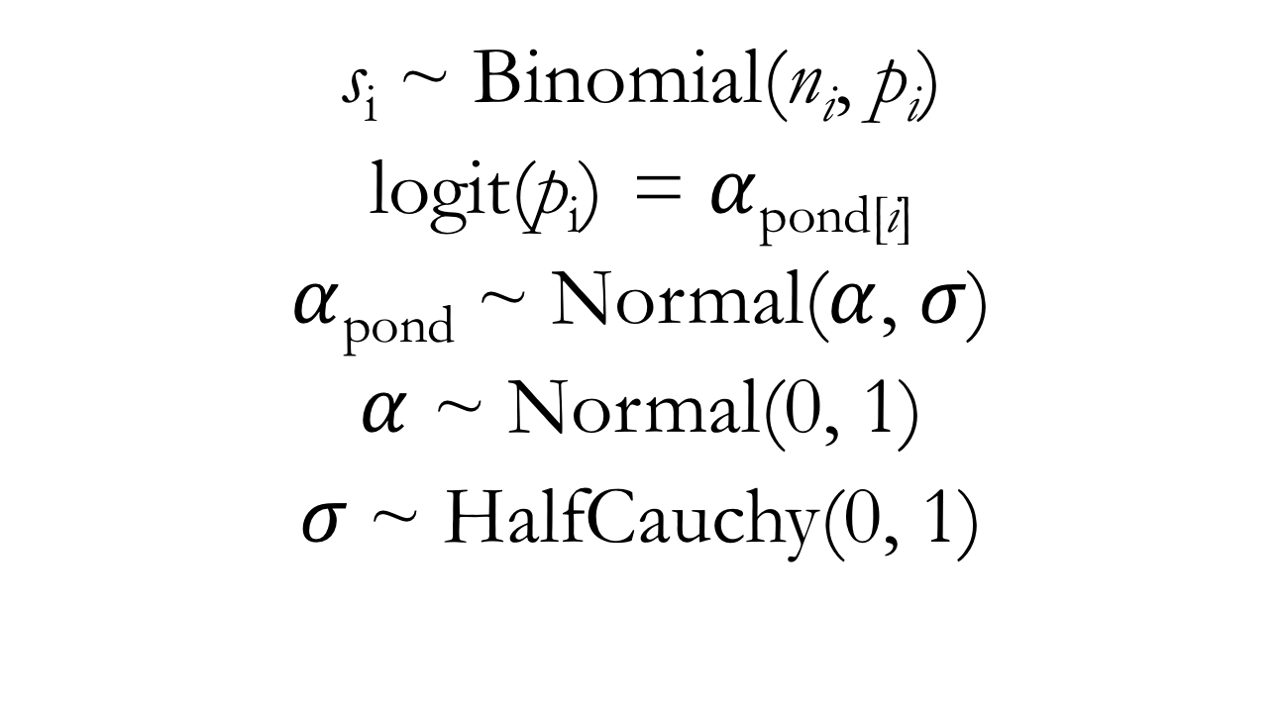
Binomial GLMM for Frog Survival Predictors: Ponds (instead of tanks)
s_{i} ~ Binomial(n_{i}, $\text{p}\text{i}$)
logit(p_{i}) = $α$_{pond[i]}
$α$_{pond} ~ Normal($α$, $σ$)
$α$ ~ Normal(0, 1)
$σ$~ HalfCauchy(0, 1)
Notes:
Show lecture code on simulating frog survival data

Slide 19
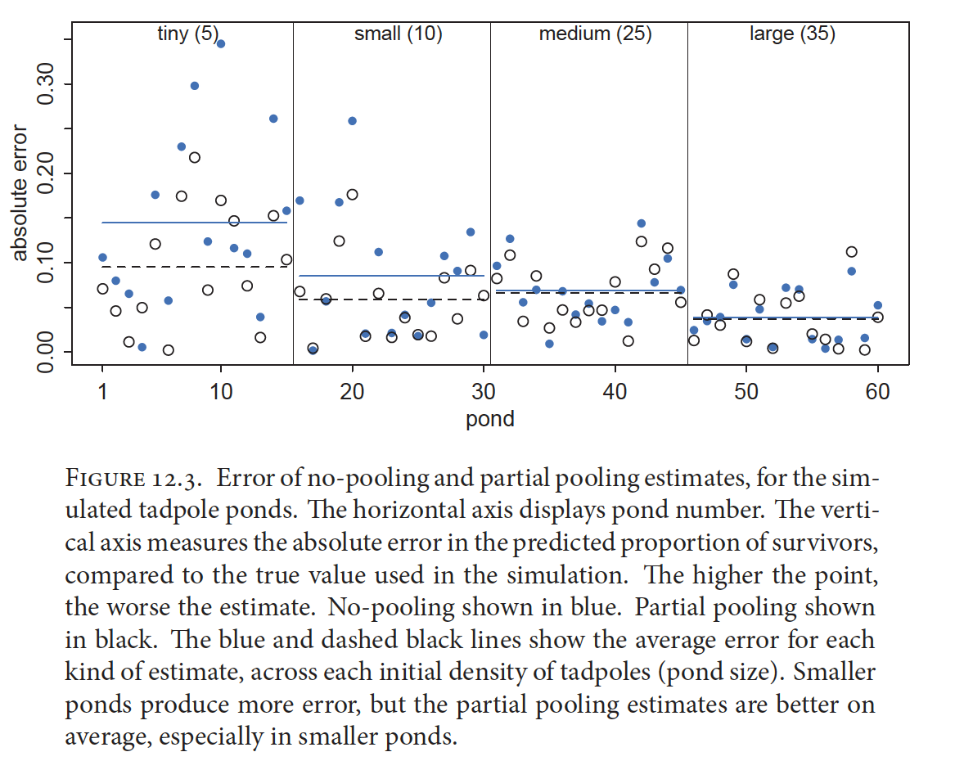
McElreath 2016, Statistical Rethinking

