Slide 1
Introduction to Statistics for Ecology and Evolutionary Biology Statistical Distributions and Summary Statistics Week 05 25 February 2019

Slide 2
Probability Distributions
Discrete probability distributions
Possible outcomes are discrete events
Implies a probability mass function (pmf)
Summation over the valid values of the pmf yields 1
Continuous probability distributions
Possible outcomes are values in a continuous range
Implies a probability density function (pdf)
Integration over the full interval of the pdf yields 1
Notes:
Probability distributions will play a major role within our models since they allow us to define priors and the likelihood function, thus enabling us to generate posterior inference

Slide 3
Binomial Distribution
A discrete probability distribution with two parameters:
n = number of trials, p = probability of success
Outcome is the number of successes (x) in n trials with probability of success p
The probability mass function in R:
dbinom(x, size, prob)
Where x = the number of successes, size = n, prob = p
Which can be visualized like so:
plot(0:10, dbinom(0:10, size = 10, prob = 0.3))
The random generation function in R:
rbinom(n, size, prob)
Where n = the number of observations to generate, size = n, prob = p
Notes:
Note that the parameters within a discrete probability distribution can be continuous
Show sample code demonstrating dbinom(), plotting, and rbinom()

Slide 4
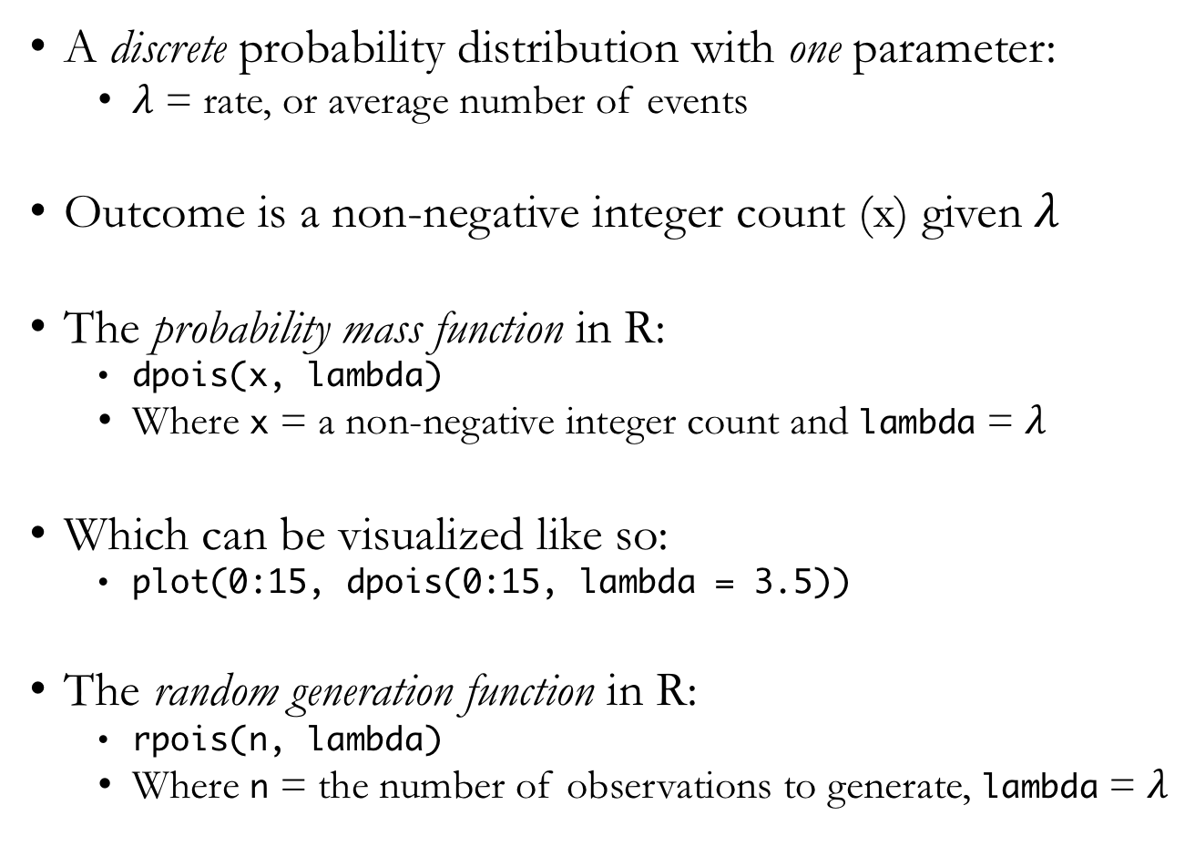
Poisson Distribution
A discrete probability distribution with one parameter:
$λ$ = rate, or average number of events
Outcome is a non-negative integer count (x) given $λ$
The probability mass function in R:
dpois(x, lambda)
Where x = a non-negative integer count and lambda = $λ$
Which can be visualized like so:
plot(0:15, dpois(0:15, lambda = 3.5))
The random generation function in R:
rpois(n, lambda)
Where n = the number of observations to generate, lambda = $λ$

Slide 5
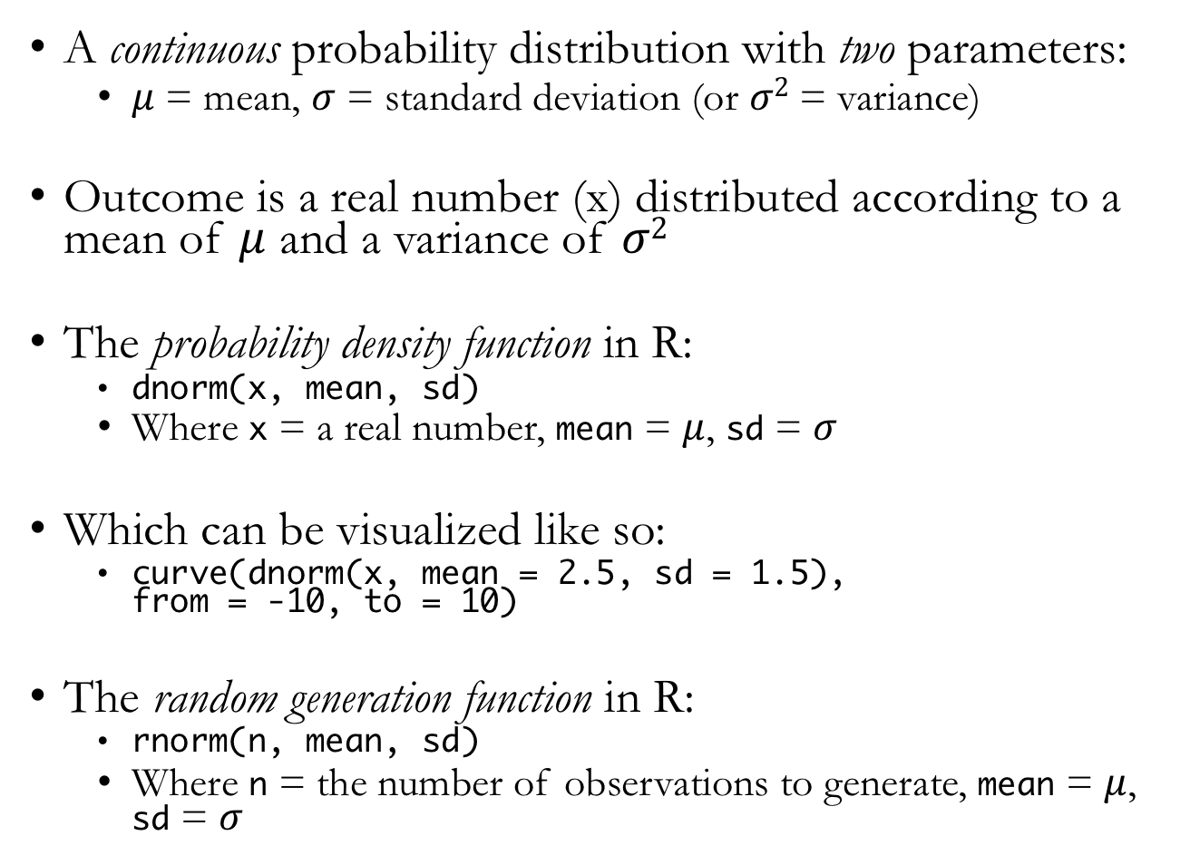
Normal Distribution
A continuous probability distribution with two parameters:
$μ$ = mean, $σ$ = standard deviation (or $σ2$ = variance)
Outcome is a real number (x) distributed according to a mean of $μ$ and a variance of $σ2$
The probability density function in R:
dnorm(x, mean, sd)
Where x = a real number, mean = $μ$, sd = $σ$
Which can be visualized like so:
curve(dnorm(x, mean = 2.5, sd = 1.5), from = -10, to = 10)
The random generation function in R:
rnorm(n, mean, sd)
Where n = the number of observations to generate, mean = $μ$, sd = $σ$
Notes:
Also called the Gaussian distribution

Slide 6
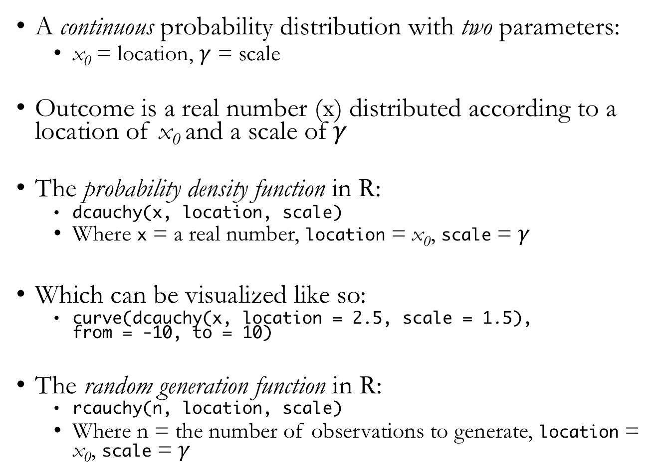
Cauchy Distribution
A continuous probability distribution with two parameters:
x₀ = location, $γ$ = scale
Outcome is a real number (x) distributed according to a location of x₀ and a scale of$γ$
The probability density function in R:
dcauchy(x, location, scale)
Where x = a real number, location = x₀, scale = $γ$
Which can be visualized like so:
curve(dcauchy(x, location = 2.5, scale = 1.5), from = -10, to = 10)
The random generation function in R:
rcauchy(n, location, scale)
Where n = the number of observations to generate, location = x₀, scale = $γ$
Notes:
Relative to the normal distribution, the Cauchy distribution has much fatter tails, making values far from the “location” more likely
Show sample code comparing pdfs for both the normal and Cauchy distributions

Slide 7
Thinking with Samples
Consider working with distributions and samples as a translational process that can flow back and forth
We can draw samples from a distribution
Samples are simpler to work with, allow for easy summary
Some methods for Bayesian inference only produce samples
But we can also visualize the distribution of our samples
Notes:
Show sample code generating samples from a grid approximate posterior distribution

Slide 8
Summarizing Samples: Intervals of Defined Mass
Percentile intervals
Assign equal probability mass to each tail
So provides the central X% probability interval
Highest posterior density intervals
The narrowest interval containing a given probability mass

Slide 9
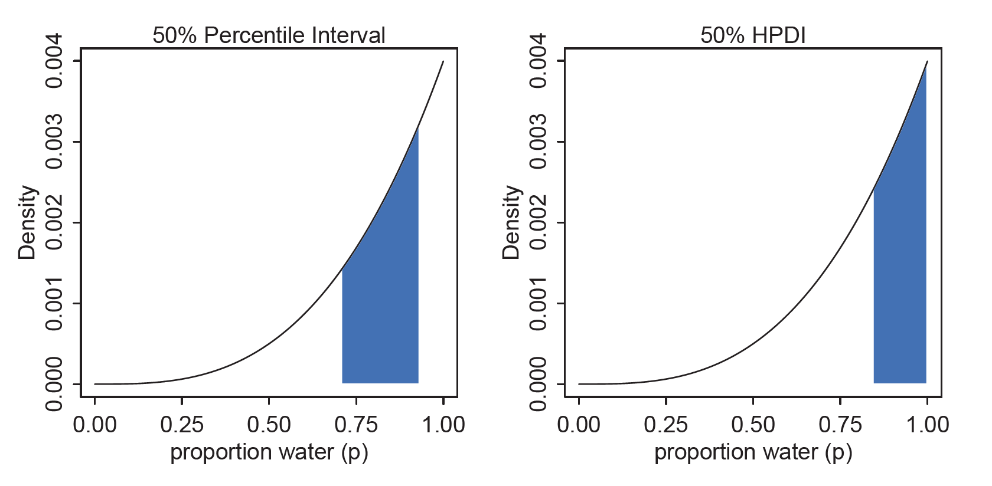
Summarizing Samples: Intervals of Defined Mass
McElreath 2016, Statistical Rethinking
Notes:
Show sample code calculating these intervals

Slide 10
Summarizing Samples: Measures of Central Tendency
Mean
The average value
Median
The middle value (aka the 50th percentile)
Mode
The most frequent value
Notes:
Also known as “point estimates”

Slide 11
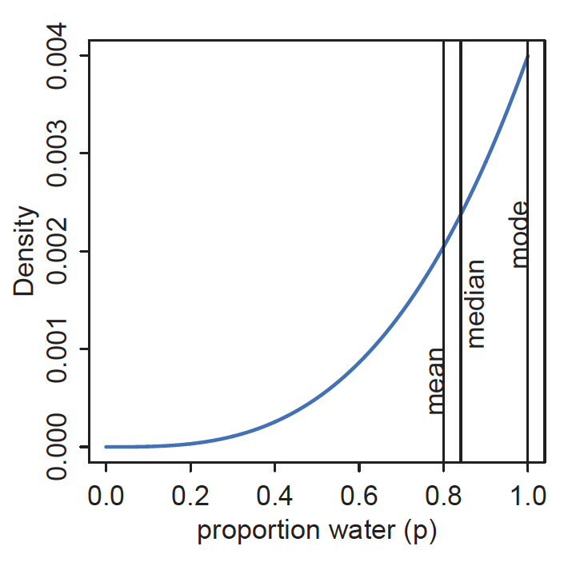
Summarizing Samples: Measures of Central Tendency
McElreath 2016, Statistical Rethinking
Notes:
For highly skewed distributions, the mean, median, and mode can be quite different

Slide 12
Keep in Mind
In Bayesian inference, the posterior distribution (in its entirety) is the statistical estimate
Intervals and point estimates are simply ways to summarize the posterior
When possible, it is often preferable to show the entire posterior distribution for a given parameter
Notes:
Just as we often want to show the raw data whenever possible with data visualization, we often want to show the entire posterior distribution rather than a summary

Slide 13
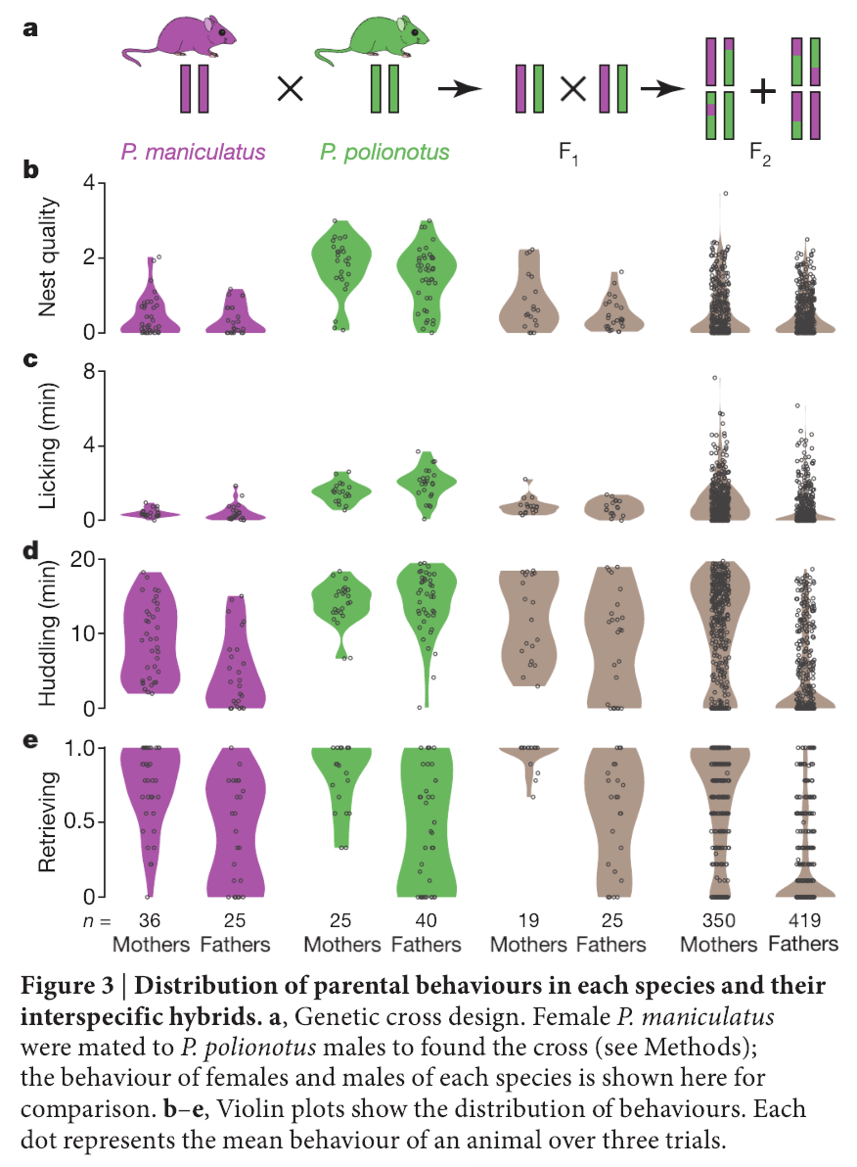
Bendesky et al. 2017, Nature
Notes:
And when showing all the data, researchers also often accompany data with a visualization of the data’s distribution

Slide 14
Sampling to Simulate Prediction
Samples from our model can also be used to help us generate implied model predictions
Critically, we have to account for two major sources of uncertainty
Observation uncertainty
Parameter uncertainty
When we properly account for these sources of uncertainty in our predictions, we have a posterior predictive distribution
Notes:
Observation uncertainty: uncertainty about outcome even given a fixed parameter value
Parameter uncertainty: uncertainty about what the true parameter values are

Slide 15
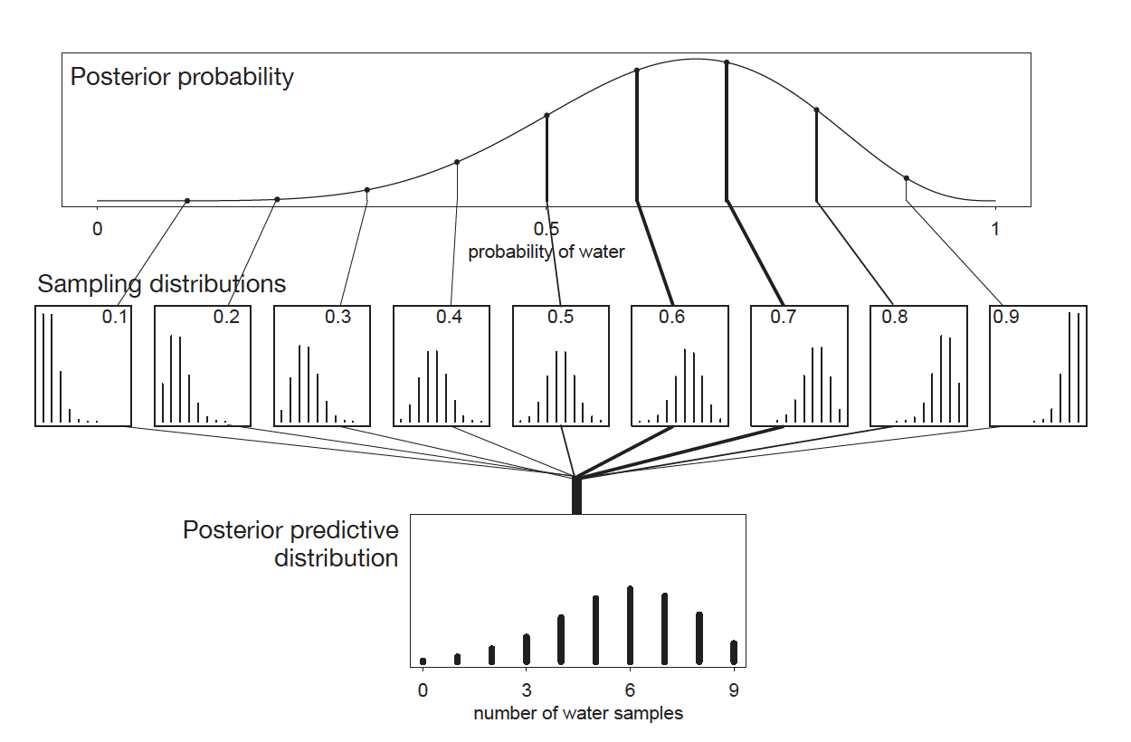
McElreath 2016, Statistical Rethinking

