Slide 1
Introduction to Statistics for Ecology and Evolutionary Biology Multiple Regression Week 07 11 March 2019

Slide 2
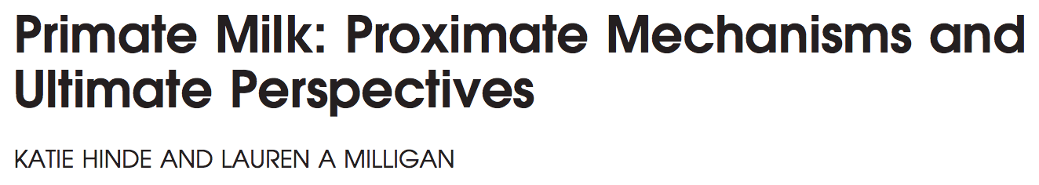
Hinde and Milligan 2011, Evolutionary Anthropology
Notes:
“Milk synthesis, arguably the most physiologically costly component of rearing infants, remains the least studied. Energy transfer becomes energetically less efficient, transitioning from placental support to milk synthesis just as the energy requirements for infant growth, development, and behavioral activity substantially increase.”
Image from: https://www.animalfactsencyclopedia.com/Gorilla-facts.html

Slide 3
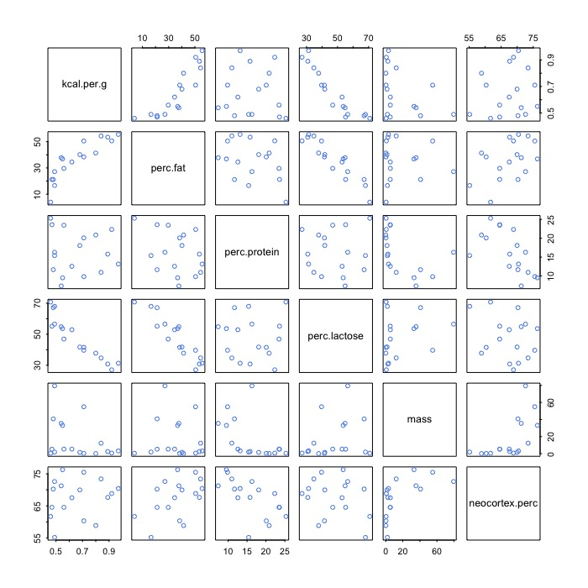
Notes:
Introduce the milk energy dataset
This plot of correlations among variables is generated using the “pairs()” function in R
A common axiom in statistical interpretation is “correlation does not equal causation”
In general, “we should never be surprised to find that two variables are correlated”
And causation is a thorny topic with different field-specific criterion for acceptance
But multiple regression is one approach we can use to try to get beyond simple correlation to something closer to causal mechanisms
Multiple regression is simply including multiple predictor variables in one regression model
CRUCIAL POINT: multiple regression answers the question, “What is the predictive value of a variable, once I already know all of the other predictor variables?”

Slide 4
Benefits of Multiple Regression
Reveals instances of spurious correlation
Can occur when a truly causal predictor is associated with both the outcome and another, spurious, predictor variable
Including both variables together in a regression reveals an effect of the causal predictor and no effect of the spurious predictor
Reveals instances of masking
Can occur when two predictor variables are positively correlated with each other and both correlated with the outcome, but in different directions
Including both variables together in a regression results in increased strength of association for each
Notes:
These benefits only accrue to us if we consider the multiple predictor variables at the same time in our analysis

Slide 5
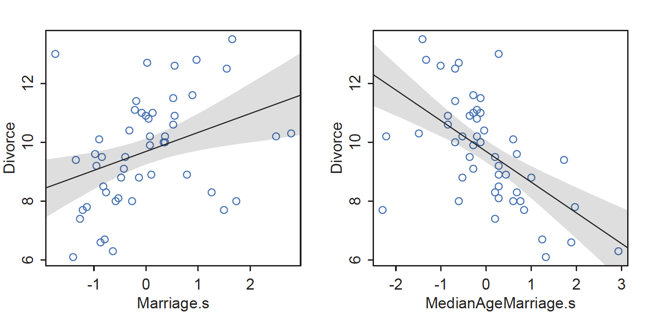
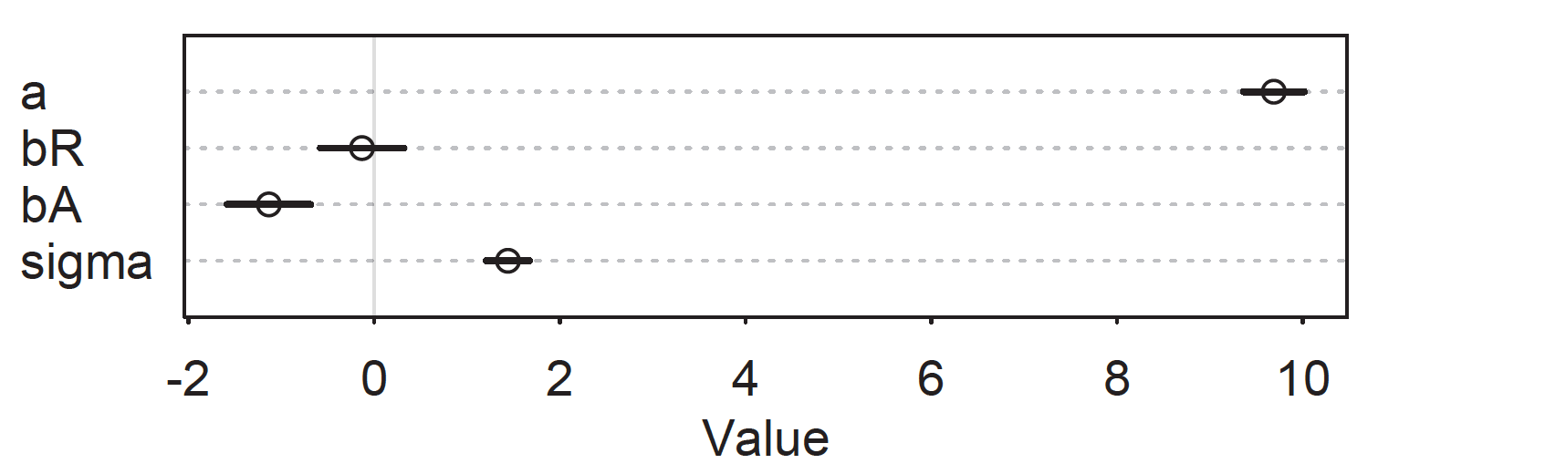
Spurious Correlation
McElreath 2016, Statistical Rethinking
Notes:
The bottom plot shows precis() output if both variables are included in the same model to predict divorce rate
Interpretation: “Once we know median age at marriage for a State, there is little or no additional predictive power in also knowing the rate of marriage in that State.”

Slide 6
Three Visualizations of Multiple Regression Fits
1) Predictor Residual Plots
Show outcome data plotted against residual predictor values
Essentially replicates the calculation that happens automatically within a multiple regression
2) Counterfactual Plots
Implied predictions for arbitrary predictor values
Especially critical for multiple regression since it allows us to imagine variation in one variable with the other held constant
3) Posterior Prediction Plots
Focuses on generating model-based predictions for the original observations and communicating error in those predictions
Notes:
What are residuals?
They’re what’s left over after another variable has been accounted for
You could think of it as the distance from an observation to the best fit line
Note for counterfactual plots: just because we can plot a scenario doesn’t mean we can intervene in the real world in that way
In other words, the counterfactual plot may suggest a lever for potential action that is not actually possible
Show lecture code for plotting two bivariate linear regressions for milk energy

Slide 7
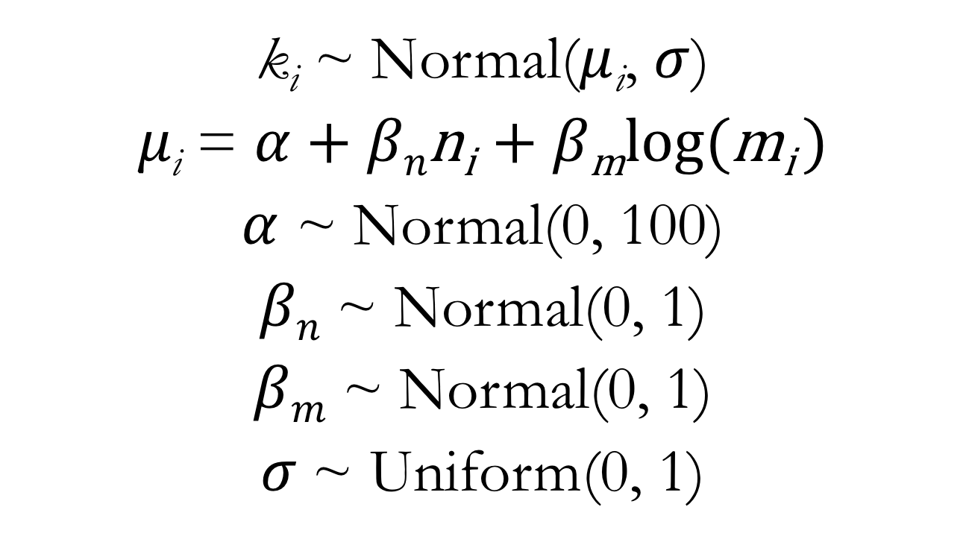
Multiple Regression for Milk Energy Data
k_{i} ~ Normal($μ$_{i}, $σ$)
$μ\text{i}$ = $α$ + $βn\text{n}\text{i}$ + $β\text{m}\text{log}\text{(}\text{m}\text{i}$ )
$α$ ~ Normal(0, 100)
$βn$ ~ Normal(0, 1)
$βm$ ~ Normal(0, 1)
$σ$~ Uniform(0, 1)
Notes:
Our mathematical notation makes it obvious that the value of the Gaussian mean parameter now depends on an observation’s values for multiple predictor variables
Discuss differences between “main effects”, “fixed effects”, “random effects”, and “varying effects”
“What the regression model does is ask if species that have high neocortex percent for their body mass have higher milk energy. Likewise, the model asks if species with high body mass for their neocortex percent have higher milk energy.”

Slide 8
Multiple Regression for Milk Energy Data
m5.7 <- map(
alist(
kcal.per.g ~ dnorm(mu, sigma),
mu <- a + bn*neocortex.perc + bm*log.mass,
a ~ dnorm(0, 100), # prior for the intercept
bn ~ dnorm(0, 1), # prior for the np effect
bm ~ dnorm(0, 1), # prior for the body mass effect
sigma ~ dunif(0, 1) # prior for the standard deviation
),
data = dcc
)
Notes:
Note that “log.mass” here is the log of body mass, as previously calculated and saved as a new variable in the “dcc” data frame
Otherwise, it’s a very direct translation of the mathematical form of the model
Show lecture code for plotting of multiple regression model

Slide 9
So Why Not Include All Predictors All The Time?
1) Multicollinearity
A very strong correlation between two predictor variables
In the extreme, this means the two variables contain the same information
2) Post-Treatment Bias
Including variables that are consequences of other variables
3) Overfitting
Focuses on the utility of a model for out-of-sample prediction
A motivating problem for model selection procedures
Notes:
Not going to discuss post-treatment bias very much and overfitting is for later on in the class

Slide 10
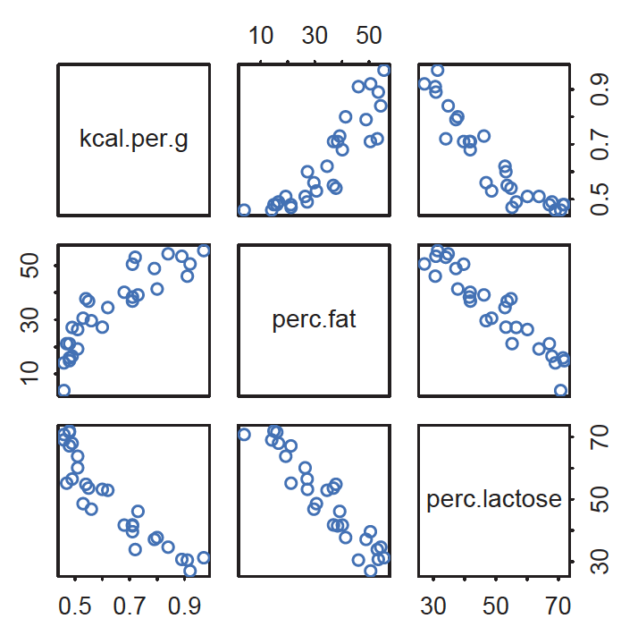
Multicollinearity
McElreath 2016, Statistical Rethinking
Notes:
What if the two predictor variables of interest were percent fat in the milk and percent lactose in the milk?

Slide 11
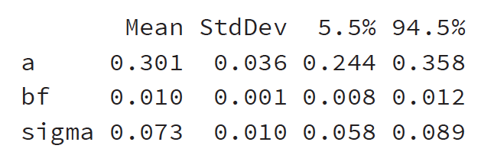
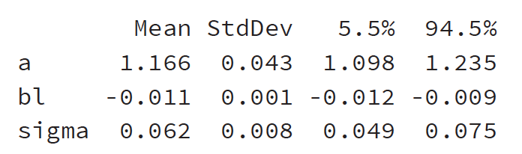
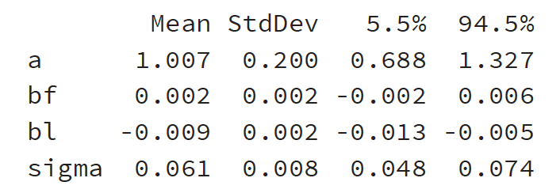
Model with percent fat alone:
Model with percent lactose alone:
Model with both:
Notes:
When both are included together in one model, the estimated effect of each is weaker
The intuitive explanation is that each variable does not help you too much IF you already know the other

Slide 12
Multicollinearity
Identifying multicollinearity:
Plot predictor variables against each other to visualize correlation before modeling
Can be diagnosed during model fitting via inflated parameter estimates
Addressing multicollinearity:
Varies by discipline and norms
Drop one of a pair of variables that is highly correlated
No objective cut off for this though…
Or fit multiple models using the collinear variables in turn

Slide 13
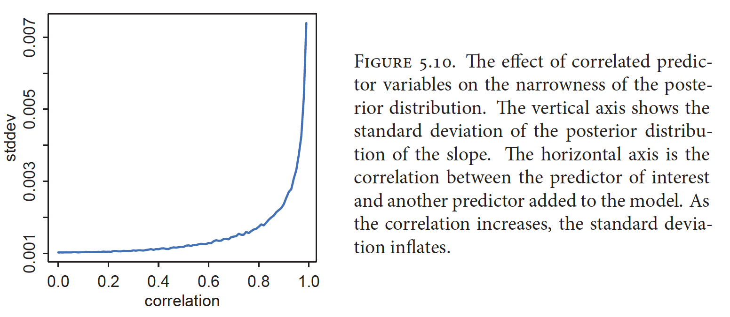
Multicollinearity
McElreath 2016, Statistical Rethinking
Notes:
In general the impact of multicollinearity on model inference will scale (but not linearly) with the magnitude of the correlation between the predictors

Slide 14
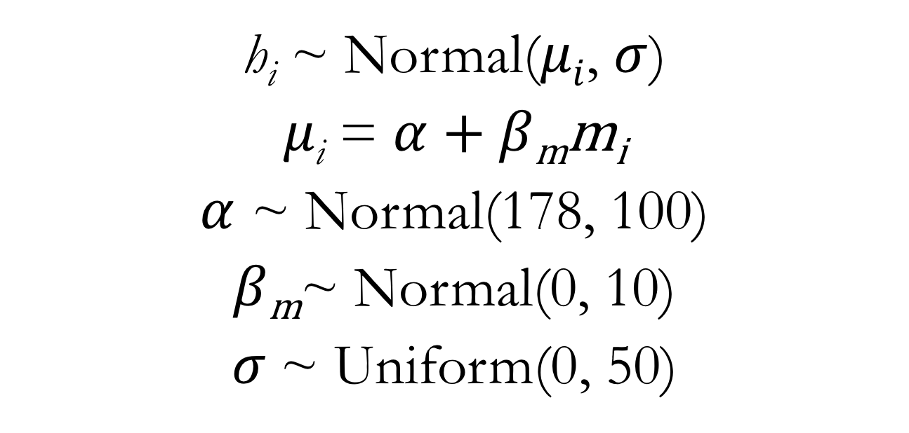
Linear Regression for Human Height: Categorical Predictor
h_{i} ~ Normal($μi$, $σ$)
$μ\text{i}$ = $α$ + $β\text{m}\text{m}\text{i}$
$α$ ~ Normal(178, 100)
$β\text{m}$~ Normal(0, 10)
$σ$~ Uniform(0, 50)
Notes:
The critical difference here is that the predictor variable, ”m”, is simply a binary (dummy) variable that indicates whether or not an observation comes from a male individual

Slide 15
Linear Regression for Human Height: Categorical Predictor
m5.15 <- map(
alist(
height ~ dnorm(mu, sigma),
mu <- a + bm*male,
a ~ dnorm(178, 100),
bm ~ dnorm(0, 10),
sigma ~ dunif(0, 50)
),
data = d
)
Notes:
Show lecture code

