Slide 1
Introduction to Statistics for Ecology and Evolutionary Biology Gaussian Regression Models Week 06 04 March 2019

Slide 2
The Modeling-Prediction Workflow
Data
Raw observations
Model-Based Predictions
Often on same scale as original data
Model Fitting
Use probability density or mass functions (i.e., dnorm, dbinom) to define the likelihood.
Define priors
Prediction Generation
Use random generation functions (i.e., rnorm, rbinom) and posterior samples to, in a sense, run the model in reverse
Model
Inference about model parameters made by examining the posterior and summarizing posterior samples
Notes:
Emphasize the posterior as the focal point of inference; samples from the posterior are often useful
Observation uncertainty: uncertainty about outcome even given a fixed parameter value
Inherent in the use of random generation functions for prediction
Parameter uncertainty: uncertainty about what the true parameter values are
Only incorporated if we feed posterior uncertainty (i.e., posterior samples) into our prediction generation process

Slide 3
Gaussian Models
Attempt to learn about the mean and variance of some (continuous) measurement
A common extension of the basic Gaussian model is to make the mean value itself a function of an additive combination of other variables (i.e., “linear regression”)
This accounts for its broad use in ecology and evolution contexts

Slide 4
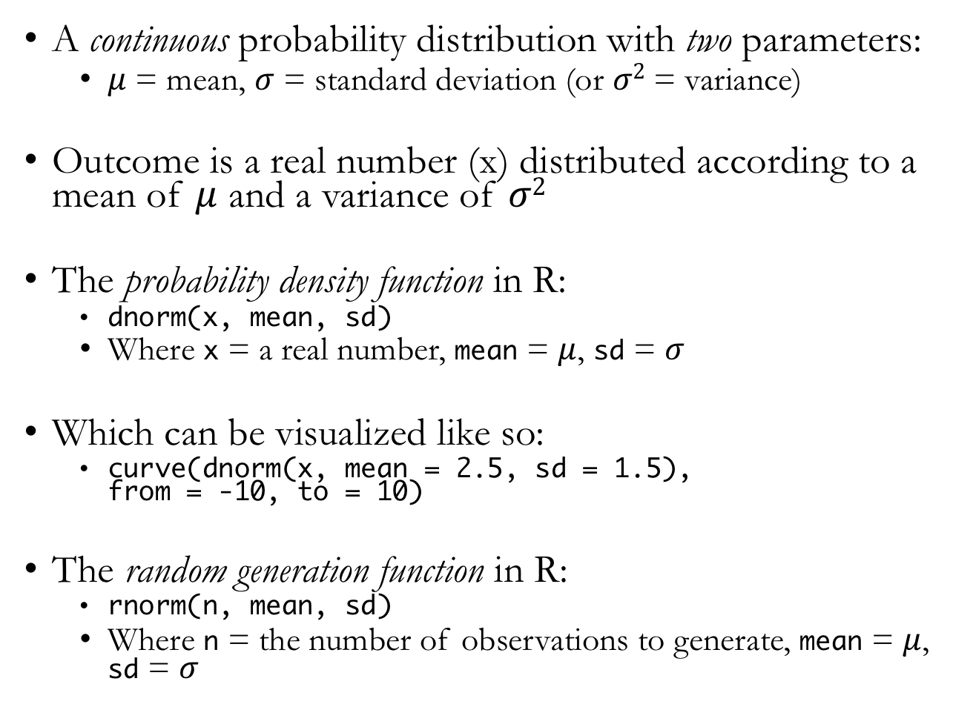
Normal Distribution
A continuous probability distribution with two parameters:
$μ$ = mean, $σ$ = standard deviation (or $σ2$ = variance)
Outcome is a real number (x) distributed according to a mean of $μ$ and a variance of $σ2$
The probability density function in R:
dnorm(x, mean, sd)
Where x = a real number, mean = $μ$, sd = $σ$
Which can be visualized like so:
curve(dnorm(x, mean = 2.5, sd = 1.5), from = -10, to = 10)
The random generation function in R:
rnorm(n, mean, sd)
Where n = the number of observations to generate, mean = $μ$, sd = $σ$
Notes:
Also called the Gaussian distribution

Slide 5
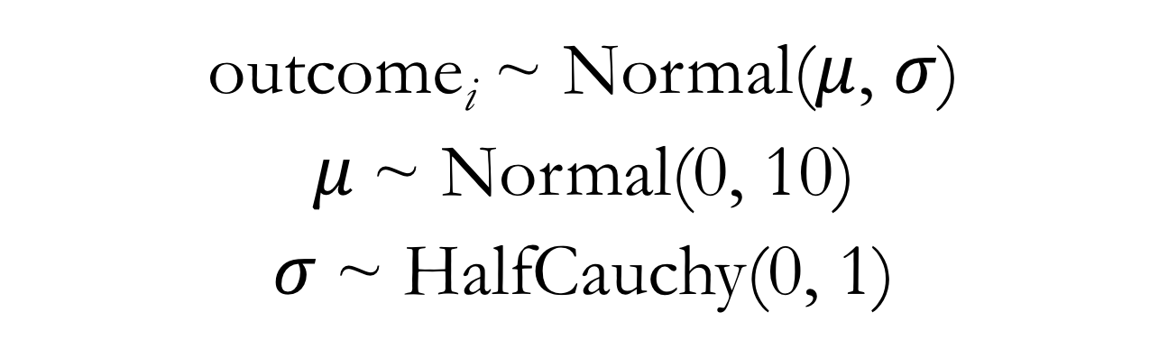
Models in Mathematical Language: Normal Distribution
outcome_{i} ~ Normal($μ$, $σ$)
$μ$~ Normal(0, 10)
$σ$~ HalfCauchy(0, 1)
Notes:
The first line of the model typically relates the outcome variable to the likelihood function
We also need to define prior distributions for all parameters being fit
In later extensions, we will recognize predictor variables that themselves are used to define parameters
The benefit of expressing models in mathematical language is it removes ambiguity about our modeling choices and makes bare all of our modeling assumptions
All lines here describe stochastic (rather than deterministic) relationships

Slide 6
Models in Mathematical Language: Binomial Distribution
w ~ Binomial(n, p)
p ~ Uniform(0, 1)
Notes:
Compare with the estimation process using grid approximation

Slide 7
Fitting Models Using map
A more practical tool than grid approximation for more complex models
But just another way to compute the posterior defined by our Bayesian machinery
Note this is still an approximation of the posterior shape
Treats the posterior parameter distributions as if they have quadratic shapes
Allows us to express our statistical models in something very close to the explicit mathematical language

Slide 8
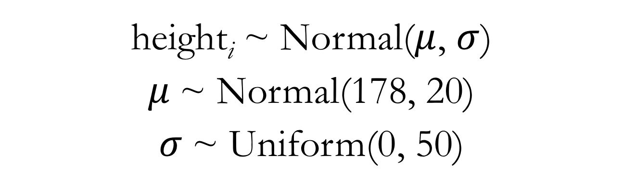
Gaussian Model for Height: Mathematical Language
height_{i} ~ Normal($μ$, $σ$)
$μ$~ Normal(178, 20)
$σ$~ Uniform(0, 50)

Slide 9
Gaussian Model for Height: map Code
m4.1 <- map(
alist(
height ~ dnorm(mu, sigma), # likelihood
mu ~ dnorm(178, 20) , # prior for the mean
sigma ~ dunif(0, 50) # prior for the standard deviation
),
data = d2
)
Notes:
Show lecture code

Slide 10
Linear Regression Terminology
This term is typically used when we have a predictor variable included to model the mean value
Also sometimes called a “linear model”
Generalized linear models – specify a different outcome distribution (coming relatively soon)
Generalized linear mixed models – a particular modeling strategy using varying (aka random) effects (coming later)
Just note that unless otherwise specified, a “linear regression” or “linear model” usually refers to a statistical modeling strategy with a Gaussian (normal) outcome distribution

Slide 11
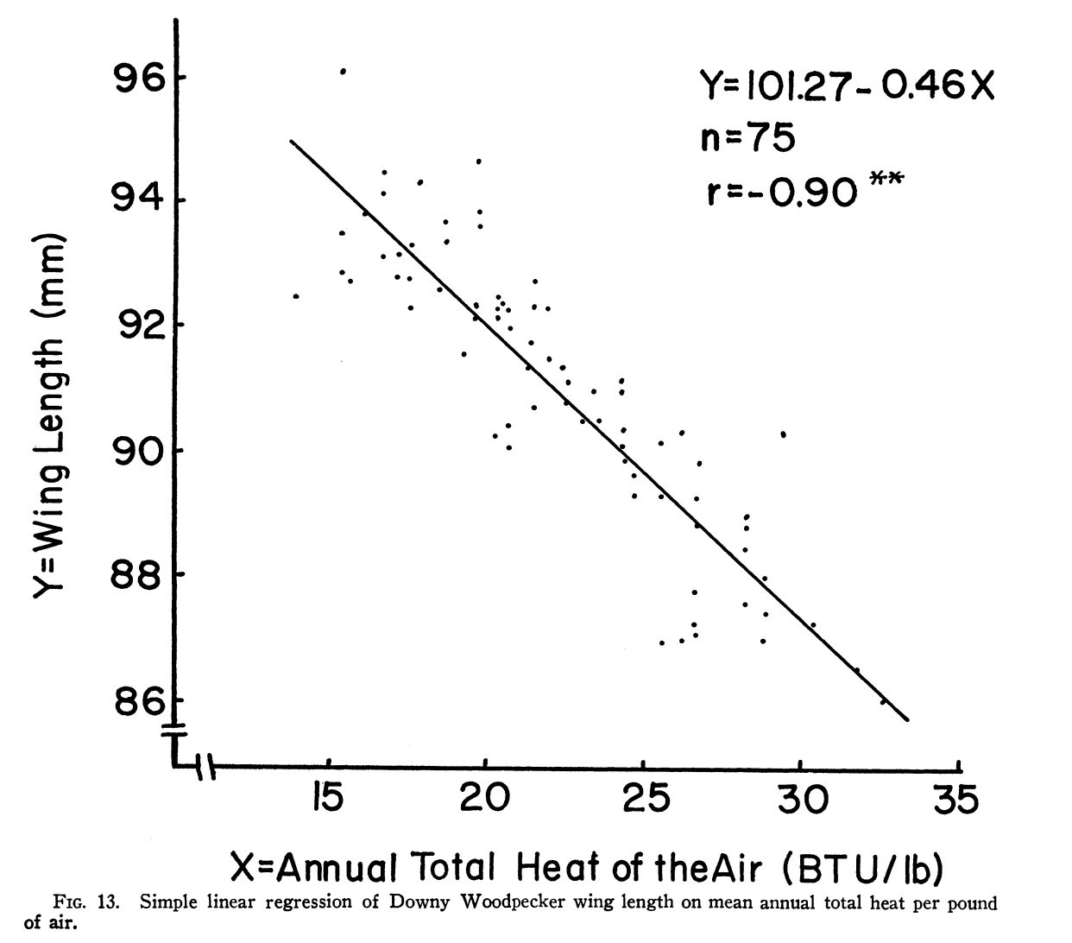
Linear Regression in Ecology and Evolution
James 1970, Ecology
Notes:
In ecology and evolution, linear regression is often used to relate environment drivers to some biological variable (e.g., an organismal, population, or community trait)
Martin 2015: “Biometricians had used linear regression to compare parents to their offspring. Ecologists were using linear regression to compare organisms to their environments.”

Slide 12
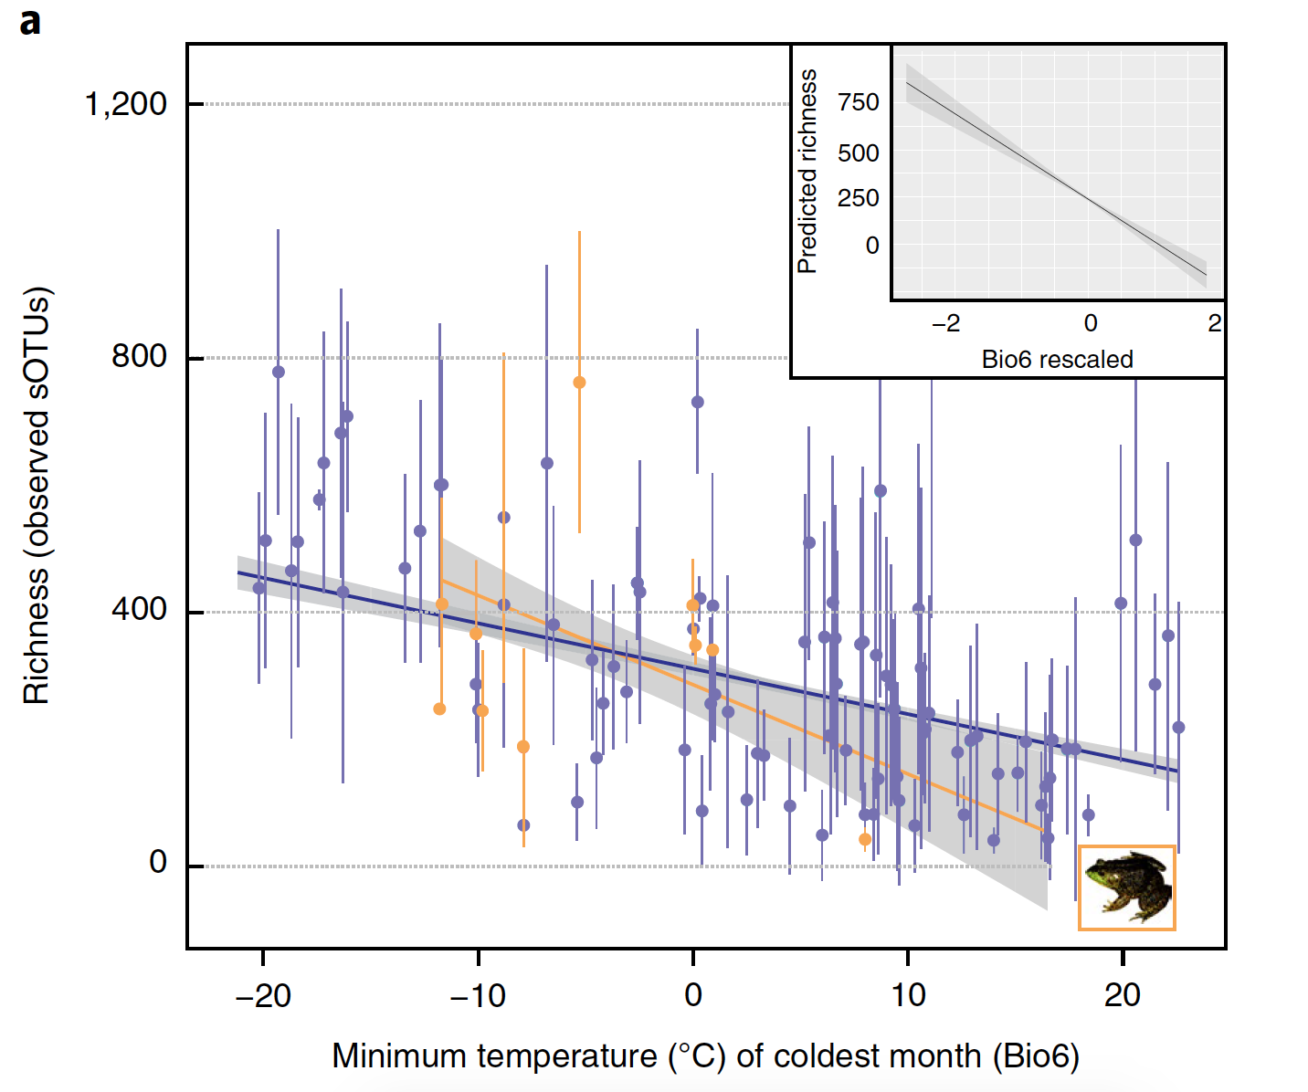
Linear Regression in Ecology and Evolution
Kueneman et al. 2019, Nature Ecology & Evolution

Slide 13
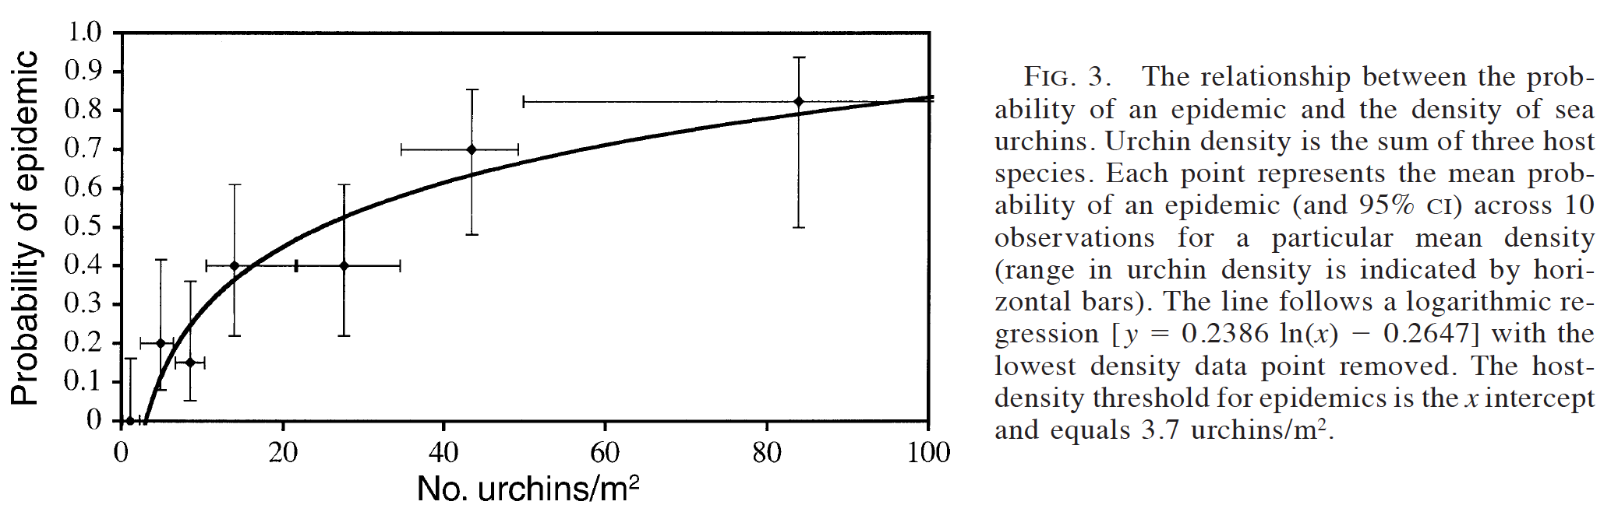
Linear Regression in Ecology and Evolution
Lafferty 2004, Ecological Applications
Notes:
There are also many, many subtle variations on linear regression, like this logarithmic regression
Paper title: FISHING FOR LOBSTERS INDIRECTLY INCREASES EPIDEMICS IN SEA URCHINS

Slide 14
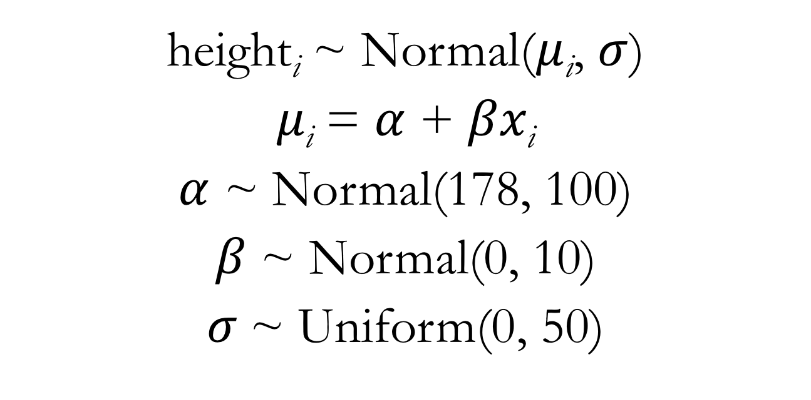
Gaussian Model for Height: Adding a Weight Predictor
height_{i} ~ Normal($μ$_{i}, $σ$)
$μ\text{i}$ = $α$ + $βx\text{i}$
$α$ ~ Normal(178, 100)
$β$ ~ Normal(0, 10)
$σ$~ Uniform(0, 50)
Notes:
This model includes a deterministic node in addition to stochastic nodes

Slide 15
Gaussian Model for Height: Adding a Weight Predictor
m4.3 <- map(
alist(
height ~ dnorm(mu, sigma), # likelihood
mu <- a + b*weight,
a ~ dnorm(178, 100), # prior for the intercept
b ~ dnorm(0, 10), # prior for the slope
sigma ~ dunif(0, 50) # prior for the standard deviation
),
data = d2
)
Notes:
Point out how mu is not being directly modeled now
Discuss interpretation of alpha and beta parameters

Slide 16
Interpretation of Slope Parameters
Slope parameters are often the focus of much attention in the interpretation of linear regression models
The slope parameter quantifies the strength of a variable’s effect on the outcome in question
Significant posterior mass above 0 indicates a positive effect, significant posterior mass below 0 indicates a negative effect, significant posterior mass overlapping 0 indicates lack of an effect
Given this typical use of slope parameters, it often makes sense to employ a prior for slope parameters that is centered at 0
Notes:
Show lecture code

Slide 17
Centering Predictor Variables
Subtract the raw variable mean from each value of the raw variable
Interpretation: a value of 0 for a centered variable corresponds to the mean value of the raw variable
Benefits:
Can improve model fitting
Can improve interpretability of the intercept parameter

Slide 18
Standardizing Predictor Variables
Subtract the raw variable mean from each value of the raw variable and divide by the raw variable’s standard deviation
Or the R function scale() will do this for you
Interpretation: a value of 0 for a standardized variable corresponds to the mean value of the raw variable, and increase in 1 unit of the standardized variable corresponds to a 1 standard deviation increase in the raw variable
Benefits:
Can improve model fitting
Can improve interpretability of the intercept parameter
Allows easier comparison among predictors in a regression model with multiple predictors (i.e., multiple regression)

