Slide 1
Introduction to Statistics for Ecology and Evolutionary Biology MCMC, Link Functions, and Poisson Regression Week 11 08 April 2019

Slide 2
Markov Chain Monte Carlo (MCMC)
Monte Carlo methods are computational algorithms based on repeated random sampling
Markov chains are stochastic models in which the future state can be predicted solely from the current state
Markov chain Monte Carlo methods can allow us to generate samples from a probability distribution
Which probability distribution? The posterior!
Notes:
So, critically, we are moving from describing the posterior distribution by using an approximation to sampling directly from it
The Stan programming language is based on the Hamiltonian Monte Carlo, a specific MCMC algorithm
Show lecture code through map2stan() model fitting

Slide 3
Validating MCMC Chains
Plot chain trace plots to check for stationarity and mixing
Examine fit statistics like Rhat
Values for each parameter should converge towards 1.00
In general, running multiple chains can help assure us that chains are converging on the target distribution
MCMC methods are guaranteed to converge towards the target distribution in the infinite. But we’re not running our chains for infinite time…
Notes:
“Stationarity refers to the path staying within the posterior distribution.”
“A well-mixing chain means that each successive sample within each parameter is not highly correlated with the sample before it.”
Show lecture code of trace plot plotting

Slide 4
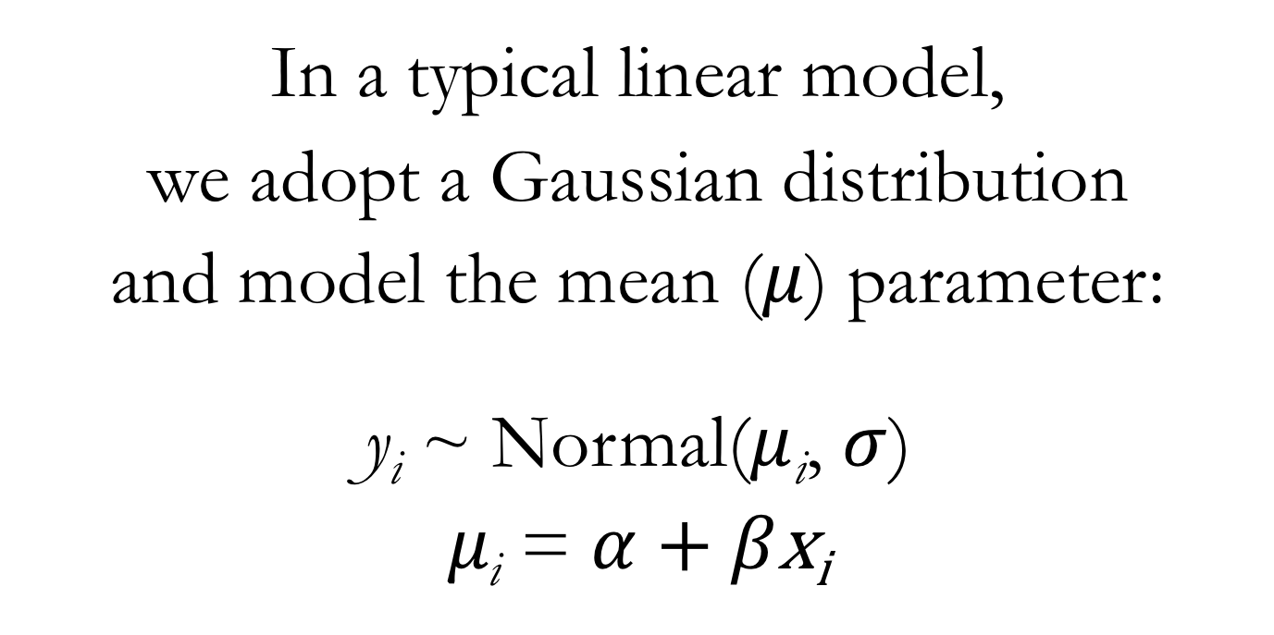
From Linear Models to Generalized Linear Models (GLMs)
In a typical linear model,
we adopt a Gaussian distribution
and model the mean ($μ$) parameter:
y_{i} ~ Normal($μ$_{i}, $σ$)
$μ\text{i}$ = $α$ + $β\text{x}\text{i}$
Notes:
Generalized linear models can be understood as extensions of linear models
Or alternatively, the typical Gaussian linear model is a particular case of a generalized linear model

Slide 5
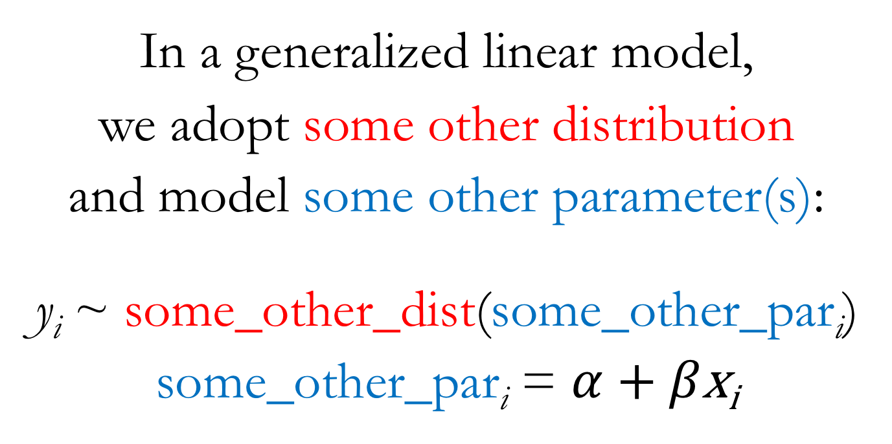
From Linear Models to Generalized Linear Models (GLMs)
In a generalized linear model,
we adopt some other distribution
and model some other parameter(s):
y_{i} ~ some_other_dist(some_other_par$\text{i}$)
some_other_par$\text{i}$ = $α$ + $β\text{x}\text{i}$
Notes:
With a GLM, we’ll use a different outcome distribution
And different outcome distributions will imply different parameters that we can use as the target of the modeling strategies we’ve learned so far

Slide 6
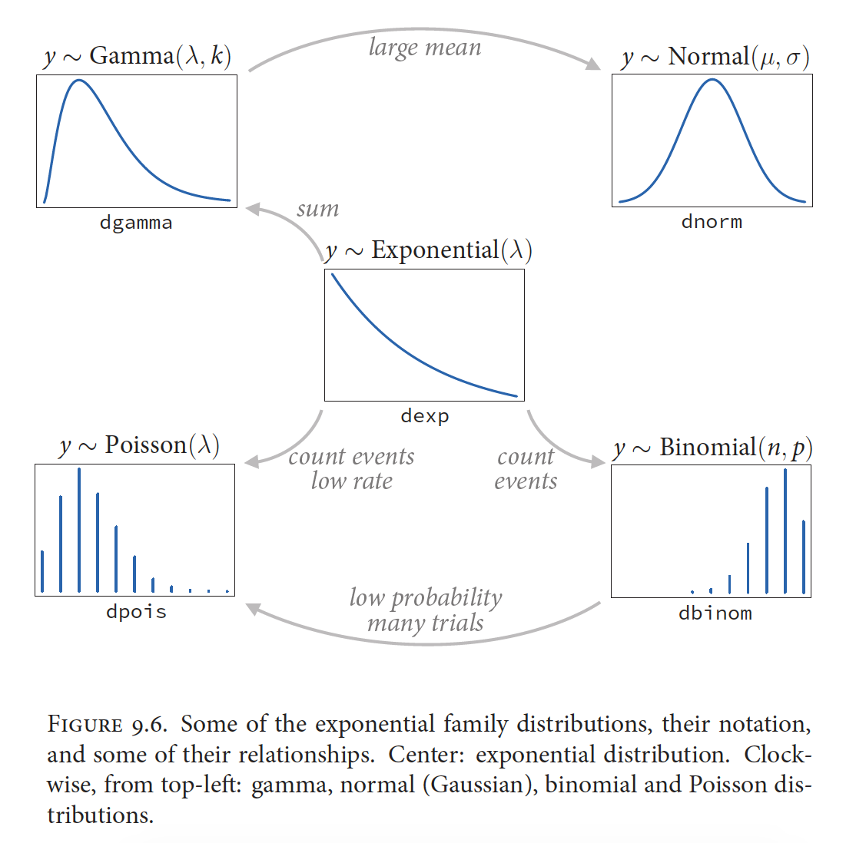
McElreath 2016, Statistical Rethinking

Slide 7
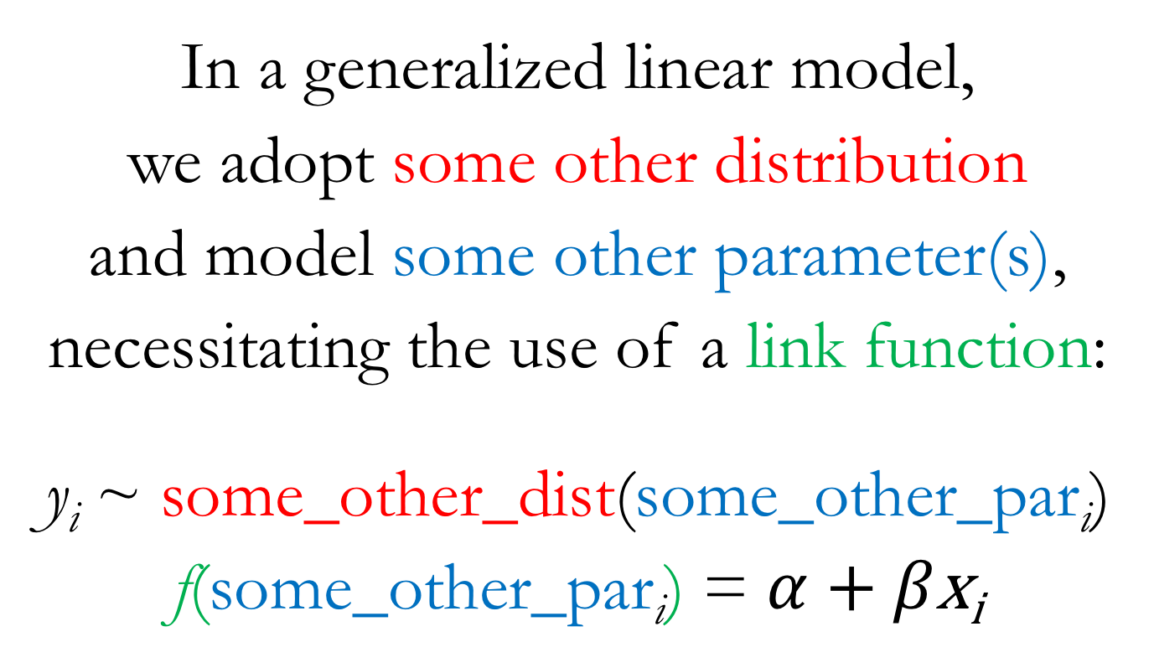
From Linear Models to Generalized Linear Models (GLMs)
In a generalized linear model,
we adopt some other distribution
and model some other parameter(s),
necessitating the use of a link function:
y_{i} ~ some_other_dist(some_other_par$\text{i}$)
f(some_other_par$\text{i}$) = $α$ + $β\text{x}\text{i}$
Notes:
Additionally, modeling of these new parameters will usually necessitate the use of a link function
This is because the new parameters we’ll be interested in modeling are typically not unbounded in both directions
Conveniently, the target of most of our modeling effort so far, the mean parameter in a Gaussian distribution, has been unbounded in both directions, making it easier for us up until this point

Slide 8
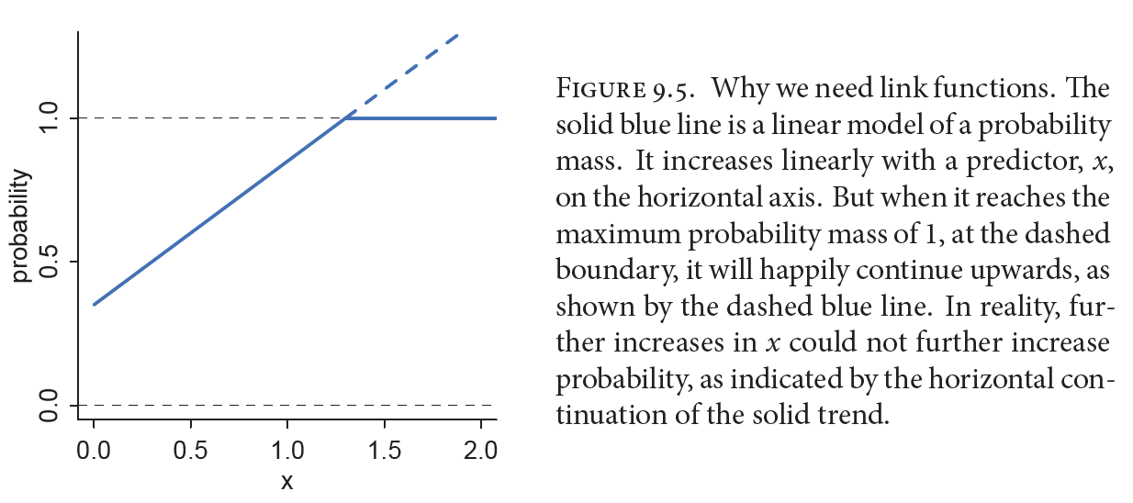
The Necessity of Link Functions
McElreath 2016, Statistical Rethinking
Notes:
“A link function’s job is to map the linear space of a model…onto the non-linear space of a parameter like...So f is chosen with that goal in mind.”

Slide 9
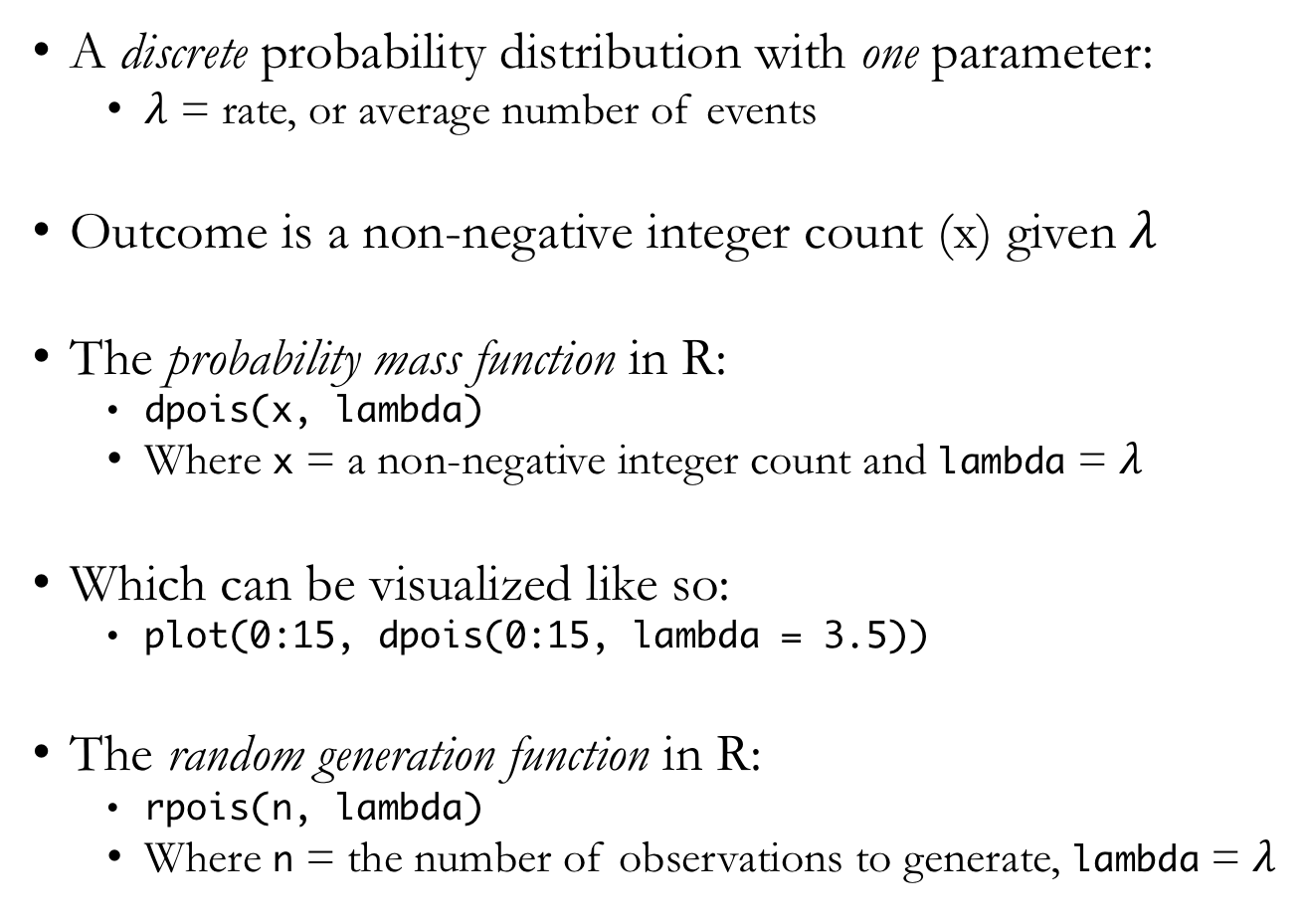
Poisson Distribution
A discrete probability distribution with one parameter:
$λ$ = rate, or average number of events
Outcome is a non-negative integer count (x) given $λ$
The probability mass function in R:
dpois(x, lambda)
Where x = a non-negative integer count and lambda = $λ$
Which can be visualized like so:
plot(0:15, dpois(0:15, lambda = 3.5))
The random generation function in R:
rpois(n, lambda)
Where n = the number of observations to generate, lambda = $λ$
Notes:
Note that a Poisson distribution is defined by a single parameter, lambda, which must be defined using positive, real values
Show lecture code on the Poisson distribution

Slide 10
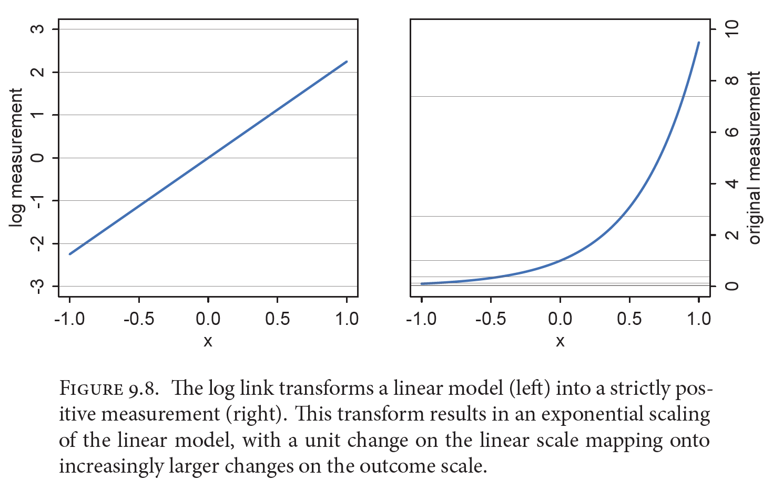
Log Link for Poisson GLMs
McElreath 2016, Statistical Rethinking
Notes:
“The second very common link function is the log link. This link function maps a parameter that is defined over only positive real values onto a linear model.”
The use of link functions means that the impact of a parameter estimate on the outcome can’t be easily ascertained through inspection of the parameter value since the impact on the outcome depends on where in the parameter space you are
Thus, plotting predictions becomes even more important when we’re using link functions

Slide 11

Poisson GLM
y_{i} ~ Poisson($λ\text{i}$)
log($λ\text{i}$) = $α$ + $β\text{x}\text{i}$

Slide 12
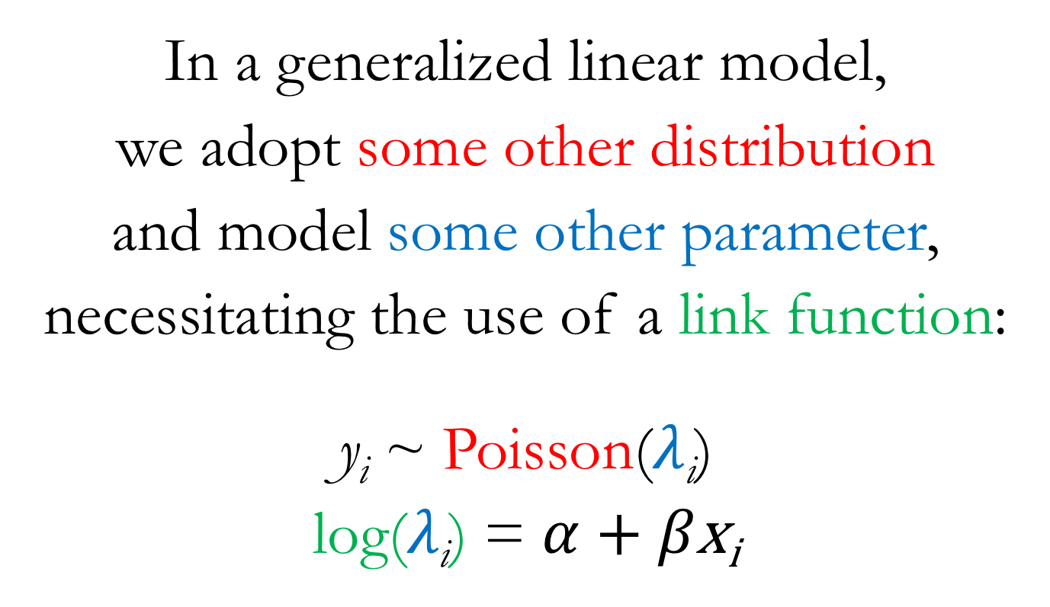
Poisson GLM
In a generalized linear model,
we adopt some other distribution
and model some other parameter,
necessitating the use of a link function:
y_{i} ~ Poisson($λ\text{i}$)
log($λ\text{i}$) = $α$ + $β\text{x}\text{i}$

Slide 13
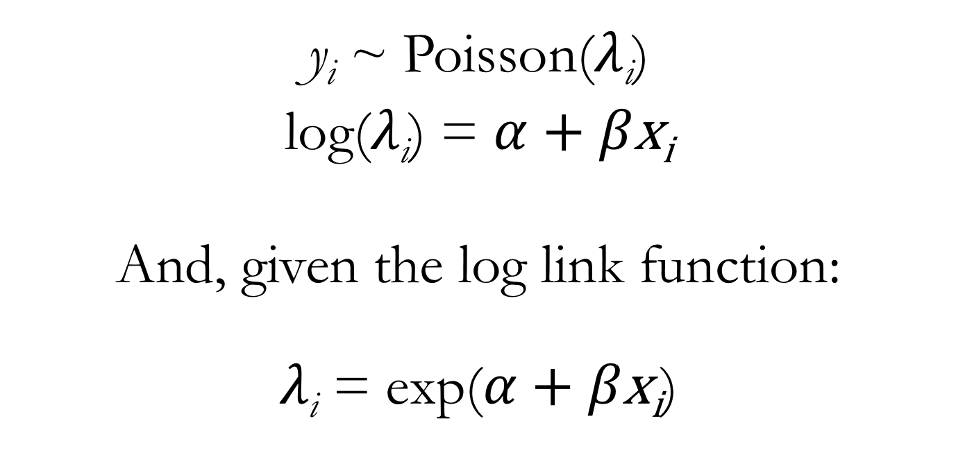
Poisson GLM
y_{i} ~ Poisson($λ\text{i}$)
log($λ\text{i}$) = $α$ + $β\text{x}\text{i}$
And, given the log link function:
$λ\text{i}$ = exp($α$ + $β\text{x}\text{i}$)
Notes:
So you can think about this one of two ways:
The linear portion of our model is used to model the log-transformed parameter value (which puts it on the unbounded scale)
OR: the raw parameter value is defined by applying the inverse link function (the exponential) to the linear portion of the model (forcing the linear portion of the model to take on real, positive values)

