Slide 1
Introduction to Statistics for Ecology and Evolutionary Biology Bayesian Basics Week 04 18 February 2019

Slide 2
Thomas Bayes
Notes:
English statistician and Presbyterian minister

Slide 3
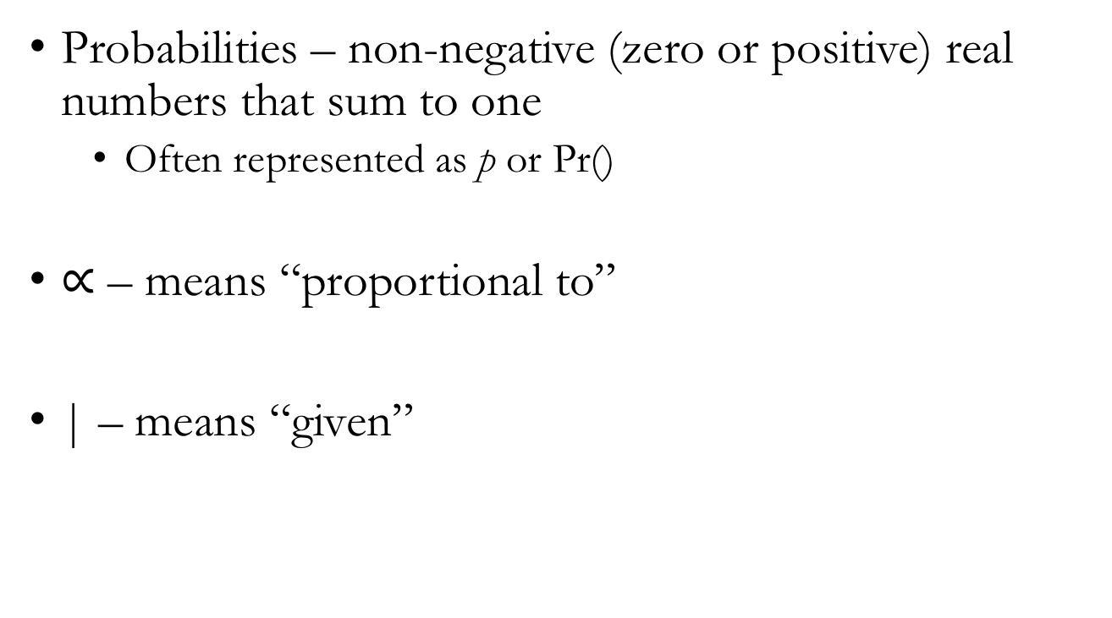
Initial Definitions and Notation
Probabilities – non-negative (zero or positive) real numbers that sum to one
Often represented as p or Pr()
$∝$ – means “proportional to”
| – means “given”

Slide 4
Initial Definitions and Notation
If we want to know the probability of both of two independent events, A and B, occurring:
Pr(A and B) = Pr(A ∩ B) = Pr(A) * Pr(B)
If we want to know the probability of either of two mutually exclusive events, A and B, occurring:
Pr(A or B) = Pr(A ∪ B) = Pr(A) + Pr(B)

Slide 5
Summary of Bayesian Inference
We make formal conjectures about the state of the world, or at least our representation of it,
(assign prior probability distributions to parameters)
and modify this information in the light of evidence
(data)
to produce updated inference
(posterior probability distributions)

Slide 6
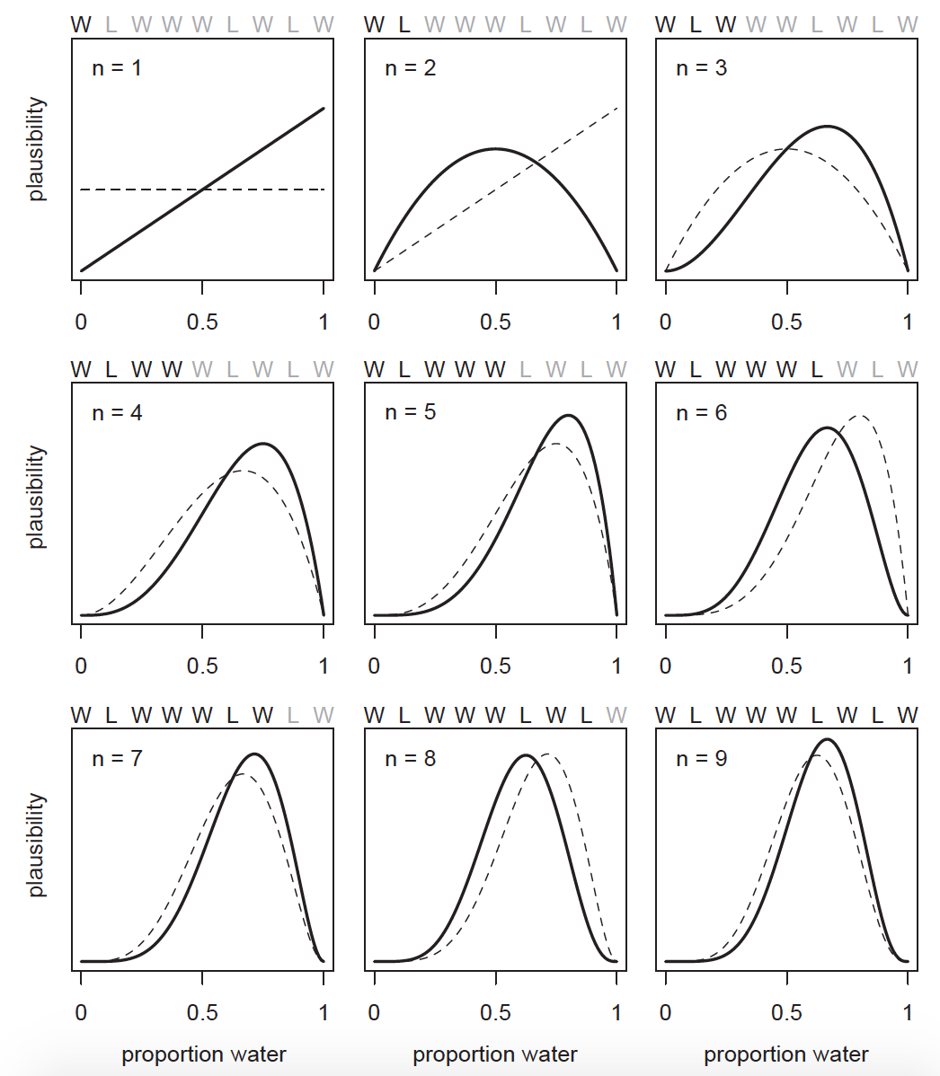
Notes:
Key points:
Updating plausibility in the light of evidence from the data. Observed Ws move the curve to the right, observed Ls move it to the left.
Maximum relative plausibility increases with data
Highlights the importance of sample size

Slide 7
Formalizing Bayesian Inference
Likelihood – mathematical formula that specifies the plausibility of the data
Parameters – quantities we wish to estimate from the data
Prior – initial set of plausibilities for a parameter
Priors with no information: “flat”, “naïve”, or “un-informative”
Priors with some information: “regularizing” or “weakly informative”
Notes:
Show dbinom() function in R script to emphasize the fact that the likelihood function is showing us the relative plausibility of different outcomes

Slide 8
Formalizing Bayesian Inference
Once a likelihood, parameter(s), and prior(s) have been specified, you expose them to data to generate inference
The resulting inference is represented by the posterior
Posterior distribution – the relative plausibility of different parameter values, given the data observed

Slide 9
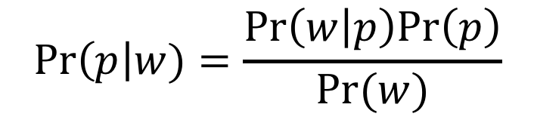

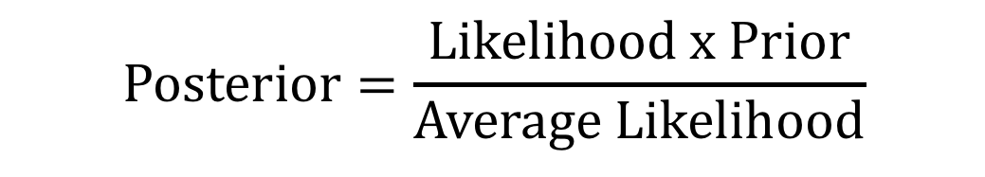
Bayes’ Theorem
$$\operatorname{Pr}\left(p\right|w)=\frac{Pr\left(w | p\right)Pr\left(p\right)}{Pr(w)}$$
$$\operatorname{Posterior}{=\frac{Likelihood x Prior}{Average Likelihood}}$$
$$\operatorname{Posterior}{∝}Likelihood x Prior$$
Notes:
“The key lesson is that the posterior is proportional to the product of the prior and the likelihood.”

Slide 10
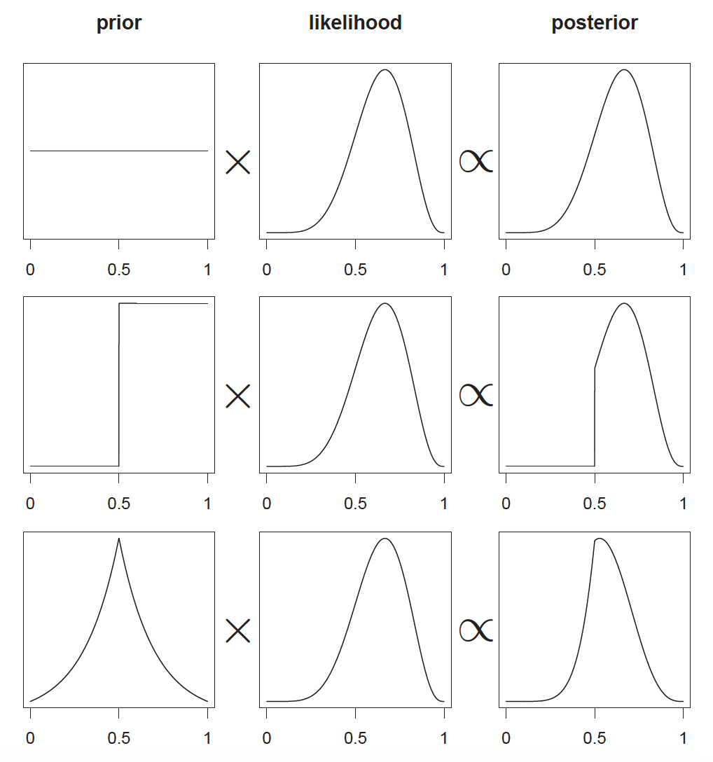
Notes:
These graphics highlight that the posterior is the result of a multiplicative interaction between the prior and the likelihood

Slide 11
Three Numerical Methods for Bayesian Inference
1) Grid approximation
This week and next week using standard R functionality
2) Quadratic approximation
Most of the rest of the semester using rethinking package functions
3) Markov chain Monte Carlo (MCMC)
A little bit further into the semester using rethinking package functions that call Stan

Slide 12
Important Caveats
Posterior distributions are a reflection of model’s certainty about a parameter given the assumptions built into the model
No guarantee the model is a good one
“All models are wrong, but some are useful”

