Slide 1
NumPy

Slide 2
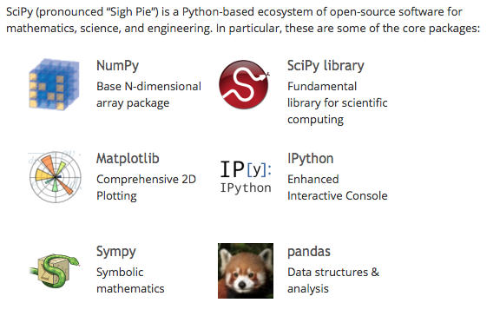
Scipy

Slide 3
NumPy
NumPy is the fundamental package for scientific computing with Python. It contains among other things:
a powerful N-dimensional array object
sophisticated (broadcasting) functions
useful linear algebra, Fourier transform, and random number capabilities
tools for integrating C/C++ and Fortran code

Slide 4
Tentative NumPy Tutorial
Web : http://wiki.scipy.org/Tentative_NumPy_Tutorial

