Slide 1
Tourist Guide Team: Bell
Anh Tuan Nguyen lndhf@mail.umkc.edu
Mohit Sriram Tirumala mtkdd@mail.umkc.edu
Alekhya Thangallapelly atzd3@mail.umkc.edu

Slide 2
Goal
Our goal is to create an GIS based application for android devices.
In this App, the users can do the following:
Login and logout using a Facebook or Google account.
Enter a city and get places including tourist attractions, hotels, bars, hospitals, etc.
The user can see some information about a place like the address, contact no, photos, opening hours, reviews, etc.
They can view the location in map.

Slide 3
Technologies
We have used the following technologies:
Ionic/Angular framework.
Google Maps Platform: Maps API and Places API.
We have used Firebase for social login.

Slide 4
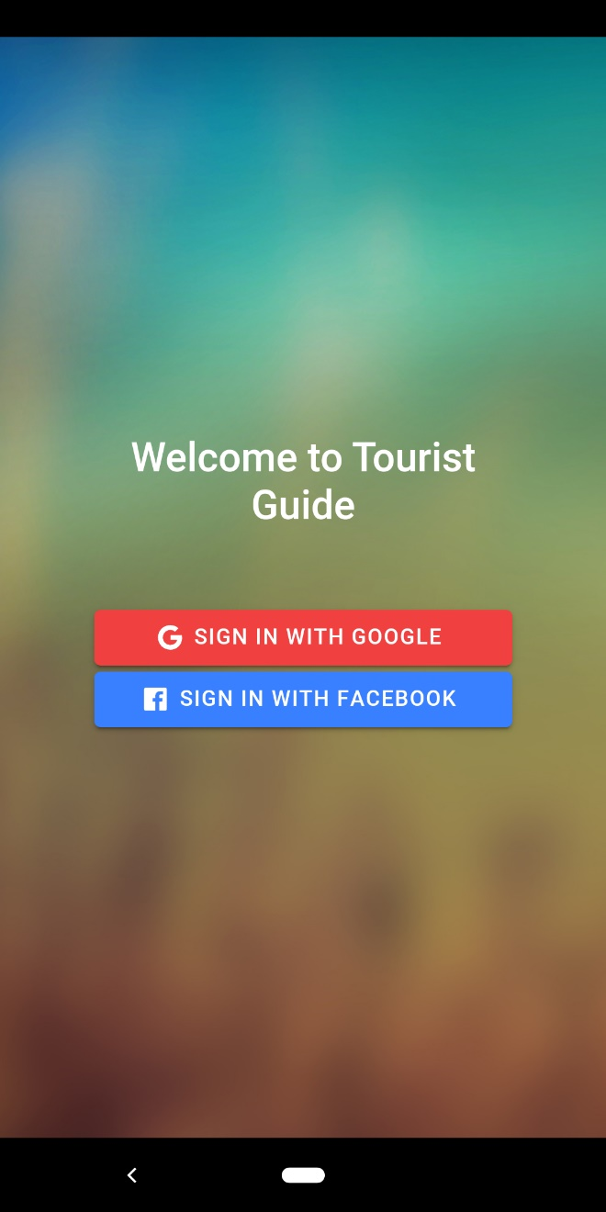
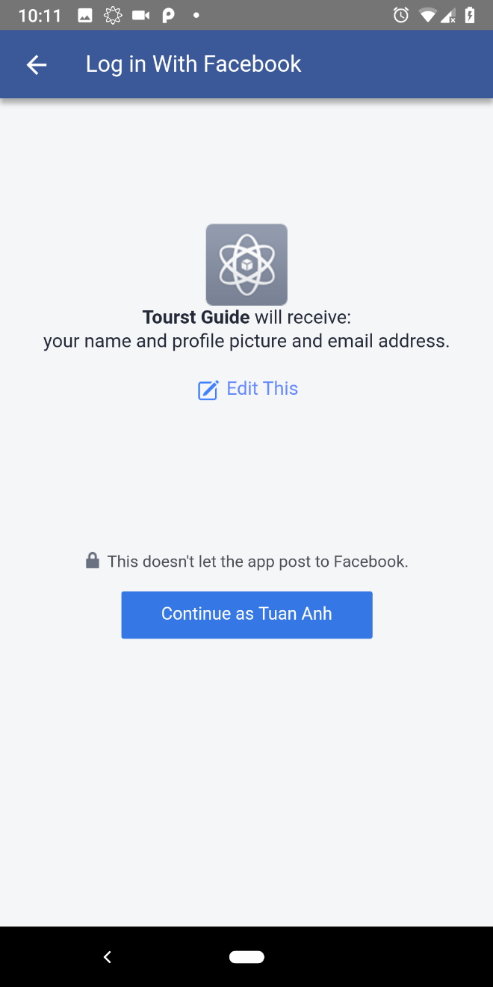
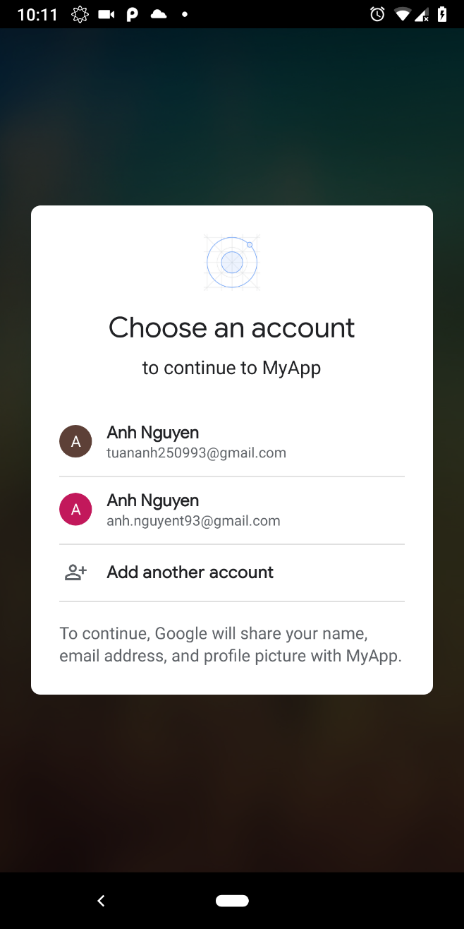
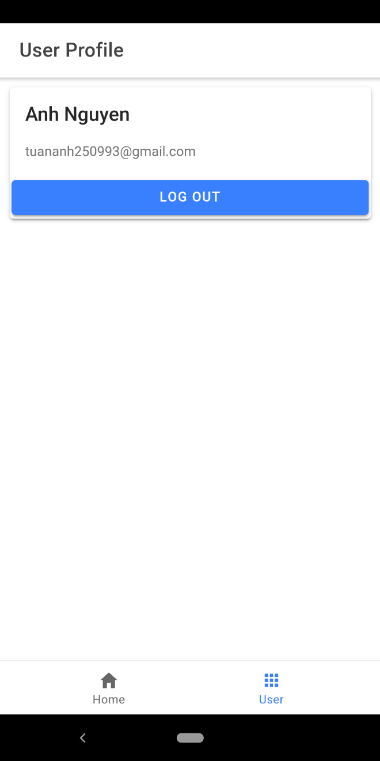

Slide 5
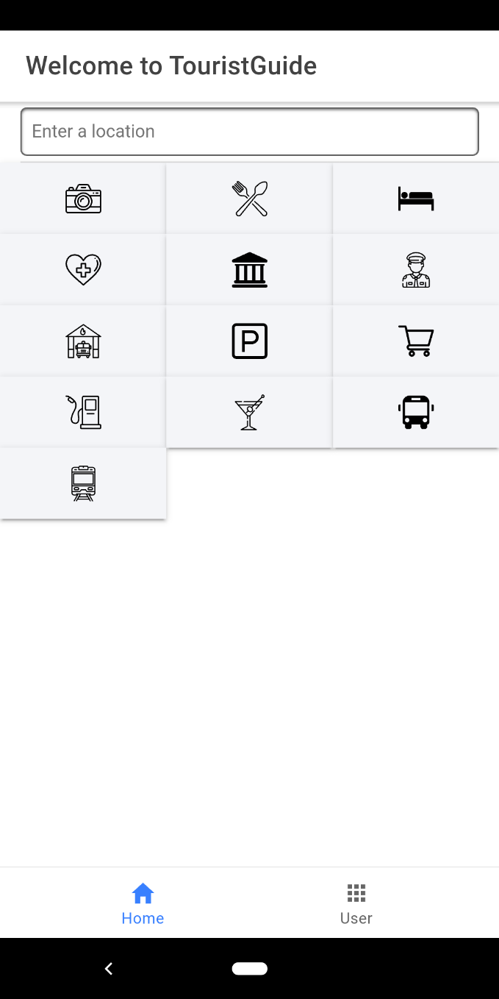
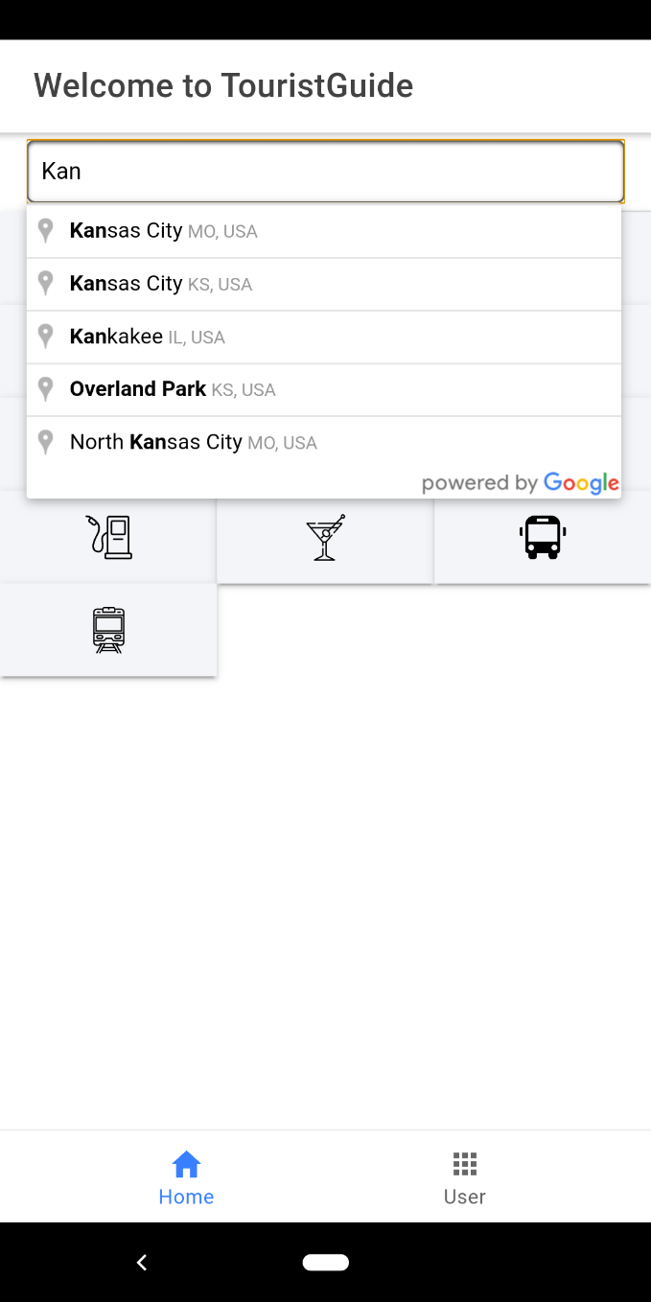

Slide 6
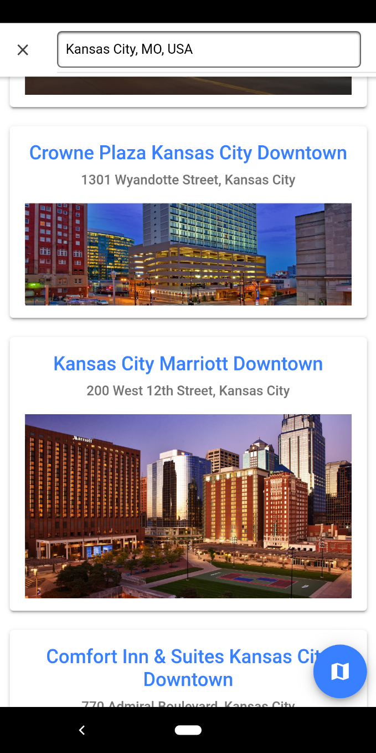
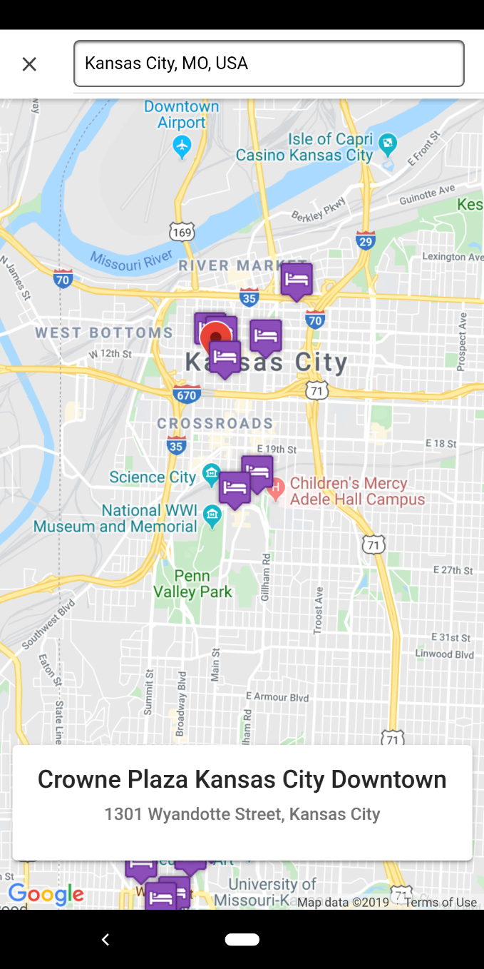

Slide 7
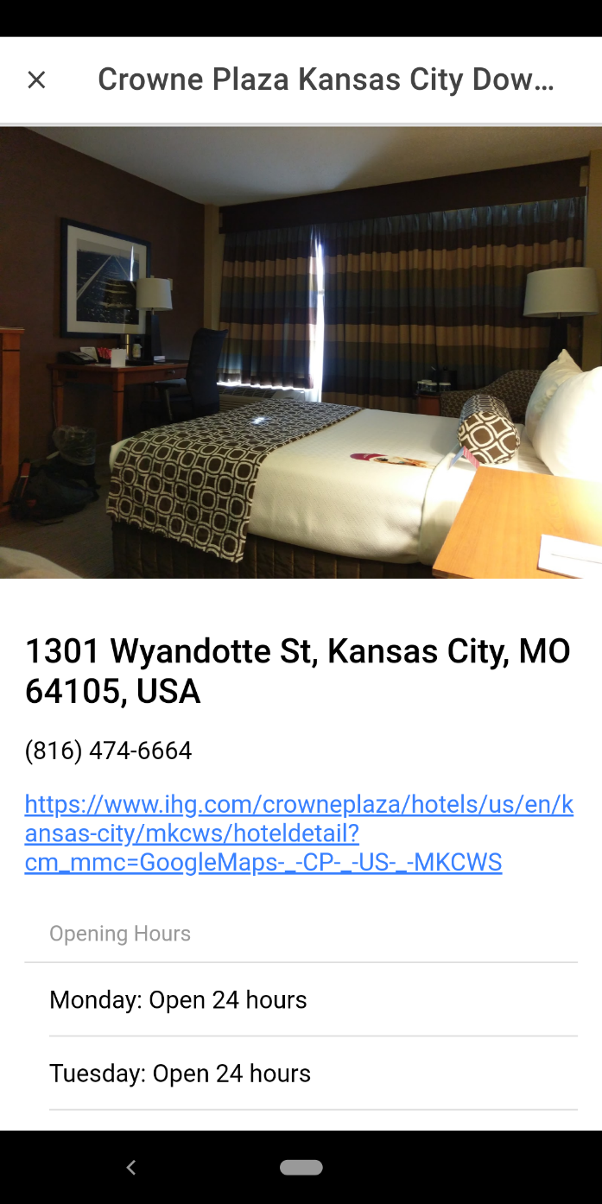
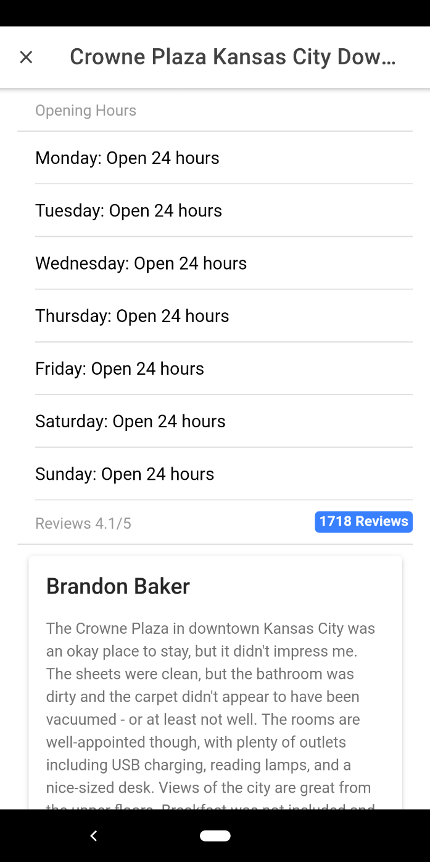

Slide 8
Thank You !

