Slide 2
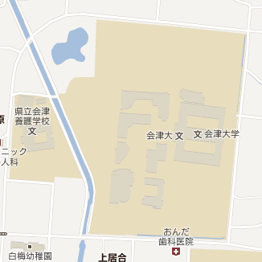
Area Estimating
min Lat, max Long
center Lat, center Long
max Lat, min Long

Slide 3
Victim Priority Determining
Idea: Add weight to victim’s situation, calculate point, comparing point and determine priority level.
Heavy weighted - characteristics:
Urgency: Immediate: 20, Expected: 16, Future: 10, Past: 0.
Severity: Extreme: 15, Severe: 12, Moderate: 8, Minor: 4.
Light weighted - characteristic:
Wait time: <30minutes: 1,
30m-1h: 2
1 day – 2 days: 3 …

Slide 4
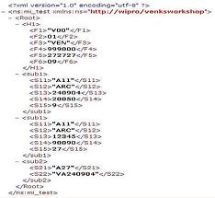
Dataflow from Database
Message Table
(Message) Info Table
Area Table
………
………
………
Store
PHP
Update
ArrivedMessage Table
………
Emergency
Web
Arrived Message
Combine
User Table
………

Slide 5
Victim
Disaster Support Center Server
Rescue Commanding Center
Personal mobile devices + Applications
Monitor Web Page
SQL Database +
PHP
Pulling and Pushing Data
HTML + Javascript
Send Message

Slide 6
Server
Database
Message | Info | Area
…. | … | ….
PHP
Store
Arrived Message Table
….
Emergency Web
The latest massage sent by each user.
Combine
Arrived Message
UserTable
….

Slide 7

PHP
HTML
JavaScript

Slide 8
Recommending | Processing
Immediate | Immediate
Expected | Expected
Future | Future
Past | Past
Unknown | Unknown

Slide 9
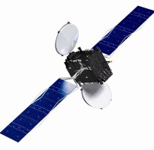
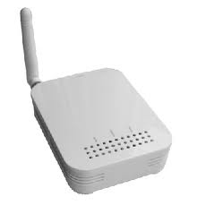
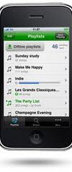

GPS
Server
Commanding Center
PHP
Victims
Mesh Wireless Network
Personal mobile devices + Applications
SQL Database
Web Page
Monitoring Web Page
Message
<xml version = 1.0/>
<info></info>
Process, Store
Disaster Rescue Support
Web Page
PHP
SQL

Slide 10
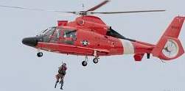
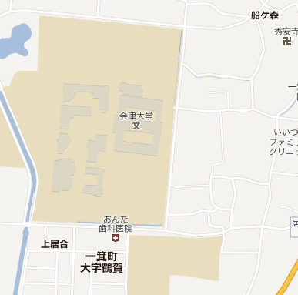
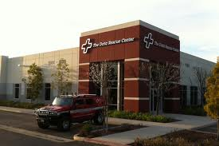
Roger! Ready to pick up
I’m here. Help me!

Slide 11
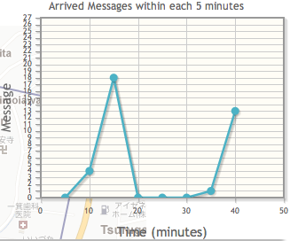
There are 18 messages arrived between 10 minutes to 15 minutes ago
There are no message arrived between 30 minutes to 35 minutes ago

Slide 12
Data flow
Server
PHP
Web Page
JS
GetData() – trigger each 10s (request .php file)
Database
Refresh Map()
Refresh Graph()
Refresh Recommend Queue()
Sort victims order on Recommend Queue

