Slide 1
Design and Implementation of the Commanding Center for WMNDMS
Nguyen Tat Thang
University of Aizu
Computer Communications Lab 305E
Wireless Mesh Network Project
Notes:
My project in the last year – The wireless mesh network based Disaster management support system.
I will focus on my work which is designing and Implementing the Commanding Center for that system

Slide 2
Content
About the project
  The project’s motivation
  The system’s aspect
Client side interface - Emergency Support Web Page
  Data controlling
  Demonstration
Notes:
The main content of the network:
_ present about the whole system
_ the main part of the commanding center support – Emergency Support Web Page

Slide 3
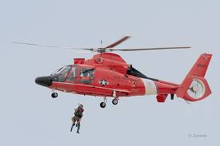
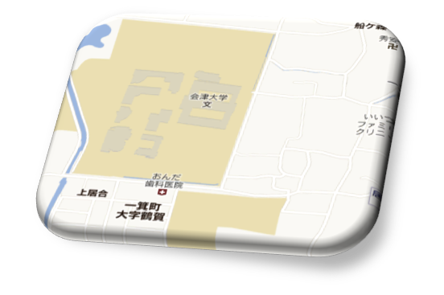
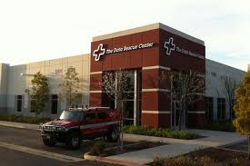
About WMNDMS
Connect victims and rescue team
Saving people’s life
Roger! Ready to pick up
I’m here. Help me!

Slide 4
The motivation
Difficulties of searching and rescuing victims on devastated areas.
"Near" means "fast". Local support is crucial
Need a reliable and easy deployable community network.
The advantage of Mesh Wireless Network on establishing and expanding connection coverage.
1
Notes:
In disaster we need fast response and near – it mean local support is crucial
For local support, we need reliable and easy deployable community network

Slide 5
System’s Aspect
Victims use mobile devices, send messages about their situation to Rescue Commanding center.
The Web Page monitor all victim's situation for Rescue Commanding Center.
Medium between victims and Commanding Center: MESH NETWORK.
2

Slide 6
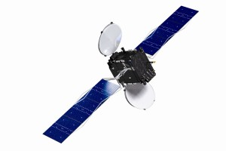
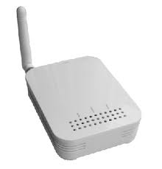
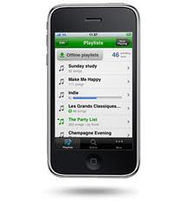

System’s Aspect
From victim to Rescue Commanding Center
GPS
Server
Commanding Center
Victims
PHP
Personal mobile devices + Applications
Mesh Wireless Network
Monitoring Web Page
SQL Database
Web Page
Message
<xml version = 1.0/>
<info></info>
Process, Store
Disaster Rescue Support
Web Page
PHP
SQL
3
Notes:
I have focused on the software run on server to process and store data and the web page.
In fact, the software on server plays the role of collecting, storing and processing data. And Duy and Bach has focused on collecting and storing function.

Slide 7


Commanding Center Web Page
PHP
HTML

Slide 8
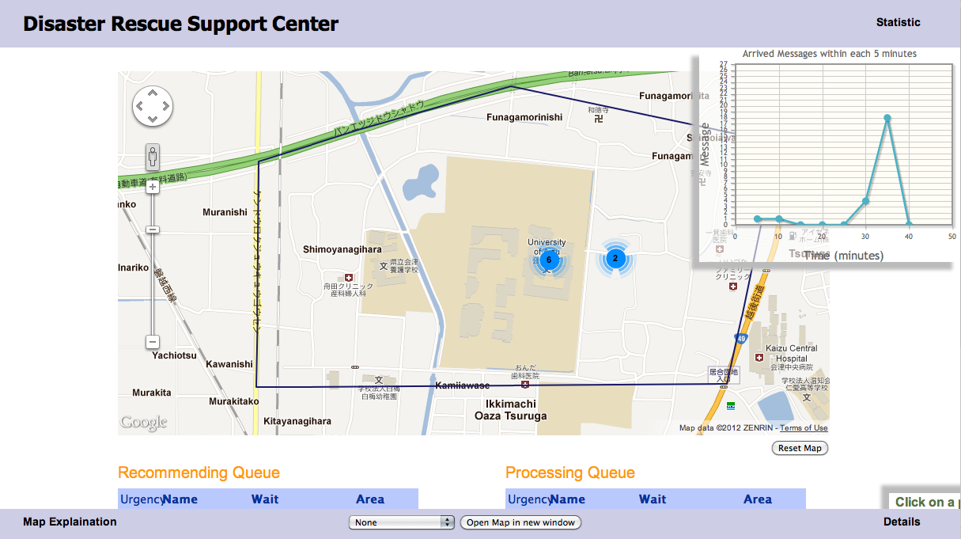
Notes:
The web page looks simple with a large map. Two tables, some pop up components to show the additional information.
I just go forward and will come back here for the demonstration later.

Slide 9
The Web Page
Problem on disaster monitoring:
Where are victims
How to determine priority on victim rescuing
How are special conditions of victims
Indicate position and Sort out victims
4
Notes:
The biggest question: where – are – the – victims
The second also as important as the first: how –to - …
Because we will as much victims will be alive as possible

Slide 10
The Web Page
Two queues of victims:
Recommending list: Victims who have sent messages will be add into this queue.
Processing list: Queue of victims who are going to be rescued with order determined by The Rescue Commander.
Victims can be switched between two queues.
The two queue will be effective with multi-interface system.
5
Notes:
Come back to web page and demo the function of the tables:
_ As you see, we have some victim in the Recommending Queue and another in the Processing Queue.
_ The victims who are in Recommend with be denote by round pin and the cross shape pin is for Processing Queue.
_ The pentangle denote the area we are focusing in, now it is UoA area.
_ We have some important information here - the urgency – the name of victim – the wait time – the place which is automatically estimated by system.
_ This wait time is calculated from the moment that victim sent the first emergency message.
_ Some details are shown on details area.
_ Click on table row to select the victim, show details, change them to processing list or vice versa.

Slide 11
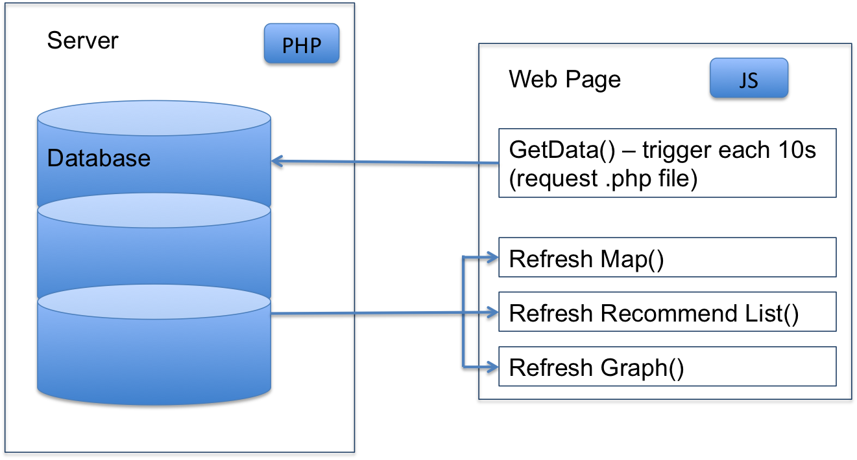
The Web Page – Data Flow
Web Page request data from Server via GET method.
The Server pull data from database and pass to Web Page.
The process is handled by PHP.
6
Notes:
_ Demo the graph.

Slide 12
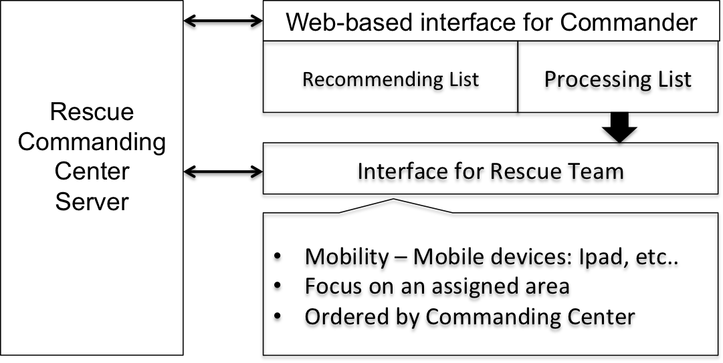
Future Work
Develop interface software for rescue teams who work "on scene" to rescue people.
Develop, expand system to support people on daily life.
7

Slide 13
Question
?

Slide 14
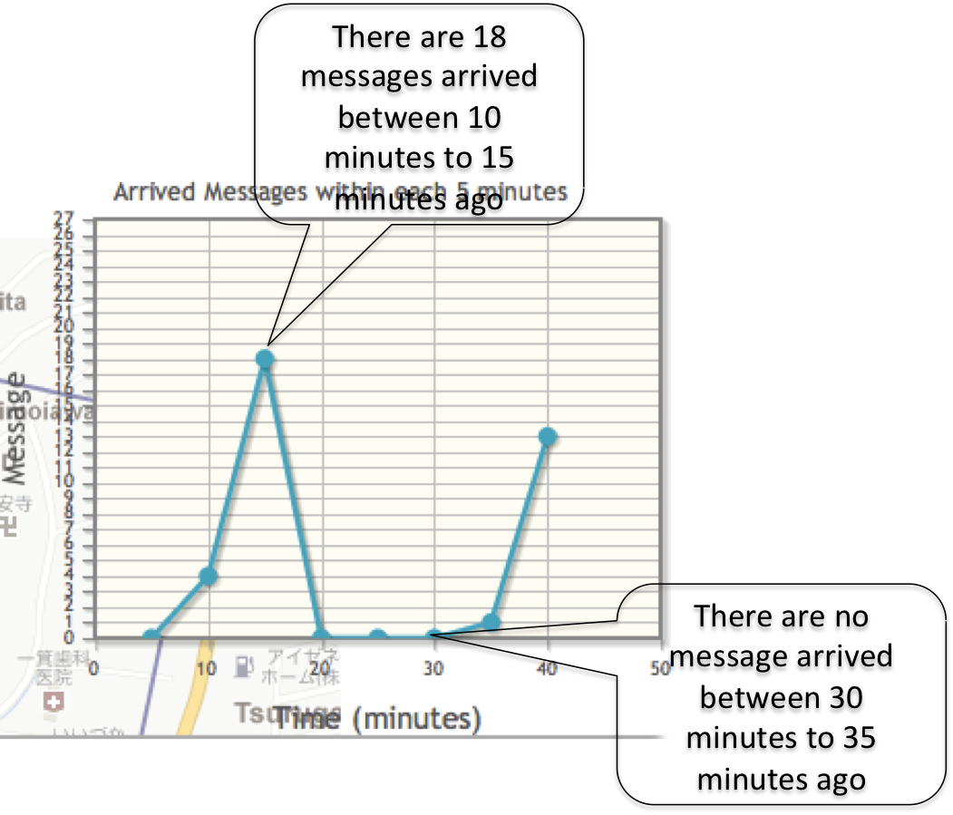
The Web Page -Miscellaneous
Statistic Graph: show how much message arrived each 5 minute from current moment.
8

Slide 15
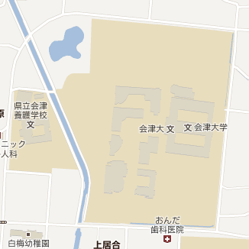
Estimating Position
min Lat, max Long
center Lat, center Long
max Lat, min Long
9

Slide 16
Sorting Victims Recommending Order
Add weight to characteristics of victim’s situation:
Immediate: 20, Expected: 16, Future: 10, Past: 4
Wait time: 0-30 minutes: 1, 30m-1h: 2, 2days – 5 days: 7, etc…
Final point of victim is the sum of all partial weights.
Sorting base on victim’s situation point.
10

