Slide 1



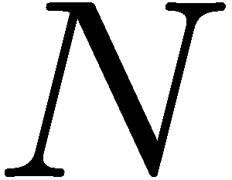

rotation_formula

Slide 2
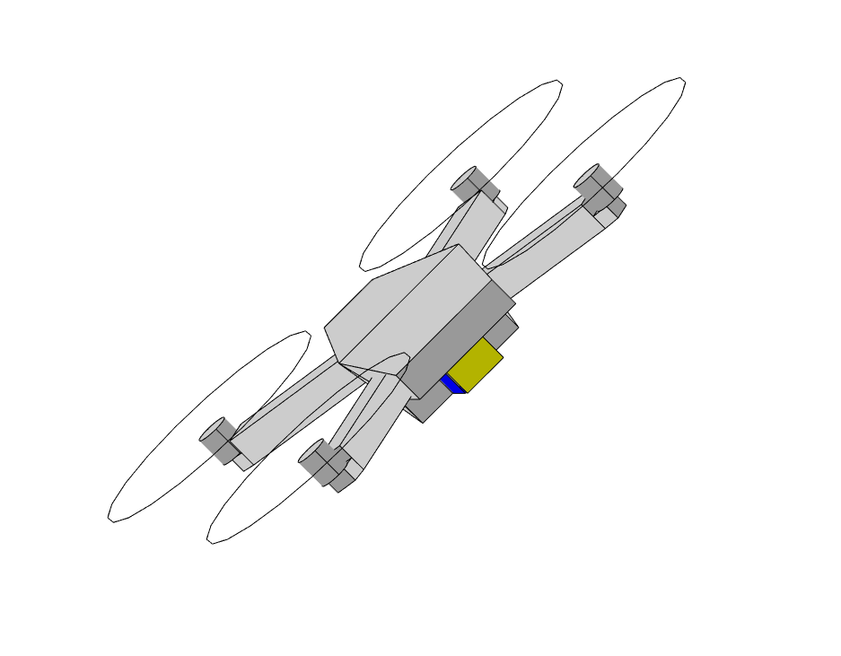
Quadrotor_roll

Slide 3
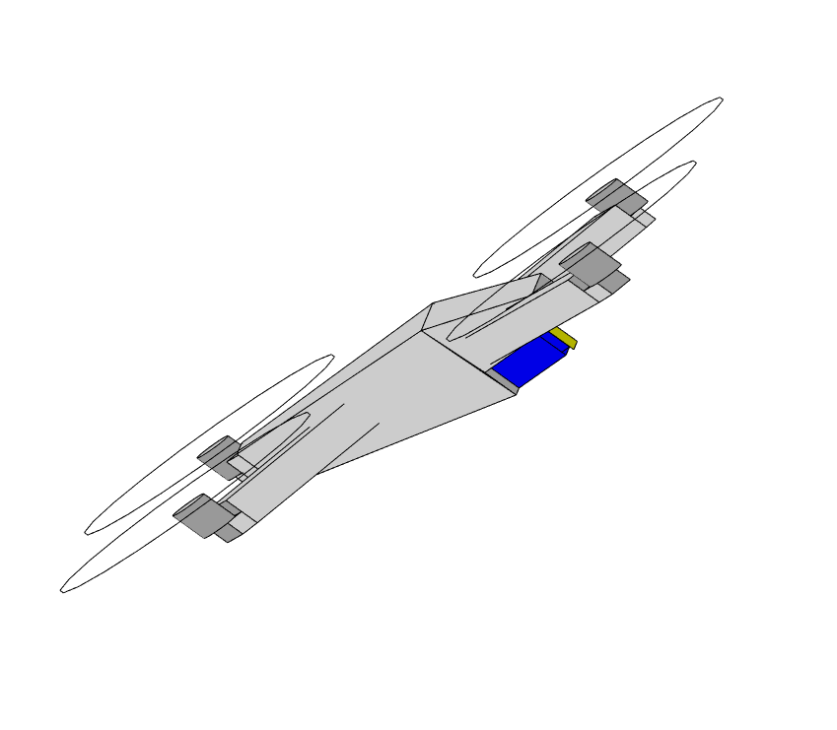
Quadrotor_pitch

Slide 4
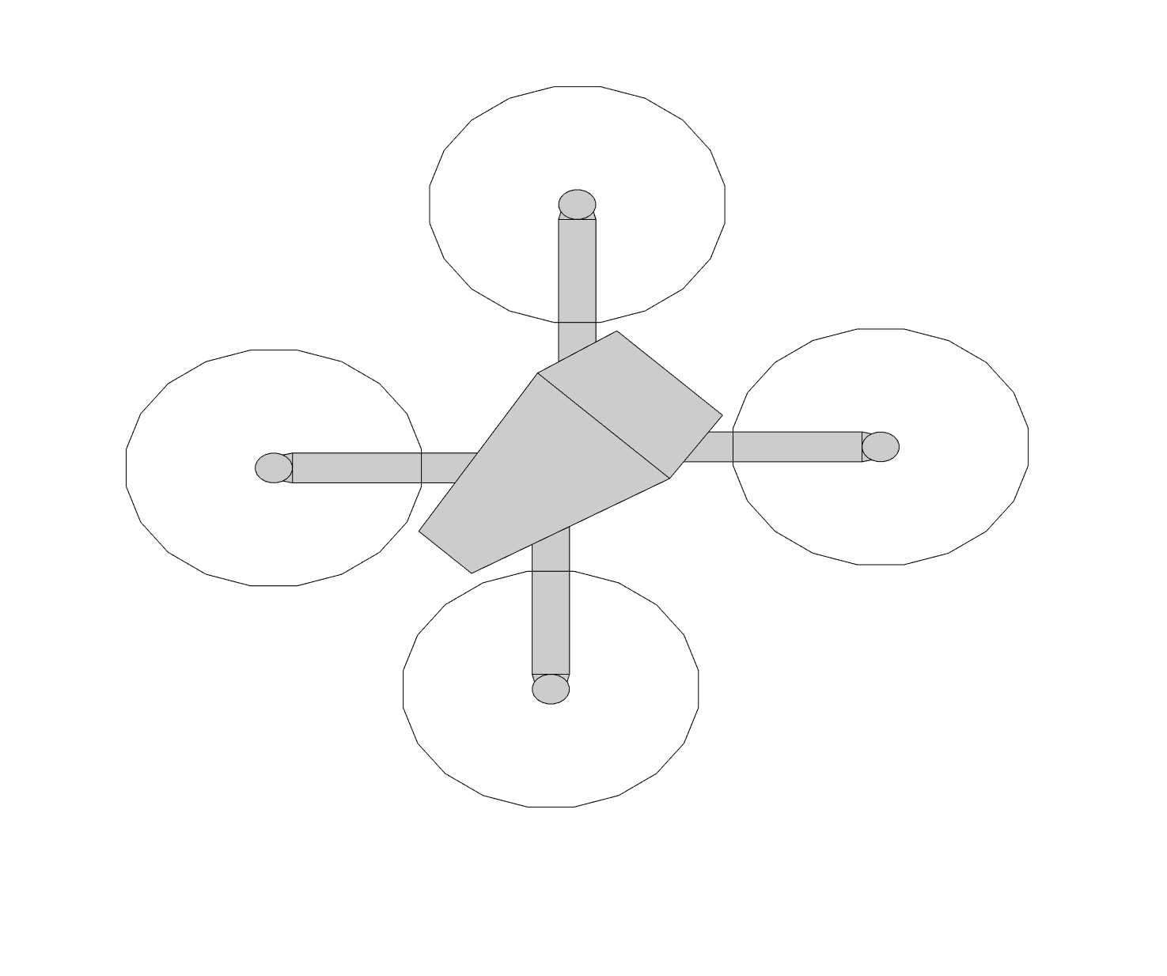
Quadrotor_yaw

Slide 5
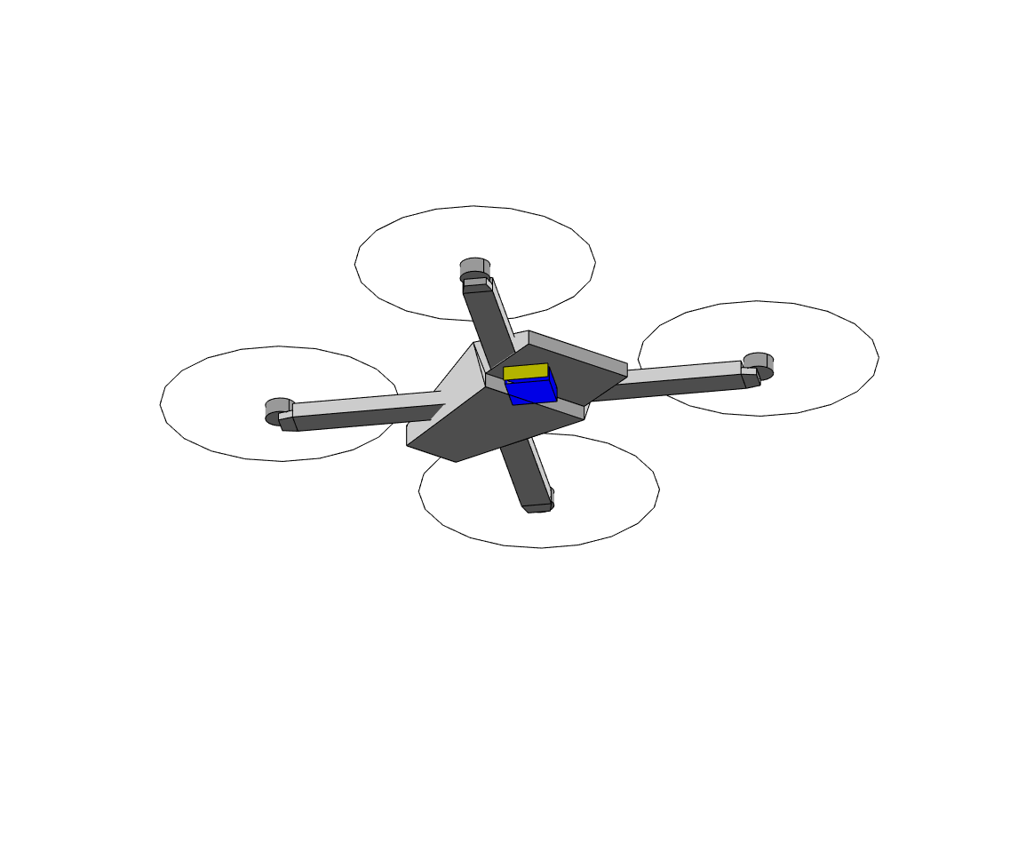
Quadrotor_azimuth

Slide 6
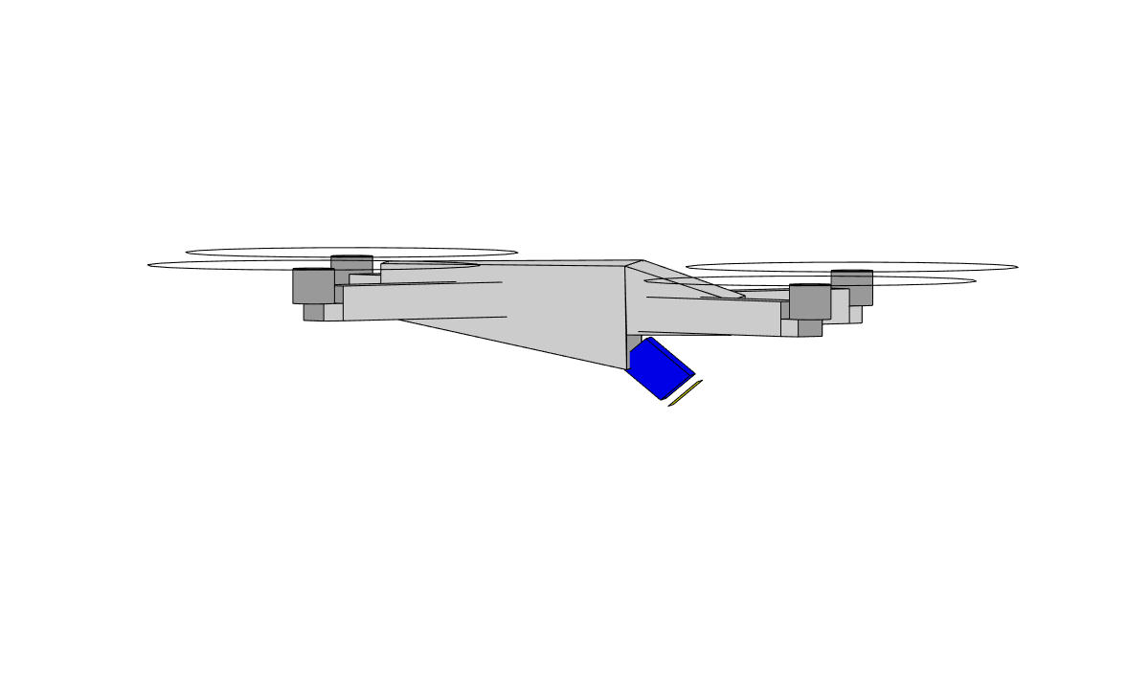
Quadrotor_elevation

Slide 7
Coriolis_formula

Slide 8
SO_2

Slide 9
Tangent_space_SO_2

Slide 10


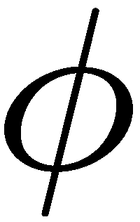
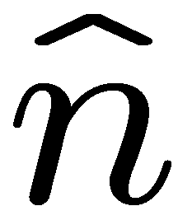
rotation_formula

Slide 12
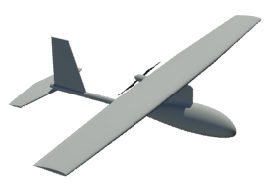
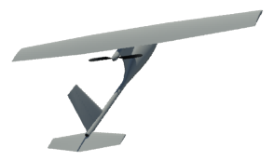
quat_rotation

