Slide 1
eom-rotor-definition

Slide 2
eom-rotor-definition-alt

Slide 3
eom-CF-quadX

Slide 4
eom-CF-quadX-alt

Slide 5
eom-CF-hexa-plus

Slide 6
eom-CF-hexa-plus-alt

Slide 7
eom-octo-std-def

Slide 8
eom-octo-std-def-alt

Slide 9
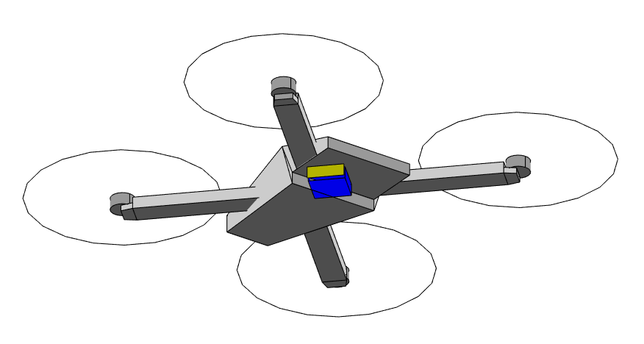
eom-quad-axes

Slide 10
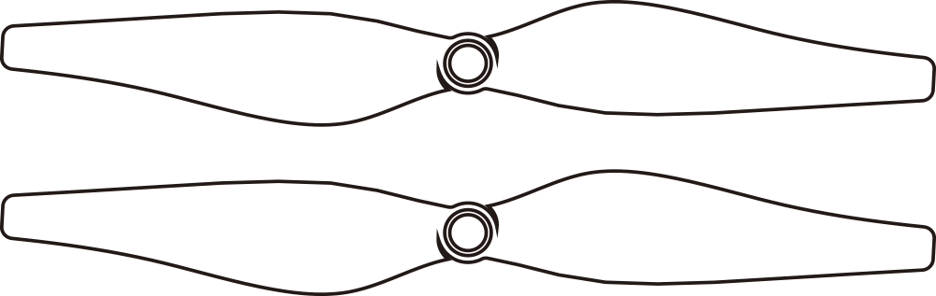
eom-induced-drag

Slide 11
eom-induced-drag2

