Slide 1
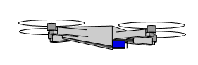
image
plane
Side view

