Slide 1
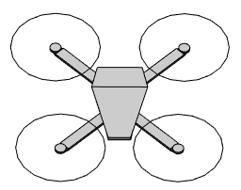
image
plane
Top down view

