Slide 1

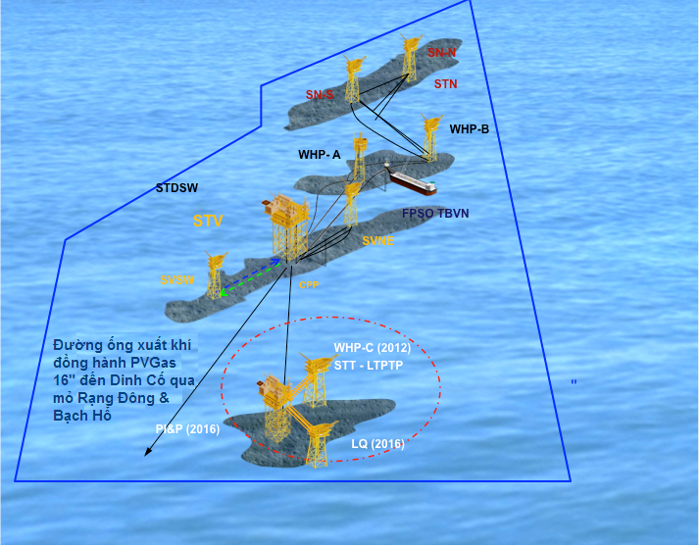
CUU LONG JOINT OPERATING COMPANY
Environmental Impact Assessment Report
For
SU TU TRANG FULL FIELD DEVELOPMENT PHASE 1 PROJECT
(Report has been adjusted and supplemented as the comments of the appraisal committee on August 20, 2015)

Slide 2
CUU LONG JOINT OPERATING COMPANY
Environmental Impact Assessment Report
For
SU TU TRANG FULL FIELD DEVELOPMENT PHASE 1 PROJECT
(Report has been adjusted and supplemented as the comments of the appraisal committee on August 20, 2015)
Project’s owner
CUU LONG JOINT OPERATING COMPANY
Consultant
VIETNAM PETROLEUM INSTITUTE
RESEARCH AND DEVELOPMENT CENTER
FOR PETROLEUM SAFETY AND ENVIRONMENT

