Slide 1
Institutional Design

Slide 2
Transaction object
Vehicle rental service
Vehicles for personal usage
Vehicles for events
Vehicles for companies/organizations
Vendor: Individuals/organizations who registered with the platform
Consumer: Individuals/organizations

Slide 3
Customization spaces
Type of vehicle: car/bus/motorbike
Size of vehicle: number of seats
Production year
Brand
Color
With driver or not
Decoration service

Slide 4
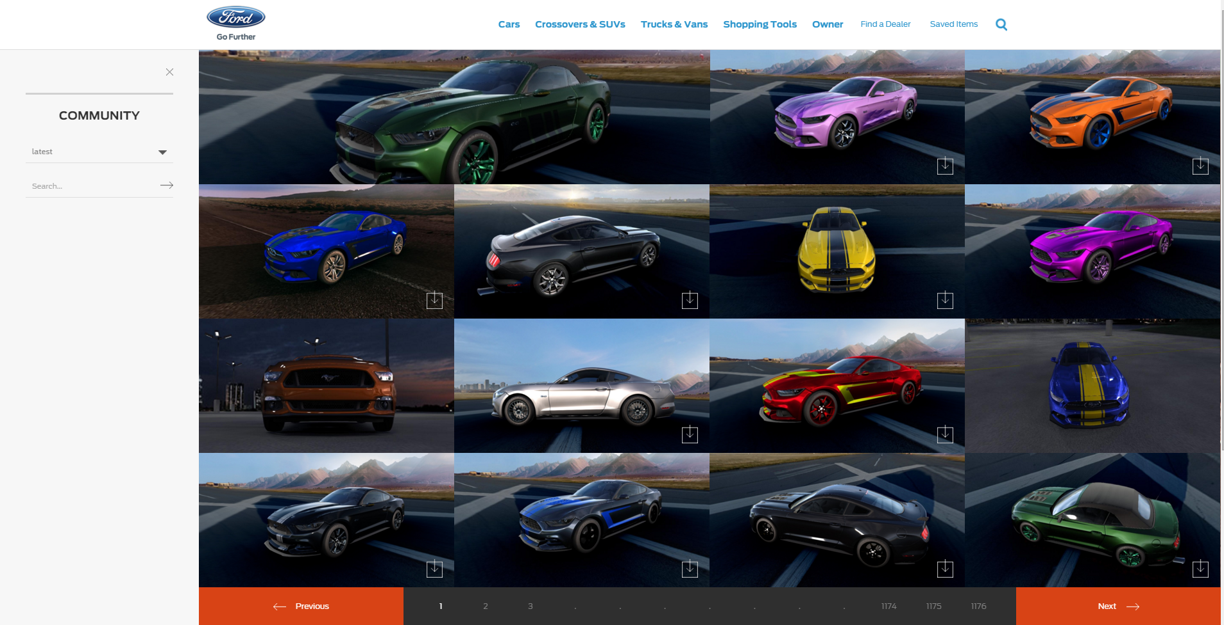
Customer choices

Slide 5
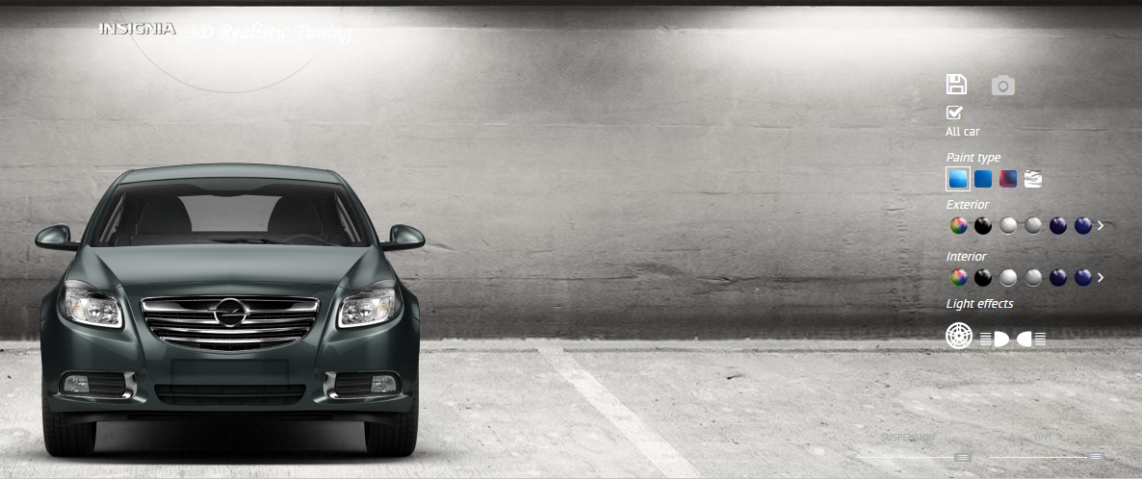
Customer’s choices

Slide 6
Customization process
Vendor:
Chooses list of customizable attributes
Set options for the chosen list
Set pre-define sets (e.g. wedding packages)
Cooperate with other vendors to meet some special requirements
Consumer:
Chooses form available options
Describes and public special needs

Slide 7
Vendor settings
Type:
Individual
Company/organization
Size : number of vehicle
Additional services:
Driver
Decoration

Slide 8
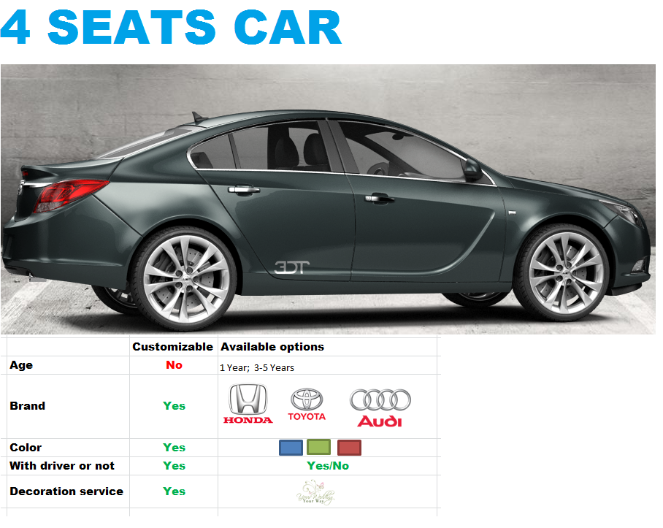
Vendor settings

Slide 9
References
http://www.ford.com/cars/mustang/customizer/#!/community

