Slide 1


Enhancing Atmospheric Gravity Wave Studies through Advanced Cloud Classification and Segmentation in Satellite Infrared Imagery: A Contribution to the AWE Mission
Anh Phan, Dallin Tucker, P.-Dominique Pautet,
Yucheng Zhao, Ludger Scherliess, and Mike J. Taylor
Utah State University

Slide 2
Introduction
Objective:
Understanding how Earth's weather influences space weather by studying atmospheric gravity waves (AGWs).
Supported by NASA, the Atmospheric Waves Experiment (AWE) mission investigates the global distribution of AGWs, their seasonal variations, and their propagation through the upper atmosphere.

Slide 3
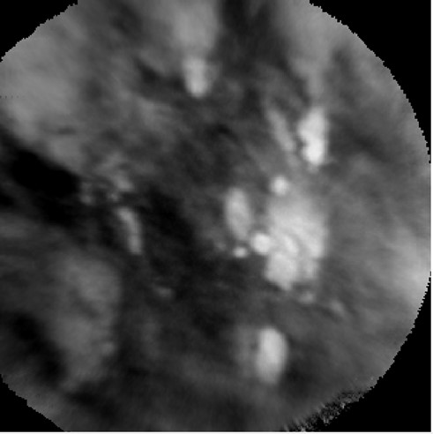
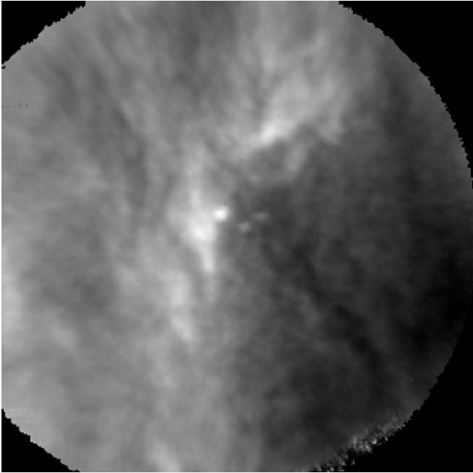
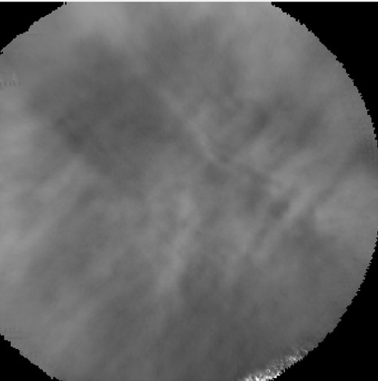
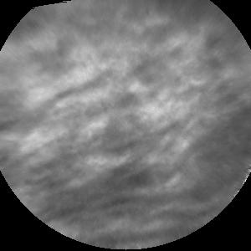
Introduction
Task:
Accurate and efficient classification of satellite infrared imagery into Cloud and Clear categories (see Figure 1) using machine learning (ML) is essential for ensuring the reliability of temperature measurements.
We use segmentation to divide each image into smaller regions to reliably identify cloud-covered areas, enhancing the correction process of AGW temperature measurements.
Figure 1a. Examples of cloud images.
Figure 1b. Examples of clear images.

Slide 4
Introduction
Scalability:
With millions of images captured over just a few months, manual categorization becomes nearly impossible. Our automated machine learning approach is critical for efficiently processing large datasets, ensuring rapid and accurate classification.
Novelty:
Although machine learning models exist for ground-based airglow images, there are currently no models that handle both classification and segmentation of satellite-based airglow images.

Slide 5
Machine Learning Models
To determine the most effective model for cloud detection, we compared the performance of several machine learning models:
Logistic Regression
Baseline Performance
Accuracy: 72%
Support Vector Machine (SVM)
Trying 18 different combinations of parameters
Accuracy: 77% for the best SVM model
Deep Learning
Using five different Convolutional Neuron Network (CNN) models
Accuracy: 85% for the best CNN model
Transfer Learning using ResNet-50
Adapting Pre-trained Models with ResNet-50
Accuracy: 88%

Slide 6
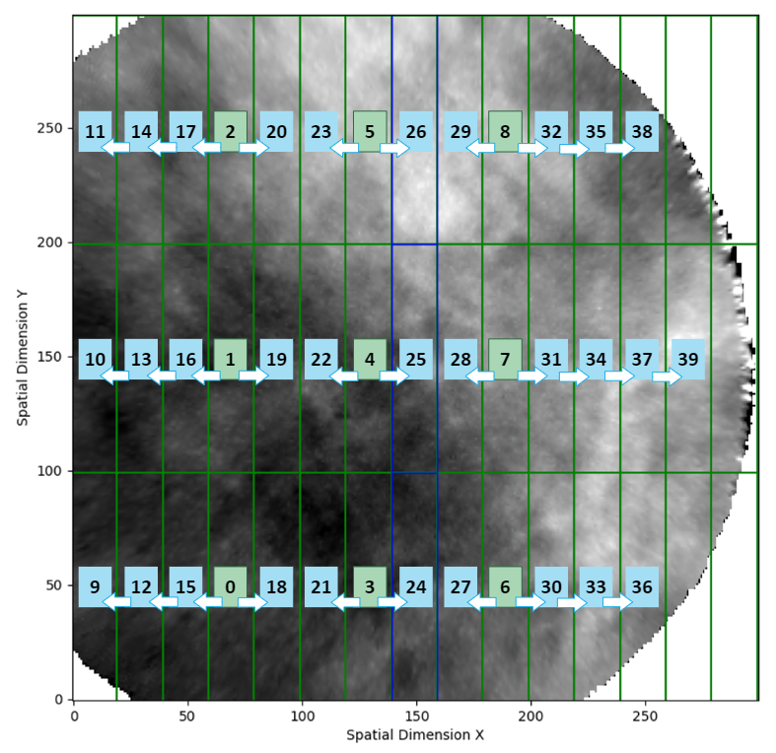
Based on the success of using transfer learning model, we advanced to image segmentation.
This involves segmenting each image into smaller rectangles and identifying cloud presence in each segment.

Slide 7
The images are segmented into 45 smaller boxes (15x3 grid). The 5 boxes on the right are excluded from the analysis due to insufficient pixel data.
The machine learning model predicts cloud presence for boxes 0 to 8. These predictions are then propagated using the expected motion of the ISS, to adjacent boxes following the arrows, effectively extending the prediction across the image.
For instance, the prediction for box 0 is extended to boxes 9, 12, 15, and 18.

Slide 8
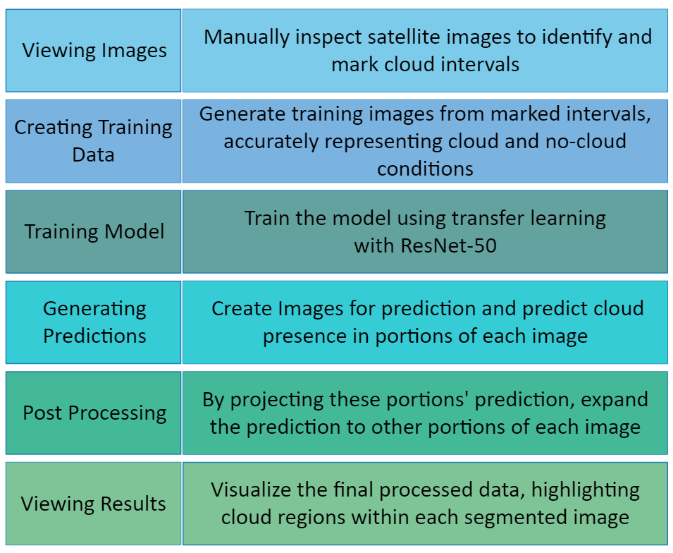
Procedure
Results:
Validation accuracy: 80%

Slide 9
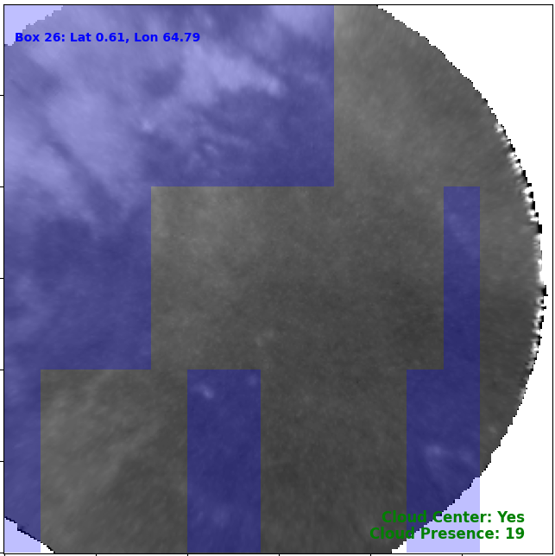
Visualization
Segmentation of a single time frame from the satellite data, visualized using the custom tool. The predicted cloud regions are highlighted in blue.
The tool also provides additional insights, including whether clouds are present in the center column of the image and the total count of cloud-affected boxes, as shown at the right lower corner of the image.

Slide 10
Conclusions
Deep learning and transfer learning models demonstrating the highest accuracy when various machine learning models were evaluated.
Advancing to image segmentation, applying to 40 smaller boxes of the big image, transfer learning showed promising results with 80% validation accuracy.

Slide 11
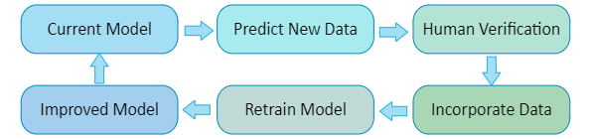
Future works
Process all data to allow users to exclude cloud-contaminated regions, enhancing the accuracy of temperature measurements. This segmentation allows for a more detailed understanding of cloud presence, leading to more accurate temperature corrections.
Develop a pipeline for future data processing and model updates.

Slide 12
Acknowledgement:
The material is based upon work supported by the National Aeronautics and Space Administration under Contract Number 80GSFC18C0007. Any opinions, findings, and conclusions or recommendations expressed in this material are those of the author(s) and do not necessarily reflect the views of NASA.

Slide 13
Thank you!

Slide 14
Additional Slides

Slide 15
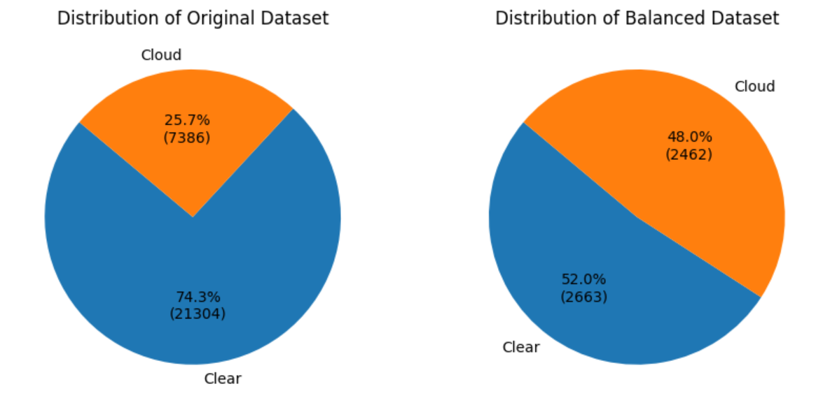
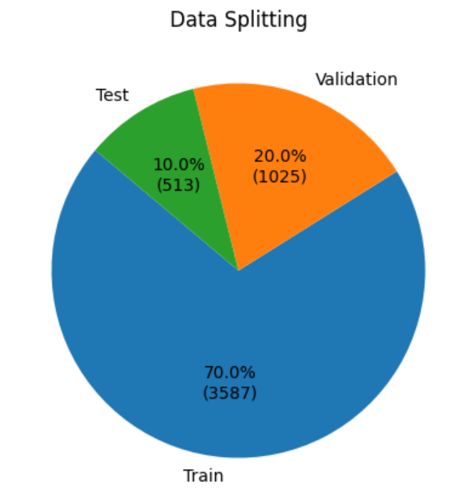
Image Classification Data
Data Overview
Data Source: Images from 15 satellite orbits on January 1st, 2024

Slide 16
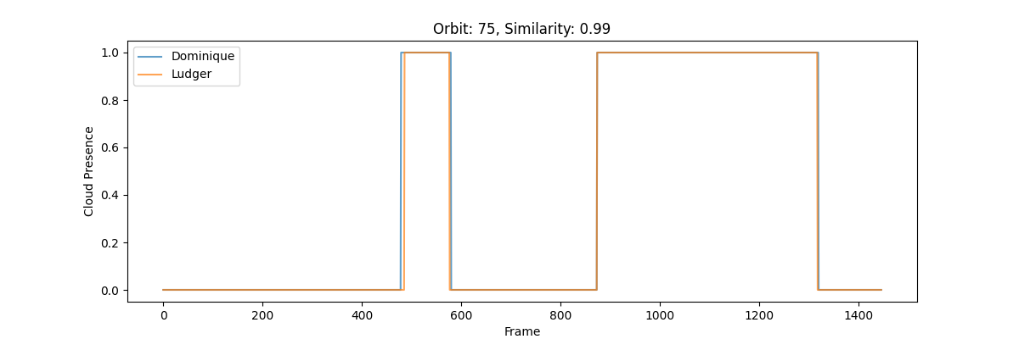
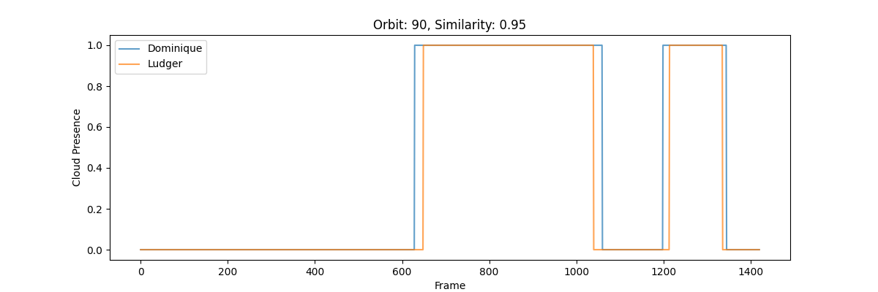
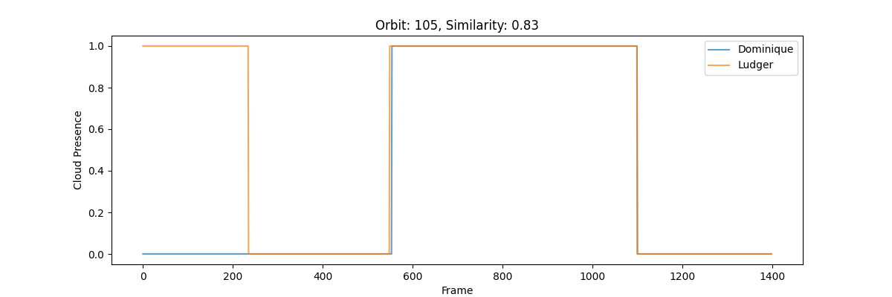
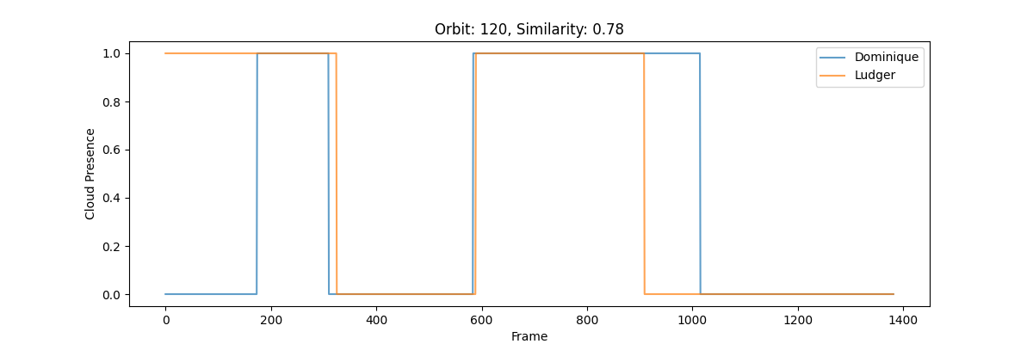
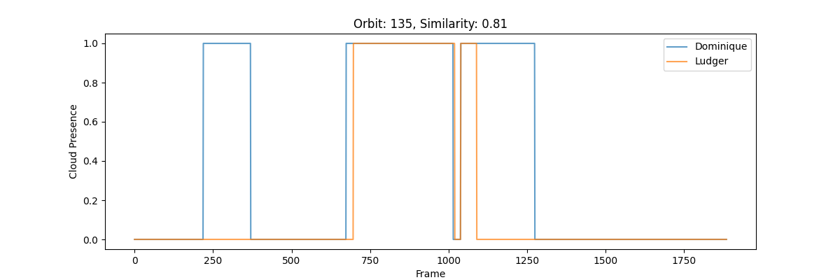

Slide 17
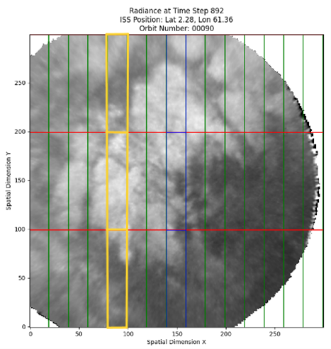
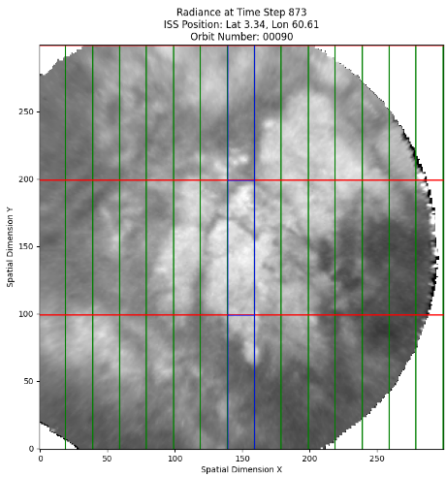
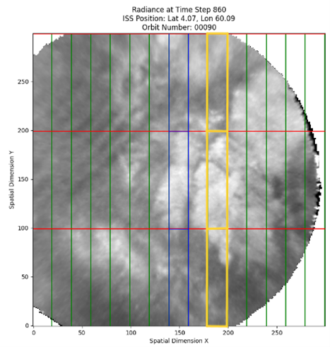
Labelling

Slide 18
Verified that in the NetCDF file, the variable Radiance is saved as Radiance(time, y_along_track, x_cross_track).
Mapped the boxes to a 2D array.
Added two new dimensions: y_box_along_track (size=3) and x_box_cross_track (size=14).
Included the MLCloud variable with dimensions (time, y_box_along_track, x_box_cross_track).
Updated the visualization script accordingly.
The boxes in the NetCDF file are now organized in the format (x_box_cross_track, y_box_along_track)

Slide 19
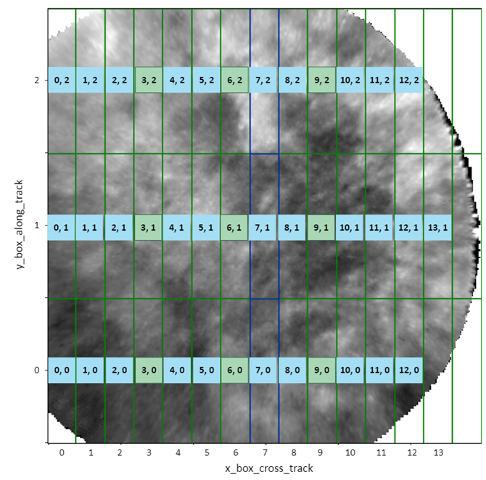

Slide 20
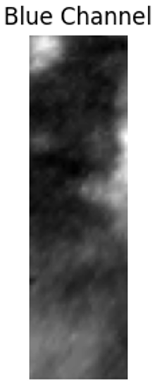
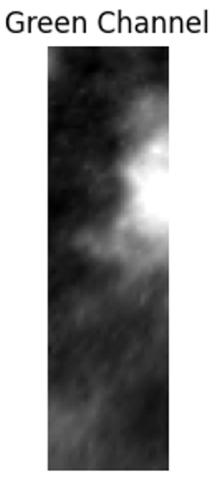
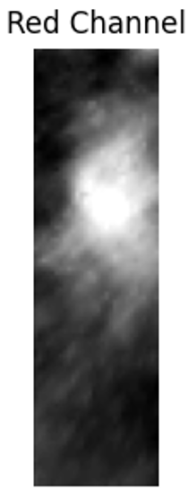
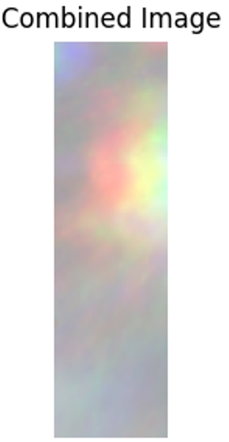
Consecutive Frames

