Slide 1
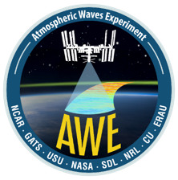

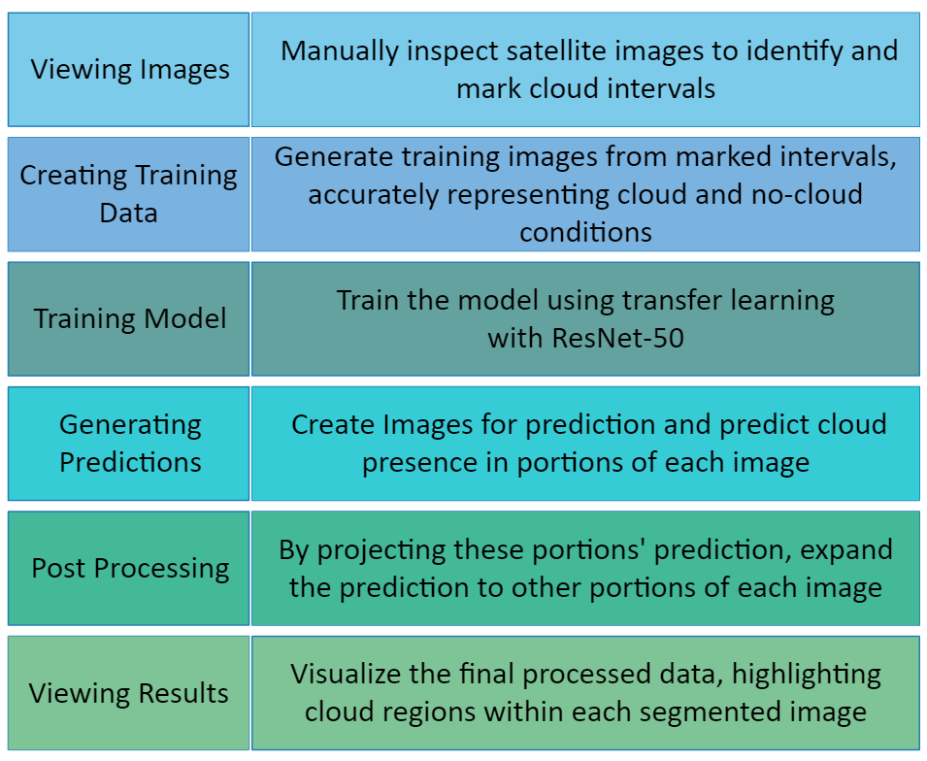
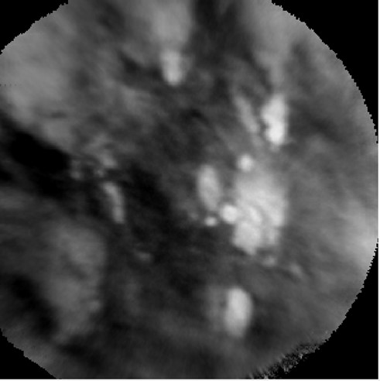
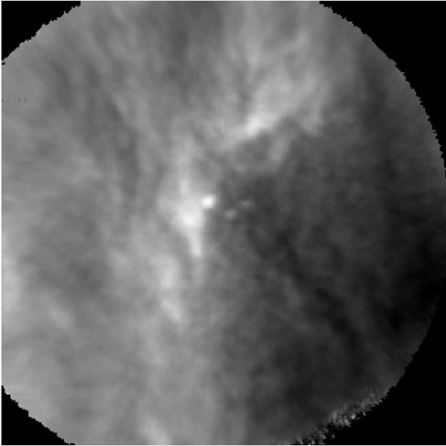
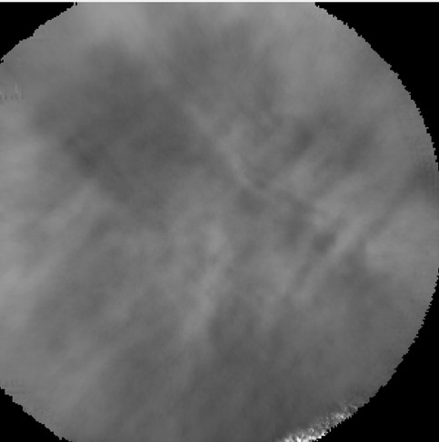
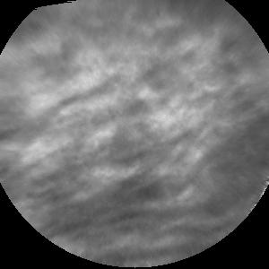
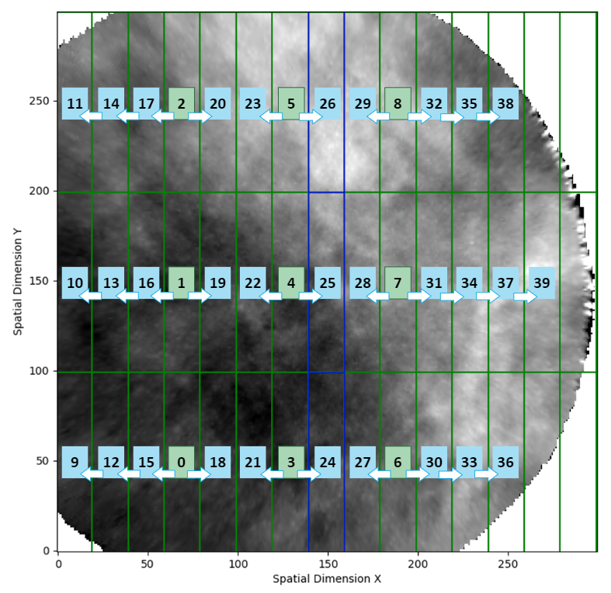
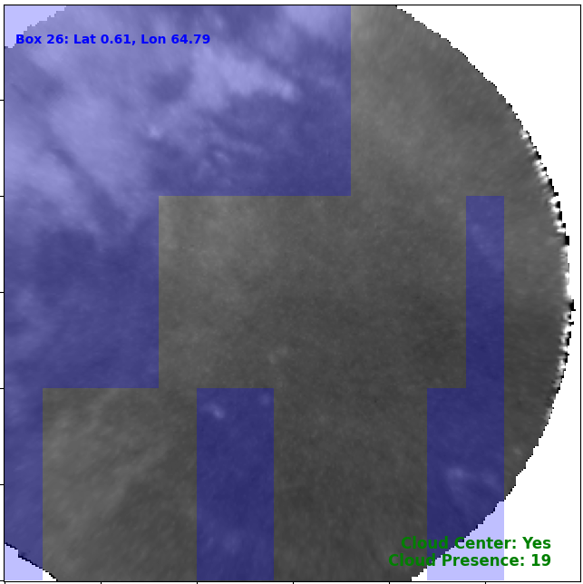
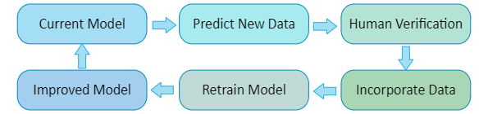
Enhancing Atmospheric Gravity Wave Studies through Advanced Cloud Classification and Segmentation in Satellite Infrared Imagery: A Contribution to the AWE Mission
Anh Phan, Dallin Tucker, P.-Dominique Pautet, Yucheng Zhao,
Ludger Scherliess, and Mike J. Taylor
Utah State University
Introduction
Image Segmentation
Objective:
Understanding how Earth's weather influences space weather by studying atmospheric gravity waves (AGWs).
Supported by NASA, the Atmospheric Waves Experiment (AWE) mission investigates the global distribution of AGWs, their seasonal variations, and their propagation through the upper atmosphere.
Task:
Accurate and efficient classification of satellite infrared imagery into Cloud and Clear categories (see Figure 1) using machine learning (ML) is essential for ensuring the reliability of temperature measurements. We use segmentation to divide each image into smaller regions to reliably identify cloud-covered areas, enhancing the correction process of AGW temperature measurements.
Scalability:
With millions of images captured over just a few months, manual categorization becomes nearly impossible. Our automated machine learning approach is critical for efficiently processing large datasets, ensuring rapid and accurate classification.
Novelty:
Although machine learning models exist for ground-based airglow images, there are currently no models that handle both classification and segmentation of satellite-based airglow images.
Procedure:
Results:
Validation accuracy: 80%
Visualization shown in Figure 3.
Figure 1a. Examples of cloud images.
Figure 1b. Example of clear images.
Figure 2. The images are segmented into 45 smaller boxes (15x3 grid). The 5 boxes on the right are excluded from the analysis due to insufficient pixel data.
The machine learning model predicts cloud presence for boxes 0 to 8. These predictions are then propagated using the expected motion of the ISS, to adjacent boxes following the arrows, effectively extending the prediction across the image.
For instance, the prediction for box 0 is extended to boxes 9, 12, 15, and 18.
Machine Learning Models
To determine the most effective model for cloud detection, we compared the
performance of several machine learning models:
Logistic Regression
Baseline Performance
Accuracy: 72%
Support Vector Machine (SVM)
Trying 18 different combinations of parameters
Accuracy: 77% for the best SVM model
Deep Learning
Using five different Convolutional Neuron Network (CNN) models
Accuracy: 85% for the best CNN model
Transfer Learning using ResNet-50
Adapting Pre-trained Models with ResNet-50
Accuracy: 88%
Based on the success of using transfer learning model, we advanced to image segmentation. This involves segmenting each image into smaller rectangles and identifying cloud presence in each segment (See Figure 2).
Figure 3. Segmentation of a single time frame from the satellite data, visualized using the custom tool. The predicted cloud regions are highlighted in blue.
The tool also provides additional insights, including whether clouds are present in the center column of the image and the total count of cloud-affected boxes, as shown at the right lower corner of the image.
Conclusions
Deep learning and transfer learning models demonstrating the highest accuracy when various machine learning models were evaluated.
Advancing to image segmentation, applying to 40 smaller boxes of the big image, transfer learning showed promising results with 80% validation accuracy.
Future works:
Process all data to allow users to exclude cloud-contaminated regions, enhancing the accuracy of temperature measurements. This segmentation allows for a more detailed understanding of cloud presence, leading to more accurate temperature corrections.
Develop a pipeline for future data processing and model updates.
Acknowledgement: The material is based upon work supported by the National Aeronautics and Space Administration under Contract Number 80GSFC18C0007. Any opinions, findings, and conclusions or recommendations expressed in this material are those of the author(s) and do not necessarily reflect the views of NASA.

