Slide 1

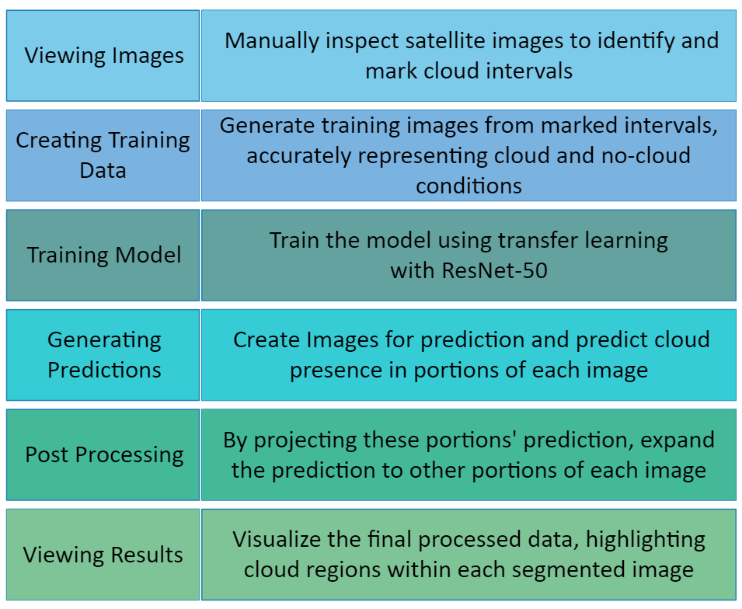
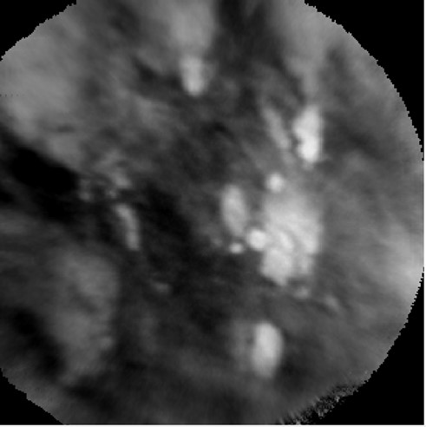
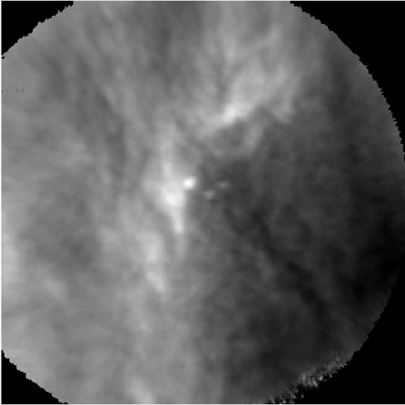
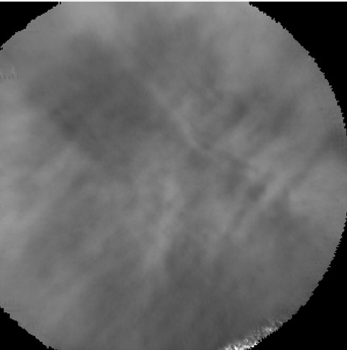
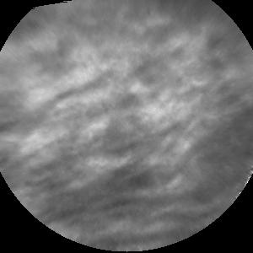
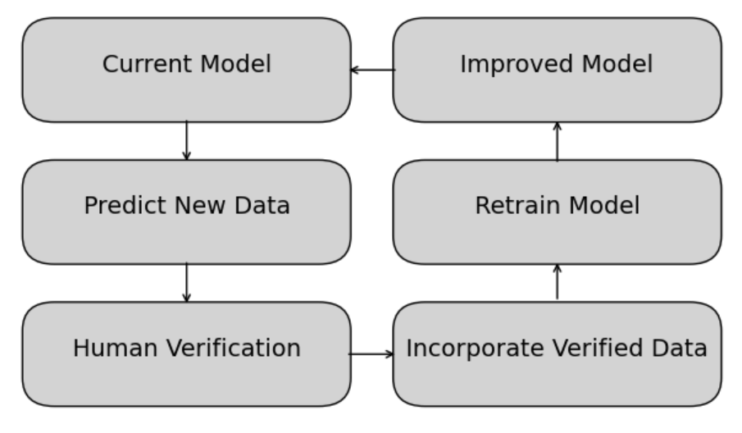
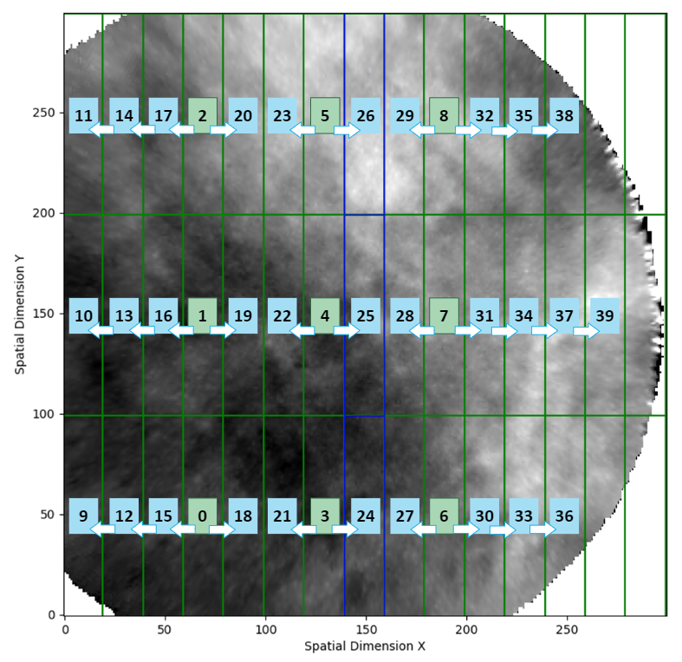

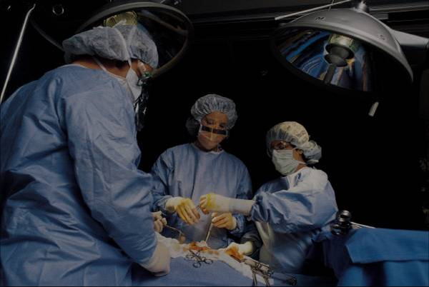

Enhancing Atmospheric Gravity Wave Studies through Advanced Cloud Classification and Segmentation in Satellite Infrared Imagery: A Contribution to the AWE Mission
REPLACE THIS BOX WITH YOUR ORGANIZATION’S
HIGH RESOLUTION LOGO
REPLACE THIS BOX WITH YOUR ORGANIZATION’S
HIGH RESOLUTION LOGO
Anh Phan, Dallin Tucker, P.-Dominique Pautet, Yucheng Zhao,
Ludger Scherliess, and Mike Taylor
Utah State University
Introduction
Procedure
Objective:
Understanding how Earth's weather influences space weather through the study of atmospheric gravity waves (AGWs).
The Atmospheric Waves Experiment (AWE) mission, supported by NASA, investigates the global distribution of AGWs, their seasonal variations, and their movement through the upper atmosphere.
Task:
Accurate classification of satellite infrared imagery into Cloud and Clear categories is essential for ensuring the reliability of temperature measurements. With the addition of image segmentation, we now divide each image into smaller regions to precisely identify cloud-covered areas, enhancing the correction process of AGW temperature measurements.
Example Images
Cloud Images Clear Images
Scalability:
With millions of images captured in a few months, manual categorization is nearly impossible. Our automated machine learning approach is critical for efficiently processing large datasets, ensuring rapid and accurate classification.
Novelty:
While there are existing models for ground-based airglow images, there are currently no models for satellite-based airglow images.
Previous Results:
In previous work presented at CEDAR, machine learning models, specifically transfer learning using ResNet-50, were applied to classify satellite infrared imagery into 'Cloud' and 'Clear' categories, achieving 88% accuracy.
Current Focus: Building on this success, we have advanced to image segmentation. This involves dividing each image into multiple smaller rectangles and identifying cloud presence in each segment. This segmentation allows for a more granular understanding of cloud interference in satellite measurements and leads to more accurate atmospheric data processing.
Abstract
Click here to insert your Abstract text. Type it in or copy and paste from your Word document or other source.
This text box will automatically re-size to your text. To turn off that feature, right click inside this box and go to Format Shape, Text Box, Autofit, and select the “Do Not Autofit” radio button.
To change the font style of this text box: Click on the border once to highlight the entire text box, then select a different font or font size that suits you. This text is Calibri 32pt and is easily read up to 4 feet away on a 48x36 poster.
Zoom out to 100% to preview what this will look like on your printed poster.
Future Directions
Creating a Pipeline
Develop a pipeline for future data processing and model updates.
Methods and Materials
Click here to insert your Methods and Materials text. Type it in or copy and paste from your Word document or other source.
This text box will automatically re-size to your text. To turn off that feature, right click inside this box and go to Format Shape, Text Box, Autofit, and select the “Do Not Autofit” radio button.
To change the font style of this text box: Click on the border once to highlight the entire text box, then select a different font or font size that suits you. This text is Calibri 32pt and is easily read up to 4 feet away on a 48x36 poster.
Zoom out to 100% to preview what this will look like on your printed poster.
Figure 1. Label in 20pt Calibri.
Figure 2. Label in 20pt Calibri.
Figure 3. Label in 20pt Calibri.
Conclusions
Click here to insert your Conclusions text. Type it in or copy and paste from your Word document or other source.
This text box will automatically re-size to your text. To turn off that feature, right click inside this box and go to Format Shape, Text Box, Autofit, and select the “Do Not Autofit” radio button.
Contact
References
<your name>
<your organization>
Email:
Website:
Phone:
Table 1. Label in 24pt Calibri.

