Slide 1
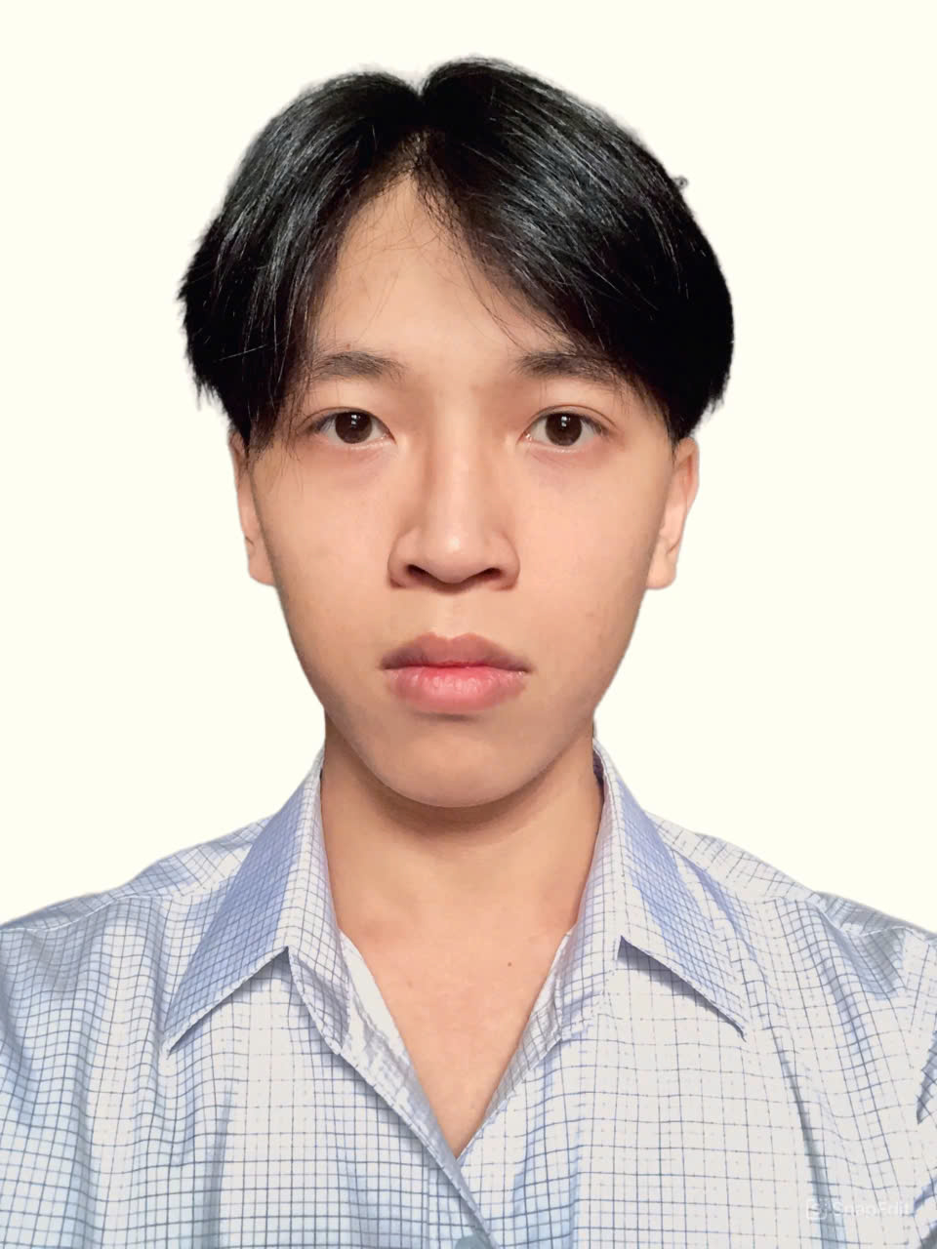

LIC
Library and Information Center
Ho Chi Minh City University of Transport
Campus 1: Number 2, Vo Oanh Street, Ward 25, Binh Thanh District, HCMC
PHAN LÊ NHẬT ANH
MEMBER
MSSV: 22H4060068

